Slide 1


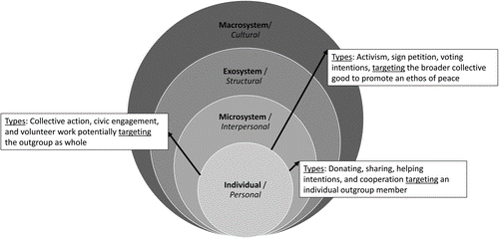
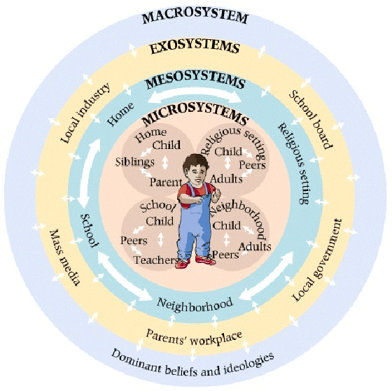
Making the LINKS: An evaluation of a performing arts based intervention on children's peacebuilding capacities
Introduction
Methodology
Data analysis
In 2019, 1.6 billion children (69%) were living in a conflict-affected country and approximately 426 million children (over one in six) were living in a conflict zone. Currently 420 million children, approximately 1 in 5 children are living in conflict. Without action on this crisis, it is estimated that by 2030 this number will have increased by 30% (Ostby et al, 2020), demonstrating the need for sustainable peacebuilding practices. This study aims to evaluate a peacebuilding intervention with children in Colombia using arts-based methods. The intervention was based across 3 municipalities outside the capital city of Bogota. Children from the ages of 5-18 participated in weekly performing arts-based workshops September 2021-April 2022. the aim of this research is to investigate whether such an intervention can contribute to sustainable peacebuilding practices.
Participants involved children and adolescents within the age bracket of 6-18 years of age, living in Colombia. These children attended educational community foundations within three municipalities outside the capital city of Bogota. The performing arts based interventions were implemented weekly in all foundations by professional theatre teachers. A qualitative approach was utilised by the researcher. Ethnographic methods were adopted by the researcher as they immersed themselves within the culture of the communities involved for a period of 4 months. The following methods were used:
extensive notetaking
Observations
Picture and video taking
Semi-structured interviews with theatre teachers, volunteers & other researchers
Focus groups with the children
This research is still ongoing therefore the data analysis has not been completed and analysis is ongoing. However, the researcher will continue to utilise a process of thematic analysis s across the data sets.
Conclusion:
This research intervention is still ongoing; therefore the results cannot be analysed indefinitely. However, the qualitative data collected and analysed thus far has shown improvement’s in children’s empathic and prosocial behaviour both at a micro level-amongst their peer group and at the meso-level, amongst their community interactions. The children have demonstrated greater empathic skills and prosocial behaviour that according the DPM can contribute to sustainable peacebuilding processes (Taylor, 2020).
Background
This research is being conducted in conjunction with the LINKS team based between Queen’s University Belfast and Lancaster University. LINKS is a global network of researcher and practitioners that share a commitment to contributing to sustainable development and peacebuilding through investment in high quality childhood programmes. The concept of sustainability is thus a vital aspect of this research study. The researcher remains focused on SDG 16, which aims to build inclusive societies with strong institutions and justice for all (SDGs 2030). Their justification for goal 16 being that conflict, insecurity, weak institutions, and limited access to justice remain a great threat to sustainable development. This research seeks to investigate the impact of a performing arts-based intervention with Colombian children and youth with potential for peacebuilding implications. Colombia is a country that has experienced decades of protracted violence. Despite the children and youth of Colombia today being termed a post-accord generation, they are not immune to the effects of what has occurred in the past (Schore, 2000). This research project applies the theories of Bronfennbrenners systems theory, & Taylor Developmental peacebuilding model to evaluate whether a performing arts based intervention can improve the prosocial behaviour of children and thus have a wider societal impact in order to create a more sustainable version of peace.
References
Bronfenbrenner, U. (1979). The ecology of human development: Experiments by nature and design. Cambridge, MA: Harvard University Press.
Østby, G., Rustad, S.A. and Tollefsen, A.F., 2020. Children affected by armed conflict, 1990–2019. Oslo: Peace Research Institute Oslo. Retrieved February, 15, p.2021.
Schore, A.N. 2000. Attachment and the regulation of the right brain. Attachment & Human development, 2, 23-47.
Taylor, L.K., 2020. The Developmental Peacebuilding Model (DPM) of children’s prosocial behaviors in settings of intergroup conflict. Child Development Perspectives, 14(3), pp.127-134
United Nations, The 2030 Agenda and the Sustainable Development Goals: An opportunity for Latin America and the Caribbean (LC/G. 2681-P/Rev.)

