Slide 1


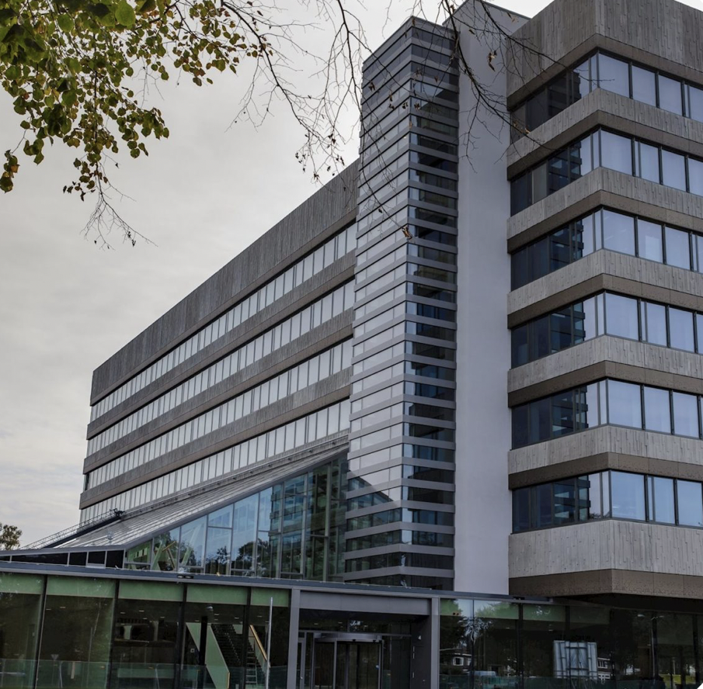

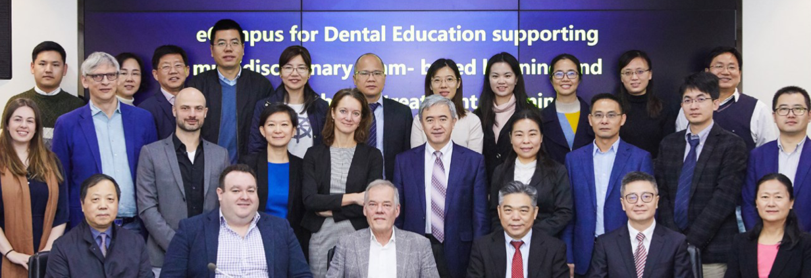


EDEMTET – E-Campus for Dental Education supporting Multi-Disciplinary Team-based learning and Evidence Based Treatment planning
What is EDEMTET?
EDEMTET (eCampus for Dental Education supporting Multi-disciplinary Team based learning and Evidence based Treatment planning) is a collaborative project involving University Dental Schools in the Netherlands (Radboud University, Nijmegen), China (Guangxi Medical University, Wuhan University and Nanjing University) and the United Kingdom (Queen’s University, Belfast).
The overall objective of this project is to improve oral health care through developing dental professionals who are well trained in evidence based treatment planning and clinical decision making. During the project, we aim to achieve our main objective by creating an online learning platform which will promote clinical decision making and transferring knowledge, not only from didactic to clinical settings, but between various cultures as well.
Maeve McAllister (Fourth Year Dentistry Student), Nicola Lapsley (Clinical Teaching Fellow), Gerry McKenna (Clinical Reader /Consultant in Restorative Dentistry)
Centre for Dentistry
Overall Project Opportunities:
International teamwork based on dental-related cases
Modernisation of the European and Chinese curriculum
Improve understanding of cultural and contextual differences in clinical decision making.
Provision of well structured e-learning modules and educational resources for dental students and their teachers.
Developing skills in the provision of giving and receiving constructive feedback
Improving International communication and co-operation
Expand this project to develop online education platforms in other healthcare fields
International Modules
During the launch of EDEMTET there will be 5 core modules created. The main module of the eCampus is treatment planning. This will require students to apply critical appraisal skills learnt from an evidence-based dentistry module.
Teams of international students will work through each case, discussing clinical scenarios and will form treatment plans; ultimately learning from each other via mutual peer feedback.
In the future, the aim is to create additional modules that will cover more of the curriculum and therefore can be used wider in dental education.
A major part of this is using cultural and contextual factors in the formulation of these treatment plans, something which is reinforced in the tutorials which are formulated.
Online Learning
Now more than ever, there has never been a greater demand for online education. In a world where technology is ever advancing, and our students’ expectations are ever higher, we need to strive for the most up-to-date online learning.
Working together with global partners, the creation of an online education platform will allow us to create a vast database of education material, including case based scenarios which we can tailor to our own universities needs. Each university is targeting a set amount of tutorials, which means the output for our students should be very advanced. This a resource that is much more powerful as an international effort than it ever could be at local level alone; thus reforming higher education all over the dental world.
Components of the project include: Case based scenarios, Online tutorials, Group Assignments, Individual quizzes
Challenges for the partners
Ensure course material conforms to standards of each country and curriculum of each university
Language barriers / Cultural differences
Understanding differences in course structure
Ensure adequate staff and student training
Ensuring deadlines are met within the context of a wider-university structure
Overall Project Aims:
To modernize Dental curriculum across the partners
To increase the accessibility to relevant dental research to Dental students
To develop an understanding of the need for context and cultural factors in evidence-based decision making
To stimulate team based learning, a transferrable skill to clinical environments
Using evidence in clinical settings for patient benefit
To add to the body of evidence for dental education
QUB student opportunities
Summer Studentship Projects through the Centre for Dentistry
Meeting Partners on the 15th April in Belfast for combined work on the project
International networking
Opportunities to expand the student team working on the project
Presenting findings at conference proceedings

