Slide 1
Student Wellbeing
Preparing for Placement

Slide 2
Overview of Session
Session Aims:
Understanding your mental health
Transition to placement
Recognition of signs and symptoms of stress
Explore range of coping strategies
Looking after your wellbeing

Slide 3
Where are you now?
Student
Where you live
Studies
Relationships
Daily Routine

Slide 4
Transition to placement
What could change?
New routine
New location
New colleagues
New job and tasks to learn

Slide 5

Resilience
How to cultivate what is best within ourselves to enhance our placement experience?

Slide 6
Ensure my work and living environments are safe and secure
Explore the most appropriate living environment for you
Plan your route to work and method of transport
Ensure you plan meals, sleeping patterns and social life
Friendships with work colleagues
Register with a GP if you have moved to a new location

Slide 7
A resilient student calls on their strengths when faced with challenges.
Establishing friendships in the workplace
Boundaries
Life style choices
Ensure you take control of this new opportunity. You know what you are comfortable with and what is a challenge for you

Slide 8


Slide 9


Feeling stress is caused by
Situations or events that put pressure on us
Our reaction to being put under pressure

Slide 10
Signs & Symptoms of Stress
Lack of motivation or focus
Irritability/anger
Sadness/depression
Overeating/undereating
Angry outbursts
Drug/alcohol/tobacco use/abuse
Social withdraw
Headache
Muscle tension/pain
Fatigue
Change in sex drive
Upset stomach
Sleep disturbances/problems
Anxiety

Slide 11
Coping Strategies – what students say
Alcohol
Self Harm
Hang out with friends
Cry
Draw/Paint
Withdraw
Drugs
Party/Socialise
Eat more/less
Shout
Go Shopping
Exercise
Listen to music
Meditate

Slide 12
Strengths

Slide 13
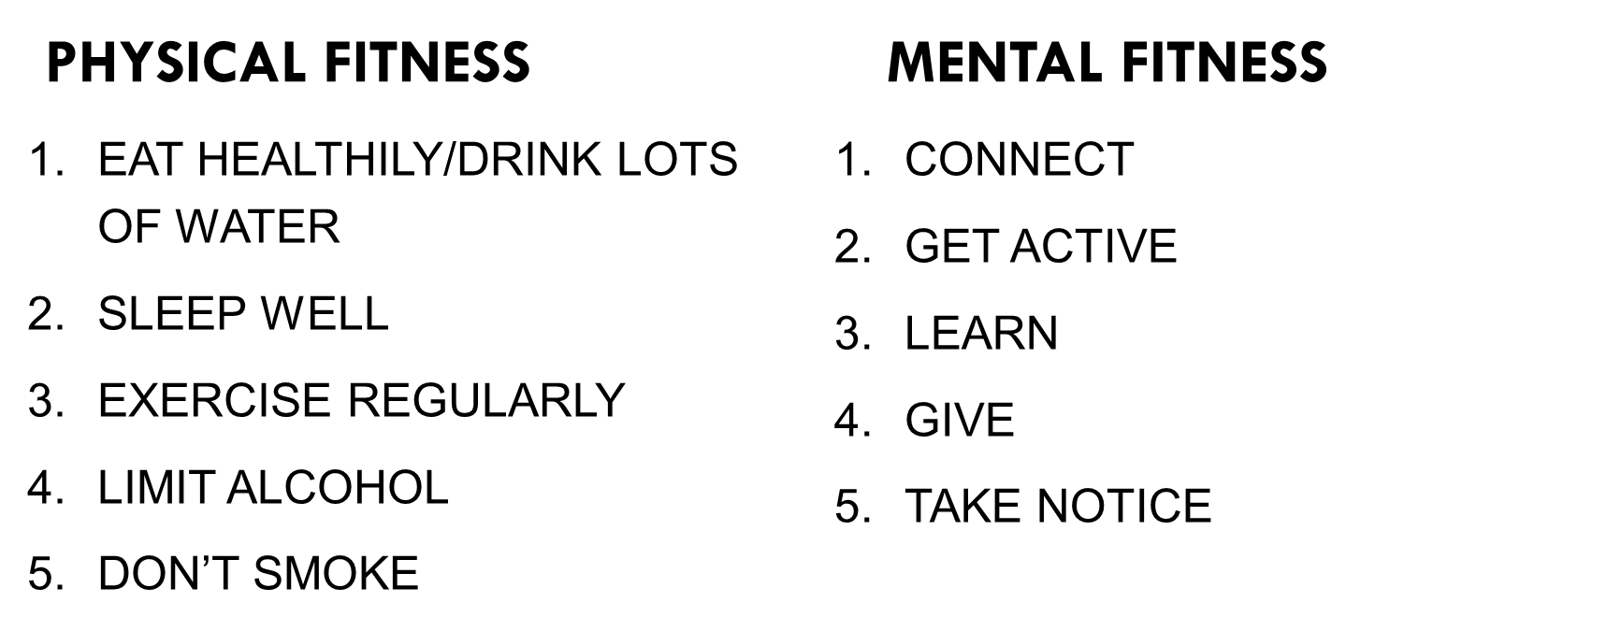





Staying Healthy Framework

Slide 14


Be willing to leave your comfort zone
Can you take the risk to feel unsure or uncomfortable but give it a go anyway?
What’s the worst thing that could happen?

Slide 15
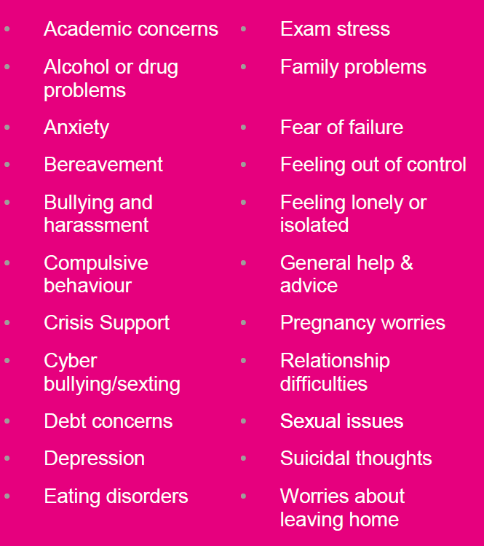
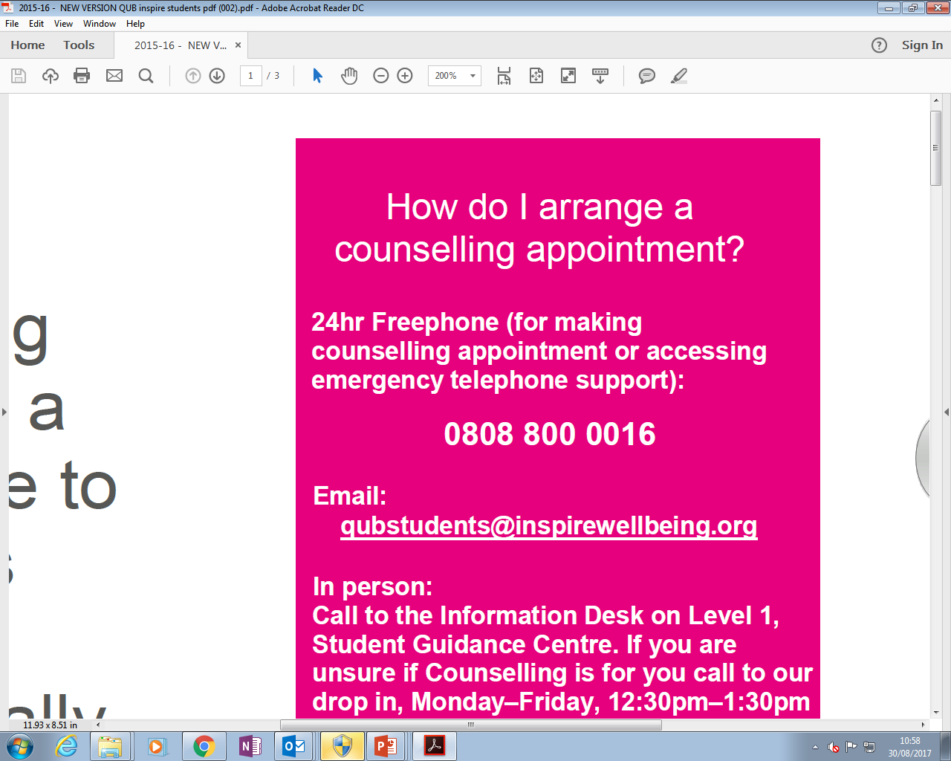
Counselling Support – Inspire
Counselling sessions are available all year round
Free to all Queen’s students
Confidential and non-judgemental place to work through challenges
Helpline number available from EU and America

Slide 16
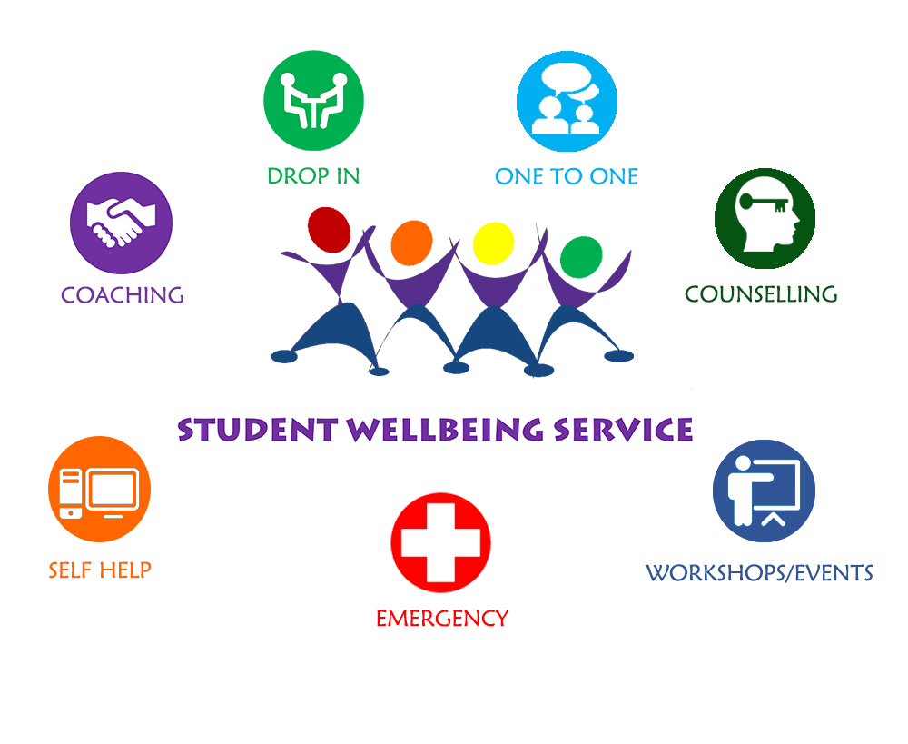
Good luck and enjoy the experience
www.qub.ac.uk/sgc/wellbeing
Email: studentwellbeing@qub.ac.uk
Tel: 028 9097 2893

