Slide 1

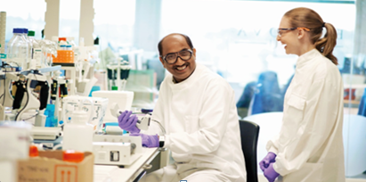

Residential Chemistry Training Experience 2019
“This course has helped me make up my mind about the career I wish to pursue”
This fully-funded, week-long training course is designed to give you practical experience of the work of a graduate chemist in the pharmaceutical industry. Based in the GSK research laboratories we will provide you with personalised laboratory tuition together with coaching in interview technique, presentation skills and working in teams.
This programme, now in its sixteenth year, will be held at the GSK Medicines Research Centre, Stevenage, Hertfordshire, on 8th – 13th September 2019.
The Residential Chemistry Training Experience is one approach that we use to encourage high calibre chemists from a variety of backgrounds to apply for positions in the pharmaceutical industry; therefore:
If you are an analytical, computational or synthetic chemistry undergraduate about to enter your final year of study and you would like to gain an insight into the pharmaceutical industry and be part of this interactive programme, please request an application form from uzy55557@gsk.com and return the completed application no later than: 13th June 2019.
“I particularly enjoyed the real-life laboratory work”
“The skills learned around CV writing, preparing for interviews and presentations are invaluable”

