Slide 1


Slide 2

Why is My Accommodation Important?
Next to studying and classes, the place you live is going to be where you spend most of your time. Your room is your comfort zone, your house is your haven. If you’re not comfortable and the four walls around you are causing you an added stress, you may find your wellbeing and mental health start to struggle.

Slide 3
Accommodation – Happiness and Home
When?
Taking time to look for what’s right for you. Signing a contract is legally binding. You will have to pay your rent even if you are not living in the property. Take your time and DON’T RUSH.
Where?
Thinking about the right type of accommodation is very important. There are three main options. University Halls, Private Halls (Purpose Built Student Accommodation) and Private Rented Housing. Thinking about the pro’s and cons of living in each may help you realise what is going to make you more comfortable throughout the yea
Who?
Remember, the greatest friends do not always make the greatest housemates. Take time to really get to know what people are like, how they like to live. You don’t want to fall out over mess or noise which may ultimately lead to you feeling isolated in your house and a negative impact on your wellbeing.

Slide 4
What to consider
Type of Accommodation | Housemates | Contract length | Security
University Halls | Random | Usually 39 weeks | Provided
Private Halls | Random | Usually 39 weeks | Provided
Private Rented Housing | You Choose | Usually 12 months | None

Slide 5


When you find the one!
Contracts
Read them thoroughly
Check the terms
Make sure everything is included
Don’t rush to sign
Get Advice!
Deposits
Check the Scheme
Has it been paid in within 14 days?
Have you received the details within 28 days?
Don’t be afraid to ask your landlord or agent!
Get Advice!

Slide 6


Viewing before Signing
Check for signs of damp and mould
Check for anything that’s damaged that might need to be replaced
Include anything you agree with the landlord of agent in the contract.
Make sure you get a copy of the contract to keep.
When you Move In
Take pictures
Complete an inventory
Email any concerns and always keep evidence of correspondence
Make your house a home!

Slide 7
What about my bills?
Type of Accommodation | Rates | Utilities & Contents Insurance | TV Licencing | Groceries, household and cleaning supplies
University Halls | Included | Included | Included for Common Areas | Not included (meal plans included in Stran Halls)
Private Halls | Included | Included | Varied – usually not included | Not included
Private Rented Housing | Usually Included – double check your contract | Not included | Not included | Not included

Slide 8

How to budget?
Make a plan and stick to it
At the start of the year agree how the household bills will be paid and how you will pay your share.
Be Prepared
Late payments can lead to your electric being cut off. You can end up running out of gas in the middle of the night and late payments may have an impact on your credit score.
Agree what is communal
Will you all chip in for cleaning products? Do you share milk? What about biscuits, tea bags, toilet roll?
buying these things together saves money

Slide 9

What if my housemate owes me money?
Agreements between housemates are not legally binding.
Household conflicts usually always revolve around someone not paying for the oil, or not contributing to household budgets.
You can make a claim through the Small Claims Court - https://www.nidirect.gov.uk/articles/small-claims-process

Slide 10
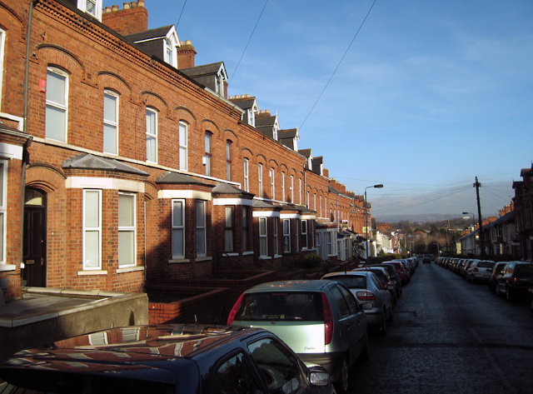
Renting in a Pandemic
Currently, there is no legislation to allow tenants to end their tenancy agreements early.
We can’t know what the coming months will bring or the impact it will have on teaching & learning.
Think about who you’re living with and where to live.

Slide 11

How to keep my household safe
Asymptomatic Testing
Practice good hygiene within your house
Keep an eye out for the vaccine rollout

Slide 12
What could possibly go wrong?!
Landlord problems
Housemate disputes
Safety and Security
Off-campus discipline

Slide 13
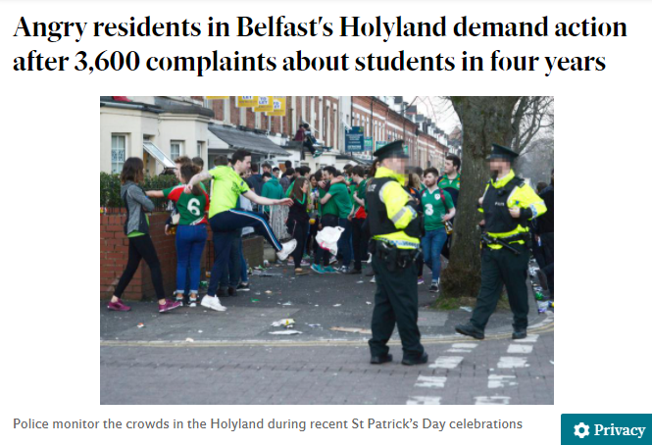
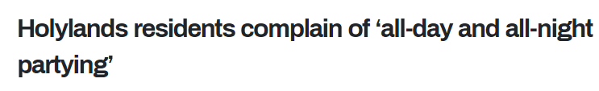

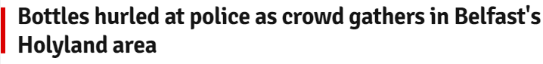
Title
Body copy

Slide 14
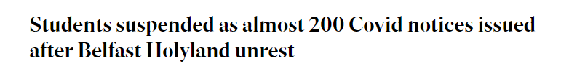
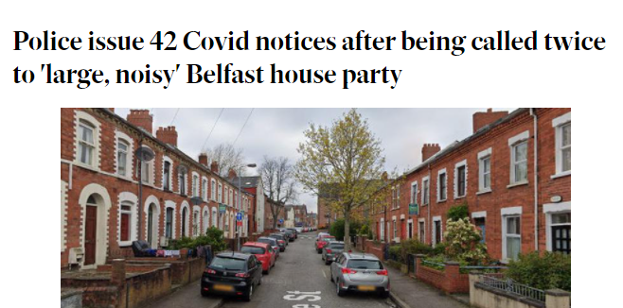
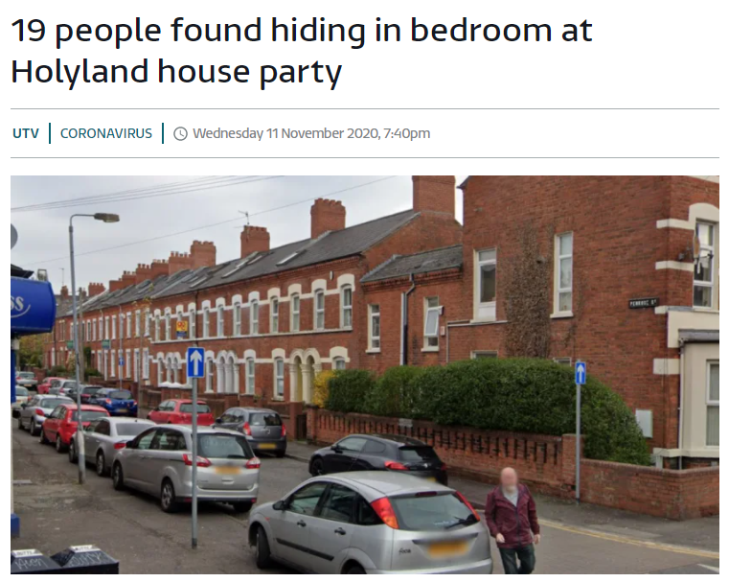
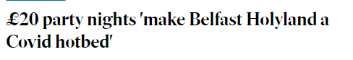
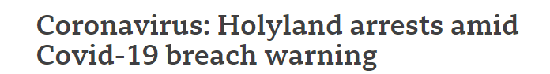
Title
Body copy

Slide 15
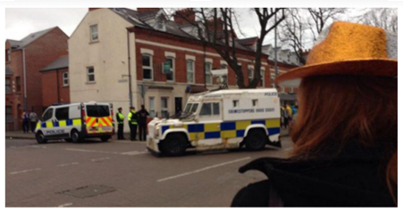
“It won’t happen to me!”

Slide 16
Enjoy your new home!
Choose your home and housemates carefully
Deal with landlord or housemate problems as they arise
Pay attention to safety and security measures
Respect your neighbours
Monitor Covid regulations and adhere to all restrictions
Contact us for free, impartial, confidential advice

Slide 17
Email us:
studentadvice@qub.ac.uk
Follow us on Twitter: @QUBSU_Advice

