Slide 1
QUEEN’S ACCOMMODATION
Michelle Carson - Allocation & Bookings Co-ordinator
Thursday 29 April 2021

Slide 2
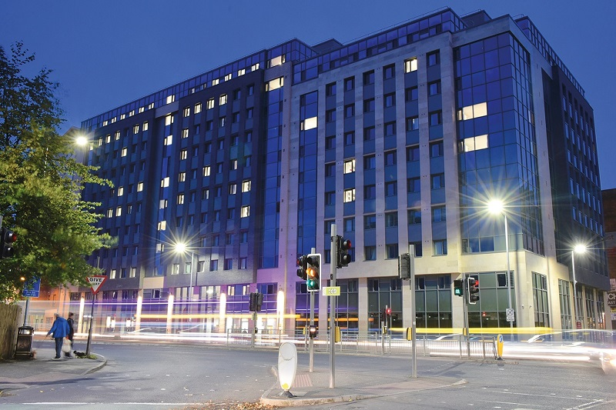
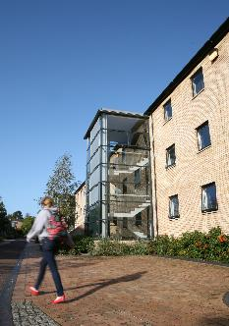
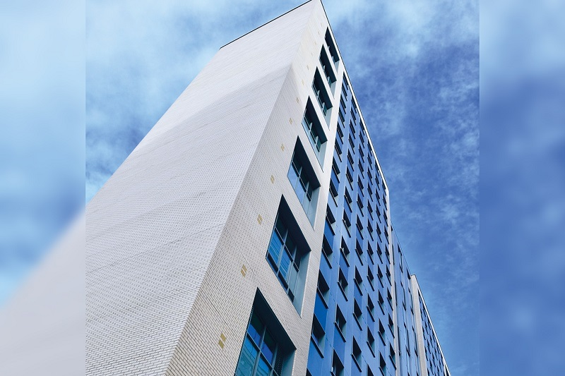
Information Session
Queen’s Accommodation
Information relating to the application process and beyond
Full Accommodation presentation available
Apply – www.qub.ac.uk/accommodation
Already applied – m.carson@qub.ac.uk
Sharing of your information

Slide 3
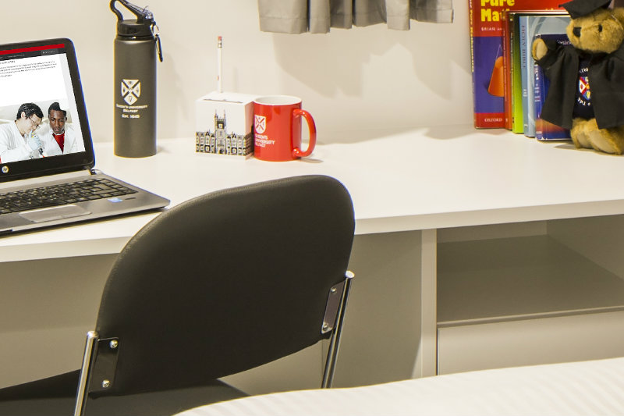
How & when can I apply?
Submit your application on line – available via the website www.qub.ac.uk/accommodation now. You can read about the accommodation and see more photos.
The Allocation Policy is also on the website - the closing date for applications is 5 August 2021 (NI students only).
Please note that we do not accept group accommodation applications.
Accommodation offers will be sent out from 10 August 2021, following the publication of A level results.
Remember when applying to use an email account that you will have access to in August 2021 as we will send the accommodation offer to it – you will have 2 days to respond and pay £300 to confirm acceptance.

Slide 4


STAY CONNECTED
Elms BT9 reception – 028 9097 4525
Elms BT1 reception – 028 9097 6040
Elms BT2 reception – 028 9097 6441
Email: accommodation@qub.ac.uk
accommodationBT1@qub.ac.uk
accommodationBT2@qub.ac.uk
Website: www.qub.ac.uk/accommodation
Queen’s Accommodation
@QueensAccomm

Slide 5
QUESTIONS

