Slide 1


Slide 3

Queen’s is in the
Top 200 Universities in the World
(QS World University Rankings 2019)

Slide 4




In the most recent Research Excellence Framework Queen’s
is in the top 20 for research quality
and impact
Queen’s is 8th
in the UK for
research intensity
Over 75% of
our research is
world-class
or internationally leading

Slide 5
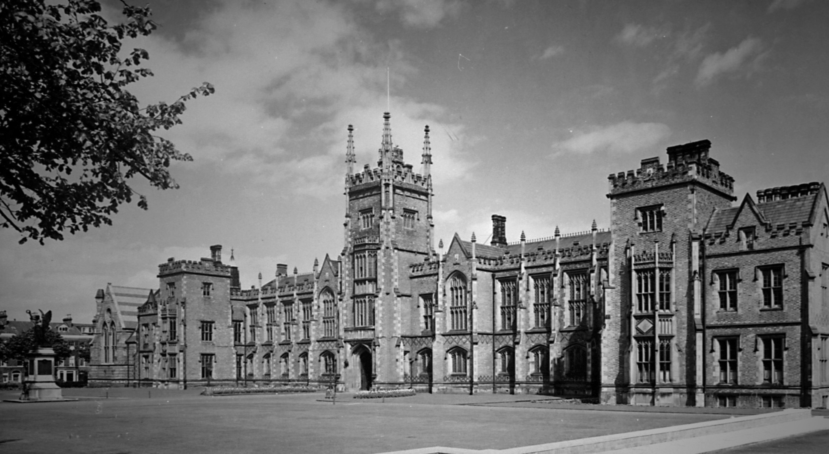
Established in 1845, Queen’s is the 9th oldest university in the UK

Slide 6
Queen’s is a member of the Russell Group*, the 24 top research-intensive universities in the UK, commonly perceived as the UK’s ‘Ivy League’
*Includes the universities of Oxford, Cambridge, Durham, LSE and Imperial College, London

Slide 7


Slide 8

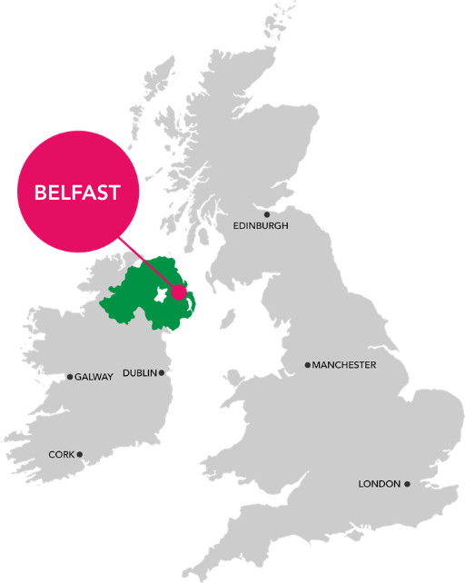
VV
NORTHERN IRELAND
NORTHERN IRELAND
Lowest cost of living in the UK (Mercer, 2016)
Northern Ireland is the ‘happiest place in the UK’
(Office of National Statistics, 2016)
World No 1 Food Destination (International Travel & Tourism Awards, 2018)
Belfast as one of National Geographic’s
“Places to Travel for Food in 2016”
1hr flight to London
Northern Ireland population = 1.8 million
Greater Belfast population = 650,000

Slide 9

BELFAST
Belfast – ‘Best UK City’
Guardian and Observer Travel Awards 2016

Slide 10
Research commercialisation
£
Queen’s is NO 1 IN THE UK for Intellectual Property (IP) commercialisation revenue
Queen’s is NO 1 IN THE UK for KTPs
Queen’s has created over 70 spin-out companies. Three of these (Kainos, Andor Technology and Fusion Antibodies) are listed on the London Stock Exchange

Slide 11


Slide 12

A WORLD LEADING INSTITUTE WORKING WITH A GREAT INDUSTRY TO DELIVER A WORLD LEADING FOOD SYSTEM

Slide 13




One of four Global Research Institutes at Queen’s:

Slide 14



Where IGFS sits:

Slide 15



FOOD SECURITY
…exists when all people, at all times, have physical and economic access to sufficient, safe, and nutritious food to meet their dietary needs and food preferences for an active and healthy life
(definition from the 1996 World Food Summit)

Slide 16


Slide 17
Food Science at Queen’s – Ranked No 1 in the UK
(REF 2014)

Slide 18
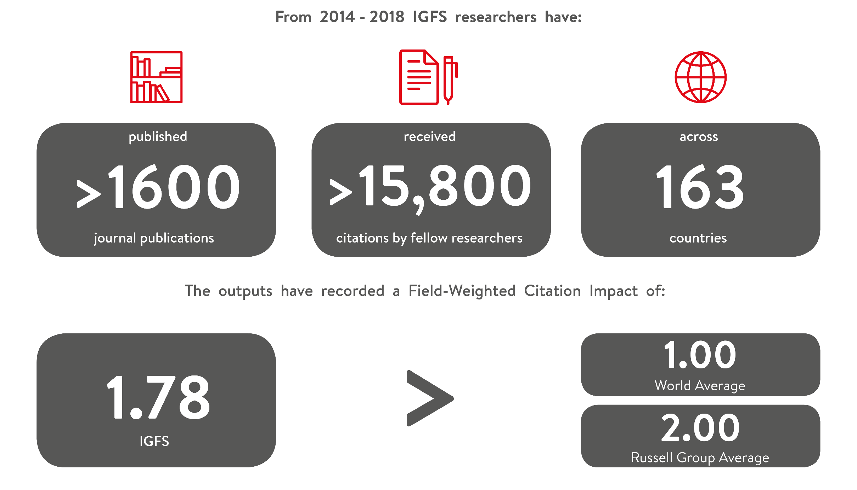
Global Research Impact

Slide 19
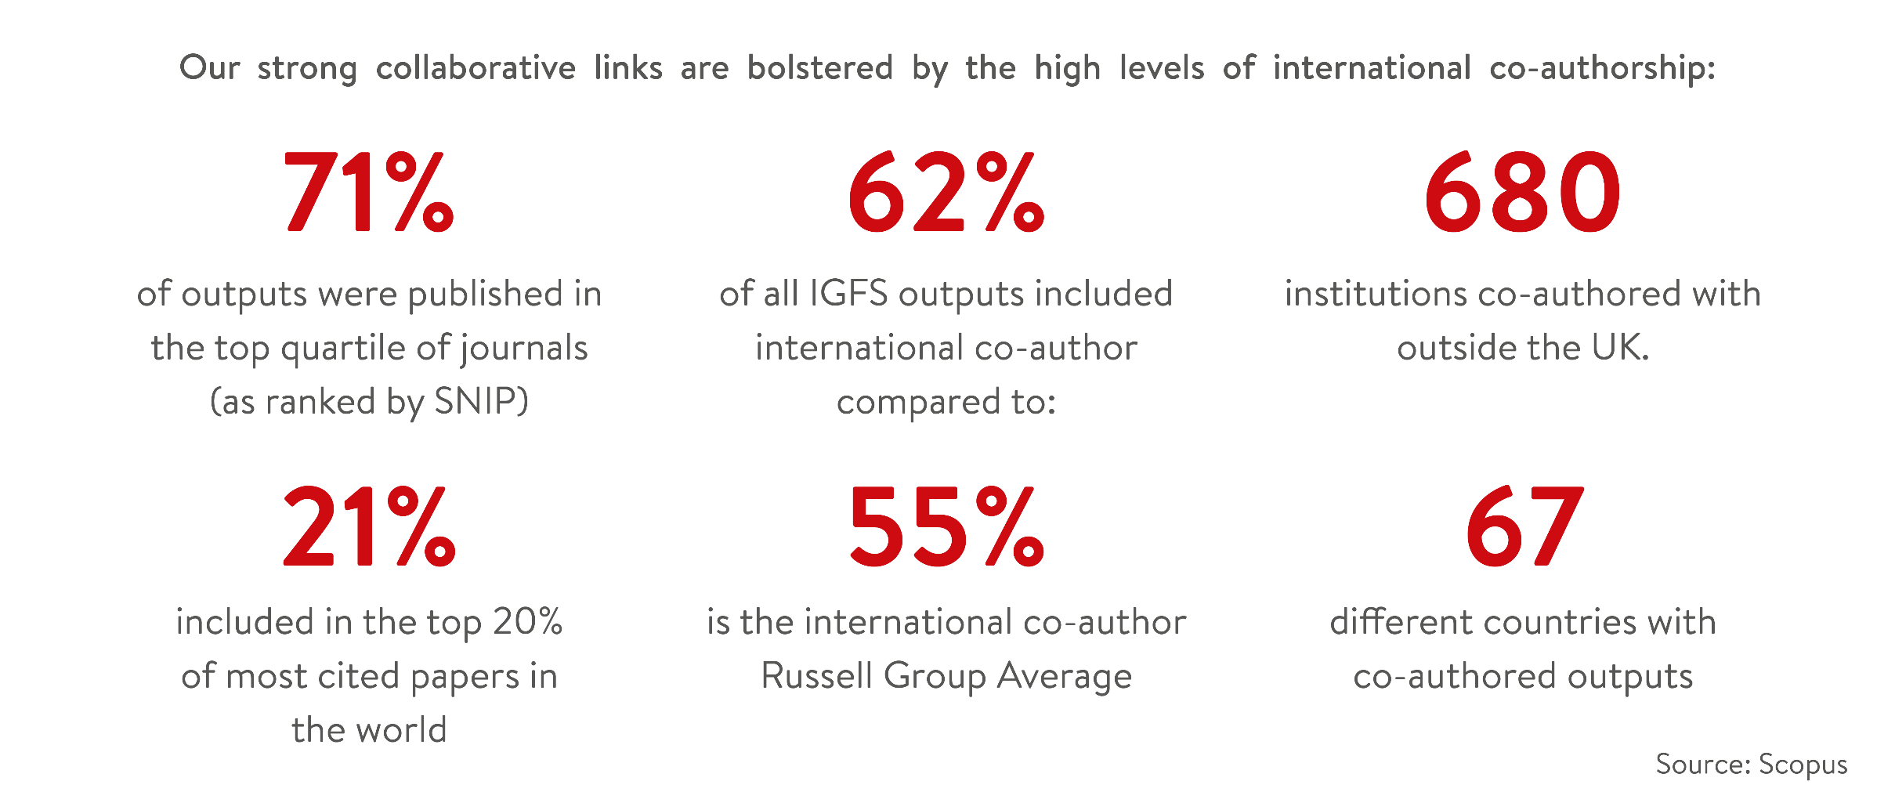
Global Research Impact

Slide 20
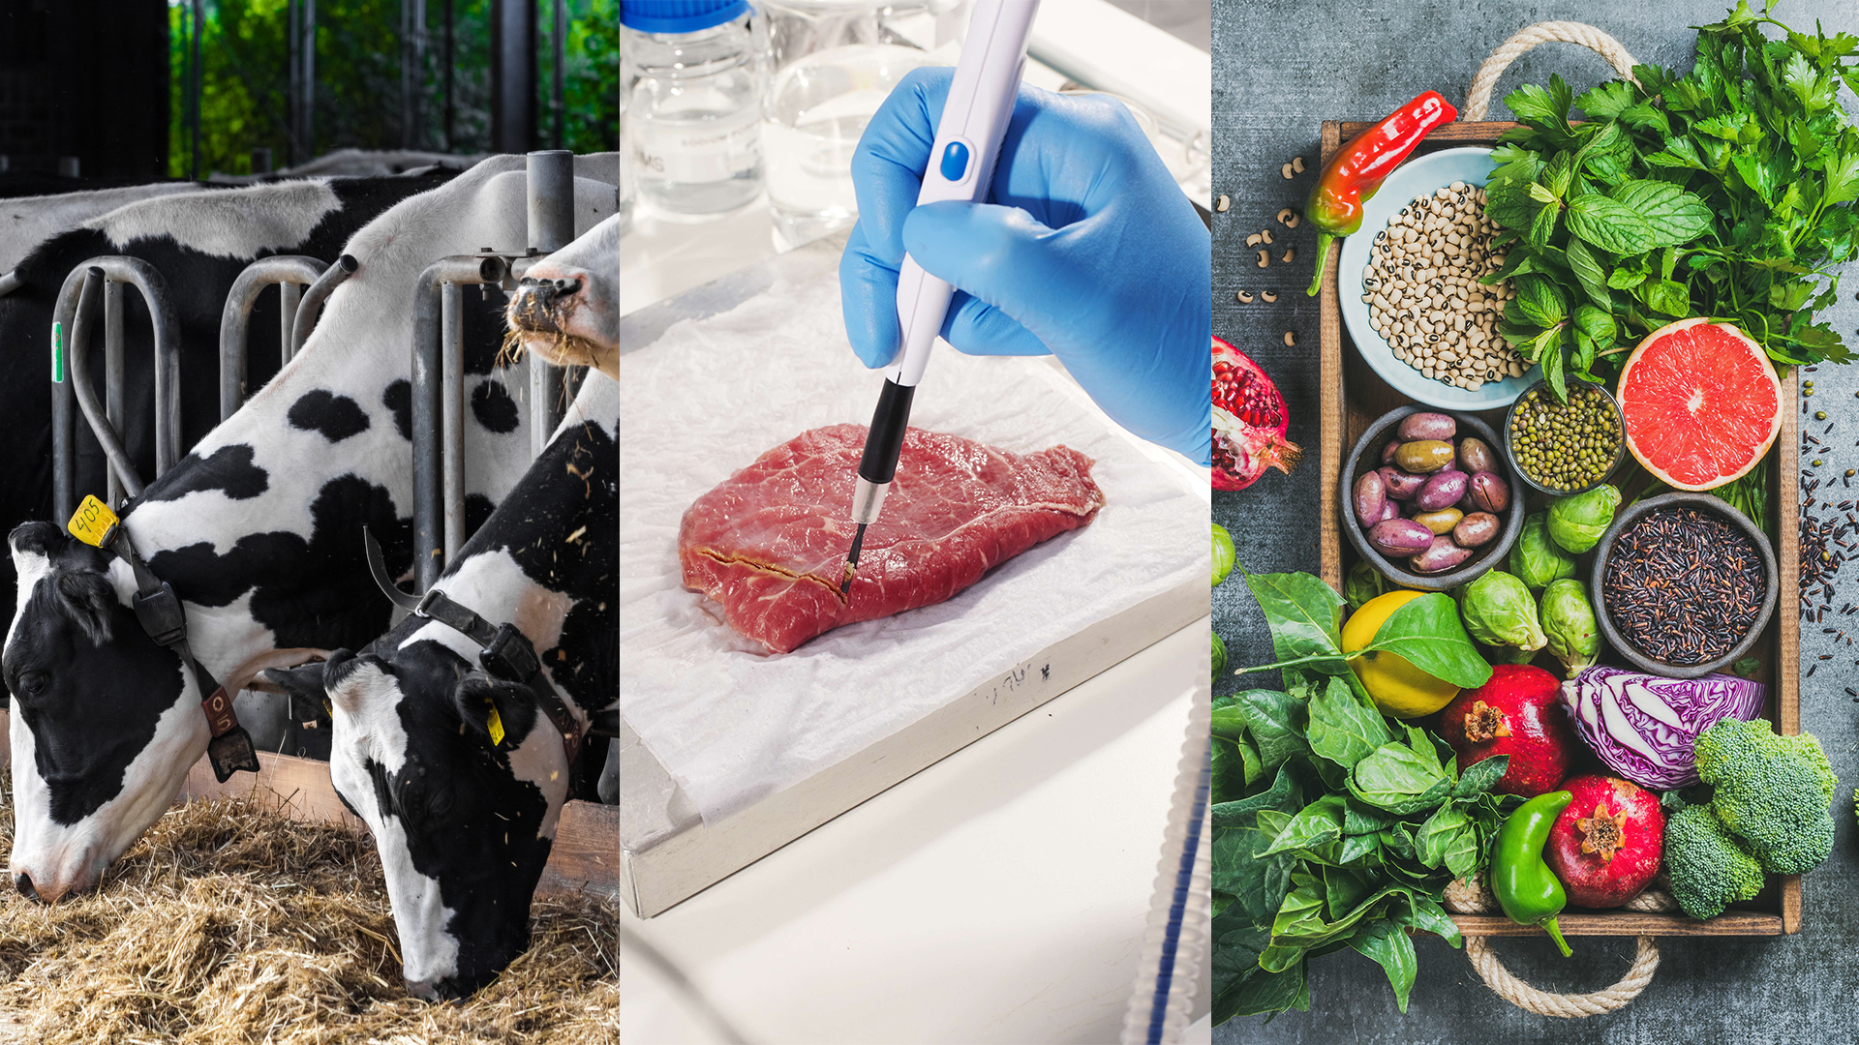

THREE GRAND CHALLENGES
FARMS OF
THE FUTURE
GLOBAL FOOD
INTEGRITY
FOOD, NUTRITION & HEALTH

Slide 22


New Biological Sciences Building
Opened
2019

Slide 23
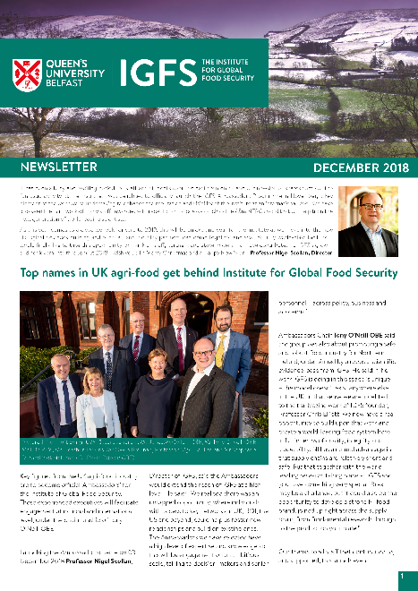
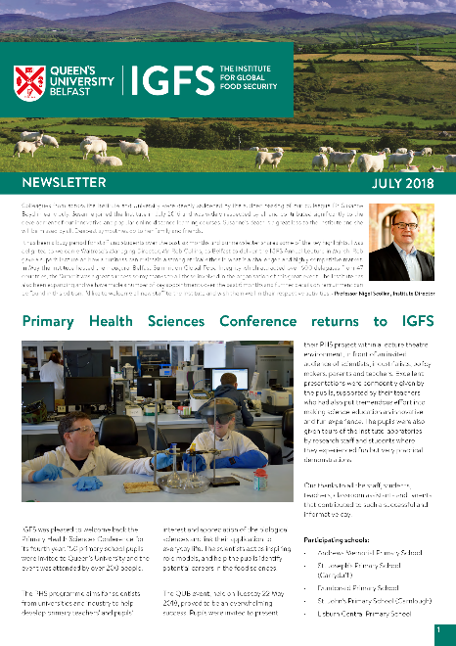
Keep up to date with IGFS
@QUBIGFS
IGFS
Newsletter
igfs@qub.ac.uk
@QUBIGFS
IGFS Official
Institute for Global Food Security

Slide 24
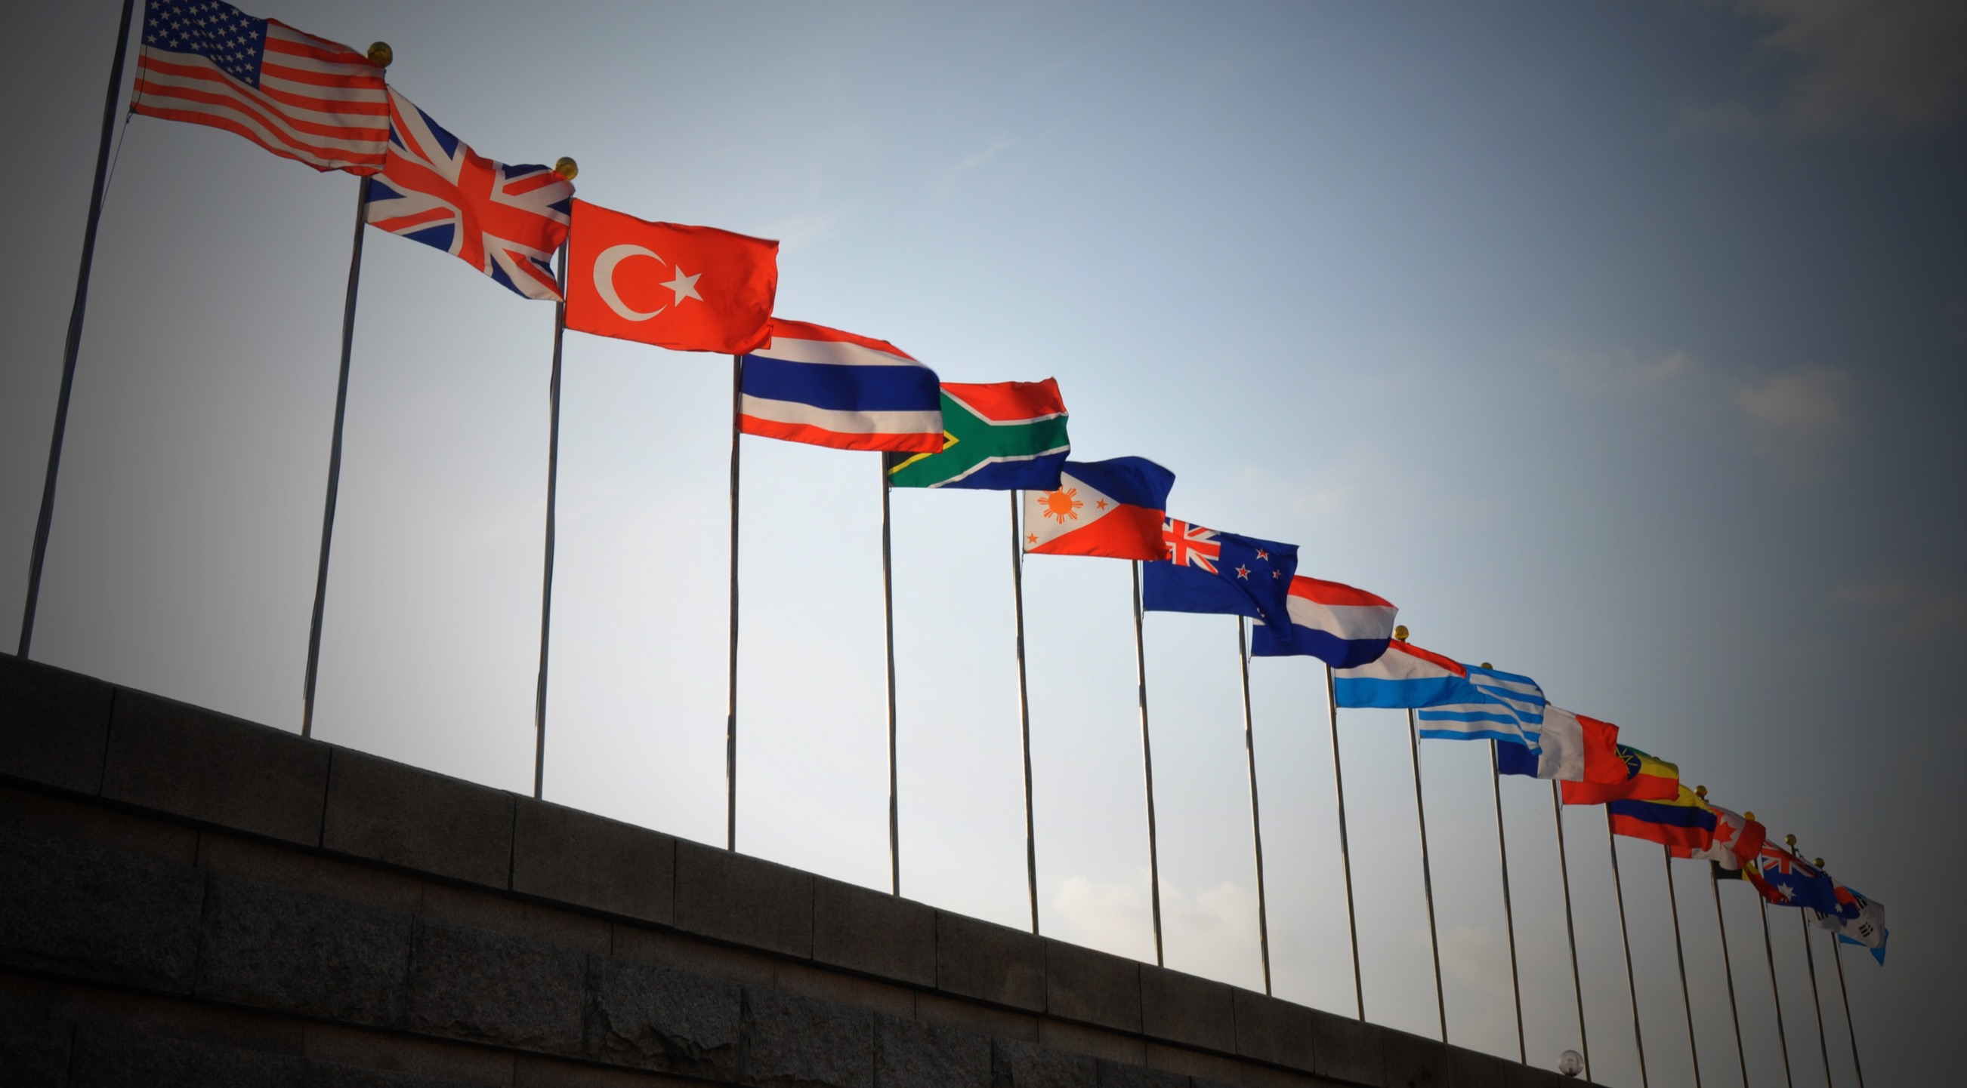
Queen’s
overseas partnerships

Slide 25
Queen’s has MOUs with universities in Brazil, South Africa, Palestine, Canada, China, Jordan, Kenya, Malaysia, USA, Vietnam, Dubai, India, Indonesia, Italy, Korea
IGFS has MOUs with universities in Ghana, Canada, Eduador and Indonseia
IGFS is about to sign a MOU with Guangzhou Medical University, China

Slide 26
1. China
Joint College with China Medical University (CMU), Shenyang, established in 2014
Queen’s and Southeast University lead the UK-China University Consortium on Engineering Education and Research – the first of its kind to bring together 15 universities, six in the UK and nine in China
20 years of partnership with Shenzhen University – over 700 students have graduated from Queen’s University Belfast through its Shenzhen Joint Foundation Programme
Leading one of the largest food-safety projects across Europe and China, EU-China-Safe to tackle food fraud
Queen’s and Beijing Institute of Technology delivered the first Future Engineers’ Leadership and Innovation Academy to 26 PhD students

Slide 27
2. South East Asia
Partnership with Malaysian oil and gas giant Petronas and strong links with Brickfields, University of Malaya and Universiti Kebangsaan Malaysia
Indonesia Endowment Fund for Education (LPDP) sponsors postgraduate studies at Queen’s
Ongoing Newton-funded research collaboration with Universitas Malaya, Malaysia, in PACED initiative (Promoting Awareness of Cancer and Early Detection)
Queen’s welcomes PhD students through the Vietnam International Education Development (VIED)

Slide 28
3. Middle East and Africa
Partnership to develop the Mohammed Bin Rashid University of Medicine and Health Sciences in Dubai
Work in Kenya to reduce global crop loss in the developing world
Improvement of child growth outcomes in Africa in partnership with the Bill and Melinda Gates Foundation
Development of drug-delivery devices to prevent HIV transmission in sub-Saharan Africa

Slide 29
4. North & South America
Partnerships with Harvard University, Johns Hopkins University, University of California at Berkley, Stanford University, University of Michigan, Boston College and Vanderbilt
Co-ordinating the UK’s input into the world’s largest solar telescope with the US National Solar Observatory in Hawaii
Research links with universities in Brazil, Peru, Ecuador and Guyana on the issue of toxic element contamination in agriculture
Almost £23m research funding has been secured since 2012 for collaborative research projects in the USA

Slide 30
5. India region
Queen’s is among a select group of institutions to partner with Infosys on InStep Global Internship Program. Infosys, a global leader in technology and consulting services, is a corporate member of the Queen’s CSIT
Project to improve soil nutrients and rice yields in Bangladesh
First-ever study on impact of the built environment on levels of exercise and physical activity among people in India

Slide 35
Field Title | Field Title | Field Title | Field Title | Field Title
00000 | 00000 | 00000 | 00000 | 00000
00000 | 00000 | 00000 | 00000 | 00000
00000 | 00000 | 00000 | 00000 | 00000
00000 | 00000 | 00000 | 00000 | 00000
00000 | 00000 | 00000 | 00000 | 00000
00000 | 00000 | 00000 | 00000 | 00000
00000 | 00000 | 00000 | 00000 | 00000

