Slide 1
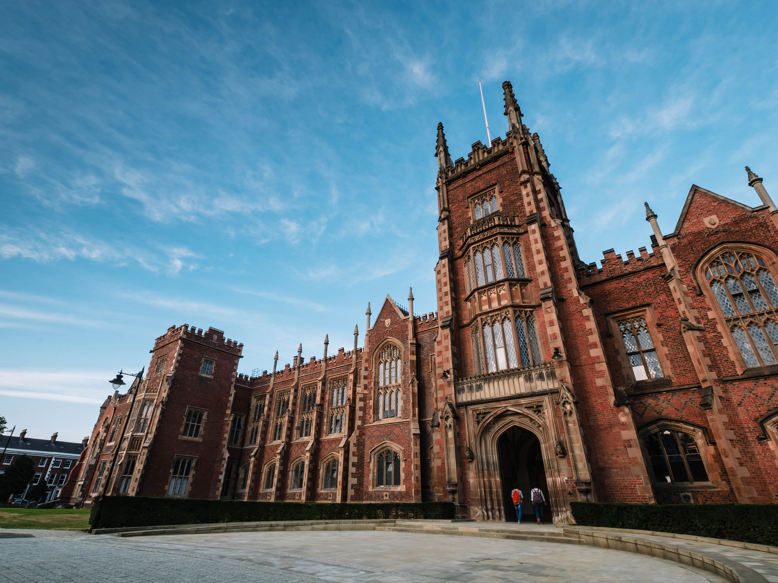


Slide 2
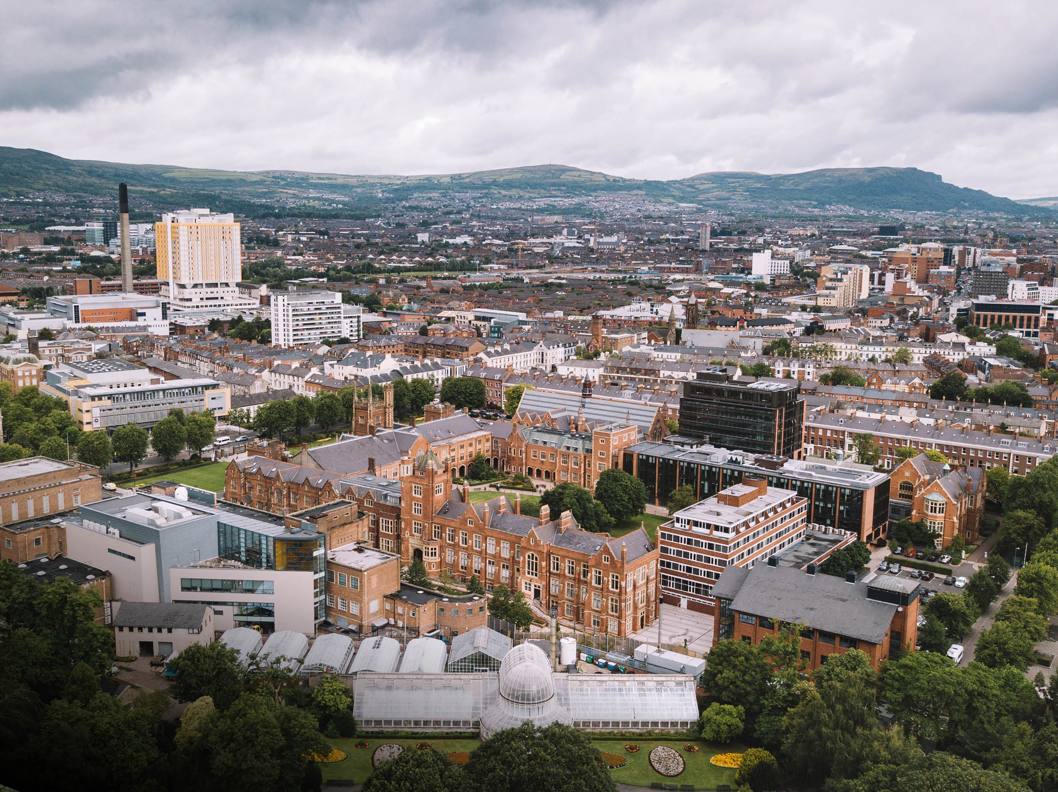

MAIN CAMPUS

Slide 3
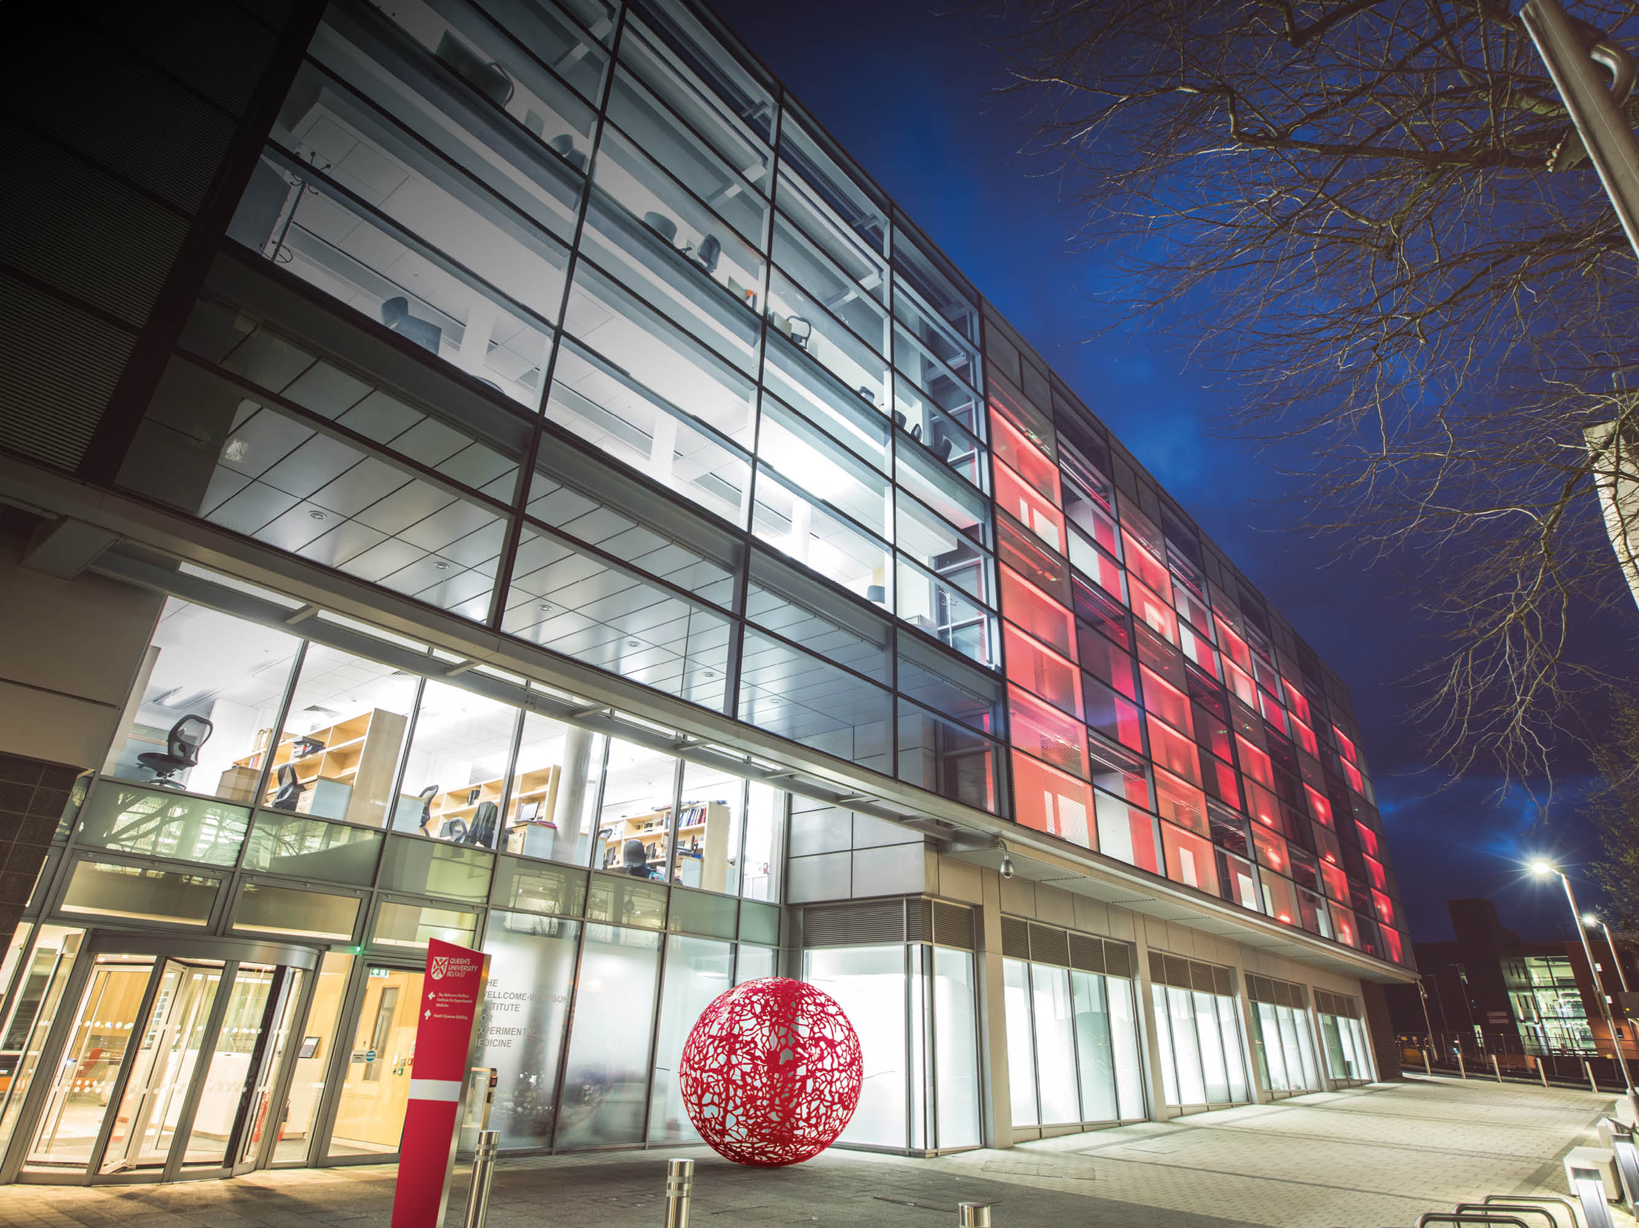
WELLCOME-WOLFSON
INSTITUTE
EXTERIOR

Slide 4
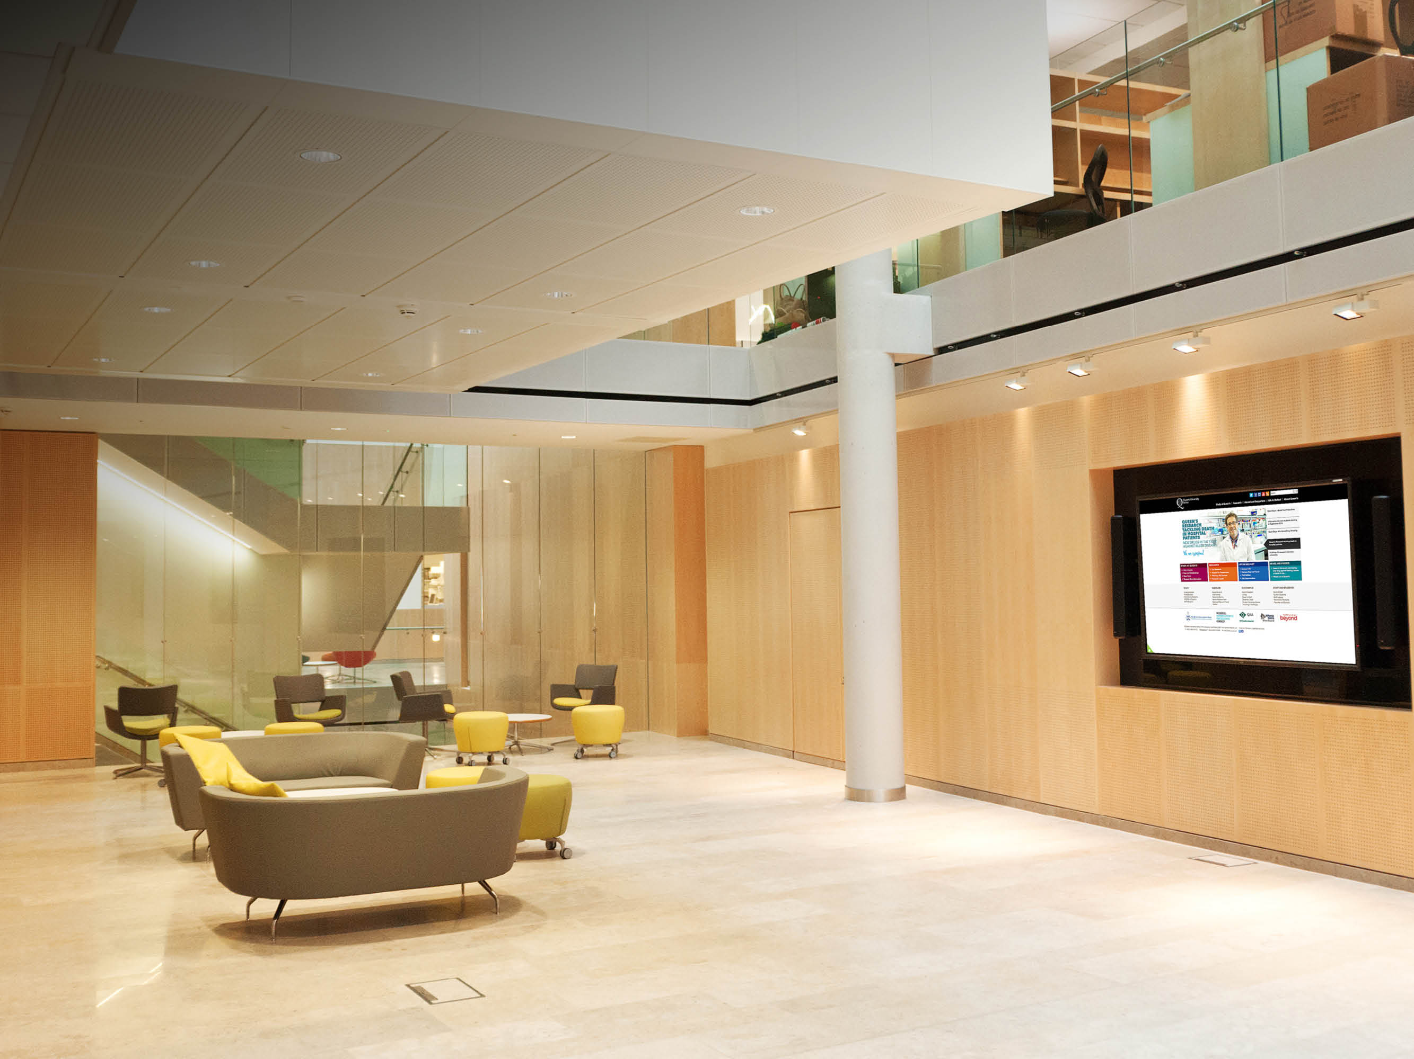
WELLCOME-WOLFSON
INSTITUTE
INTERIOR

Slide 5
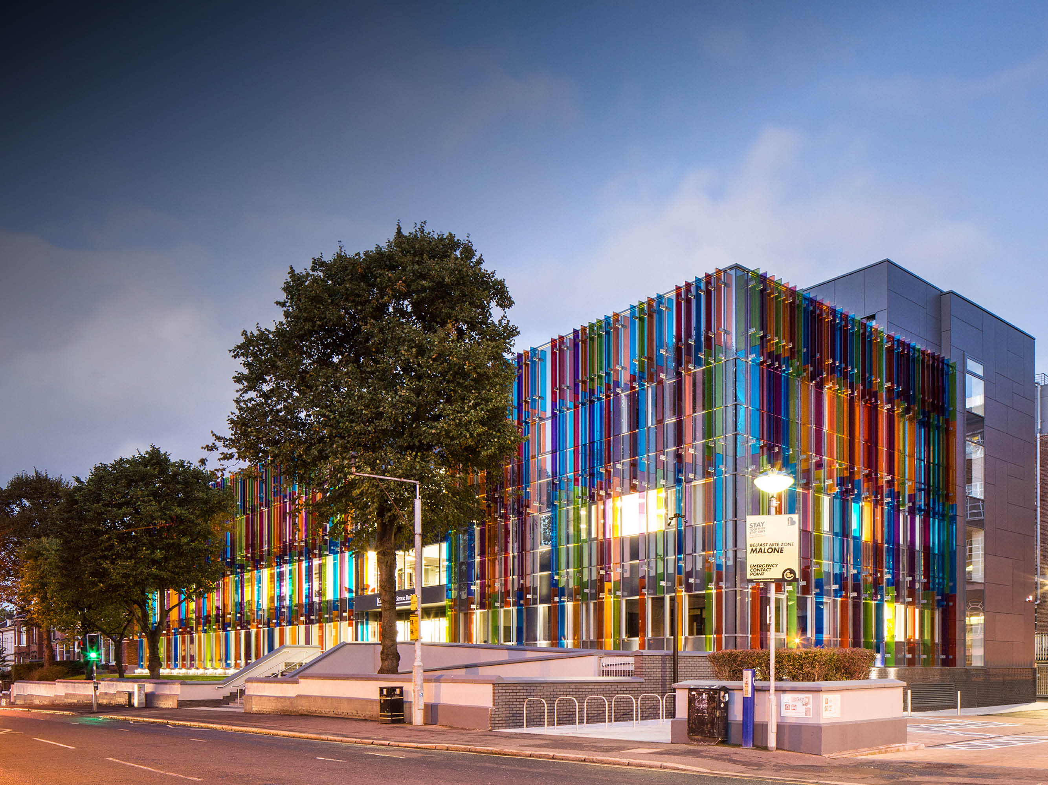
COMPUTER SCIENCE BUILDING
EXTERIOR

Slide 6
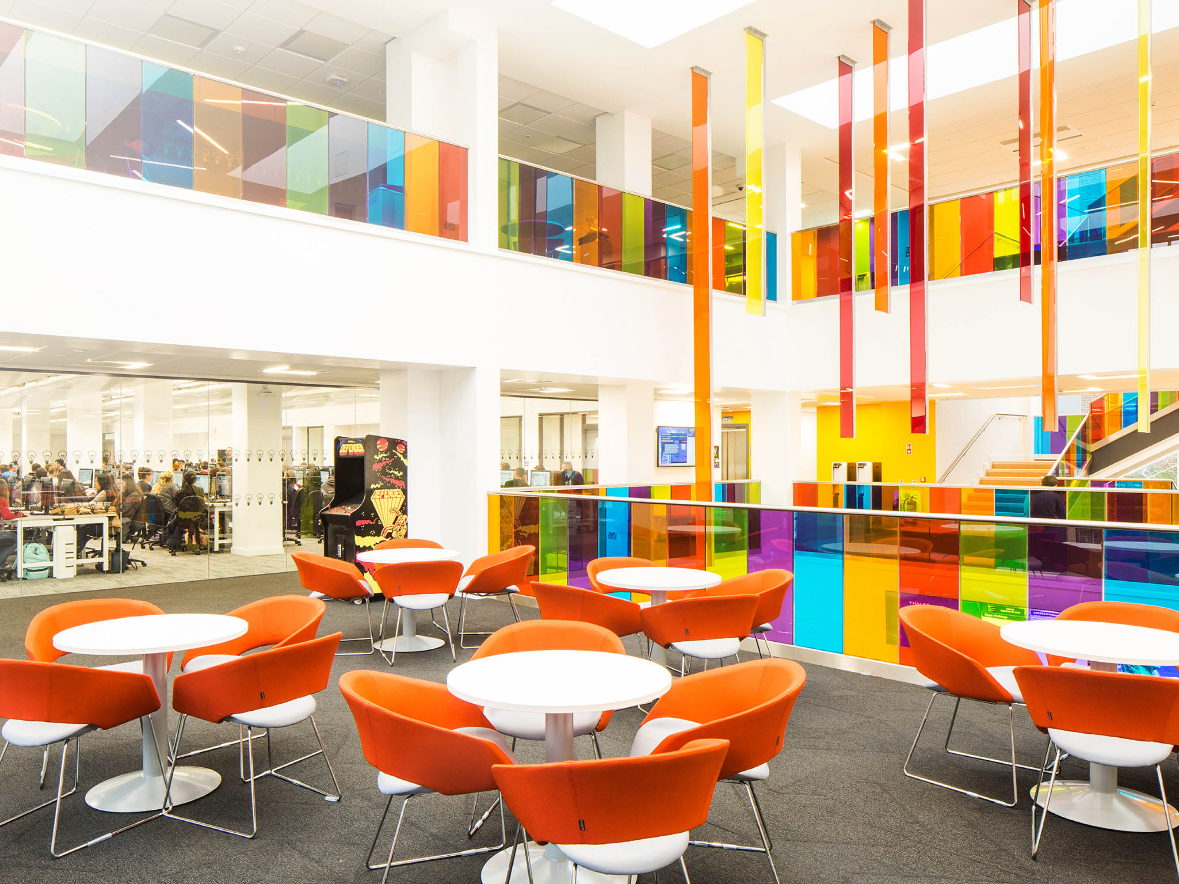
COMPUTER SCIENCE BUILDING
INTERIOR DESIGNED BY STUDENTS

Slide 7
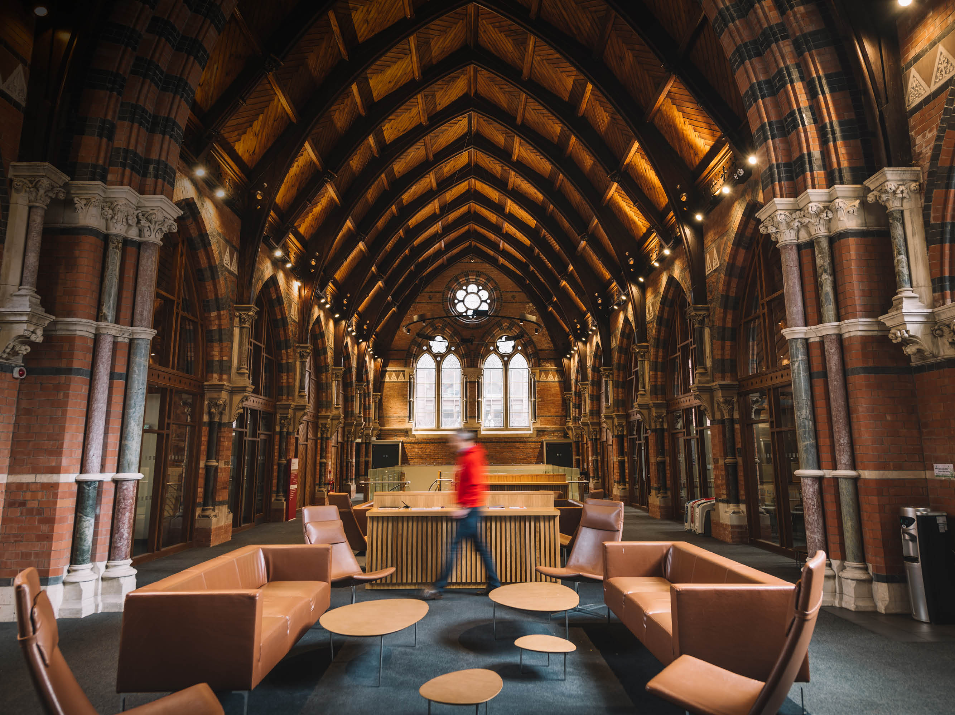
QUEEN’S
GRADUATE SCHOOL
NO 1 IN UK (ISB)

Slide 8
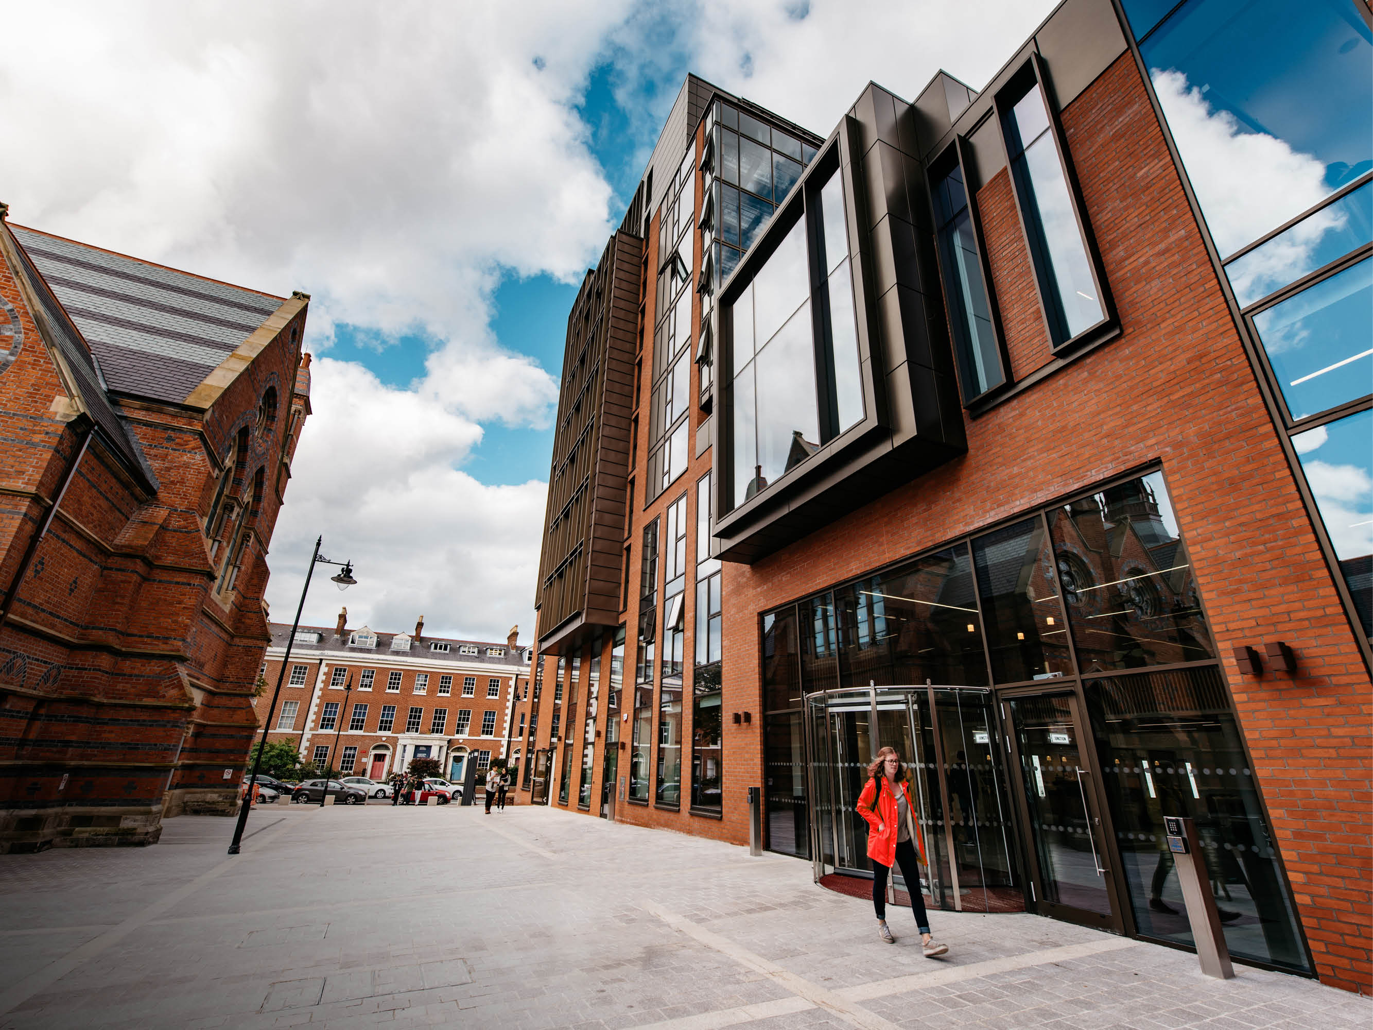
QUEEN’S LAW SCHOOL

Slide 9
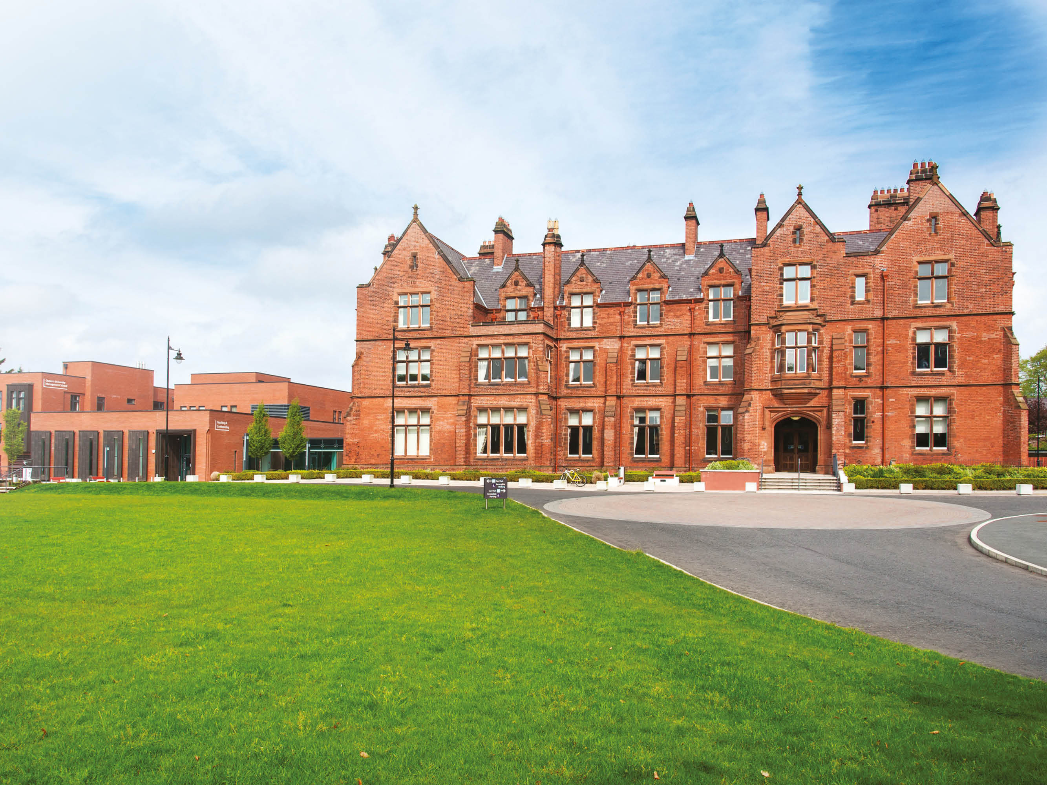
RIDDEL HALL

Slide 10
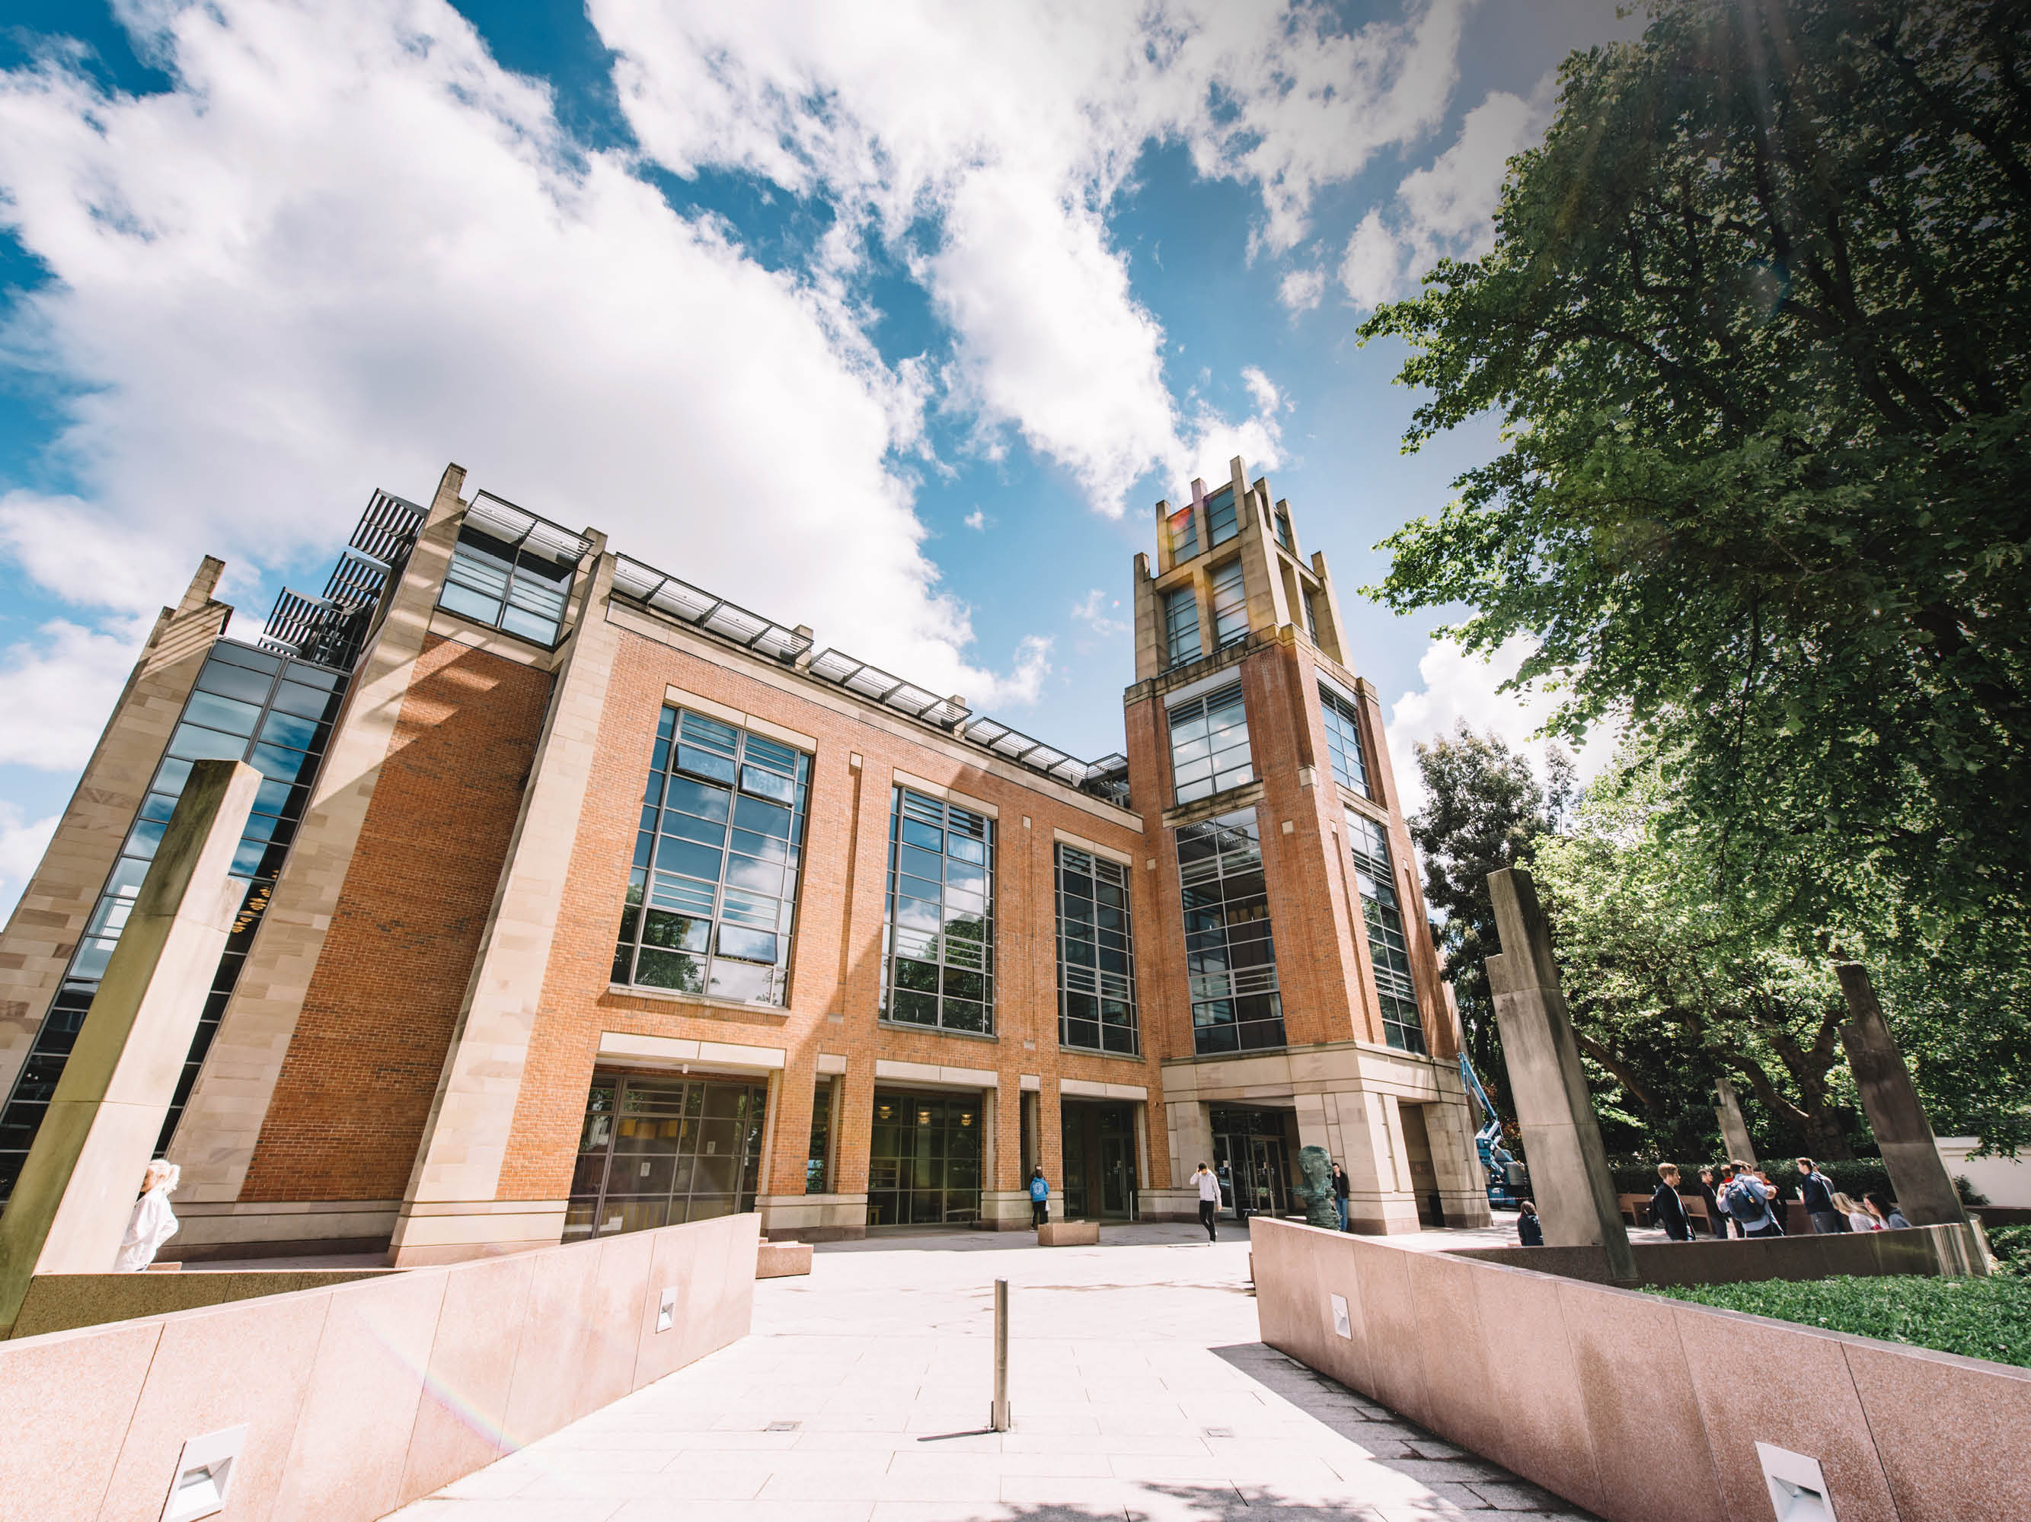
McCLAY
LIBRARY

Slide 11
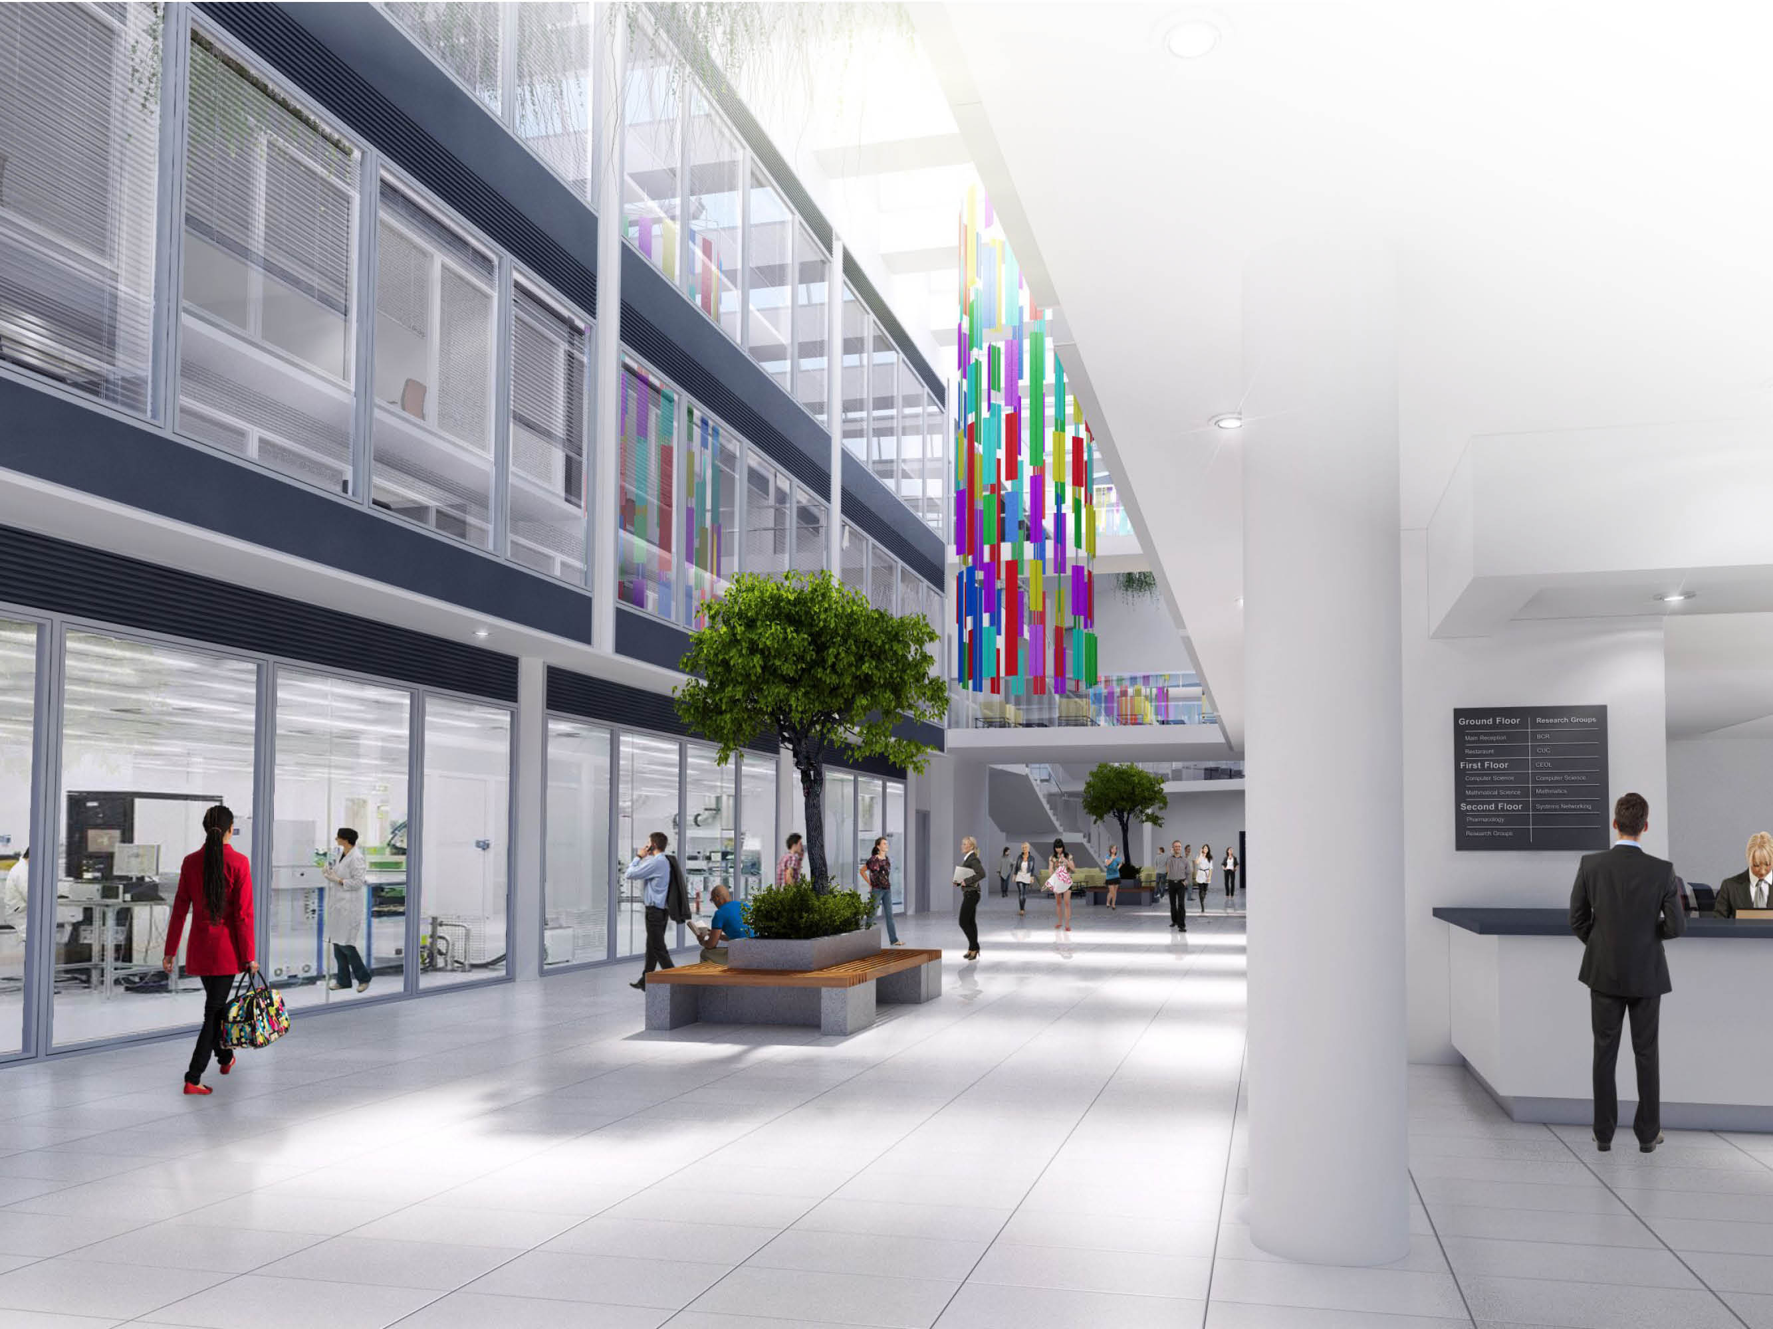
BIOLOGICAL
SCIENCES
BUILDING
OPENING
EARLY 2019

Slide 12
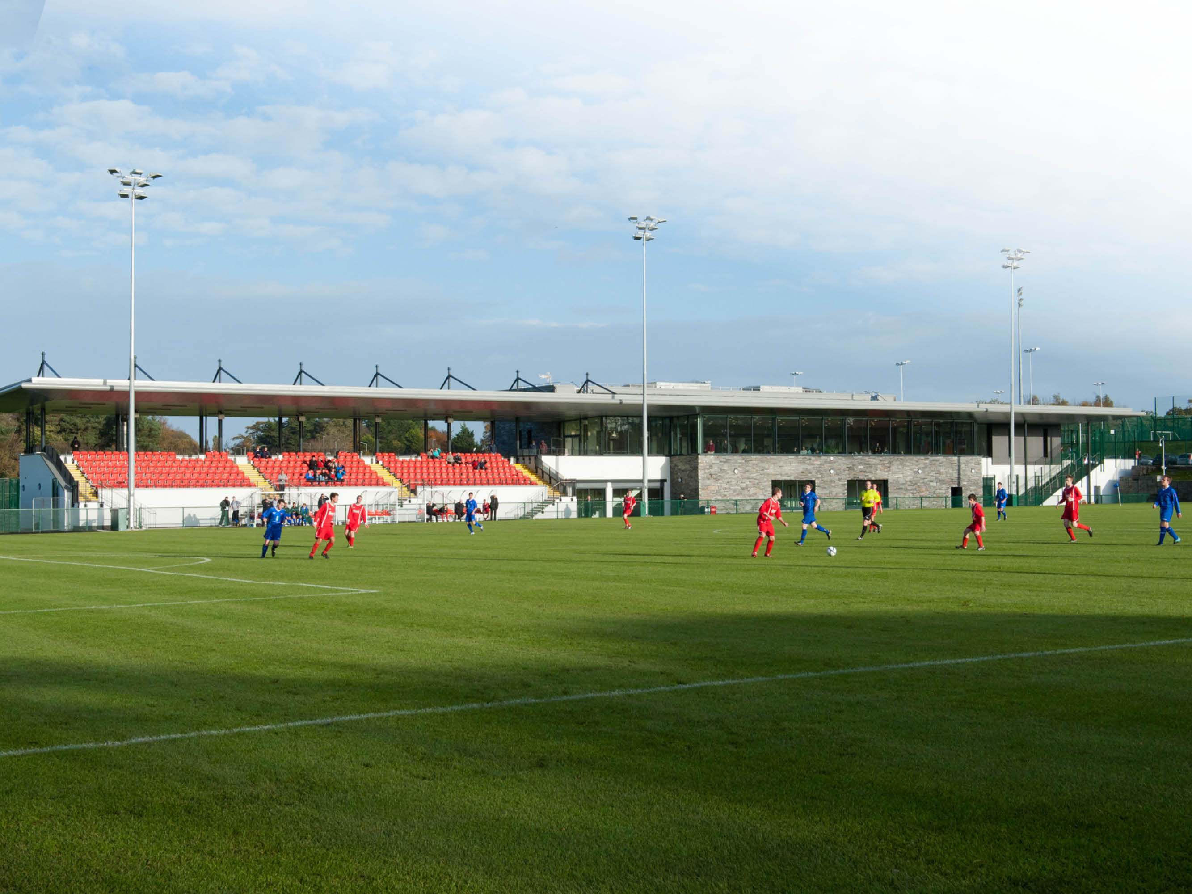
QUEEN’S SPORT
UPPER MALONE

Slide 13
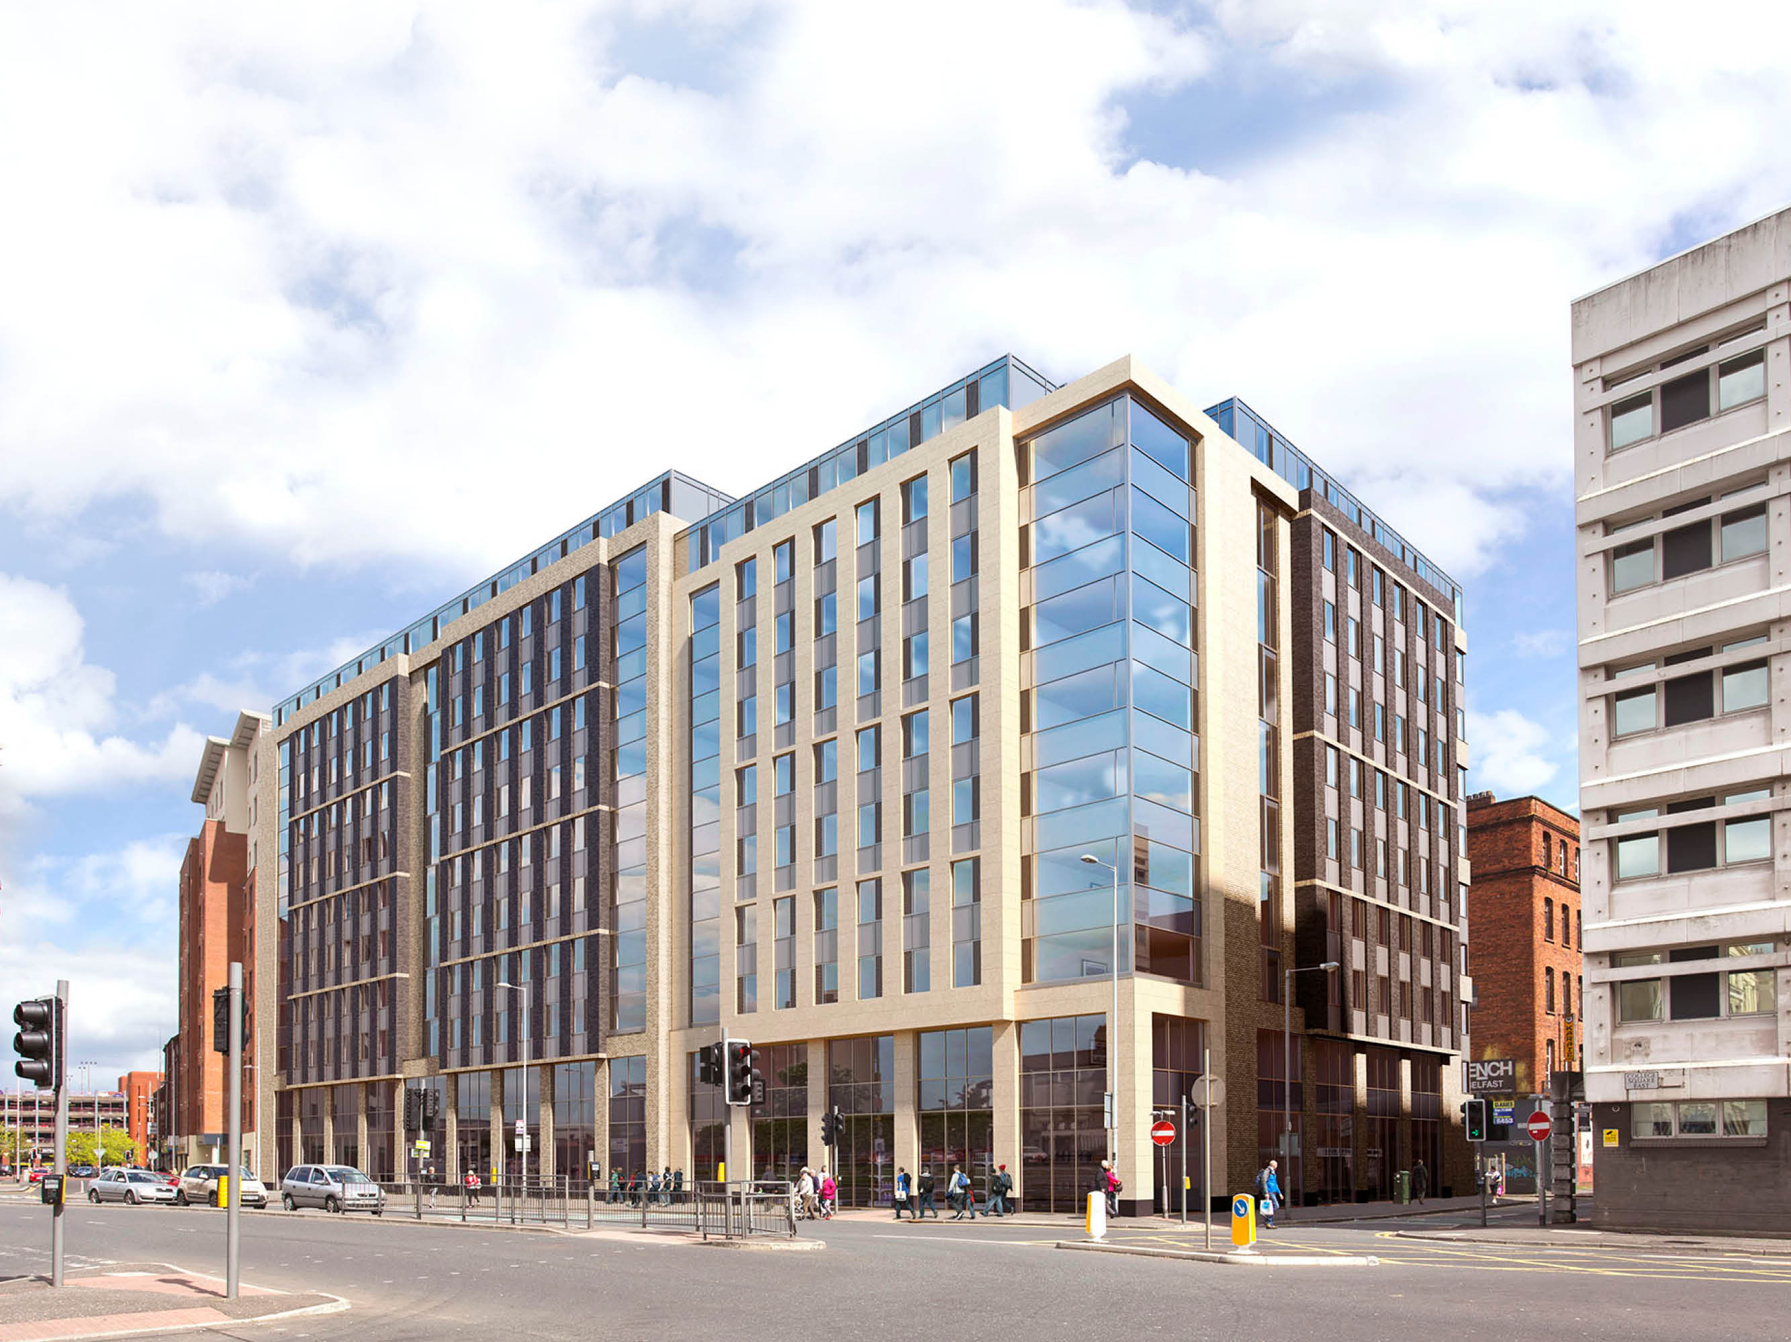
NEW QUEEN’S CITY CENTRE ACCOMMODATION

Slide 14
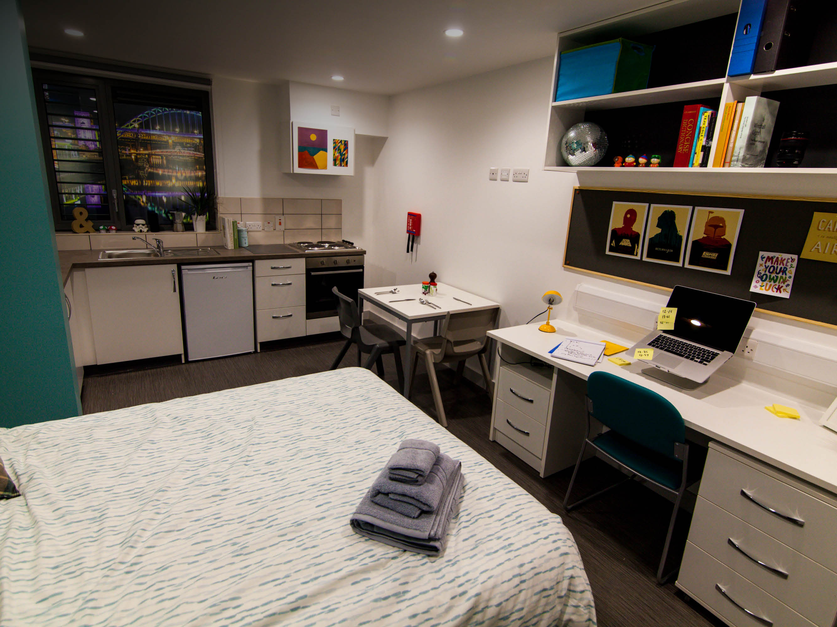
QUEEN’S STUDENT ACCOMMODATION

Slide 15
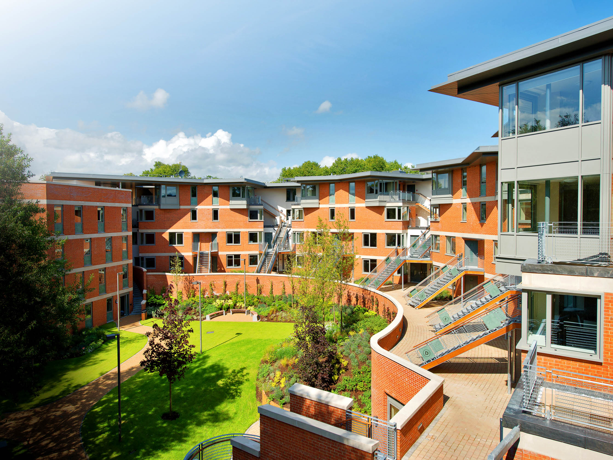
QUEEN’S STUDENT ACCOMMODATION

