Slide 1
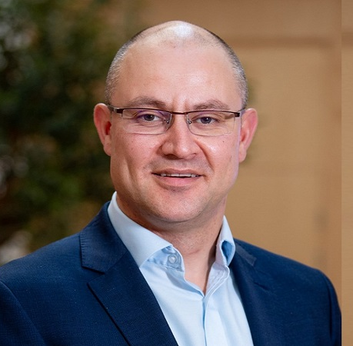
Applying for a PhD at
Queen’s University Belfast
Professor DAVID grieve
DEAN OF INTERNATIONALISATION
FACULTY of Medicine, HEALTH and LIFE scienceS

Slide 2

We are ranked 43rd in the world in The Times Higher Education Impact Rankings,
So a PhD from Queen’s is something to be proud of.
(Times Higher Education Impact Rankings 2021)
Notes:
1. We’re a Russell group university

Slide 3

Notes:
2. OUR RESEARCH HAS GLOBAL IMPACT

Slide 4
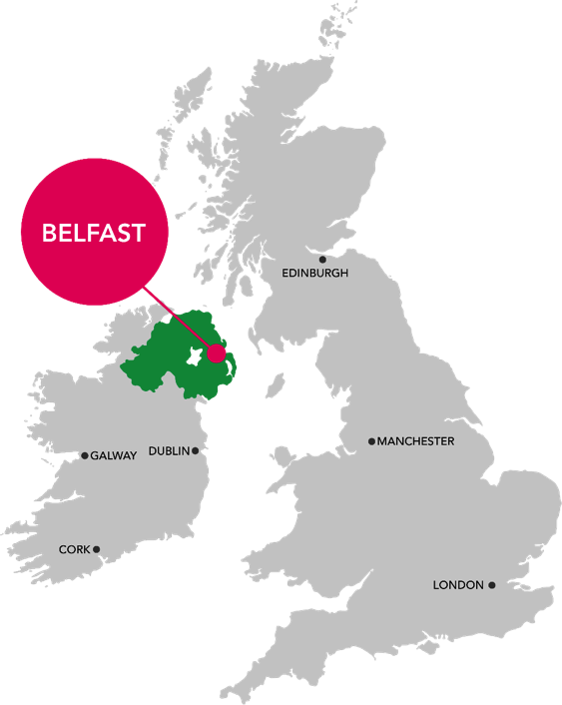





Life at Queen’s University Belfast
NORTHERN IRELAND IS THE HAPPIEST PLACE TO LIVE IN THE UK
(Lloyds Bank Happiness Index, 2020)
BELFAST HAS THE LOWEST STUDENT RENT IN THE UK (NatWest Student Living Index 2020)
BELFAST IS IN THE SAFEST REGION IN THE UK
(UK British Crime Surveys 2019/20)

Slide 5
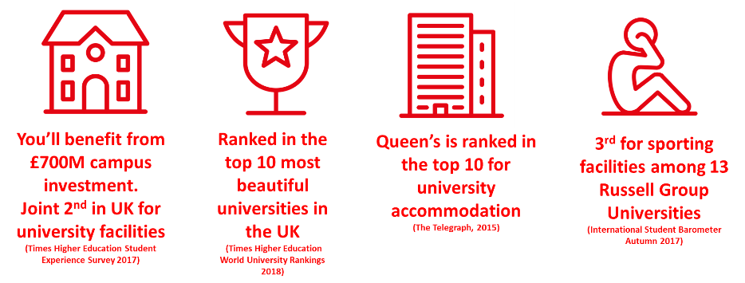
A CAMPUS UNIVERSITY IN THE HEART OF BELFAST
You’ll benefit from £700M campus investment
Ranked in the top 10 most beautiful historic universities in the UK
(QS World Rankings 2021)
Dedicated accommodation for Postgraduate Students
Ranked 1st out of 8 Russell Group Universities
(International Student Barometer 2020/21)
Queen’s is at the heart of the city’s culture, arts and social scenes

Slide 6



FACULTY OF MEDICINE, HEALTH AND LIFE SCIENCES
The Faculty is distinguished by its academic strengths and is recognised globally for the social, economic and cultural benefit it delivers through its research.
Our researchers are working at the cutting edge, applying their insight to ambitious programmes with the potential to yield world-changing solutions to major population and planetary health challenges.

Slide 7


RESEARCH CENTRES
IGFS
Institute for global food security
QUB Heritage
CPH
Centre for Public health
WWIEM
Wellcome-WoLFSON Institute for
Experimental medicine
PGJCCR
The Patrick g Johnson centre for cancer research
MATCH
Material and Advanced Technologies for Healthcare

Slide 8

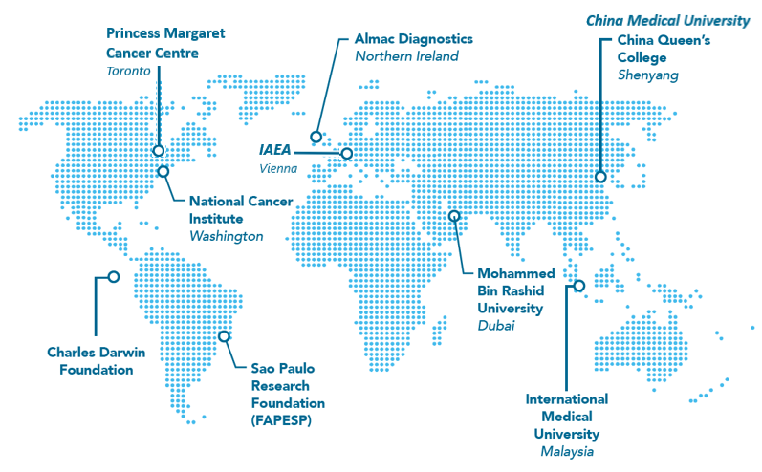



partnerships

Slide 9
POSTGRADUATE RESEARCH
SCHOOL OF BIOLOGICAL SCIENCES
Food Safety and Nutrition
Microbes and Pathogen Biology
Ecosystem Biology and Sustainability
SCHOOL OF MEDICINE, DENTISTRY AND BIOMEDICAL SCIENCE
Cancer Research and Cell Biology
Experimental Medicine
Public Health
Medical Education
SCHOOL OF PHARMACY
Nanomedicine and Biotherapeutics
Pharmaceutical Materials Science and Formulation
Drug Delivery and Biomaterials
Infection and Antimicrobial Resistance
Healthcare Delivery and Medicine Optimisation
SCHOOL OF NURSING AND MIDWIFERY
Maternal and Child Health
Chronic Illness and Palliative Care
Education and Practice

Slide 10

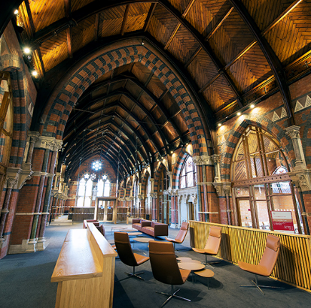
POSTGRADUATE RESEARCH TRAINING PROGRAMME
TAILORED SUPPORT FOR INTERNATIONAL STUDENTS
Optional taught classes
Opportunity to attend research seminars and conferences
Peer-mentoring, careers workshops, academic mentoring
Specialist practical research skills training
Engagement with biotech and pharmaceutical companies
Innovation, business and entrepreneurial skills training
International research collaborations

Slide 11

Faculty Core Technology Units

Slide 12

English Language and Academic Skills Support

Slide 13

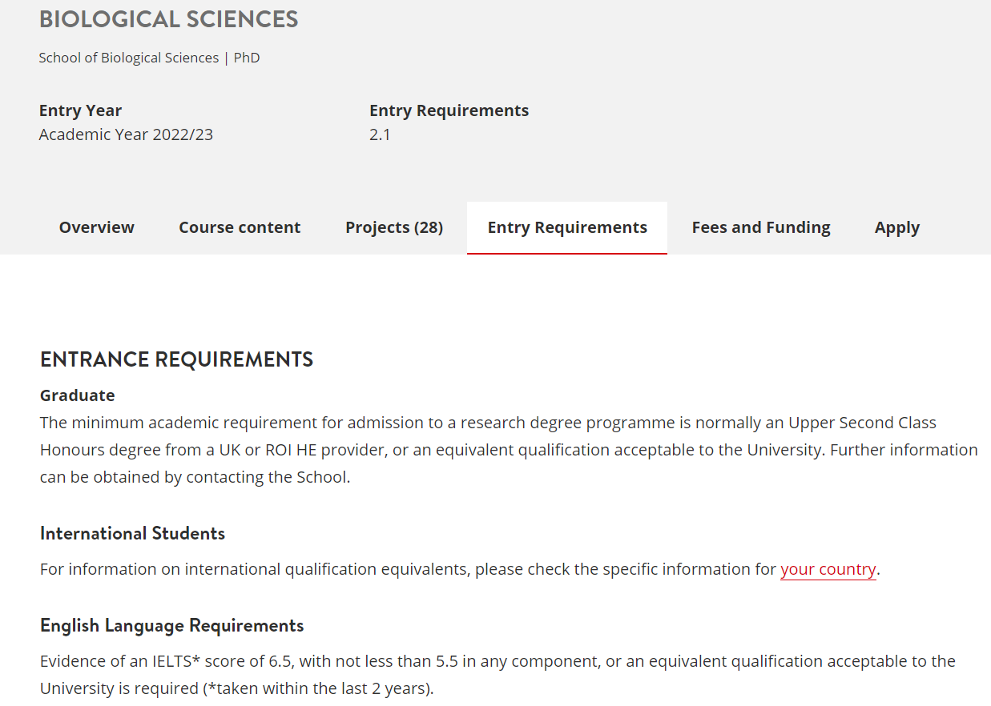
Steps To Apply
Step 1: Check you meet the entry requirements
Check that you meet, or expect to meet the academic requirements and if applicable, the English language entry requirements for your chosen programme on our website: www.qub.ac.uk
Depending on your chosen area of research, professional qualifications or experience may also be taken into consideration.

Slide 14

Steps To Apply
Step 2: Consider Funding
If you are not in receipt of financial support, you should ensure that you are fully aware of the financial commitments and that you have the necessary resources to cover the cost of fees and maintenance for the duration of your studies.
Information on tuition fee rates and procedures for the payment of fees can be found on our website: www.qub.ac.uk

Slide 15
How To Find Funding
Fully funded PhD projects or studentships are usually well advertised; however, you should be prepared to spend some time researching your options and checking the details of any project you are interested in.
Our funded projects are usually listed on our PhD projects page:
https://www.qub.ac.uk/courses/postgraduate-research/phd-opportunities/

Slide 16
How To Find Funding
Funding may be available from external funding bodies such as trusts and charities, research foundations, government agencies, the private sector or your home government.
The Alternative Guide to Postgraduate Funding is a popular resource helping all postgraduates, regardless of subject or nationality, to find PhD funding.
https://www.postgraduate-funding.com/
Employers are always keen to develop their employees through training. Medical, legal and technology driven businesses may be interested in sponsoring you for your PhD.

Slide 17
PGR Scholarships
Scholarship Name | Amount | Eligible Students | Application Process
Early Bird Reward (EBR) | £1500 discount in tuition fees | All new International Students with unconditional offer holders not later than 90 days before the start date given in their offer letter | email proof of payment to internationalscholarships@qub.ac.uk
QUB Loyalty Scholarship | 20% discount on Year 1 fees only | Queen’s University alumni, Exchange, Study Abroad, International Summer School or AHSS Winter School Students | Complete form which is sent to offer holders
QUB Family Scholarship | 20% discount on Year 1 fees only | Queen’s University alumni, Exchange, Study Abroad, International Summer School or AHSS Winter School Students | Complete form which is sent to offer holders

Slide 18

Steps To Apply
Step 3: Identify a research theme and potential research supervisor(s)
Our world-class academics provide research students with excellent supervision.
If you’re considering a research degree, you will need to identify a research theme and a research supervisor.
To identify a research theme, find the school and research theme relevant to your area of interest. Familiarise yourself with our staff profiles via:
www.go.qub.ac.uk/PhDSupervisor

Slide 19

Steps To Apply
Step 4: Get in Touch
Prepare a research overview and email it to the team at: askmhls@qub.ac.uk.
At this stage, it would be useful to identify which research theme you are interested in and your potential supervisor(s).
We will make contact with a supervisor on your behalf which may require additional communication via phone, email or skype with the designated supervisor.

Slide 20
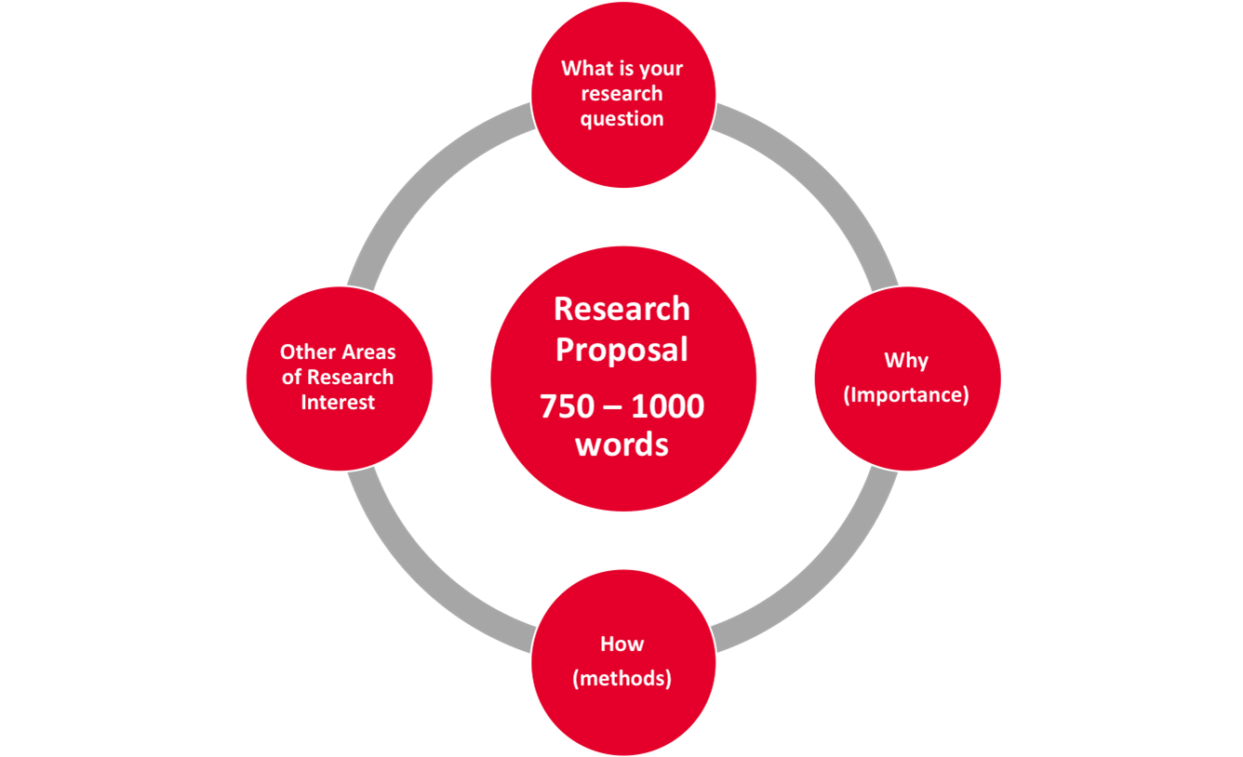
Developing your research project
Contact prospective supervisors
https://www.qub.ac.uk/courses/postgraduate-research/find-a-phd-supervisor/
Contact Faculty Hub
askmhls@qub.ac.uk
Arrange an informal meeting
Discuss general research interests or specific project
Develop your proposal with supervisor
Discuss specific ideas and requirements
https://www.qub.ac.uk/Study/PostgraduateStudy/Postgraduate-research/pgr-steps-to-apply/writing-a-research-proposal/
Submit formal online application
https://dap.qub.ac.uk/dapprd/portal

Slide 21

Steps To Apply
Step 5: Gather Supporting documentation
To make sure your application is processed in the fastest possible time, you must scan and upload supporting documents along with your application. We may not be able to make a decision on your application until we have received all your relevant documents.
Step 6: Apply Online
Applications should be submitted online via the Postgraduate Applications Portal . New applicants will need to register via the Portal to create an application account.
Apply online via: www.qub.ac.uk

Slide 22
Thank You
QUB Heritage
For any further enquiries, please contact askmhls@qub.ac.uk

