Slide 1
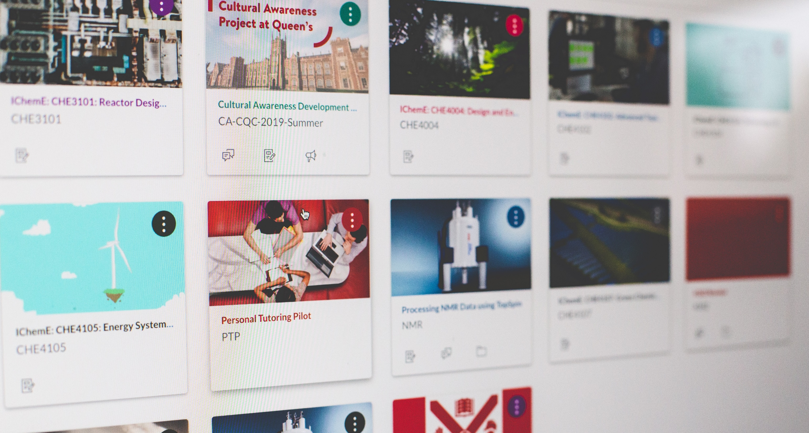
Personal Tutor Scheme on Canvas
Dr Ciarán O’Neill, Learning Development Service
Dr Dan Corbett, Chemistry and Chemical Engineering

Slide 2

PTS on Canvas - background
May 2019: Supporting Student Attainment Action Group agreed that a PTS on Canvas pilot project should be explored in 2019-20. Canvas was identified as a means to improve student and staff engagement with the scheme and enhance student accessibility to support services
October 2019 to February 2020: Initial development phase - core package of content written on Canvas Free for Teachers platform
March 2020: PTS on Canvas content presented at the Personal Tutor Forum
May 2020: Research protocol (draft) and logic model devised to support roll-out of PTS on Canvas in 2020-21

Slide 3
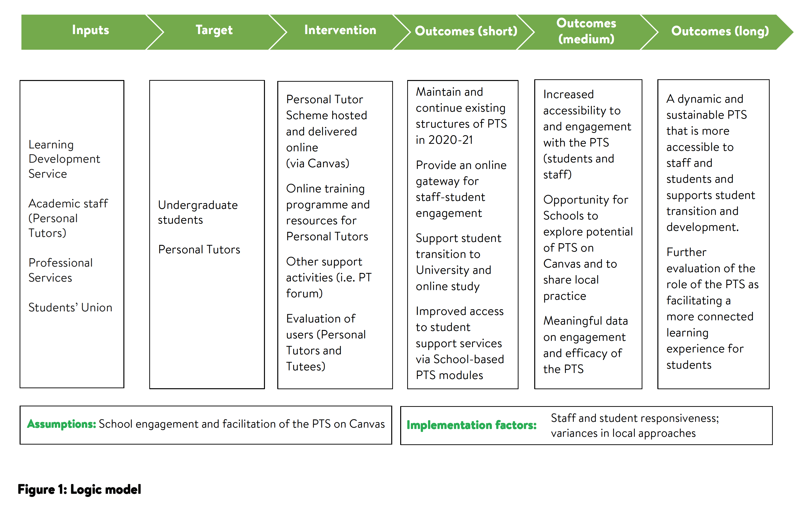

Slide 4
Project evaluation
2019-20: Development phase
Survey completed by Lead Personal Tutors in July 2020 informed core package of content and requirements ahead of 2020-21
2020-21: Pilot and scoping activity
A majority of Schools have integrated PTS on Canvas content in 2020-21. A review of School PTS modules was completed in Feb/March and recommendations for 2021-22 were shared at the PT Forum on 24 March.
Annual School activity reports are being completed by all Lead Personal Tutors in April/May. The reporting template includes questions on the PTS on Canvas content so to enable feedback on the 2020-21 pilot.

Slide 5

PTS on Canvas
– next steps
Recommendations shared at the PT Forum, together with School reports on 2020-21 activity, will support planning / arrangements for 2021-22.
The goal is for all Schools to integrate PTS on Canvas in 2021-22. Communications are ongoing with Lead PTs and relevant professional staff in all Schools to support this process.
Opportunity for School level student evaluation of PTS on Canvas in 2021-22?

