Slide 1
Joint and Major-Minor Degrees
Prof. Robin Hickey
Dean of Education, Faculty of Arts, Humanities and Social Sciences
September 2021

Slide 2
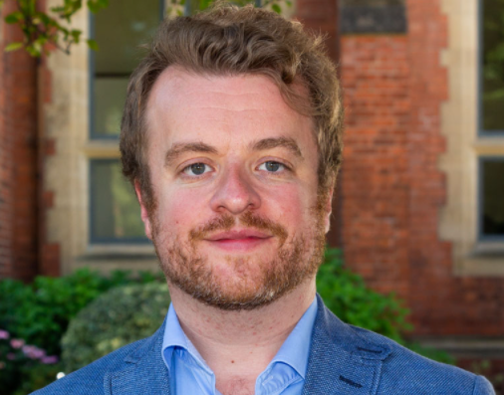
Faculty of Arts, Humanities and Social Sciences
School of Arts, English and Languages (AEL)
School of History, Anthropology, Philosophy and Politics (HAPP)
Queen’s Management School (QMS)
School of Law (LAW)
School of Social Sciences, Education and Social Work (SSESW)
Prof. Robin Hickey
Dean of Education

Slide 3
Faculty of Arts, Humanities and Social Sciences
A variety of types of degree:
Single Honours: Anthropology, English, Economics, French, History, Law, Philosophy, Politics, Sociology, Spanish
Joint Honours (‘Joints’): English and Spanish, History and Politics, Sociology and Social Policy
Major-Minor: Accounting with Spanish, English with Creative Writing, Law with Politics

Slide 4
Faculty of Arts, Humanities and Social Sciences
 | Level 1 |  | Level 2 |  | Level 3
Single Honours | Subject | Elective | Subject |  | Subject
 | 80 CATS | 40 CATS | 120 CATS |  | 120 CATS
Joint Honours | Subject A | Subject B | Subject A | Subject B | Subject A | Subject B
 | 60 CATS | 60 CATS | 60 CATS | 60 CATS | 60 CATS | 60 CATS
Major Minor | Subject A | Subject B | Subject A | Subject B | Subject A | Subject B
 | 80 CATS | 40 CATS | 80 CATS | 40 CATS | 80 CATS | 40 CATS

Slide 5
Faculty of Arts, Humanities and Social Sciences
Level 1
Joint Honours | Subject A | Subject B
CATS | 60 | 60
Modules | 3 | 3
Major Minor | Subject A | Subject B
CATS | 80 | 40
Modules | 4 | 2

Slide 6
Faculty of Arts, Humanities and Social Sciences
Level 1
Joint Honours | Subject A | Subject B
CATS | 60 | 60
Modules | 3 | 3
Major Minor | Subject A | Subject B
CATS | 80 | 40
Modules | 4 | 2
Semester 1 |  | Semester 2
Subject A | Subject B | Subject A | Subject B
40 or 20 | 20 or 40 | 20 or 40 | 40 or 20
2 or 1 | 1 or 2 | 2 or 1 | 1 or 2
Subject A | Subject B | Subject A | Subject B
40 | 20 | 40 | 20
2 | 1 | 2 | 1

Slide 7
Faculty of Arts, Humanities and Social Sciences
Your ‘owning’ School?
Manages your degree programme
Arranges for you a Personal Tutor/Adviser of Study
Processes Exceptional Circumstances requests
Determines your progression and degree classification

Slide 8
Faculty of Arts, Humanities and Social Sciences
Schools will normally be able to answer any questions you have about your modules, your degree programme and your studies more generally.
If your joint/major-minor degree involves subjects in more than one School, and you are having difficulties securing answers to questions, contact:
Deirdre McCrory (Faculty Administrator)
E-mail: d.mccrory@qub.ac.uk
Phone: 028 9097 5351

Slide 9
Thank you
Joint and Major Minor Students
Prof. Robin Hickey
Dean of Education, Faculty of Arts, Humanities and Social Sciences
September 2021

