Slide 1
MLibArts
AHSS Faculty Focus
October 2017

Slide 2

MLibArts
Innovative New 4-year UG Programme for 2018 Entry
MLibArts
Flexible Degree
International Study
Placement Opportunities
Multi and Inter-disciplinary Teaching

Slide 3
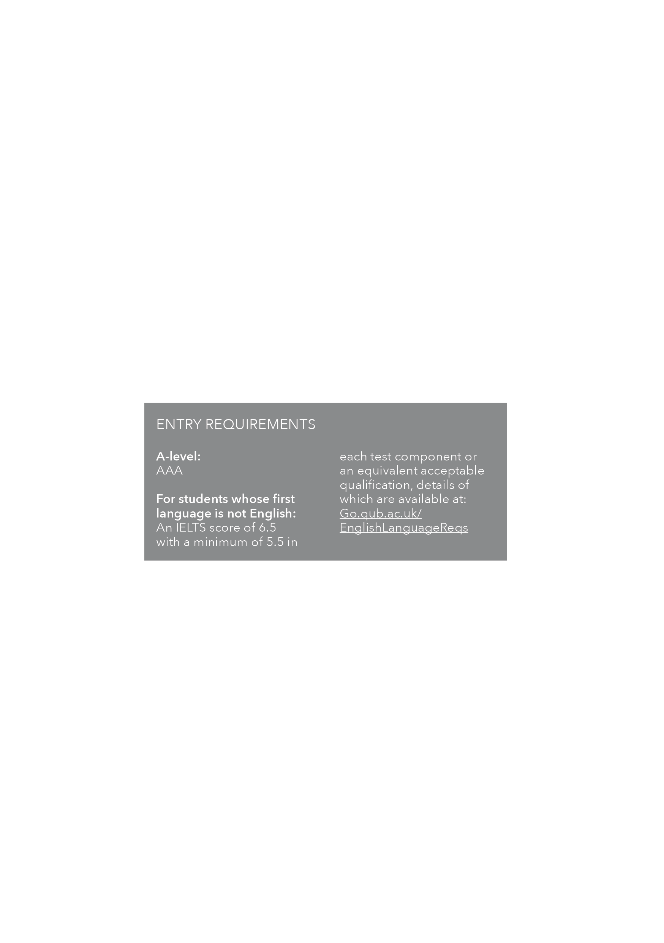
MLiberal Arts
Liberal Arts Lead:
Dr Philip McGowan
School of Arts, English & Languages
e: philip.mcgowan@qub.ac.uk
t: 02890 973261

Slide 4
MLiberal Arts
Flexible degree opportunities combining Liberal Arts with pathways in:
Anthropology French Music
Drama History Philosophy
Economics Politics Portuguese
English International Studies Spanish
Film Irish Theology

Slide 6
Liberal Arts … and beyond
Thematic interdisciplinary pathways … American Studies, Conflict, European Studies, Irish Studies …
Major-minor degrees?
Thematic joints … thematic minors

Slide 7
Student Experience
AHSS Faculty Focus
October 2017

Slide 8
OVERVIEW OF KEY FINDINGS
Queen’s is most behind the Top Quartile on
the following metrics:
Learning Community (-12%)
Student Voice (-10%)
Assessment & Feedback (-9%)
Academic Support (-8%)
Learning Resources remains the highest
scoring area and is the only metric on which
Queen’s exceeds the Top Quartile average
Student Voice and Assessment & Feedback
are the weakest performing metrics across
the university
However, Organisation & Management
suffered the biggest drop in performance
falling by 7 percentage points from 2016
 | Queen’s | Top Quartile | Difference (+/-)
Teaching | 86 | 91 | -5
Learning Opportunities | 83 | 90 | -7
Assessment & Feedback | 71 | 80 | -9
Academic Support | 79 | 87 | -8
Organisation & Management | 79 | 82 | -3
Learning Resources | 89 | 87 | +2
Learning Community | 76 | 88 | -12
Student Voice | 68 | 78 | -10
Overall Satisfaction | 87 | 90 | -3

Slide 9
KEY FINDINGS CONTINUED…
Survey questions performing significantly worse that the Top Quartile average include:
Learning Opportunities
My course has provided me with opportunities to apply what I have learnt (QUB 80%, TQ 90%, Diff -10%)
Assessment and Feedback
I have received helpful comments on my work (QUB 69%, TQ 83%, Diff -14%)
Academic Support
Good advice was available when I needed to make study choices on my course (QUB 71%, TQ 84%, Diff -13%)
Learning Community
I feel part of a community of staff and students (QUB 66%, TQ 83%, Diff -17%)
Student Voice
Staff value students’ views and opinions about the course (QUB 72%, TQ 83%, Diff -11%)
It is clear how students’ feedback on the course has been acted on (QUB 54%, TQ 72%, Diff -18%)

Slide 10
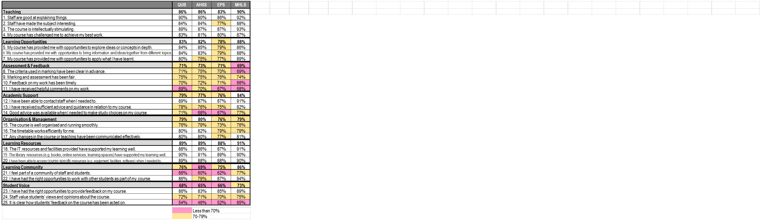
UNDERPERFORMING AREAS BY FACULTY

Slide 11
UNDERPERFORMING AREAS BY FACULTY

Slide 13
NSS 2017: section scores by subject
JACS3 Subject Area | TEACHING | LEARNING OPPS | ASSESSMENT & FEEDBACK | ACADEMIC SUPPORT | ORG & MGT | LEARNING RESOURCES | LEARNING COMM | STUDENT VOICE | OVERALL SATISFACTION
QUB | 86 | 83 | 71 | 79 | 79 | 89 | 76 | 68 | 87
Accounting | 81 | 75 | 58 | 84 | 81 | 86 | 79 | 55 | 87
Anthropology | 85 | 80 | 76 | 67 | 75 | 82 | 62 | 60 | 85
Celtic studies | 96 | 95 | 91 | 100 | 95 | 89 | 97 | 92 | 95
Drama | 79 | 80 | 50 | 66 | 71 | 76 | 73 | 52 | 69
Economics | 84 | 74 | 74 | 75 | 77 | 89 | 75 | 66 | 84
English studies | 89 | 83 | 76 | 79 | 81 | 89 | 67 | 67 | 88
Finance | 87 | 82 | 83 | 87 | 88 | 91 | 83 | 74 | 91
French studies | 90 | 82 | 83 | 81 | 75 | 88 | 80 | 64 | 88
History | 90 | 82 | 75 | 76 | 82 | 94 | 67 | 65 | 93
Iberian studies | 88 | 83 | 83 | 83 | 76 | 91 | 76 | 72 | 81
Imaginative Writing | 90 | 78 | 80 | 86 | 77 | 83 | 69 | 64 | 86
Law | 82 | 81 | 71 | 73 | 81 | 87 | 50 | 62 | 85
Management | 77 | 82 | 79 | 80 | 86 | 92 | 69 | 61 | 85
Music | 92 | 86 | 88 | 91 | 88 | 90 | 86 | 77 | 98
Philosophy | 81 | 66 | 73 | 66 | 62 | 87 | 40 | 59 | 84
Politics | 86 | 82 | 74 | 78 | 81 | 92 | 55 | 62 | 84
Psychology | 87 | 81 | 81 | 74 | 87 | 92 | 69 | 71 | 85
Social Policy | 81 | 79 | 76 | 74 | 75 | 88 | 73 | 67 | 82
Social Work | 89 | 92 | 59 | 75 | 78 | 91 | 75 | 66 | 90
Sociology | 88 | 81 | 62 | 66 | 79 | 91 | 73 | 66 | 88
Theology | 89 | 75 | 71 | 76 | 78 | 79 | 76 | 68 | 93

Slide 14
AREAS OF WEAKNESS
Although there are some differences at subject level the analysis by Faculty revealed that the key areas of weakness are fairly consistent university wide.
The weakest performing metrics for Queen’s (and AHSS):
Student Voice – 68%
Assessment & Feedback – 71%
Learning Community – 76%

Slide 15
ASSESSMENT & FEEDBACK: RESULTS BY FACULTY
TOP QUARTILE
79
79
79
78
81

Slide 16
LEARNING COMMUNITY: RESULTS BY FACULTY
TOP QUARTILE
84
79
88

Slide 17
STUDENT VOICE: RESULTS BY FACULTY
TOP QUARTILE
76
89
82
69

Slide 18
AREAS OF WEAKNESS
Student Voice
  It is clear how students’ feedback on the course has been acted on (54%)
  Staff value students’ views and opinions about the course (72%)
Assessment & Feedback
  I have received helpful comments on my work (69%)
  Feedback on my work has been timely (70%)
  The criteria used in marking have been clear in advance (71%)
Learning Community
  I feel part of a community of staff and students (66%)

Slide 19
STUDENT VOICE
“A lot of the student feedback seemed to be ignored
and not much was done in the way of improvements.”
“Sometimes it appeared that feedback from
students was not always taken into consideration.”
“The School takes any criticism of its
undergraduate curriculum very poorly.”

Slide 20
LEARNING COMMUNITY
Comments reflected a lack of community especially on courses with big intakes; lack of contact hours and group-related projects were also frequently cited
“I find it shameful that we as students have to pay so much for so little, for
9 hours a week of teaching for a social science we should be paying less as
or at least be given additional teaching hours so that we can gain better
knowledge of the subject as a whole.”
“The sense isolation of myself from other students.
I haven't had opportunities to work with and interact
with other students.”

Slide 21
NSS QUESTIONS – Learning Community
NSS ‘asks’
I feel part of a community of staff and students
I have the right opportunities to work with other students as part of my course

Slide 22
DISCUSSION QUESTIONS – Learning Community
What are the key attributes of ‘a community of staff and students’?
How can we ensure that students feel part of a ‘learning community of staff and students’?
How can professional support contribute to enhancing ‘a community of staff and students’?
How can academic staff contribute to enhancing ‘a community of staff and students’?

Slide 23
NSS QUESTIONS – Student Voice
NSS ‘asks’:
I have had the right opportunities to provide feedback on my course
Staff value students’ voice and opinions about the course
It is clear how students’ feedback on their course has been acted on
The students’ union effectively represents students’ academic interests

Slide 24
DISCUSSION QUESTIONS – Student Voice
How can we ensure the student voice is heard in the development of our provision?
Are present structures and processes adequate or simply not used effectively?
How can we demonstrate to students that we have listened and acted on their feedback?

