Slide 2
NIHR GLOBAL HEALTH RESEARCH GROUP ON EARLY CHILDHOOD DEVELOPMENT FOR PEACEBUILDING, QUEEN’S UNIVERSITY BELFAST

Slide 3
WHO WE ARE (QUEEN’S TEAM)
Core Team
Professor Paul Connolly (Director)
Dr Laura Dunne
Dr Sarah Miller
------------------------
Dr Nicole Craig (Research Fellow)
Dr Aoibheann Brennan-Wilson (Research Fellow)
Barbara Stewart / David Piekaar (Administrators)
Specialists
Professor Frank Kee (Public Health)
Dr Mark McGovern (Economics)
Dr Laura Taylor (Social Psychology)
Dr Karen Winter (Social Work)

Slide 4
WHO WE ARE (STRATEGIC PARTNERS)
UNICEF HQ
Friedrich Affolter
Yale Child Study Center
Professor James Leckman
Dr Angelica Ponguta
NYU Global TIES for Children
Professor Lawrence Aber
Professor Hirokazu Yoshikawa
Harvard Humanitarian Initiative
Dr Phuong Pham
Dr Patrick Vinck
Early Years – The Organisation for Young Children
Siobhan Fitzpatrick
Pauline Walmsley
Mary O’Reilly
Noletta Smyth

Slide 5
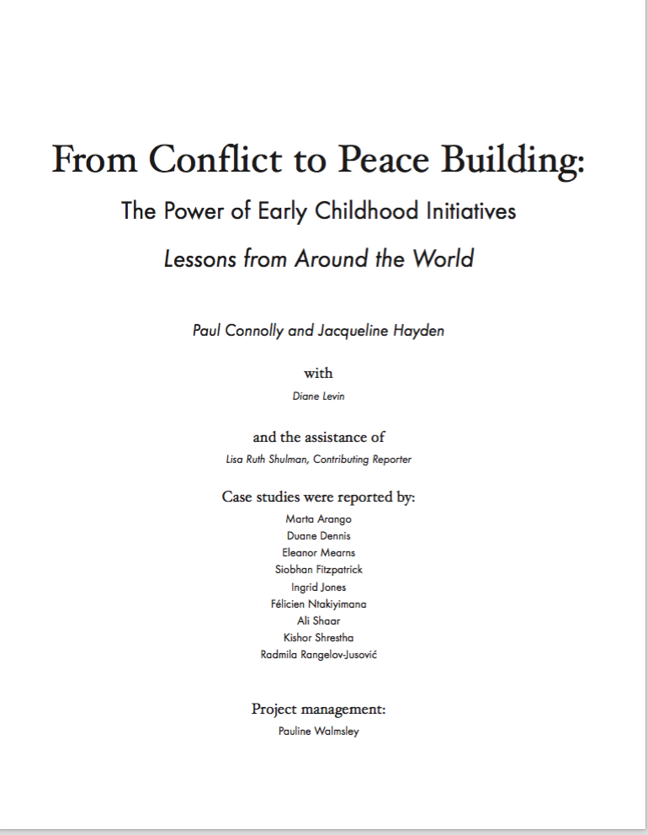
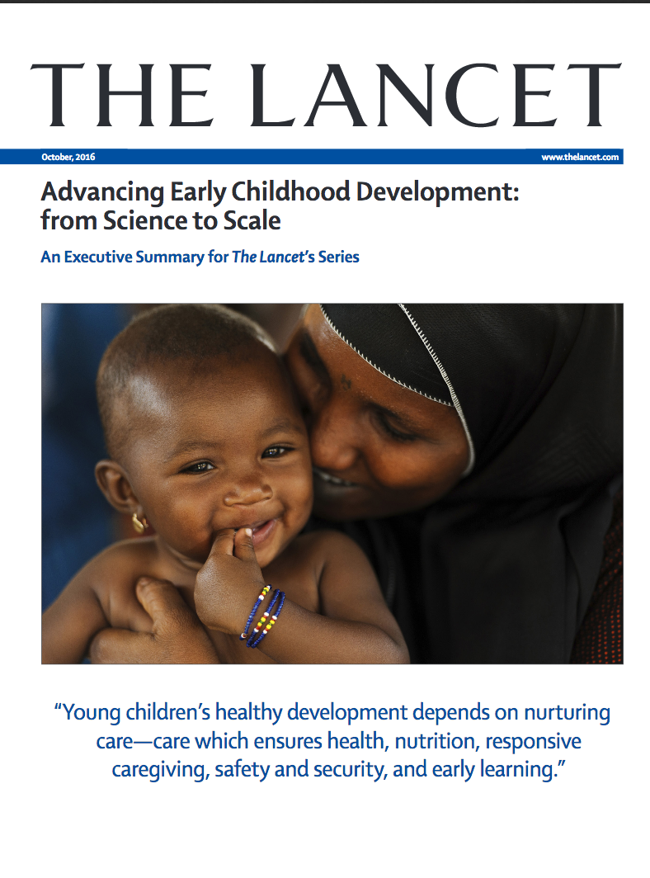
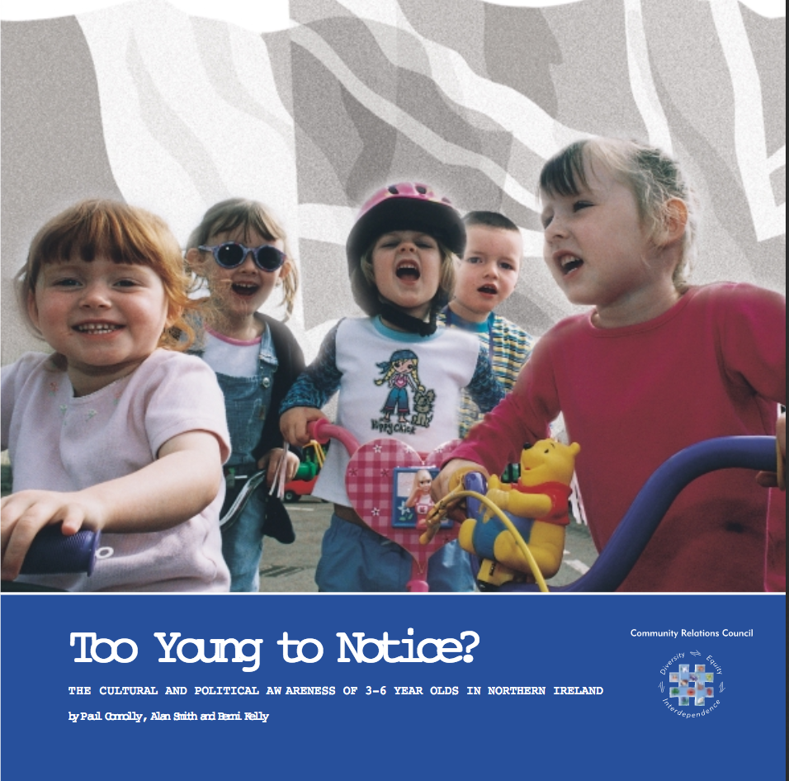
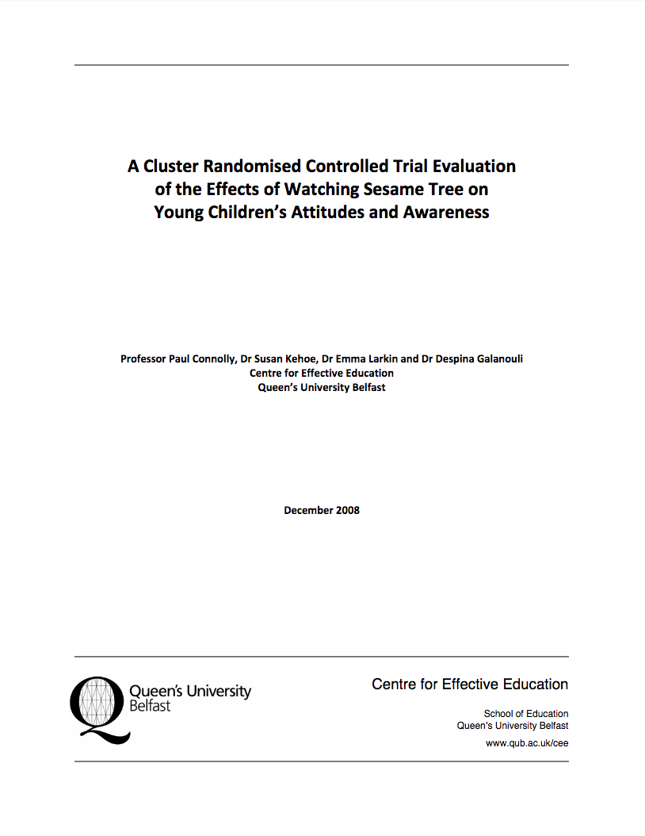
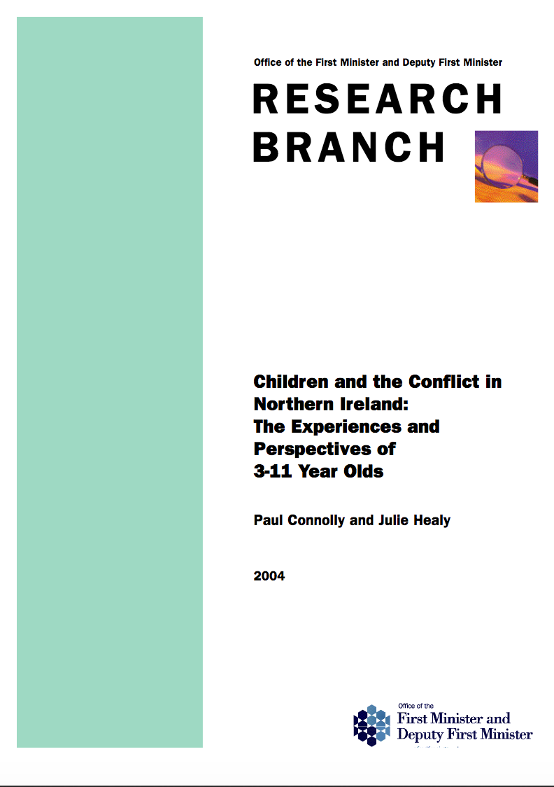
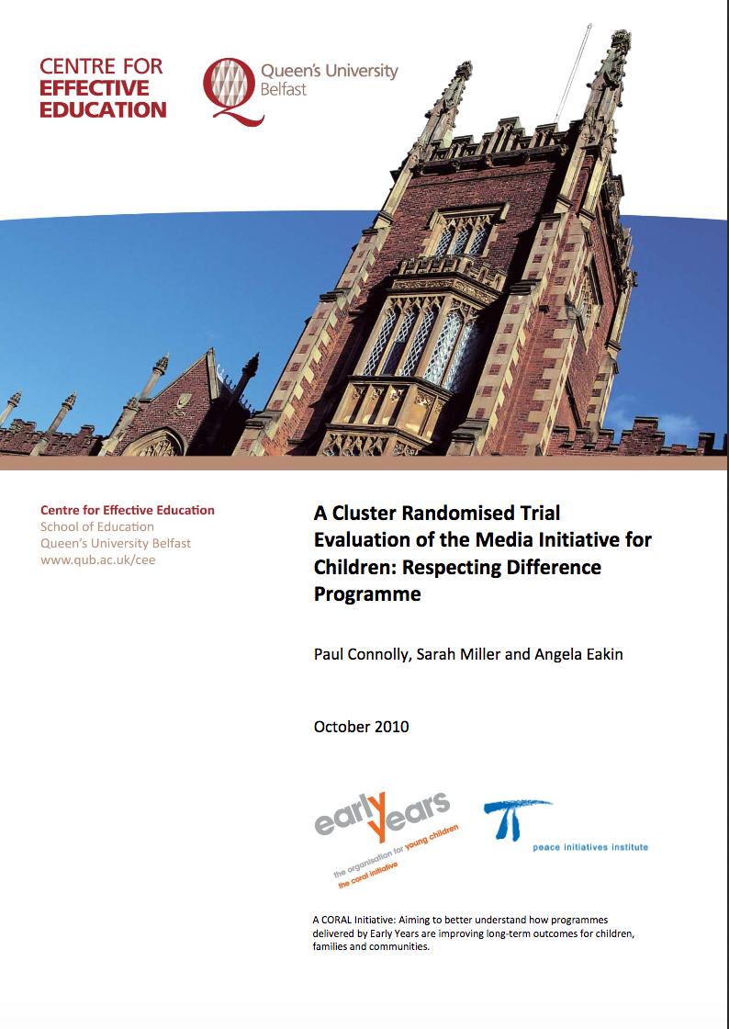
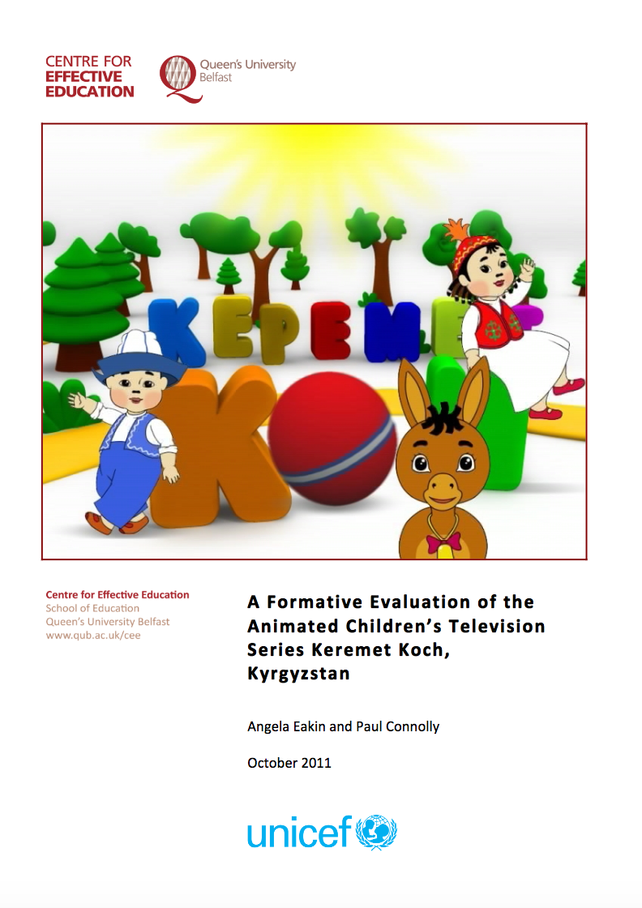
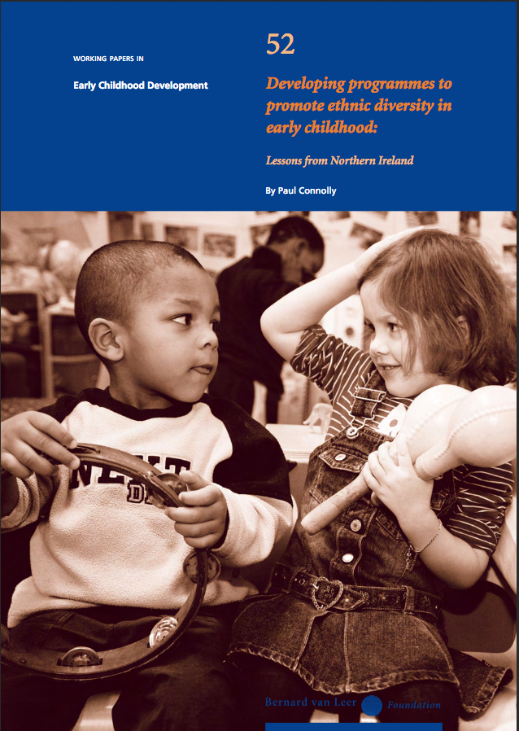

Slide 6
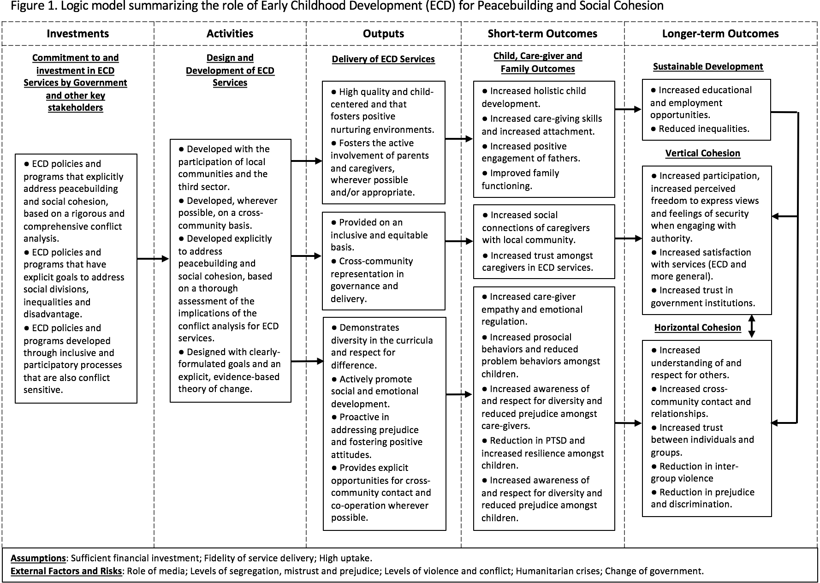
OUR EVOLVING THEORY OF CHANGE – THE MEASUREMENT FRAMEWORK
A high-level logic model, setting out what the essential elements are that we believe need to be in place in the funding, design and delivery of ECD programmes for them to achieve measurable impact in promoting peacebuilding.

Slide 7
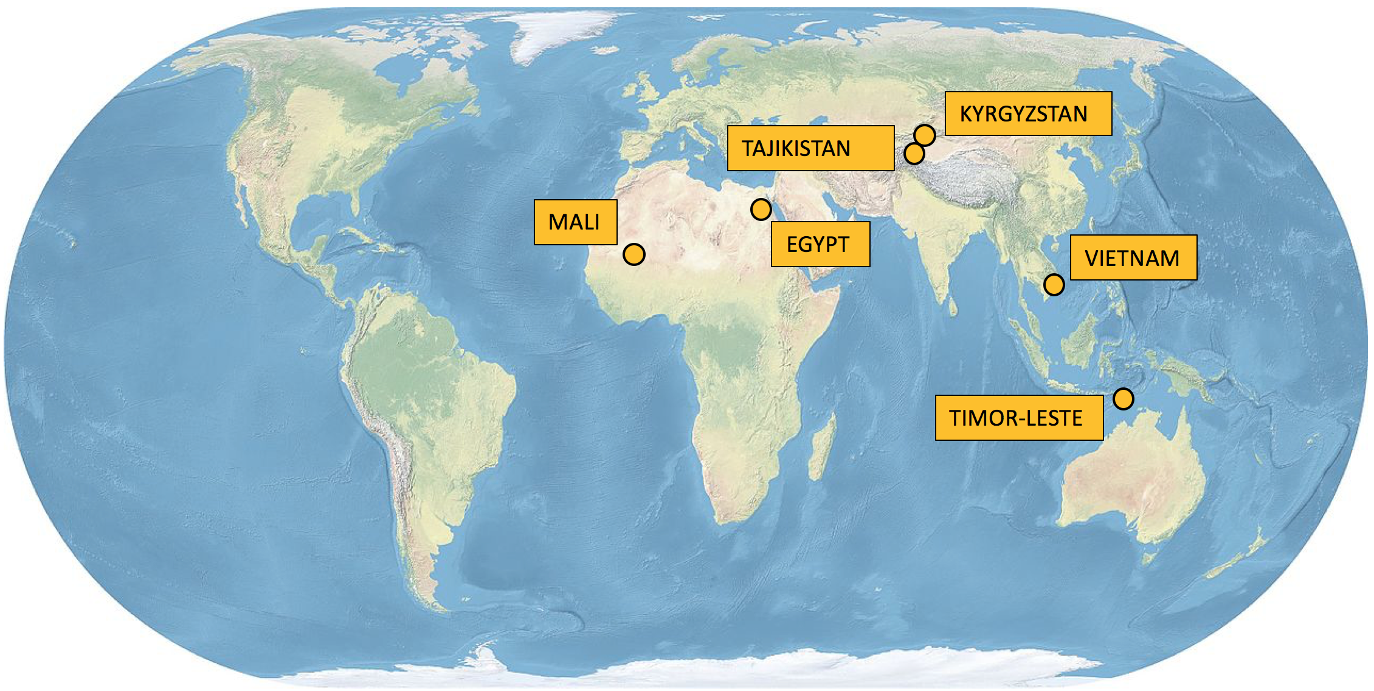
WHERE WE ARE WORKING
Countries where we are also supporting UNICEF-funded ECD programmes
Additional countries where we are supporting researchers and seeking funding for research to support ECD programmes
COLOMBIA

Slide 8
