Slide 1

Learning at Queen’s University, Belfast

Slide 2

Learning at QUB
Canvas is the Virtual Learning Environment (VLE) used by all students and staff at Queen’s University, Belfast. It offers an interactive and engaging learning experience, as Canvas allows you to:
Communicate with academic staff and students,
Access all information in one space (e.g. Lecture slides, contact info. etc.)
View learning materials (i.e. videos, text, images, weblinks etc.),
Upload assignments,
Receive annotated feedback on any assignment,
View your module grades,
And much more…!
An introduction Canvas course has been especially prepared for you. Please take time to explore it (see next slide):

Slide 3
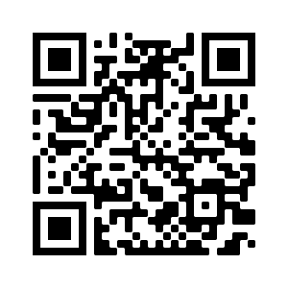
How do I login to Canvas? Page 1/2
1. Click on the Canvas URL below on your laptop/desktop computer: www.canvas.instructure.com/courses/4860270
OR
Scan this QR Code from your phone*:
NOTE*: Canvas works best on a laptop or desktop computer, but can also be used on the Canvas APP.

Slide 4
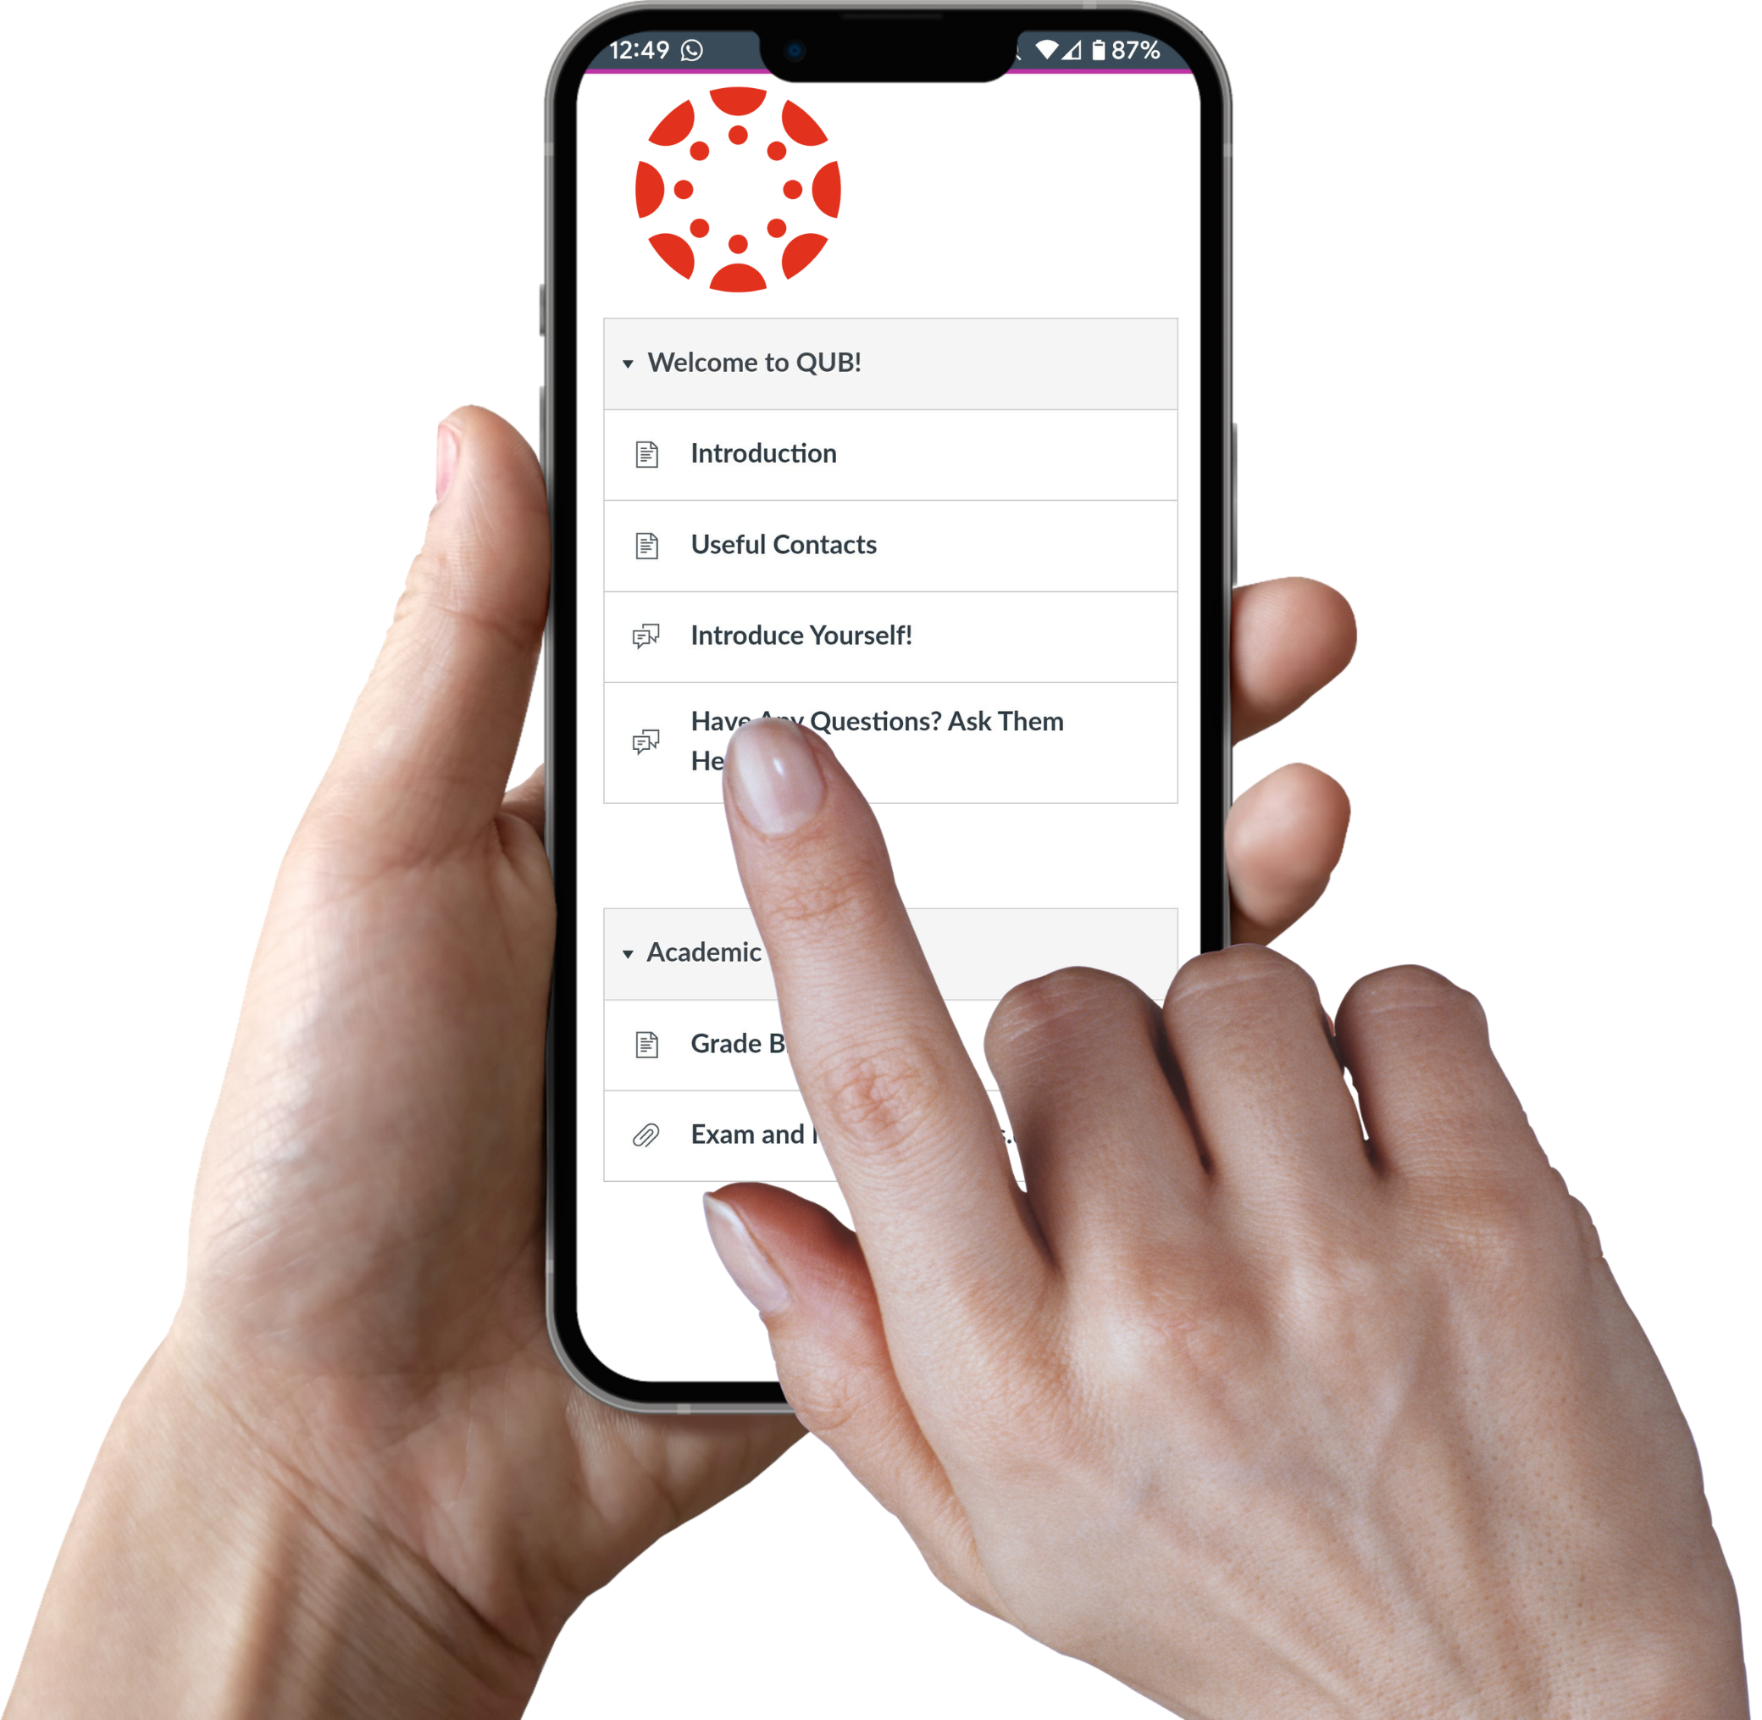
How do I login to Canvas? Page 2/2
2. Create a Free Account when prompted.
3. Explore the ‘Introduction to Canvas & Queen’s’ course.
This course has been specifically prepared for you by one of the AHSS Student Digital Champions, and includes information such as;
  Welcome & Introduction to Queen’s,
  Academic Life at QUB,
  Student Finances,
  Accommodation,
  Life in Northern Ireland,
  Health & Wellbeing,
  Transitioning to QUB Canvas.

Slide 5

Digital Learning Question?
Ask a Student Digital Champion!
Email Us:
AHSSDigitalChampions@qub.ac.uk
OR
Click here for Digital Learning resources

