Slide 1

Student Wellbeing
Ciara Harkin
Wellbeing Advisor (Team Lead)
Notes:
Good morning afternoon evening or night wherever you are and whatever time it is, you’re very welcome to Student Wellbeing’s professional skills module on Mindset Mastery.
As per the introduction video we hope to provide you with some hints and tips on developing your own personal wellbeing whilst developming a growth mindset for your student journey ahead,

Slide 2

Model of Supports for Students

Slide 3
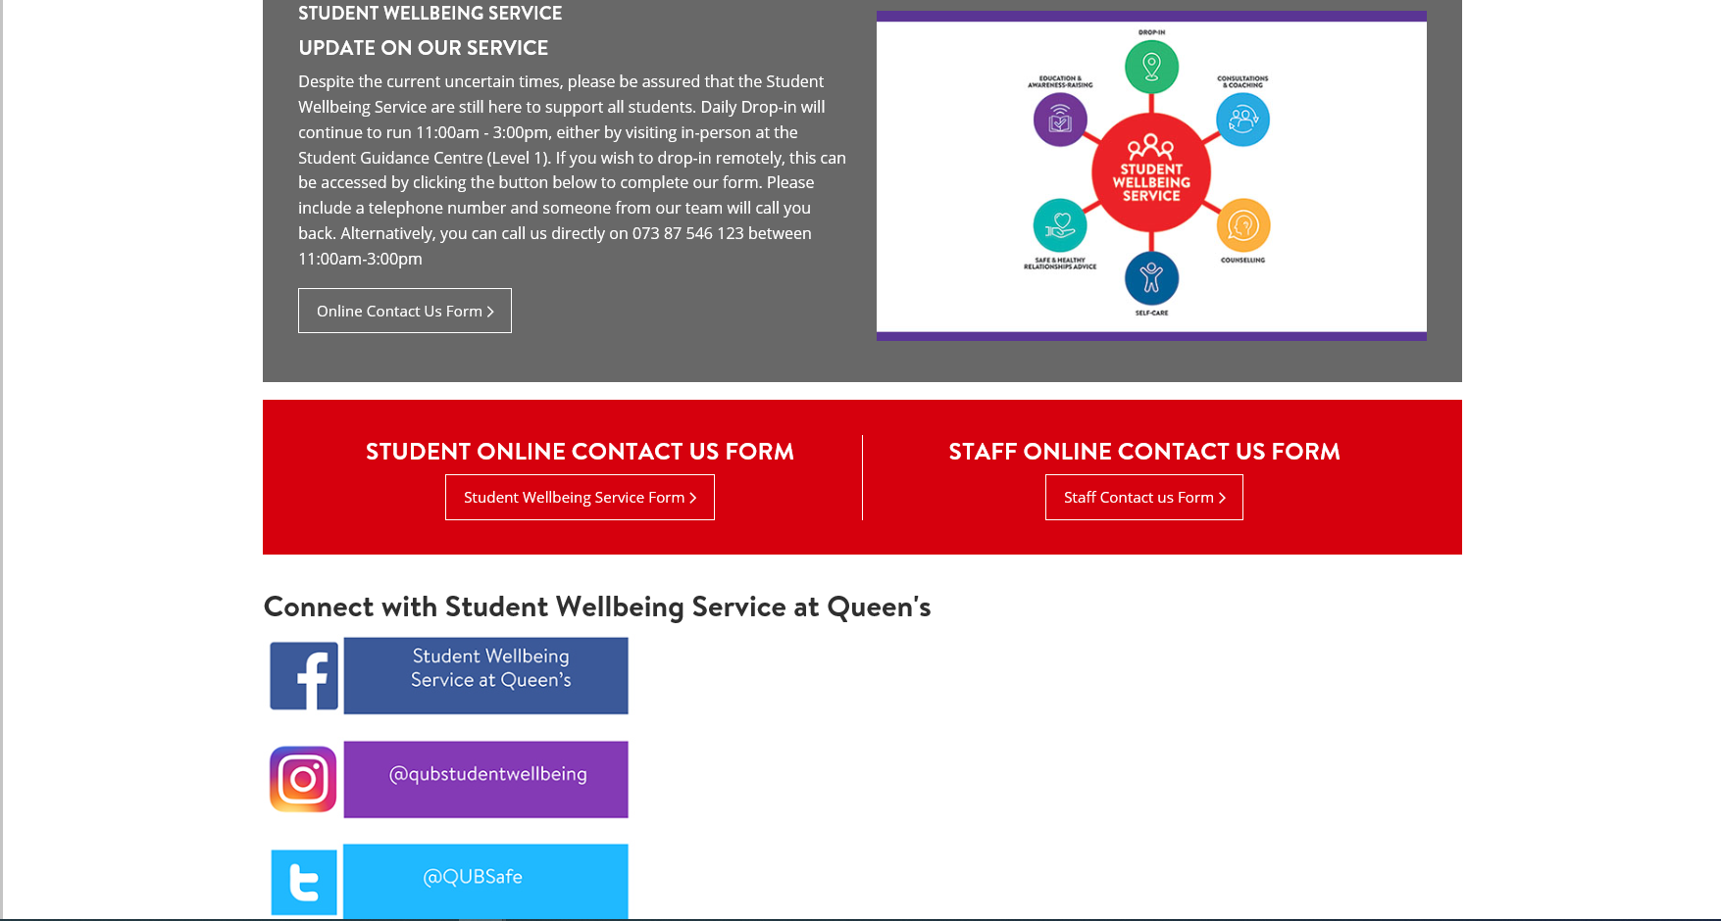


Slide 4


Counselling Service (Inspire)
Free Counselling sessions are available all year round
4 - 6 sessions
Confidential and non-judgemental place to work through challenges
24/7 telephone counselling or emergency support
Students can re –refer
Inspire Student Hub – Self help
https://www.inspiresupporthub.org/students/
PIN is QUB2019!
24hr Freephone: 0808 800 0016
Email: qubstudents@inspirewellbeing.org

Slide 5
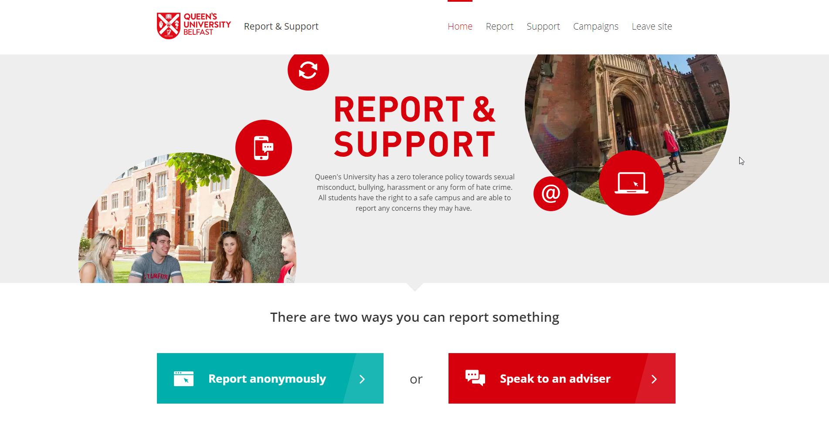
ReportandSupport.qub.ac.uk

Slide 6
Outside Of Hours Supports
Counselling & Crisis support
Lifeline: 0808 808 8000 or the Samaritans: 116 123
Inspire Student Helpline 0808 800 0016 (24 hours a day, 7 days per week)
Hospital
Kingsbridge Private Hospital -44 (0)28 90 667 878
Community and Campus Safety
If you have been subject to a Criminal Incident (including hate crime, sexual assault, domestic violence etc.) Please report via the following options:
Police 999 (in an emergency), or 101 (non-emergency)
Report and Support
Security 24-hour number on 028 9097 5099.
Queen’s Accommodation: accommodation@qub.ac.uk or Elms BT9: 028 9097 4525

Slide 7

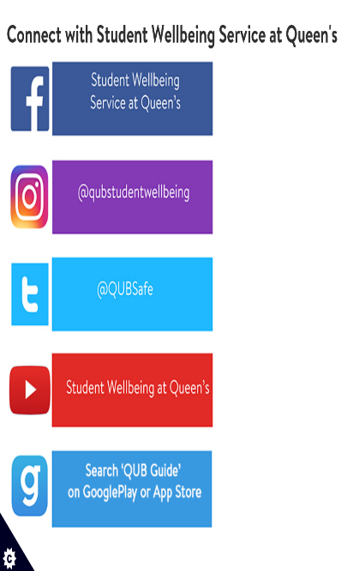
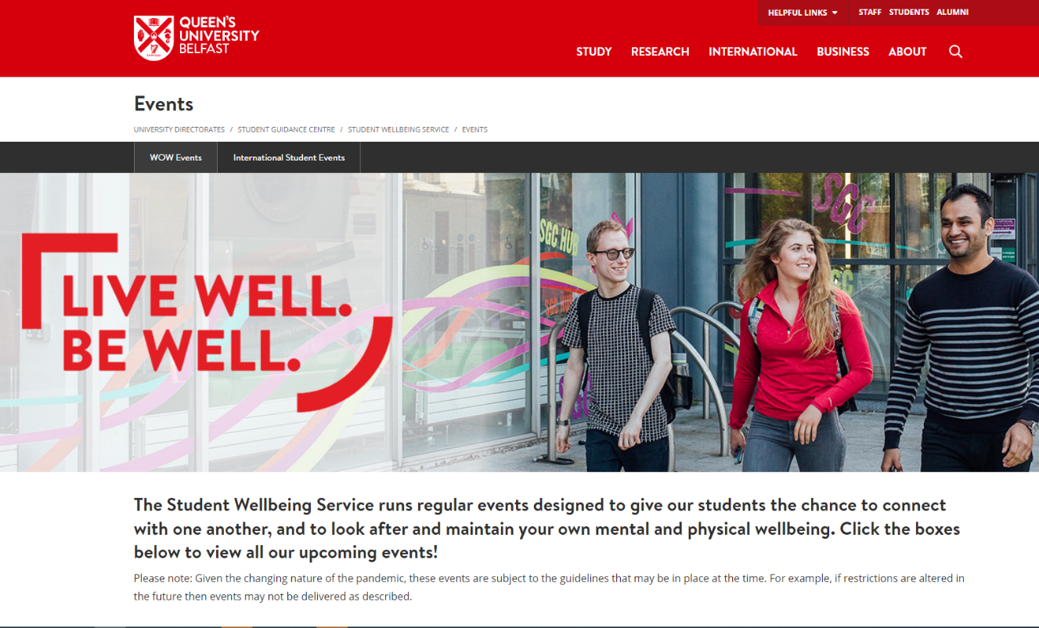
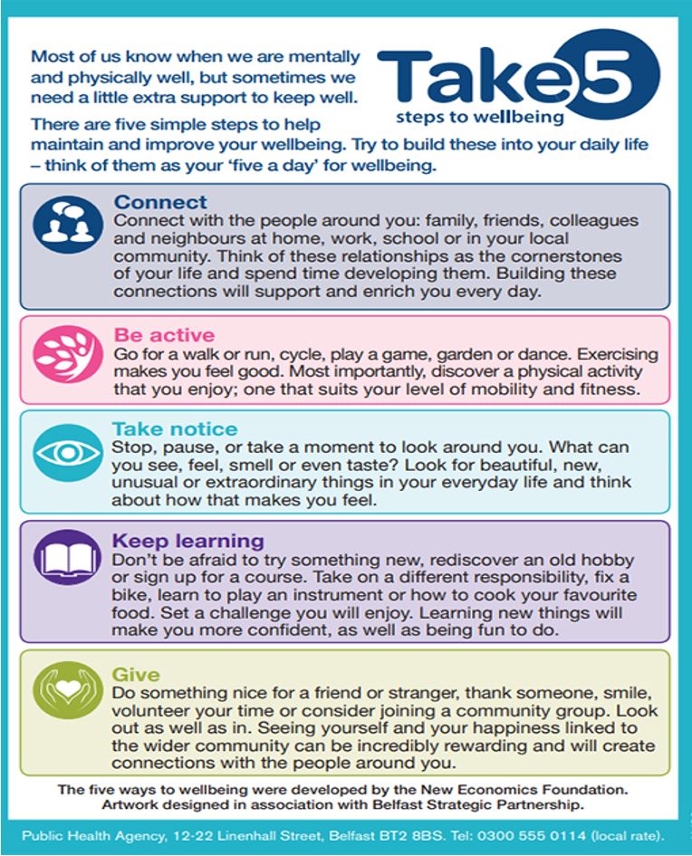
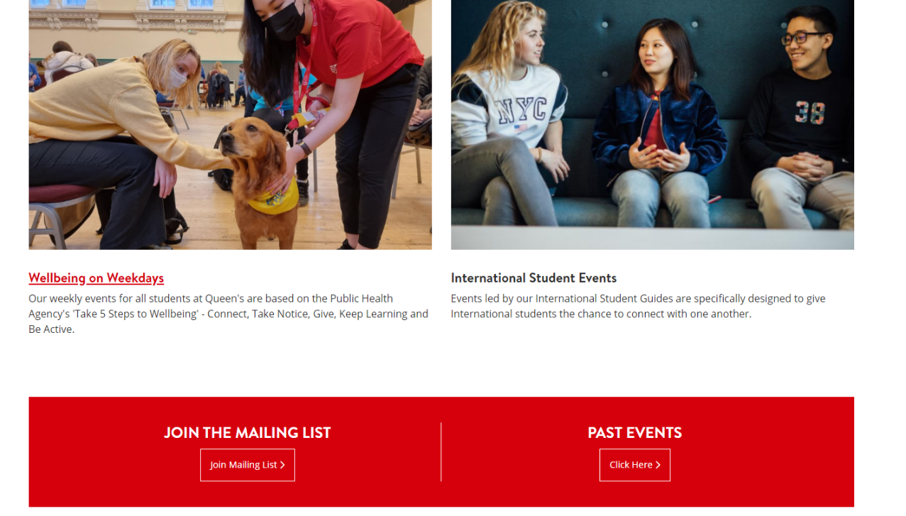
/

Slide 8
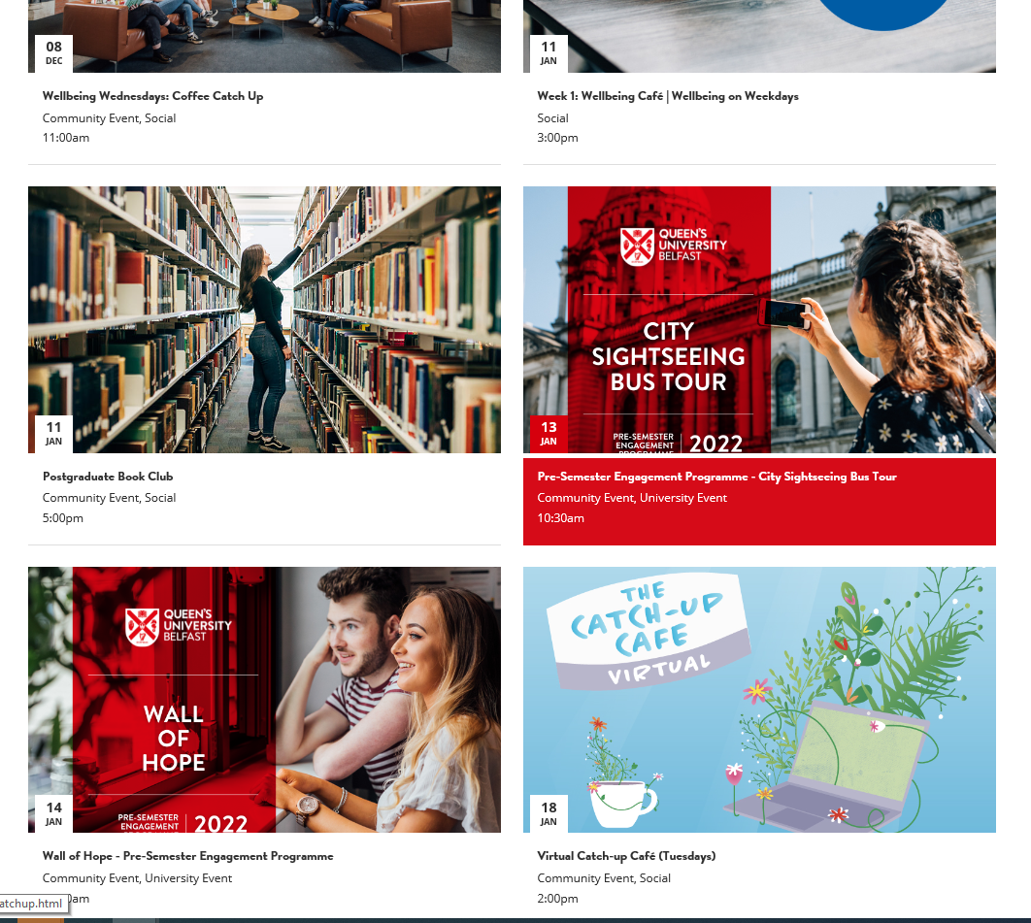
WELLBEING EVENTS THIS WEEK

Slide 9


Slide 10


CONNECT
Student Wellbeing
Web: www.qub.ac.uk/sgc/wellbeing
Email: studentwellbeing@qub.ac.uk
Drop In Service:
Monday - Friday, 11am – 3pm, during term time at the Student Guidance Centre
Tel: 07387546123
Inspire counselling – Email: hello@inspirewellbeing.org
Tel: 028 9032 8474
Lifeline Helpline: 0808 808 8000
Interactive self help resources -https://www.inspiresupporthub.org/students/ PIN is QUB2019!
Student’s Union - studentadvice@qub.ac.uk
Learning Development - lds@qub.ac.uk

