Slide 1
CONFERENCE TOOLKIT

Slide 2
HOW TO USE THIS CONFERENCE TOOLKIT
In this slide deck you will find slides designed specifically for your faculty. It contains up to date stats can be edited to create bespoke stats. There are a number of slides with faculty images as well as blank slides where you can add your own imagery.

Slide 3
PRESENTATION SLIDES

Slide 4
CONFERENCE NAME
IS PLACED HERE
PRESENTER NAME
MONDAY JANUARY 1 2019
SHAPING A
BETTER WORLD
SINCE 1845

Slide 5
CONFERENCE NAME
IS PLACED HERE
PRESENTER NAME
MONDAY JANUARY 1 2019
SHAPING A
BETTER WORLD
SINCE 1845

Slide 6
CONFERENCE NAME
IS PLACED HERE
PRESENTER NAME
MONDAY JANUARY 1 2019

Slide 7
OUR EXCELLENCE BY NUMBERS
Over 75% of our research activity
Is judged to be internationally-excellent or world-leading
(REF2014)
Queen’s is ranked
22nd in the world
for international outlook
(Times Higher Education World University Rankings 2020)
Ranked
173 in the world
(QS World University Rankings 2020)

Slide 8
OUR EXCELLENCE BY NUMBERS
Over 75% of our research activity
Is judged to be internationally-excellent or world-leading
(REF2014)
Queen’s is ranked
22nd in the world
for international outlook
(Times Higher Education World University Rankings 2020)
Ranked
173 in the world
(QS World University Rankings 2020)

Slide 9
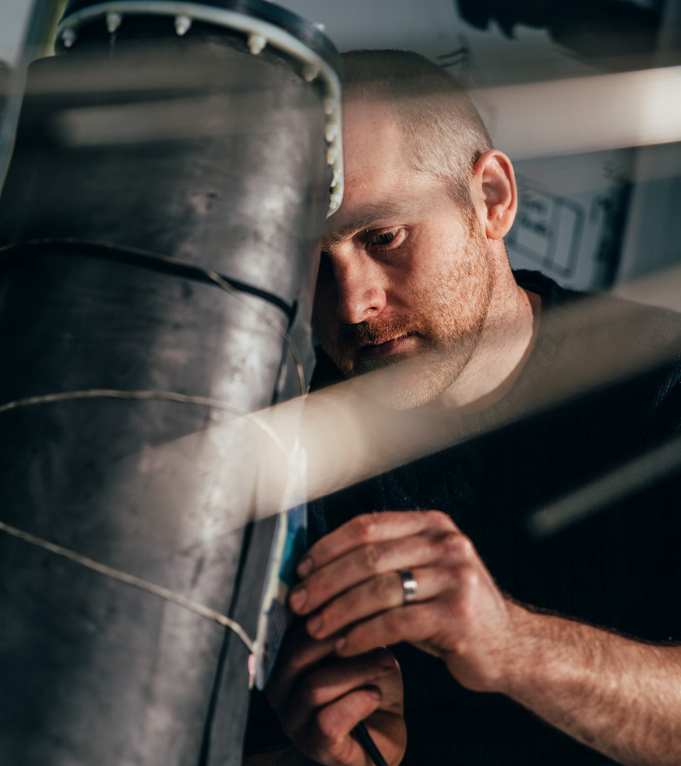
QUEEN’S UNIVERSITY
Queen’s University Belfast is one of the leading universities in the UK and Ireland with a distinguished heritage and history.
With an annual turnover of £330m, some 24,000 students and 3,800 staff, Queen’s plays a unique leadership role in Northern Ireland. We contribute over £1 billion to the local economy and support 9,250 full-time jobs across Northern Ireland.

Slide 11
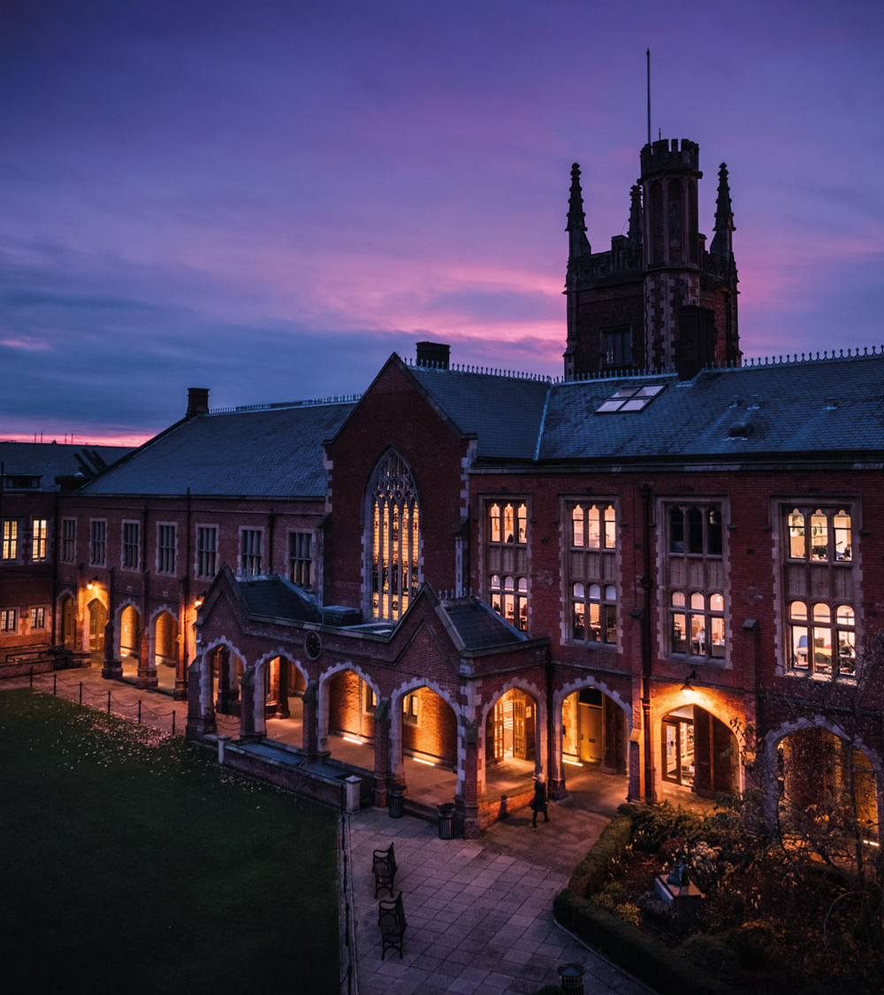
QUEEN’S UNIVERSITY
Queen’s University Belfast is one of the leading universities in the UK and Ireland with a distinguished heritage and history.
With an annual turnover of £330m, some 24,000 students and 3,800 staff, Queen’s plays a unique leadership role in Northern Ireland. We contribute over £1 billion to the local economy and support 9,250 full-time jobs across Northern Ireland.

Slide 13
BLANK SLIDE TITLE GOES HERE
Us ocus hostiam dem talissi
lisupimum te con nos hosta cont
non Itanula vid non vitrum
vivirtam ocae pra videm et? Ictam
mortiaet? Ahalego et? quo mo

Slide 14
EXAMPLE TOOLKIT OF PPT ASSETS

Slide 15
EDITABLE BRAND STATEMENTS
ESTEM DOLORIS
AUT OFFIT
OMNIS ICTAT
ESTEM DOLORIS
AUT OFFIT
OMNIS ICTAT

Slide 16
EDITABLE CORPORATE SELLING POINTS
96% of our graduates
are in employment or further study six months after graduation
(HESA Destination of Leavers from Higher Education Survey, 2016/17)
14 Queen’s subjects
in the top 200
In the world
(QS World Rankings by subject 2018)
94% of our international students
Were satisfied with their safety and security at Queen’s
(International Student Barometer 2017)
96% of our graduates
are in employment or further study six months after graduation
(HESA Destination of Leavers from Higher Education Survey, 2016/17)
14 Queen’s subjects
in the top 200
In the world
(QS World Rankings by subject 2018)
94% of our international students
Were satisfied with their safety and security at Queen’s
(International Student Barometer 2017)

Slide 17
EDITABLE SELLING POINTS
Queen’s is ranked
22nd in the world
for international outlook
(Times Higher Education World University Rankings 2020)
We've invested
over £700m
in our exceptional facilities ranked among the best in the UK and Ireland
Northern Ireland has the lowest student cost of living in the UK (Which? University, 2018)
Queen’s is ranked
22nd in the world
for international outlook
(Times Higher Education World University Rankings 2020)
We've invested
over £700m
in our exceptional facilities ranked among the best in the UK and Ireland
Northern Ireland has the lowest student cost of living in the UK (Which? University, 2018)

Slide 18
EDITABLE SELLING POINTS
Belfast is in the
safest region
in the UK
(British Crime Surveys, 2015/16)
14 Queen’s subjects
in the top 200
In the world
(QS World Rankings by subject 2019)
We offer £1.5 million of scholarships to international students
Belfast is in the
safest region
in the UK
(British Crime Surveys, 2015/16)
14 Queen’s subjects
in the top 200
In the world
(QS World Rankings by subject 2019)
We offer £1.5 million of scholarships to international students

Slide 19
EDITABLE FACULTY SELLING POINTS
In the top 200
in the world for Engineering and Technology
(Times Higher Education World University Rankings 2020)
17th in the UK
for Electronic and Electrical Engineering
(Complete University Guide 2020)
12th in the UK
for Architecture
(Complete University Guide 2020)
N^{th} somewhere
for subject
(Publication YEAR)
In the top 200
in the world for Engineering and Technology
(Times Higher Education World University Rankings 2020)
17th in the UK
for Electronic and Electrical Engineering
(Complete University Guide 2020)
12th in the UK
for Architecture
(Complete University Guide 2020)
N^{th} somewhere
for Medicine
(Publication YEAR)

Slide 20
EDITABLE FACULTY SELLING POINTS
In the top 200
in the world for Computer Science
(Times Higher Education World University Rankings 2020)
2nd in the UK
for Building and Town and Country Planning
(Times and Sunday Times Good University Guide 2020)
15th in the UK
for Chemical Engineering
(Times and Sunday Times Good University Guide 2020)
N^{th} somewhere
for subject
(Publication YEAR)
In the top 200
in the world for Computer Science
(Times Higher Education World University Rankings 2020)
2nd in the UK
for Building and Town and Country Planning
(Times and Sunday Times Good University Guide 2020)
15th in the UK
for Chemical Engineering
(Times and Sunday Times Good University Guide 2020)
N^{th} somewhere
for Medicine
(Publication YEAR)

Slide 21
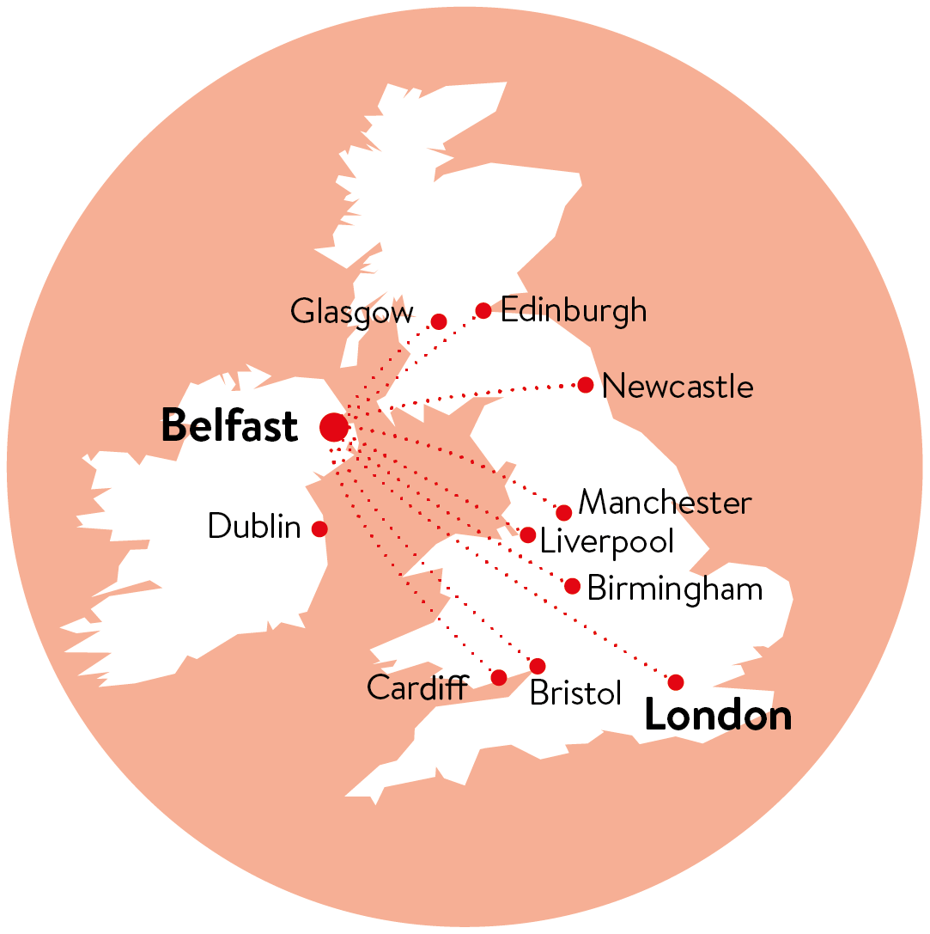
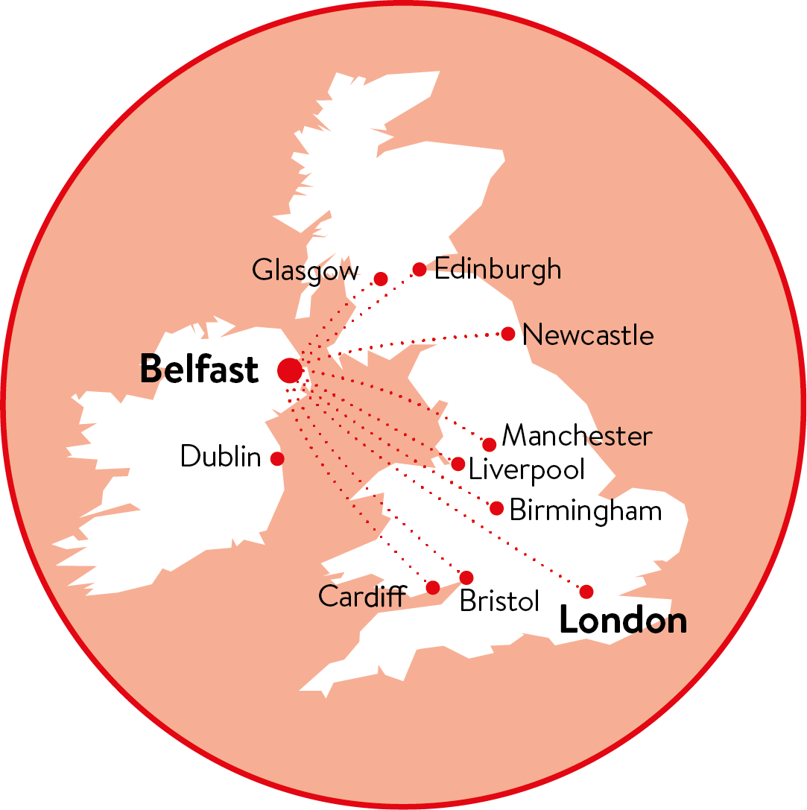
MAPS

Slide 22
LOGOS

Slide 23
EPS LOGOS

