Slide 1
A guide to the UK and Irish Fulbright Scholarship Programs

Slide 3
B Brunei Bulgaria Burkina Faso Burma C Cambodia Cameroon Canada Chad Chile China Colombia Comoros
Congo, Costa Rica Côte d'Ivoire Croatia Cyprus Czech Republic
D Denmark Dominica Dominican Republic
GLOBAL FULBRIGHT
A Afghanistan Albania Algeria Andorra Angola Antigua & Barbuda Argentina Armenia Australia Austria Azerbaijan B Bahamas Bahrain Bangladesh Barbados Belarus Belgium Belize
Benin Bhutan
Bolivia
Bosnia Herzegovina Botswana Brazil
E Ecuador Egypt El Salvador Estonia Ethiopia F Fiji Finland France
G Gaza Georgia Germany Ghana Greece Grenada Guatemala Guinea Guyana
H Haiti Honduras Hong Kong Hungary
M Macau Macedonia Madagascar Malawi Malaysia Maldives Mali Malta Mauritania Mauritius Mexico Moldova Mongolia Montenegro Morocco Mozambique
N Namibia Nauru Nepal Netherlands New Zealand Nicaragua Niger Nigeria Norway
O Oman P Pakistan Palestinian Territories Panama Papua New Guinea Paraguay Peru Philippines Poland Portugal
Q Qatar R Republic of the Congo Romania Russia Rwanda
S Samoa Saudi Arabia Senegal Serbia
I Iceland India Indonesia Iraq Ireland Israel Italy J Jamaica Japan Jordan K Kazakhstan Kenya Kiribati Kosovo Kuwait Kyrgyzstan
L Laos Latvia Lebanon Lesotho Lithuania Luxembourg
S
Sierra Leone Singapore Slovak Republic Slovenia Soloman Islands South Africa South Korea Spain Sri Lanka St. Kitts and Nevis St. Vincent and the Grenadines Suriname Swaziland Sweden Switzerland
St. Vincent and the Grenadines Suriname Swaziland Sweden Switzerland
T Taiwan Tajikistan Tanzania Thailand Timor-Leste Togo Tonga Trinidad and Tobago Tunisia Turkey Turkmenistan Tuvalu U Uganda Ukraine United Arab Emirates United Kingdom Uruguay Uzbekistan V Vanuatu Venezuela Vietnam Z Zambia Zimbabwe

Slide 4
fulbright Ireland overview
IRISH FULBRIGHT COMMISSION
The Fulbright Irish Awards provide grants for Irish citizens, and E.U. citizens who have been resident in the Republic of Ireland for three or more years, to research, study, or lecture in the U.S. on an annual basis
The Application Period for 2019-2020 Irish Awards opens 31st August 2018 with a deadline of 6th November 2018
There are four types of Fulbright grants available to Irish citizens during this application period:
1. Student
2. Scholar
3. TechImpact Scholar
4. FLTA (Foreign Language Teaching Assistant)

Slide 5
fulbright ireland awards
FULBRIGHT IRISH STUDENT AWARDS
The Fulbright Irish Student Awards are grants for Irish citizens, or E.U. citizens resident in ROI for 3+ years, to complete postgraduate research in the U.S. for a period of 4 months, up to 1 year.
Fulbright Student Awardees can go to the U.S. to:
a) complete a Masters or PhD (degree-seeking award) at a U.S. institution
b) conduct research as part of a current postgraduate program in Ireland or the E.U
c) visiting researcher awards.
Preference will be given to visiting researcher applicants in the latter stages of their PhDs

Slide 6
fulbright ireland awards
1. FULBRIGHT IRISH STUDENT AWARDS continued
A Grants in all disciplines to complete postgraduate research or study in the U.S. for a min period of 4 months. Applicants can do a full PhD or Masters in the U.S. or portion of an Irish postgraduate degree*
B Previous Additional Sponsored Awards (2019-2020 TBC):
Fulbright-Creative Ireland Museum Fellowship: Exploratorium
Fulbright-Creative Ireland Museum Fellowship: Harry Ransom Center
Fulbright-Creative Ireland Museum Fellowship: Smithsonian
Fulbright-Enterprise Ireland Award in Innovation
Fulbright-EPA Award in Water, Climate Change, or Sustainability
Fulbright-GSI Award in Geoscience
Fulbright-Marine Institute Award in Marine Science or Business
Fulbright-Teagasc Award in Agriculture, Food, and Forestry
Fulbright Student LL.M. Award at the University of Indiana Maurer School of Law
Fulbright-University of Notre Dame LL.M Award in Law
Fulbright-University of Pennsylvania LL.M. Award in Law
* Maximum 1 year study funded by Fulbright, additional funding to be sourced privately.

Slide 7
fulbright ireland awards
1. FULBRIGHT IRISH STUDENT AWARDS continued
B Previous Additional Sponsored Awards (2019-2020 TBC):
Fulbright-Creative Ireland Museum Fellowship: Exploratorium
- to complete short-term research at the Exploratorium, San Francisco
Fulbright-Creative Ireland Museum Fellowship: Harry Ransom Center
to complete short-term research at the Harry Ransom Center, Austin, Texas
Fulbright-Creative Ireland Museum Fellowship: Smithsonian
to complete short-term research at the Smithsonian Institution, Washington DC
Fulbright-Enterprise Ireland Award in Innovation
including new technologies that will lead to job creation and increased exports

Slide 8
fulbright ireland awards
1. FULBRIGHT IRISH STUDENT AWARDS continued
B Previous Additional Sponsored Awards (2019-2020 TBC):
Fulbright-EPA Award in Water, Climate Change, or Sustainability
in the areas of water, climate change, and sustainability. Proposals are particularly welcomed that will create linkages to government bodies or private companies that are working on environmental protection issues and will reach beyond academia
Fulbright-GSI Award in Geoscience
includes but is not limited to geological and marine mapping, geological processes, Earth observation, groundwater, raw materials and minerals, public perception of Earth resources
Fulbright-Marine Institute Award in Marine Science or Business
- in the area of Marine Science or Business. Applications in Marine Sensor Technologies and Observation Systems, Maritime Economics, Ocean Energy, Marine Biotechnology, Oceanography and Marine Modelling, Food Safety, and Ecosystem-based Management are particularly encouraged

Slide 9
fulbright ireland awards
2. FULBRIGHT IRISH SCHOLAR AWARDS
The Fulbright Irish Scholar Awards are grants for Irish citizens, or E.U. citizens resident in the Republic of Ireland for three or more years, to complete postdoctoral or professional research or lecturing for a period of 3 months up to 1 year
Applicants can choose one of the following four categories of Fulbright Scholar Awards:
Lecturing: If the primary purpose of the project is to teach or team-teach at least one full semester course. Applicants will be required to submit course syllabi
Research: If the primary purpose of the project is to conduct research. Applicants will be required to submit a research bibliography
Lecturing/Research: If the project will include significant portions of both lecturing and research as defined above. Candidates will be required to outline both activities in their project statement, as well as submit course syllabi and a research bibliography
The new Fulbright-HRB HealthImpact Award allows professionals to undertake research or professional development

Slide 10
fulbright ireland awards
2. FULBRIGHT IRISH SCHOLAR AWARDS continued
A. Grants in all disciplines to complete postdoctoral /professional research or lecturing in the U.S. These awards are open to scholars and non-academics with 5+ years of experience in their field The minimum grant period is 3months and the maximum is 1 year
B Previous Additional Sponsored Awards (2019-2020 TBC):
Fulbright-Enterprise Ireland Award in Innovation
Fulbright-EPA Award in Water, Climate Change, or Sustainability
Fulbright-GSI Award in Geoscience
Fulbright-HRB Health Impact Award
Fulbright-Marine Institute Award in Marine Science or Business
Fulbright-NUI Scholar Award

Slide 11
fulbright ireland awards
2. FULBRIGHT IRISH SCHOLAR AWARDS continued
B Previous Additional Sponsored Awards (2019-2020 TBC):
Fulbright-Enterprise Ireland Award in Innovation
- including new technologies that will lead to job creation and increased exports.
Fulbright-EPA Award in Water, Climate Change, or Sustainability
- in the areas of water, climate, and sustainability.
Fulbright-GSI Award in Geoscience
- includes but is not limited to geological and marine mapping, geological processes, Earth observation, groundwater, raw materials and minerals, public perception of Earth resources.
Fulbright-HRB Health Impact Award
- to undertake research or professional development in any area of Health. Applications from health professionals, senior health research administrators, health research managers and researchers are welcome, particularly in the areas of Research Management in a Healthcare Setting, Development & Implementation of Institutional Health Research Strategies, Public and Patient Involvement in Health Research, Health Services and Health Systems Research, Implementation Research, and Health Research Policy.

Slide 12
fulbright ireland awards
2. FULBRIGHT IRISH SCHOLAR AWARDS continued
B Previous Additional Sponsored Awards (2019-2020 TBC):
Fulbright-Marine Institute Award in Marine Science or Business
- in the area of Marine Science or Business. Applications in Marine Sensor Technologies and Observation Systems, Maritime Economics, Ocean Energy, Marine Biotechnology, Oceanography and Marine Modelling, Food Safety, and Ecosystem-based Management are particularly encouraged.
Fulbright-NUI Scholar Award
- for NUI graduates to complete post-doctoral or professional research and/or lecturing.

Slide 13
fulbright ireland awards
3. FULBRIGHT IRISH TECHIMPACT AWARDS
Fulbright TechImpact Scholar Awards are research grants for Irish citizens, or E.U. citizens resident in the ROI for 3+ years, to complete short-term, non-commercial projects and research in the U.S. for a period of two weeks to three months. They are designed to respond to the potential and pace of Information and Communications Technologies (ICT).
The Fulbright Commission is interested in supporting candidates across all disciplines who are exploring how technology contributes to development in particular of big data, sustainable development and diaspora interactions.
Grants to complete postdoctoral or professional non-commercial based research on the impact and application of ICT across all disciplines for 2weeks - 3months.
Preference will be given to candidates who have received their PhD since 2013 & are exploring how technology contributes to the development of big data, sustainable development and diaspora interactions.

Slide 14
fulbright ireland awards
4. FULBRIGHT IRISH FLTA AWARDS
The Fulbright Foreign Language Teaching Assistantship (FLTA) Awards are non-degree grants for Irish citizens, or E.U. citizens resident in ROI for 3+ years, to teach Irish and enrol on courses at a college in the U.S. over a ten-month period. The FLTA Awards are sponsored by the Department of Arts, Heritage, Regional, Rural & Gaeltacht Affairs and the National Lottery.
Applicants must have a postgraduate degree or diploma with a minimum 2.1 (consideration will be given to those with a 2.2 in their primary degree if they have achieved excellence in a postgraduate degree; consideration will also be given to those with just a primary degree but excellent Irish language teaching experience)
The Fulbright Foreign Language Teaching Assistantship (FLTA) Awards are grants to teach the Irish language and take courses at a U.S. college fora period of 10 months.
FLTAs are required to attend a pre-departure orientation in Ireland and a U.S.-based orientation during the summer of 2018. FLTAs are also required to attend a mid-year enrichment conference in the U.S.

Slide 15
fulbright ireland awards
AWARDS
Comprise of:
1. Monetary grant based on the location and duration of the award
2. Accident and emergency insurance
3. Cultural, orientation and professional programming
4. J1 Visa Administration
5. FLTA only - Tuition and fees for four courses in the U.S.

Slide 16
fulbright ireland application
HOW TO APPLY
- Visit www.fulbright.ie to confirm eligibility
- Contact awards@fulbright.ie to receive guidelines
- Apply as a Student, Scholar, TechImpact Scholar or FLTA
- Apply separately to US institution for Masters/PhD program (or professional development course for Fulbright-HRB Health Impact Award) or for research affiliation (except for FLTA Award)

Slide 17
fulbright ireland application
APPLICATIONS MUST INCLUDE
- Personal Information & CV
- Written Statements
- References
- Transcripts
- Samples of work for visual/performing artists

Slide 18
fulbright ireland requirements
REQUIREMENTS
Successful applicants will:
1. Attend a pre-departure orientation in Dublin
2. Submit reports and J-1 visa administration.
3. Comply with the two-year home-country residency requirement associated with the J-1 visa.
4. Not be eligible for a U.S. residency or work visa until they have fulfilled the J-1 visa two-year home residency requirement.

Slide 19
fulbright uk overview
UK FULBRIGHT COMMISSION
We offer programmes, events and advice for UK students, academics and professionals interested in studying, researching or teaching at accredited higher education institutions in the USA.
Non-UK citizens are required to apply through the Commission/Post in their country of citizenship. Applications from non-UK citizens based in the UK and committed to a life and career in the UK may also be considered if the applicant is not able to apply for a Fulbright award through their country of citizenship.
The levels of study in the USA:
Postgraduate - master’s and doctoral degrees
Academic and Professional - academia and other professional projects
Visiting researcher awards.

Slide 20
fulbright uk awards
1. FULBRIGHT UK STUDENT AWARDS
A Grants in all disciplines to complete postgraduate research or study in the U.S. Applicants can do a full PhD or Masters in the U.S. or portion of a postgraduate degree. Up to $45,000. This is intended as a contribution towards the first year of tuition fees and general maintenance costs in the USA.
B Additional Sponsored Awards – grant amount varies, see website for more info:
The Fulbright Nursten Award in Medical Studies
Alistair Cooke Award in Journalism
British Friends of Harvard Business School Award, MBA
Indiana University Maurer School of Law
Lloyd's of London Award, any master's degree related to risk, at any US university,
University of Minnesota Humphrey School of Public Affairs, public policy and planning,
Elsevier Data Analytics Award, any postgraduate degree requiring data analytics to advance understanding of research, at any US university
NYU Wagner, Executive Master of Public Administration Award, part of the EMPA for Global Policy Leaders
Brown University PhD in any discipline available at the university
University of South Florida, PhD available in several disciplines (see website)

Slide 21
fulbright uk awards
2. FULBRIGHT UK SCHOLAR AWARDS
The Fulbright UK Scholar Awards are grants for UK citizens, to complete postdoctoral or professional research or lecturing for a period of 3-12 months
Applicants can choose one of the following four categories of Fulbright Scholar Awards:
Lecturing: If the primary purpose of the project is to teach or team-teach at least one full semester course. Applicants will be required to submit course syllabi
Research: If the primary purpose of the project is to conduct research. Applicants will be required to submit a research bibliography
Lecturing/Research: If the project will include significant portions of both lecturing and research as defined above. Candidates will be required to outline both activities in their project statement, as well as submit course syllabi and a research bibliography

Slide 22
fulbright uk awards
2. FULBRIGHT UK SCHOLAR AWARDS continued
A. Grants in all disciplines to complete postdoctoral /professional research or lecturing in the U.S. These awards are open to scholars and non-academics. The minimum grant period is 3months and the maximum is 9 months (some sponsored awards are up to 12 months)
B Additional Sponsored Awards:
Northern Ireland Public Sector Award
British Heart Foundation Award
Royal College of Surgeons Award
Fight for Sight Award
Cancer Research UK Award
University of South Florida Award
Urology Foundation Award
Elon University Award allows academics and professionals to teach and pursue independent research in any subject area offered by the university.

Slide 23
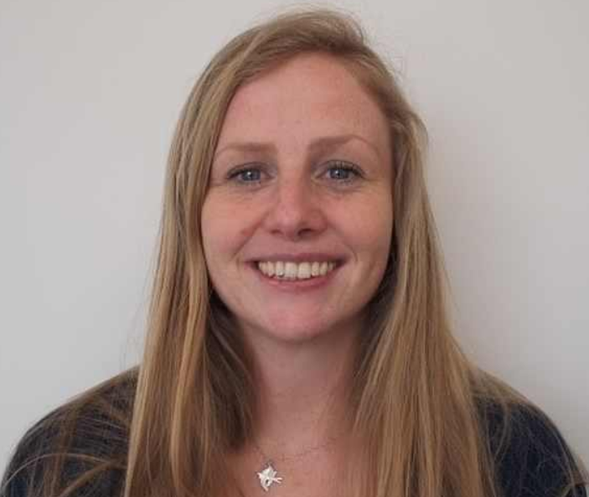
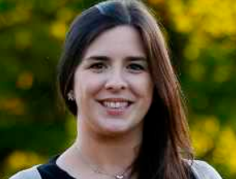
fulbright commission
Amy Moore UK Fulbright Commission
Director, Fulbright Awards Programme
Amy oversees all of the Fulbright Award programmes for both American and British grantees. Prior to Fulbright, Amy ran customised, faculty-led programmes for American students in London, and managed the student services department. Amy spent a year at University of Pittsburgh as part of her American studies degree at University of Sheffield, which is perhaps why she has dedicated her career to promoting cultural exchange.
Emma Loughney Irish Fulbright Commission
Communication & Administration Manager
Emma is the Communication and Administration Manager. She has a BA in Italian & Archaeology from Trinity College Dublin and a Masters in Cultural Policy & Arts Management from University College Dublin. Emma spent time working in New York before joining the Fulbright Commission in June 2014. She was Co-organiser of TEDxFulbright Dublin 2016

Slide 24
Any questions for Amy and Emma?

Slide 25
fulbright ireland student form
FULBRIGHT STUDENT APPLICATION FORM
General Information – Name, DOB, Address, etc.
Study Plans – Degree, Field of Research, Future Plans
Education – Graduate, Postgraduate, Professional
Awards & Recognitions – Scholarships, Academic Honours, Prizes, Publications, Teaching Experience, Research Experience
Occupational Experience
Language Skills

Slide 26
fulbright ireland student form
FULBRIGHT STUDENT APPLICATION FORM continued
7. Travel -
8. Emergency Contact
9. Personal Information – Hobbies, marital status, children.
10. University you plan to attend – Not expected that you will have been officially admitted by time of application
11. References - Academics under whom you have studied or pursued research or by someone who has supervised you in work related to your proposed field of study
12. Financial Information – Available funds, Travel funds, Dependants

Slide 27
fulbright ireland student form
FULBRIGHT STUDENT APPLICATION FORM continued
13. Study / Research Objective* – a clear and very detailed description of the program they want to pursue in the US in essay format
14. Personal Statement* – a careful, well thought out, self-assessment with reference to the Fulbright Program’s purpose and objectives
15. Curriculum Vitae – Academic Excellence, Leadership, Volunteering
16. Transcripts – complete university transcripts from all 3rd level institutions attended
17. Writing Sample – a research paper, published article, paper done for a course, etc
18. Recent Work – Visual, architecture and performing arts applicants are required to submit 4 samples
19. Passport

Slide 28
fulbright ireland student form
FULBRIGHT STUDENT APPLICATION FORM continued
13. Study / Research Objective
Write a clear and very detailed description of the program they want to pursue in the US in essay format. As this is an indication of your written communication skills, make sure it is well organised, written and the proper spelling and grammar is used throughout
Outline your purpose for applying to the Fulbright Program
Clearly identify the area(s) within your field of study in which you want to specialise or concentrate. If there is specific research that you want to accomplish, please explain it as fully as space allows
Outline how the period in the U.S. will enhance your knowledge, skills and understanding and future development in the specified discipline
Reference the specific universities where you would like to study or have applied to and highlight your top choice

Slide 29
fulbright ireland student form
FULBRIGHT STUDENT APPLICATION FORM continued
14. Personal Statement
Conduct a careful, well thought out, self-assessment with reference to the Fulbright Program’s purpose and objectives to be able to articulate an understanding of the Fulbright Program, the qualities of a Fulbrighter and how you and Fulbright will benefit from your receiving an award
Compose a narrative essay in which you include information about your formative experiences (educational, professional, personal), personal and professional ambitions and special non-academic, extracurricular interests
Describe who you are, what your goals are, and what you hope to achieve in the US and upon your return to Ireland
Outline your motivations, relevant preparations and expectations of the Fulbright Program
Do not repeat or re-hash the study objective essay or provide a narrative of your CV
Remember the personal statement is an indication of your written communication skills. Make sure it is well organised, written and proper grammar and spelling is used

Slide 30
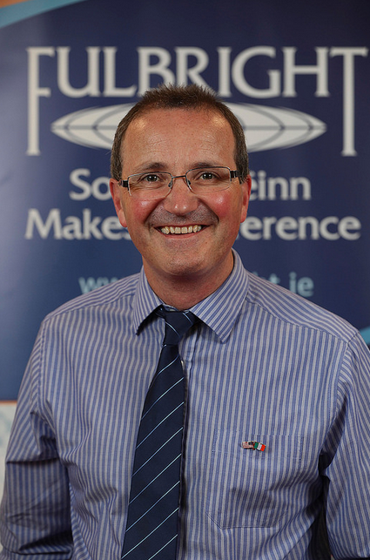
2018 fulbright award winners
Dr Paul Bolger is manager of the Environmental Research Institute at UCC. He holds a PhD in Chemistry and a Master’s in Business Administration, and has worked across academia, industry and government in developing long term research solutions for global sustainability challenges. He is currently Principal Investigator on a number of research projects on climate change and the circular economy. Dr Bolger’s Fulbright scholarship will investigate how interdisciplinary and transdisciplinary research is being utilised at sustainability research institutes at Duke University, Cornell University, Colombia University and Arizona State University to achieve more robust and sustainable research outcomes, and to examine the skills needed by researchers for successful transdisciplinary collaboration.

Slide 31
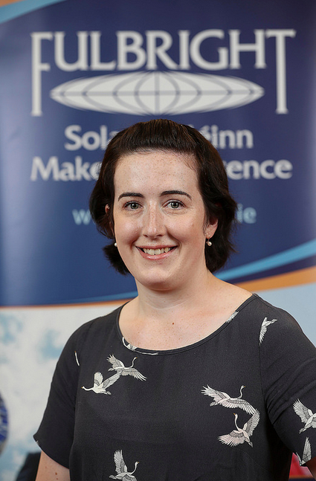
2018 fulbright award winners
Ms Jasmine Headlam is a doctoral candidate at the School of Natural Sciences, NUIG. Her PhD research focuses on harmful jellyfish species such as the mauve stinger and the lion’s mane jellyfish, which are known to negatively impact coastal industries (e.g. cause large fish mortalities in the salmon aquaculture industry). Her PhD research is funded under the EU’s H2020 CERES Project which is examining how climate change will influence Europe’s most important fish and shellfish resources. As a Fulbright Marine-Institute awardee, Ms Headlam will be mentored in state of the art techniques to investigate the structural and functional characteristics of cnidae and the composition of venom by Fulbright Specialist, Dr Angel Yanagihara, Director of the Pacific Cnidaria Research Laboratory, University of Hawaii at Manoa..

Slide 32
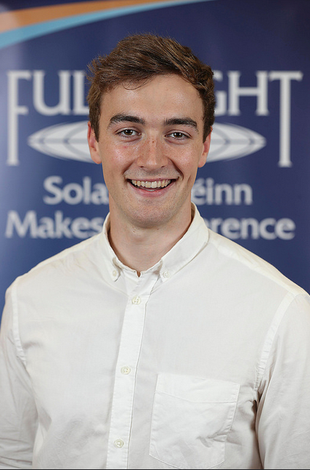
2018 fulbright award winners
Mr Ben Moore is a final year B.E. Mechanical Engineering student and Ad Astra Scholar at UCD. His current work focuses on the development and testing of the Attitude Determination & Control System for the first Irish satellite, EIRSAT-1. As a Fulbright Student he will pursue a Master of Science degree in Aeronautics & Astronautics at Stanford University. He will direct the focus of his studies and conduct research into satellite design and control.

Slide 33
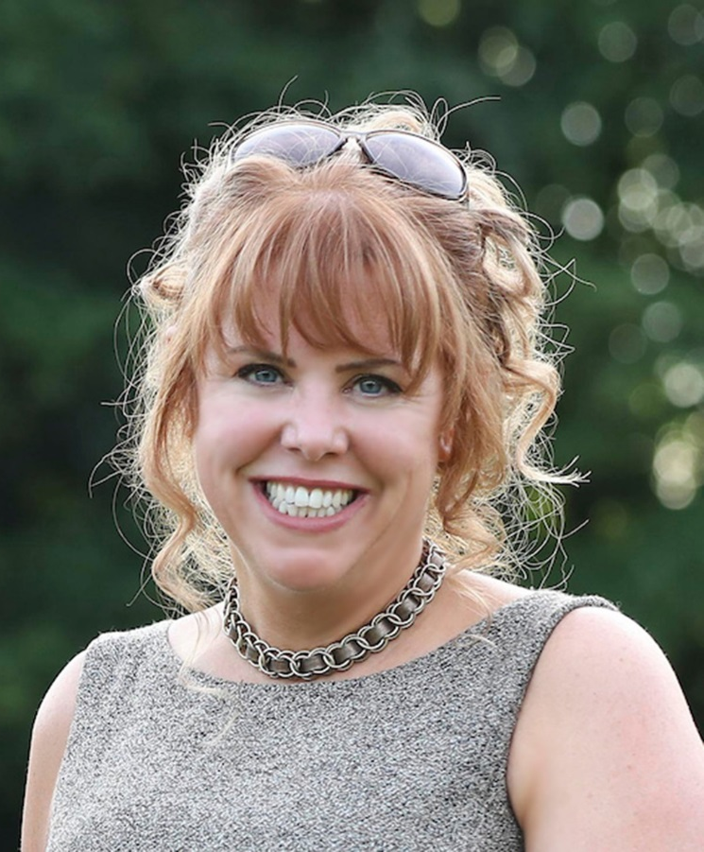
2018 fulbright award winners
Ms Roisin Hyde (middle right) is a Doctoral Research Student at QUB School of Natural & Built Environment. She received her Bachelor of Architecture from UCD and became a Chartered Member of the RIAI. She also holds a Higher Diploma in Computing for DIT. Her current research focuses on the development of a high-performance, low-impact, cement-free geopolymer concrete cladding panel through the use of innovative automated technologies including 3D Laser Scanning, Point Cloud Modelling and 3D Printing. As a Fulbright PhD Research Student in University of North Carolina at Charlotte, she will work with Researchers in the Schools of Architecture, Civil and Environmental Engineering to produce a full-scale prototype panel using local industrial by-product and waste materials.

Slide 34
fulbright links
WEB RESOURCES & FORUMS
Fulbright US https://www.cies.org
https://www.iie.org/Why-IIE/History/IIE-and-Fulbright-Program
Fulbright Ireland http://www.fulbright.ie
Fulbright UK http://www.fulbright.org.uk
Reddit forum https://www.reddit.com/r/fulbright
Gradcafe forum https://forum.thegradcafe.com/topic/105359-fulbright-2019-2020
Chronicle forum https://www.chronicle.com/forums/index.php/topic,128929
Other https://worldscholarshipforum.com/category/fulbright-scholarship
https://www.profellow.com/tips/the-one-article-to-read-before-submitting-your-fulbright- application
https://www.phdfriend.com/fulbright-ebook/

Slide 35
Any further questions?

