Slide 1
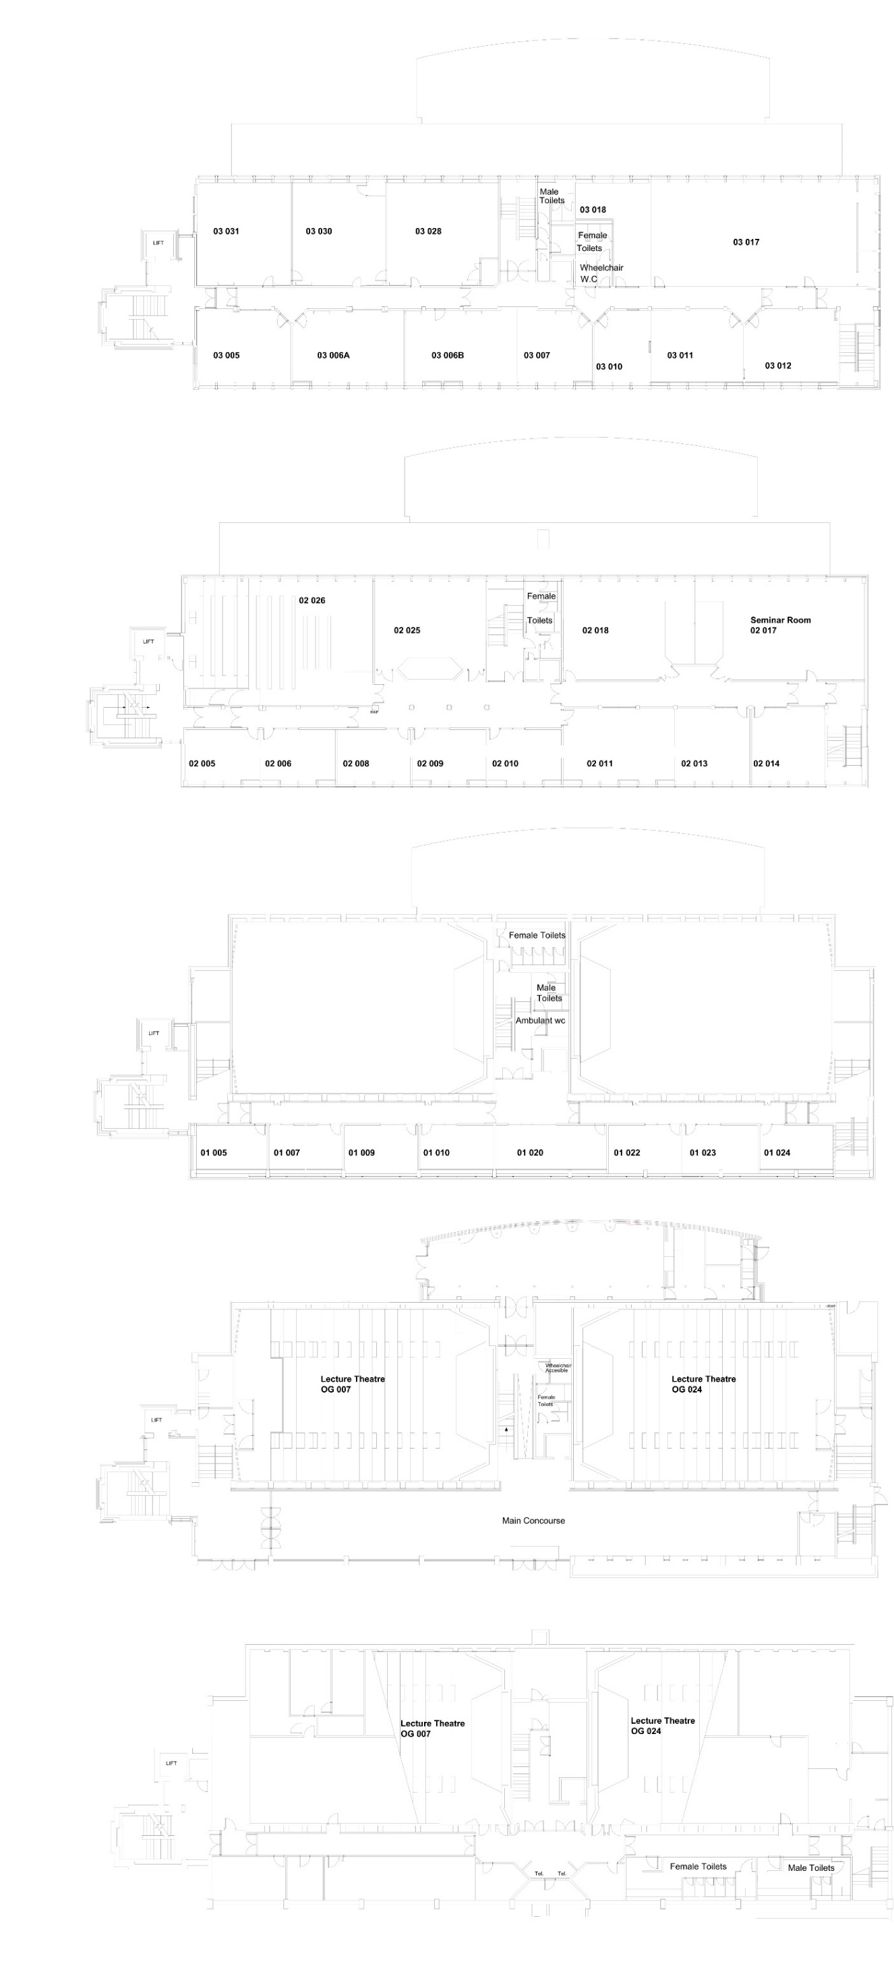
PETER FROGGATT CENTRE (PFC)

