Slide 1
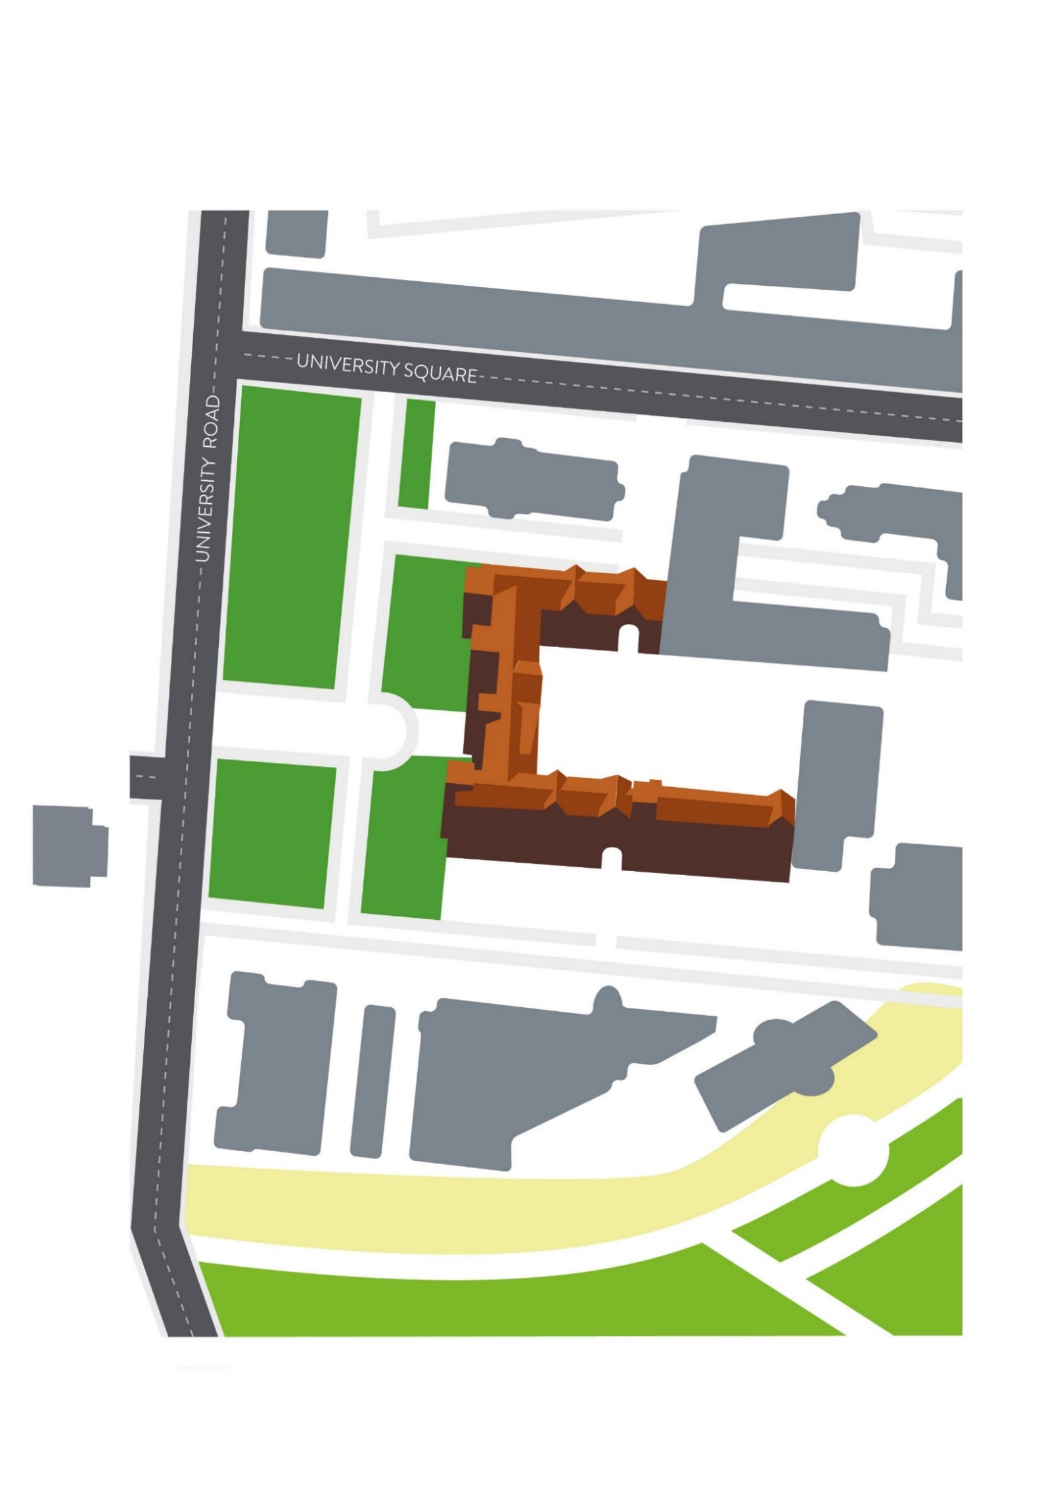
HEADING IN BRANDON TEXT BOLD (UPPERCASE)

