Slide 1
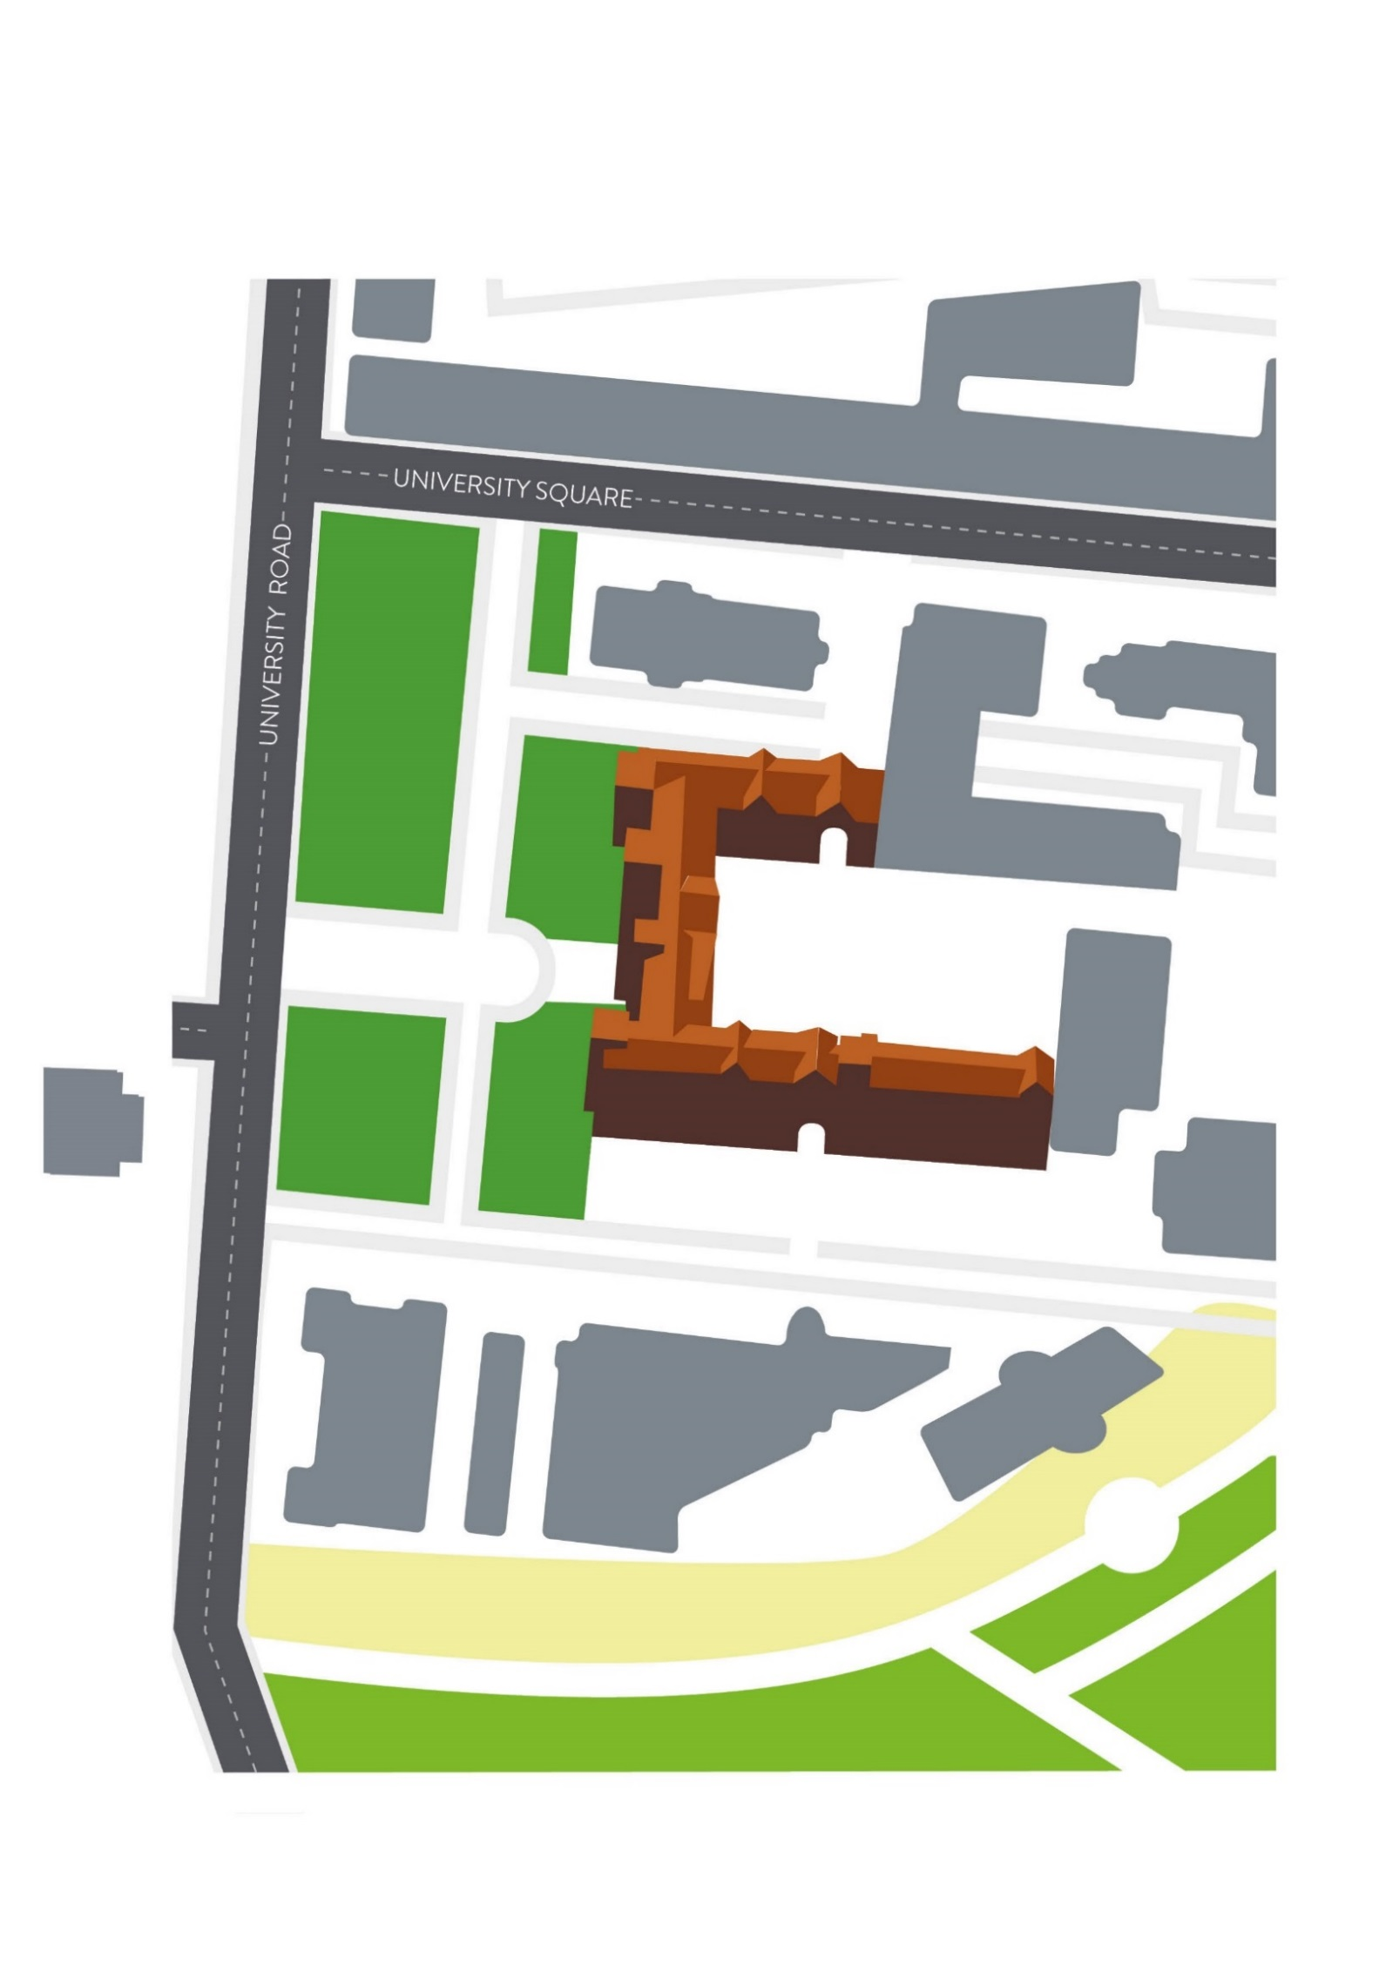
















HEADING IN BRANDON
TEXT BOLD (UPPERCASE)

