Slide 1
Authoritarianism and punishment Understanding penal persistence in Argentina
Máximo Sozzo
Professor of Sociology of Law & Criminology, National University of Litoral (Argentina)
Lerverlhume Visiting Professor, School of Law, University of Edinburgh (United Kingdom)

Slide 2
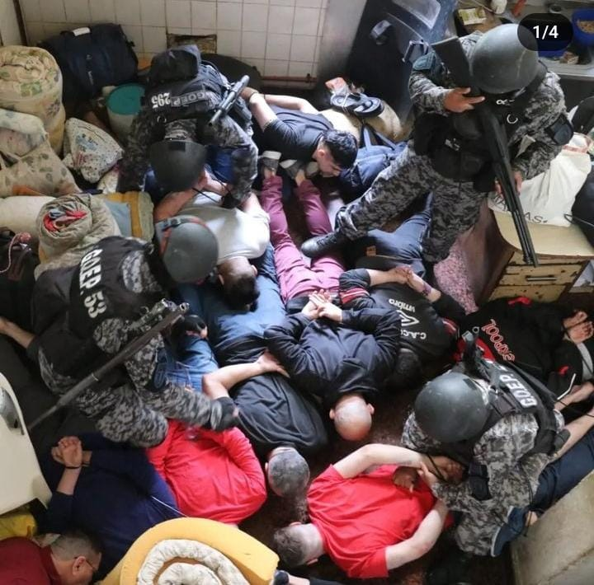
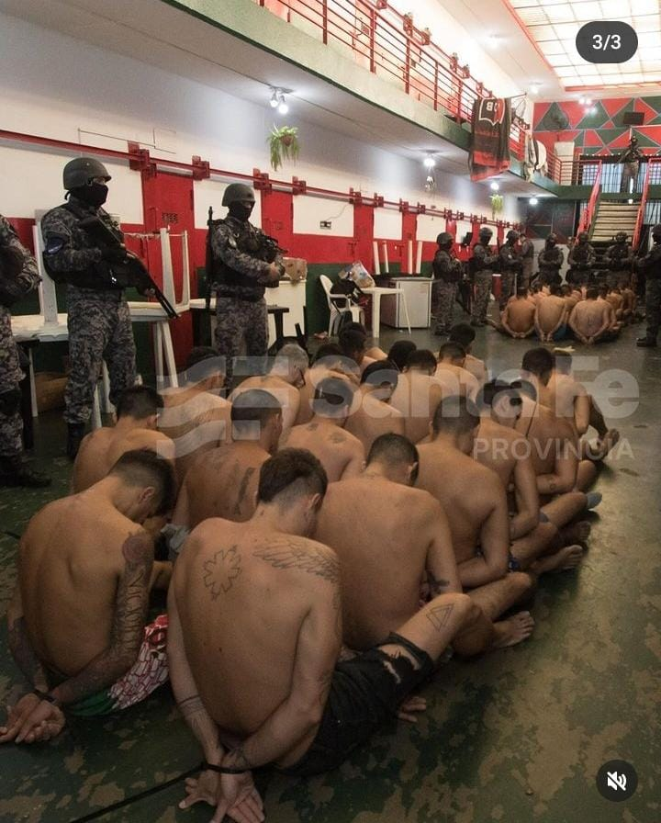
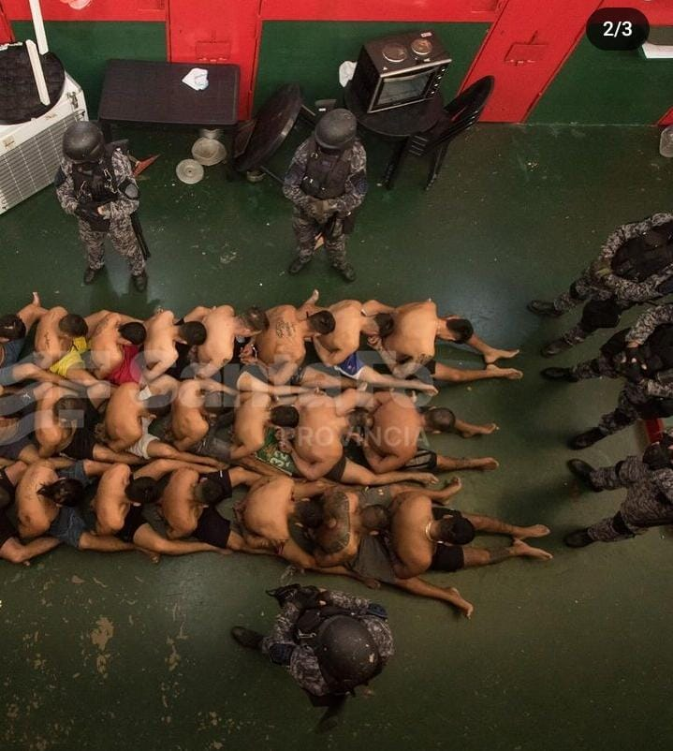

Slide 3
Fifteen people deprived of their liberty in Wings 7 and 8 of the Prison N° 11 in the province of Santa Fe (Argentina) reported to the Public Criminal Defence Service that on 2 March 2024, during a search, all the people detained in these two areas (158 prisoners) were subjected to repeated blows (punches and kicks) of various kinds by the prison officers, although only this group reported it because of the widespread fear of reprisals by the prison staff. Some of them said that towels were placed over their heads while water was poured over them to drown them. Others had plastic bags placed on their heads and tightened for the same purpose. Others said they were beaten on the soles of their feet with truncheons. One detainee said he had been given electric shocks. Several of the detainees reported sexually aggressive actions by the guards, including one case of impalement. One detainee had urine poured over him. Another detainee had his head placed in a puddle on the ground to drown him. The prisoners were examined by a forensic doctor, who found numerous injuries on the bodies of the complainants that were consistent with the description of the facts.
(Summary of the complaint submitted by the Public Criminal Defence Service to the Specialised Prosecutor for Institutional Violence in the Judicial District No. 2 of the Province of Santa Fe, 14.3.24)

Slide 4
1. Exploring penal persistence
Punishment & society studies and the centrality of penal change in the last four decades (Sozzo, 2025a).
The neglect of inertia, persistence, continuity in the penal field. Some work has attempted to reverse this in recent years (O’ Malley & Meyer, 2005; Hutcheson, 2006; Mauruto & Hannah-Moffat, 2006; Phelps, 2011; Garland, 2011; Goodman, Page & Phelps, 2015; 2017; Rubin, 2016; 2019; 2023; Rubin & Reiter, 2017; Goodman & Quinn, 2023).

Slide 5
1. Exploring penal persistence
A contribution to this problematisation of penal persistence, from the global peripheries, exploring a Latin American context (Sozzo, 2023; Iturralde, 2023; Dal Santo and Sozzo, 2024;).
The discussion on the presence of authoritarianism in the contemporary penal field, its characteristics, conditions and effects (Sozzo, 2005; 2016a; 2016b).
Starting point: an incident of massive torture of prisoners by prison officers in contemporary Argentina. “Picanear”, “submarino seco”, “pata pata”, old names for torture techniques with a long history in this country.

Slide 6
1. Exploring penal persistence
What makes these practices of torture possible in Argentine prisons today?
Conditions and dynamics inside and outside the prison world, which are complexly intertwined.
Both are linked to authoritarianism as a governmental rationality.
The possibility of exploring this link between authoritarianism and punishment makes sense in other Latin American settings that share a number of features in common with Argentina in their past and present (Iturralde, 2020; 2023) - but also beyond the region in other settings in the Global North and South (Sozzo, 2023; Dal Santo & Sozzo, 2024).

Slide 7
2. Authoritarianism
Liberalism, ambiguity and the possibilities of despotism (Valverde, 1996; Hindess, 2001). Intersection and hybridisation between governmental rationalities (Dean, 1999, 145, 147; 2002, 56; 2025).
Authoritarianism as a governmental rationality that imagines the subject to be governed as incapable of governing itself as a free and rational being, and therefore as someone to be coerced, neutralised or eliminated (Dean, 1999; 2002; 2025).
Beyond the principle of "limited" or "frugal government", the justification for the maximum degree of intervention by the governmental authorities, including the use of force against the governed - and to the extreme- in order to produce obedience (Dean, 1999, 2002; 2025).

Slide 8
2. Authoritarianism
Authoritarianism as a governmental rationality that runs through the history of Argentina (and Latin America).
Its association with dictatorial regimes of the 20th century (Sozzo, 2005; 2016a; 2016b).
Its connection with a "colonial matrix of power" as a long-term process and the production and reproduction of class and racial hierarchies and extreme levels of inequality (Quijano, 2000; Mignolo and Walsh, 2018).

Slide 9
3. “From inside”
Prison Services in Argentina born in the second half of the 20th century in the context of military dictatorships. Santa Fe (1968), Cordoba (1970) and Buenos Aires (1971).
Previously, strong links with police institutions. (Olaeta & Cannevassi, 2020; González Alvo, 2022) In some provinces prisons are still under control of provincial police forces (Neuquen and Chubut).
High levels of militarisation and the grammar of the "political enemy” (Sozzo, 2005; 2016b)
Strong levels of influence of the positivist criminological tradition and the grammar of the "social enemy" (Sozzo, 2000; 2005; 2016b)

Slide 10
3. “From inside”
Differences and connections between the figures of the "political prisoner" and the “ordinary prisoner" as objects of control practices by prison authorities and guards.
The marginalisation of the law. Prisons as a "zone without law" (Costa, 1974; Pavarini, 2006; Sozzo, 2007; 2009; Rivera Beiras, 2023). The vagueness and ambiguity of the law and the high degree of informality of prison governance. The absence or weakness of state mechanisms to oversee and monitor prison practices.
The paroxysmal moment of the last dictatorship (1976-1983) and the massification of state crimes, prisons as part of the circuit of "state terrorism“ (Guglielmucci, 2007; Garaño, 2010; 2020; D'Antonio, 2009, 2013a; 2013b; 2019; D'Antonio and Eidelman, 2010; Cesaroni, 2013; Merenson, 2014).

Slide 11
3. “From inside”
Transition to democracy and attempts at police reform in Argentina since the late 1990s onwards. Their ambitious promises in some (few) jurisdictions and their limited scope. The importance of counter-reform processes. (Tiscornia, 2000; Sozzo, 2005; 2016a; Sain, 2008; 2012a; 2012b; González, G. 2019; Dammert, 2019; Gonzalez, Y. 2020).
The absence of structural reform of prison services in Argentina. Some specific measures of modest scope in different jurisdictions. The only exception: Province of Santa Fe (2003-2005 and 2008-2011). Limitations and reversals (Narciso, 2017, 2020; Arce, 2018; Varela, 2019; Claus and Sozzo, 2023).

Slide 12
3. “From inside”
Autonomy of prison services from elected authorities. Their influence on prison policy-making and reinforcement of traditional features.
Authoritarian features of the culture of "front line" prison officers. Qualitative and quantitative studies (Mouzo, 2010a; 2010b; Claus & Sozzo, 2012; Manchado & Narciso, 2014; Claus, 2015; Galvani, 2016; Abramovich et al, 2024; Sozzo & Zuzulich, 2025).

Slide 13
3. “From inside”
In a survey of a representative sample of prison officers in the Province of Santa Fe in 2011: (a) 24% agreed with the statement that "prisoners only respect brute force"; (b) 58% with the statement that "the treatment given to prisoners is too good and creates problems"; (c) 58% with the statement that "judges have given prisoners so many rights that it is practically impossible to maintain order in prison"; d) 58% with the statement that "prisons are too soft on criminals"; e) 47% with the statement that "a prisoner will only go on the right track when he has seen that prison life is hard"; f) 36% with the statement that "a military-type regime is the best way to run a prison". (Claus and Sozzo, 2012).

Slide 14
3. “From inside”
In a survey of a representative sample of female prison officers in the Province of Santa Fe in 2023: a) 39% agreed with the statement that “the majority of prisoners could not be rehabilitated”; b) 27% with the statement that "judges have given prisoners so many rights that it is practically impossible to maintain order in prison" e) 32% with the statement that "a prisoner will only go on the right track when he has seen that prison life is hard"; f) 24 % with the statement that "a military-type regime is the best way to run a prison".

Slide 15
3. “From inside”
The diffusion of authoritarian control practices –especially, through the use of violence- by authorities and guards from the transition to democracy onwards (Sozzo, 2007; 2009; Gual, 2013; 2015, 2016, 2020, 2024; Daroqui et al. al, 2014; Anitua and Gual, 2016).

Slide 16
3. “From inside”
The creation of state mechanisms of external control over prison life as a response. Uneven developments across jurisdictions. Federal jurisdiction: Procuración Penitenciaria de la Nación (1994), Defensoria General de la Nación (1998) and Comité Nacional de Prevención de la Tortura (2017). Inspections, reports and recommendations but also judicial litigation (Somaglia, Taboga and Sozzo, 2024; Sozzo, 2025b).
The paradox of increasing openness of the prison to external actors, such as national universities. “Porosity“ and its effects on incarcerated life (Gual and Sozzo, 2024a; Sozzo, 2025b).

Slide 17
3. “From inside”
Constant challenges and contestation of institutional violence by various external actors (judicial, political and social) and prisoners (in some cases, through some form of collective organisation, D’ Amelio, 2022; Claus & Sozzo, 2023; Gual & Sozzo, 2024b).
Constant efforts and actions of prison authorities and guards to maintain authoritarian control practices. Beyond initial conditions that would automatically and directly generate effects that prevent change. Examples.
Struggles around institutional violence in prison contexts and the metaphor of the “tug-of-war” (Dieter, 2025).

Slide 18
3. “From inside”
As a result, institutional violence in Argentine prisons has had different extensions and intensities at different times and in different places over the last 40 years. And its modalities have also mutated (Gual, 2013; 2015, 2016; 2020, 2024).
In times and places where the strength of the actors who carry out initiatives to contest and challenge institutional violence is greater, it becomes less widespread and less intense and its modalities less open and obvious.

Slide 19
3. “From inside”
The 2008 report Cuerpos Castigados of the Procuración Penitenciaria de la Nación on the prevalence of torture in federal prisons. A political and public scandal.
Subsequent strengthening of external control mechanisms in federal prisons - and in some of them, the presence of external actors. Since the beginning of the 2010s, decrease in direct institutional violence officially recorded by the PPN as external control mechanisms (PPN, 2023, 179). A view shared by people deprived of their liberty in the male federal prison of the City of Buenos Aires, recorded during ethnographic fieldwork (Gual 2024, 124).

Slide 20
3. “From inside”
Changing the modalities of institutional violence? The example of the disappearance of the "welcome" in some federal prisons (Gual, 2024). Studies documenting that has recorded the "outsourcing" of the use of violence by prison authorities and guards into the hands of certain prisoners, in the framework of corrupt exchange schemes (Gual, 2013; 2015, 2016, 2020, 2024; Daroqui et al., 2014; Anitua and Gual, 2016).
However, there is recent evidence of the persistence of direct institutional violence (Gual, 2020; 2024).

Slide 21
3. “From inside”
In a survey of a representative sample of inmates in Chaco Province - a medium-sized prison service in the country - in 2023, 26% of respondents stated that they had ever been subjected to physical abuse by prison staff during their period of incarceration. Of these, 75% reported having experienced at least one instance of such violence in the last year (Nielsen and Sozzo, 2023).
In a similar study carried out in Catamarca Province - a small prison service in the country - in 2024, 35% of respondents said that they had ever been subjected to physical abuse by prison staff during their period of imprisonment. Of these, 81% said they had experienced at least one instance of such violence in the last year. (Sozzo, 2024)

Slide 22
3. “From inside”
Going back to the description of the event we referred to at the beginning of this presentation, is this a sign of a new mutation of institutional violence in Argentine prisons in the opposite direction, towards more cruel, widespread and open forms? A kind of "return of the repressed“?

Slide 23
4. “From outside”

Slide 24
4. “From outside”
Transition to democracy and penal moderation in the 1980s and the first half of the 1990s. Human rights, rule of law and legal changes. (Sozzo, 2011; 2013; 2016b)
The emergence of the language of “mano dura”, but with limited scope. Its association with the “war on drugs” and the influence of the US government. (Sozzo, 2011; 2013; 2016b)
Neoliberal reforms, devastating economic and social effects and the crisis of “insecurity”. The spread of the language of “mano dura”, political consensus and electoral competition. Punitive populism “from above”, legal and policy changes and the growth of incarceration since the mid-1990s (Sozzo, 2016b; 2016c; 2018)

Slide 25
4. “From outside”
Economic, social and political crises and punitive populism “from below” in the early 2000s. Social mobilisation around victims, legal and policy changes and the growth of incarceration. (Sozzo, 2016b; 2016c; 2018).
Post-neoliberal governmental alliance and the limited and temporary reversal of the punitive turn (2003-2015). Moments of political weakness, the temptation of punitive populism and penal ambivalence (Sozzo, 2016b; 2016c; 2018).

Slide 26
4. “From outside”
The return of a center-right governmental alliance and a new wave of punitive populism (2015-2019). Migrants and “narcos” as not-so-new “suitable enemies” (Christie, 1986). Legal and policy changes and growth of incarceration.
Political and economic crisis, a centrist governmental alliance, COVID19 pandemic and penal stability (2020-2023).

Slide 27
4. “From outside”
An ultra-right governmental alliance and the combination of extreme versions of neo-liberalism and neo-conservatism.
A reloaded rhetoric of “mano dura”. Legal changes initiatives (from lowering the age of criminal responsibility to authorising the military to fight crime, from “reiteration” as a basis for the imposition of pre-trial detention to “anti-mafia” special powers). Policy initiatives (from the criminalisation and repression of social protest to a new regime of restrictions for “highly dangerous” federal prisoners). Continuities and discontinuities with previous punitive discourses and initiatives since the 1990s.

Slide 28
4. “From outside”
A “right against rights”: an open break with the key political idea that “where there is a need, there is a right”. Against “social justice” and the “presence of State” . Numerous legal changes and policy initiatives.
The mutation of the link between punitive populism with authoritarianism as a governmental rationality. “Authoritarian populism” (Hall et al, 1978; Hall, 1980; 1985) as a way of reading contemporary trends?.

Slide 29
4. “From outside”

Slide 30
4. “From outside”
Peculiarities of the case of the Province of Santa Fe during the 2010s and 2020s.
Drug trafficking, police corruption and high levels of violent crime. Homicide rate in the city of Rosario (20,3/100,000 in 2014, 19,8/100,000 in 2023).
Police and criminal justice reforms, high levels of public investment and increased state capacity.
New governmental alliance at a provincial level, rhetoric of “mano dura” and political strength since December 2023. The privileged relationship in this area with the federal government of President Milei.

Slide 31
4. “From outside”
Legal changes. The new Prison ACT and the new Prison Service ACT sanctioned both in December 2023.
Many regressive changes:
“defense of the society” as a main objective of the prison
displacement of the language of prisoners’ rights
limitation of the judicial control of prison life
collective petition by prisoners to the authorities as a serious disciplinary offence
the regulation of work as a duty
the regulation of “prison intelligence”
“high profile prisoners” and their very restrictive regime, etc.

Slide 32
4. “From outside”
Policy changes. Less permeability and more restrictions for prisoners. The “high-profile prisoners” as a central figure. The paroxysmal example of the use of uniforms. But the restrictions “spill over”. Examples: restrictions on visits, restrictions on many external actors and their activities (cancellations and obstacles).
Humiliating official videos and photos of prisoners and “bukelization” (Weegels & Araya, forthcoming), especially during the first months of the new government.

Slide 33
5. Conclusions
The persistence of authoritarian practices in contemporary Argentine prisons and the challenge of understanding them.
The metaphor of the ‘penal layer’ (Rubin, 2016). Accumulation rather than substitution, even if the later layer take precedence over the earlier ones. The longevity of authoritarian practices in Argentine prisons is an indicator of the ‘depth’ of the penal layer in which they were created, just as their proliferation throughout the prison field is evidence of their ‘thickness’ (Rubin, 2016, 432).
At some moments and places a “penal layer” may be ‘compressed’, ‘submerged’, even confined to ‘tunnels’ or ‘reservoirs’, but this does not prevent them from ‘rebounding’ at another juncture (Rubin, 2016, 432).

Slide 34
5. Conclusions
The discussion of the idea of “feedback effects” in the contemporary literature on punishment and society (Shoenfeld, 2010; 2014, 2018; Dagan & Teles, 2014; Rubin, 2023) in order to think about the persistence of authoritarian practices in Argentine prisons.
It is not enough to simply point out the existence of initial conditions that would have long-lasting effects. There is a need for a more dynamic way of thinking about what persists which gives centrality to the agency of the actors involved in penal institutions and practices (Goodman and Quinn, 2023, 122). The actors who wish to support their continuity strive to do so in the face of those who challenge them in a constant struggle (Rubin, 2023, 274; see also Goodman, Phelps & Page, 2015; 2017).

Slide 35
5. Conclusions
In turn, the appearance of continuity can mask the fact that there are sometimes changes beneath the surface (Rubin, 2023, 278; Goodman, Phelps & Page, 2015, 2017) As Thelen puts it in the literature on ‘path dependency’: ‘there is a partial renegotiation of some elements of an institution while leaving others in place’ (Thelen, 2003, 278). ‘Institutional innovation’ and ‘institutional reproduction’ are combined (Rubin, 2016, 433). There is no zero-sum game between innovation and reproduction (Rubin and Reiter, 2017).
Goodman and Quinn's interesting suggestion to think about this through the prism of the ‘palimpsest’: ‘change and continuity are deeply intertwined and mutually informing processes’ (2023, 122).

Slide 36
5. Conclusions
I think this is better captured through the metaphor of “metamorphosis” (Sozzo, 2006; 2024), as a ‘dialectic of the same and the different’ (Castel, 1997, 17-18).
‘The past does not repeat itself in the present, but the present plays and innovates using the legacy of the past’ (Castel, 1994, 238).
What exists in a given time and place is not exactly the same as it was when it emerged, but it is not entirely different. This is indeed what has effectively happened with institutional violence in Argentine prisons from the transition to democracy to the present day.

Slide 37
5. Conclusions
The "return of the repressed" revealed by the case with which I began this presentation has revealed could reasonably invite pessimistic views about the future. But at the same time the need to avoid “catastrophic” representations of our present (O’ Malley, 2000), although we might recognise that this is becoming increasingly difficult!
It is not the case that the (relatively limited) number of actors who challenge and fight against practices of institutional violence do no longer have any kind of impact on the prison field. Prison as a field of struggles and conflicts (Goodman, Phelps & Page, 2015; 2017; Sozzo, 2025b).

Slide 38
5. Conclusions
The inspection and interviews by the Public Criminal Defense Service and the report of the massive tortures.
The indictment of eight prison officers for ill-treatment (but not torture!) by the Specialised Prosecutor for Institutional Violence.
A visit in April 2024 by the National Committee for the Prevention of Torture to the prison where this took place, interviews with inmates and external actors and report to the provincial authorities.
The provincial government stop publishing humiliating photos and videos of prisoners as part of its communication policy. There were not new reports of massive torture practices, although several cases of institutional violence have been recorded.

