Slide 1
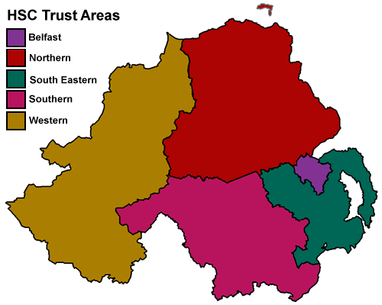
HSC Collaborative Recruitment Presentation

Slide 2
Introductions
Notes:
Speaking specifically re the 5 H&SC Trusts only.

Slide 3
We have posts!

Slide 4
An exciting time to be a nurse
Demographic changes – NI growing & ageing population.
Service Transformation.
New service developments E.G. Ambulatory Hubs.
Technological Advancements.
Advancing Nursing Practice – new roles/career pathways.
Trusts invested in supporting you

Slide 5
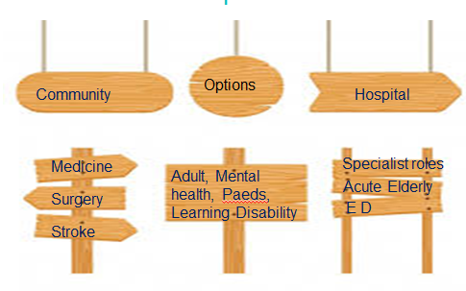
Career Options

Slide 6
Benefits of Working in NI
Get paid as Band 4 whilst waiting NMC registration.
Consolidate your training.
Induction.
Preceptorship.
Regionally agreed staffing ratios – about to be reviewed
Staff development – NIPEC Career Framework (Delivering Care Framework)
CPD
Working within an integrated Health and Social Care model.
NI takes real pride in Nursing
You are the future nurse leaders
Notes:
Means that you can get experience familiarise with area whilst awaiting pin.
Induction / preceptorship robust programmes in place.
Delivering Care regionally agreed safe staffing levels across services.
Joined up intergrated approach i.e. MDT approach to nursing care system integrated for onward discharge and follow up services such as social care packages.

Slide 7
NIPEC website Career Information

Slide 8
Overview of 5 Trusts
Belfast Trust – Borough of Castlereagh and Belfast
Population of 340,000 people
Employs 20,000 staff, and is one of the largest Trusts in the UK.
Budget of approximately £1bn (spending about £3m each day)
Hospitals: RVH, City Hospital, Mater, Musgrave, Muckamore Knockbracken + community nursing.
Northern Trust – covers Newtownabbey, Causeway Coast and Glens, Mid and East Antrim, Mid Ulster Area.
Population of overs 479,000 Population largest population in NI.
Employs Staff of 12,000 staff
Budget of £650 million
Main Hospitals: Antrim Area Hospital/ Causeway Hospital/ Holywell plus 4 community hospitals and community nursing.

Slide 9
Overview of 5 Trusts
South Eastern Trust –Districts of Ards, North Down, Down and Lisburn.
Population of 345,651 people - 19% of NI population
Employs 10,000 staff
Budget of £511 million.
Hospitals are: Ulster Hospital, Lagan valley Hospital, Down Hospital, + 2 community hospitals and community nursing
Southern Trust : District areas of Armagh, Banbridge, Craigavon, Dungannon, and Newry and Mourne.
Population of 366,000 people
Employs 13,000 staff
Budget of £532 million annually
Acute hospitals are Craigavon Area Hospital and Daisy Hill Hospital
Sub-Acute Hospitals are Lurgan Hospital and South Tyrone Hospital.

Slide 10
Overview of the 5 Trust
Western Trust - covers Limavady, L’Derry, Strabane, Omagh & Fermanagh
Population of 300,000 people
Employs 12,000 staff
Budget of £588 million annually
Main hospital are Altnagelvin, South West Acute Hospital and the New Omagh Hospital and Primary Care Complex.

Slide 11
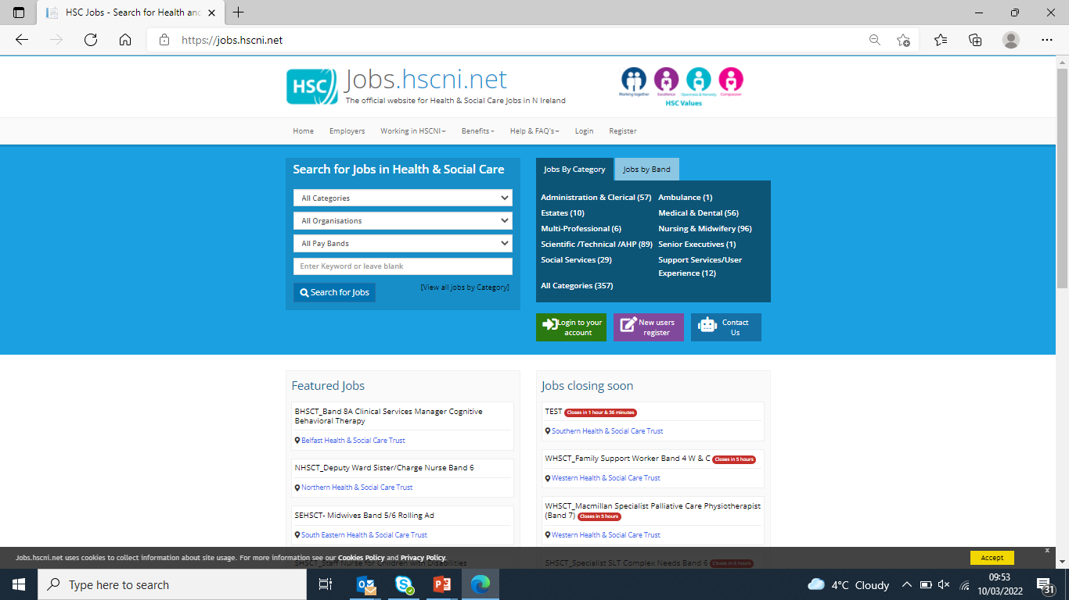
Recruitment Process – Where to look
All Trusts have live advertisements for Band 5 Nurses. 4 are on this site and 1 is on the older site

Slide 12
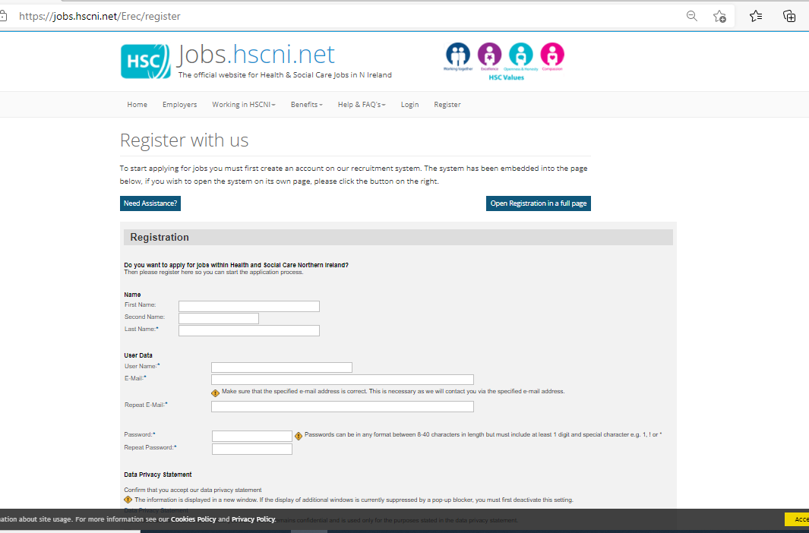
Registration

Slide 13
Don’t forget
your
password

Slide 14
Recruitment Process – How to Apply
You need to Register on the Website
Fill out your Profile Pages
Log in when you want to apply for a post

Slide 15
Recruitment Process – How to Apply
Complete the On line Application
Follow each step in the process

Slide 16
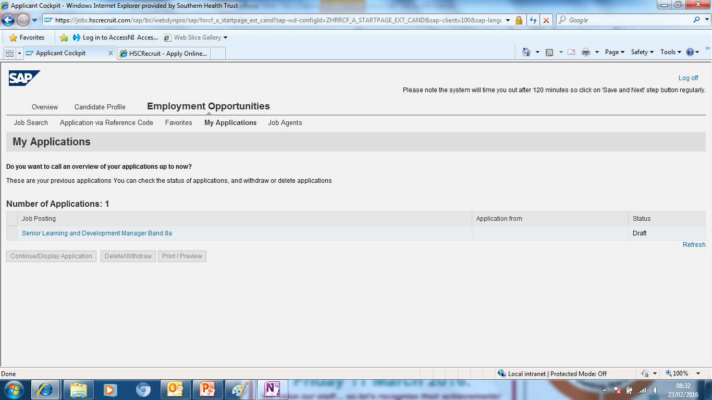
Ensure that you submit by the closing date and time

Slide 17
New Application Process
1 regional ad for all fields of practice
Ad opens on 3rd May until 10th June
Rank Trusts in order of preference
Complete survey re: location and area of preference
W/C 17th June – call with Trust to have professional conversation and discuss potential posts
Trusts will try to allocate a post during professional conversation
If you are interested in an area that is oversubscribed you will be asked a question that will be ranked and posts will be offered based on ranking
If you are not in the top ranking, the Trust will have further discussions to try and allocate you second choice

Slide 18
New Application Process
If the Trust cannot offer you a post you want, you have the option of your details being sent to your second choice of Trust or remaining on the waiting list for your first Trust choice for future posts – please note this will be with all of these who apply to the Trust rolling ads

Slide 19
Job Offers Dependant on vacancies in specific operational areas
Conditional offers based on standard pre-employment checks:
ID verification
Qualification verification
NMC registration check
References
Sickness/Attendance records
Occupational Health
Access NI

Slide 21
Questions?

