Slide 1



Cross-sector Partnerships for Palliative and End-of-life Care Research
Patient and Public Involvement in Palliative Care Research:
Challenges and Opportunities
QUB 13th October 2022
Sonia Patton Margaret Grayson

Slide 2
Personal and Public Involvement (PPI) – the definition
..... research that is done ‘with’ or ‘by’ patients and public, not ‘to’, ‘about’ or ‘for’ them
….. it is active involvement in research decisions, partnership working
….. it does not refer to research participants taking part in a study
….. it is different to public engagement when information and knowledge about research is shared with the public

Slide 3




‘Public involvement is important, expected and possible in all types of health and social care research'.

Slide 4
….. important, expected and possible in palliative care research

Slide 5

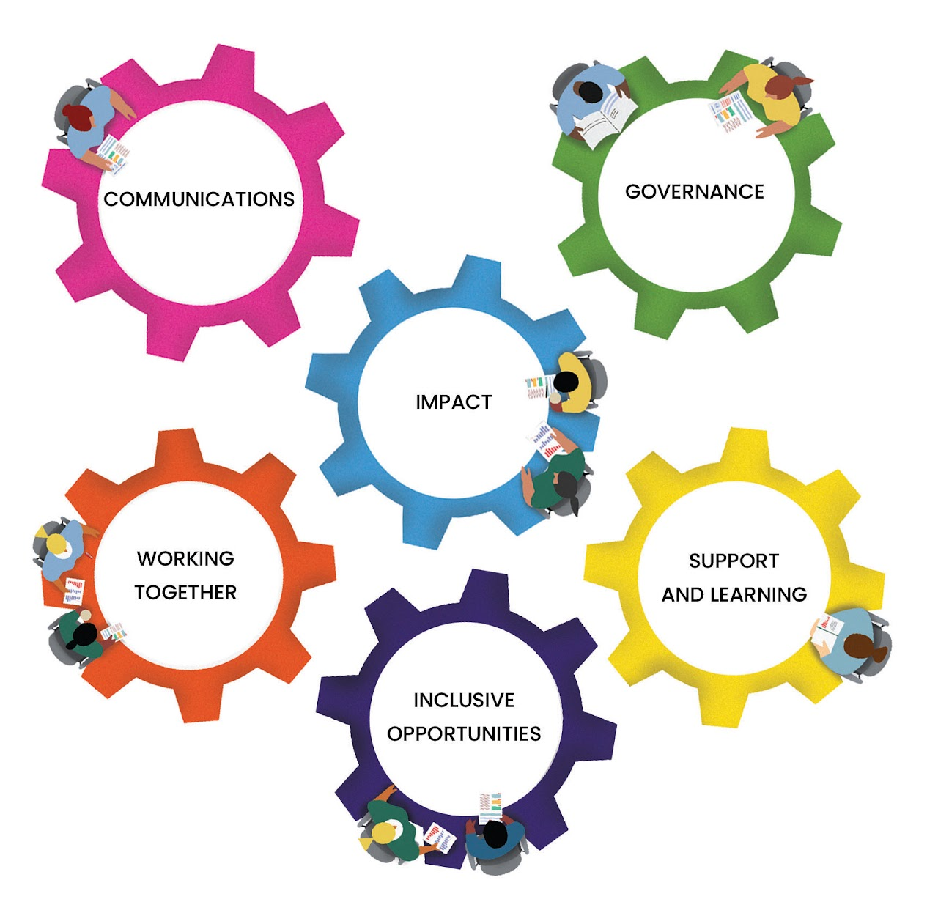
UK Public Involvement Standards

Slide 6
You are a researcher, thinking about involving people on a project on Palliative Care……
When
Who
How Many
Where
What

Slide 7
PPI in Palliative Care Research
Patients, carers, service users and the public can:
Identify, Inform, Prioritise, & Collaborate on Relevant research topics with Researchers and User Group connections
Identify topics
Prioritise questions
Design research
Grant proposal
Undertake
Manage
Research
Analyse
Interpret
Results
Disseminate
Implement
Evaluate
Advise on where to share results
Co-present the results
Develop patient info for new services, interventions
Collaborate with researchers to evaluate the process
Reflect on the PPI role
Inform research design Clarify research question
Co-design the project
Development of the grant proposal
Define outcome methods
Named as co-applicants
Partner with the research team to interpret data and develop themes
Work as a member of a project
Steering and management groups
Assist in writing PIL/consent
Conduct patient interviews and surveys
Notes:
Identifying and Prioritising
Patients and public can
Help inform research priorities through local user groups
Be consulted about research topics and priorities important to them as service users
Collaborate with researchers to identify topics for research
Identify topics themselves
Design
Patients and public can
Inform the design of the research study
Clarify he research question and affirm its importance
Ensure the methods selected are appropriate for patients
Assist in creating a recruitment strategy
Review and comment on proposed questionnaires and data collection tools
Development of the Grant Proposal
Patients and public can
1 .Help to ensure that the research proposed and chosen methods are ethical
2. Inform areas where patients and public could be involved
3. Provide ongoing advice on where patients and public could be involved
4.Define outcome measures
5.Advise on appropriateness of lay summary
6.Raise awareness of costs of involvement and expenses and prompt researchers to cost for involvement
7.Be named as co-applicants
Undertaking and Managing
Setting up a steering group to manage and monitor the research, Patients and public can
Steer the project throughout the research process
Assist in writing the patient information and consent forms
Aid in designing the research protocol
Produce research updates that are patient friendly
Can assist in conducting patient interviews and surveys
Analysing and interpreting
Patients and Public can
1.Assist the research team in developing themes from data
2.Be consulted to see if they understand and interpret data in he same way as the research team
Dissemination
Patients and public can
1. Advise on different avenues for disseminating results
2. Jointly present the research findings with the researchers
3. Write information for local patient groups/hospitals
4.Assist in getting results/findings published on charities’/local voluntary organisations’ websites
Help distribute results within their informal networks
5.Produce summaries of findings
Implementation
Patients and public can increase the likelihood of results being implemented by adding validity to the findings
Develop patient information for new services/interventions within hospitals/GP surgeries etc
Monitoring and Evaluation
Patients and public can
have continued involvement with the study to maintain focus and address issues as they arise.
Collaborate with researchers to evaluate the research process
Reflect on their role and what they have learned

Slide 8












Turning Barriers Challenges into Opportunities
Ethics Role Recruitment
Timing Emotional Distress Health Issues
Think EDI
Develop Profile
User groups
Commitment
SUPPORT
Quality of Life
Internet Understanding Expenses/Payment Feedback Thank you Partnership
Consider all forms
Training/mentoring
UK Standards for Involvement
ALWAYS!
ALWAYS!
WIN-WIN
Notes:
Plan PPI from outset throughout the research life cycle (and think PPI funding)
How – a type of opportunity (focus group, co-applicant, steering group…..)
Who - patients / carers / public. What skills or experience (needed or not)
When - time commitment / how long / how often / time of day
Where - venue / access / online
Think equality, diversity, inclusion 
Develop PPI Role Profile - background to the project and role expectations
Advertise with specific criteria – scope groups and clinics
Application/interview process?
Think support – PPI role induction, resources, training, jargon busting
Confidentiality – agreement
Meetings – preparation / support / mentor
Expenses and Payment – guidance or policy on what’s covered / prompt easy claim process
Feedback – impact Letting them know whether they are doing a good job/or not
Thank you - how? Events, publications …
Check alignment of expectations throughout
– partnership development win-win for all true co production

Slide 9

A Personal Reflection
Notes:
My friend Sharon Jackson. I first met her with my husband Michael when we stayed at her Airbnb in July 2013 for the Bruce Springsteen concert
She was a total firecracker, full of joy and mad as a hatter. We hit it off straight away and she soon became part of our family naming us ‘My Pattons’
She was there for me when I was diagnosed with breast cancer in 2014 and thought nothing of jumping in the car and travelling 80 miles to help our family when we needed her.
She was instrumental in helping my daughter Molly, who at that time was experiencing terrible angst as her Mammy was so unwell.
Molly is 24 today and is eternally grateful for what Sharon did.
When going through Radiotherapy in late 2014, I stayed a few nights per week with her, she fed and watered me and we did zany decoupage on lampshades and anything remotely vintage.
In 2016, Sharon was diagnosed with stage 4 Oesophageal Cancer and was give a prognosis of 6-12 months, but that was not going to defeat Sharon.
Sharon decided it was time for a Mohican and in her true warrior style would not let cancer defeat or define her.
Her “will to live” was to do just that and she was not afraid that she would eventually die. She wanted to enjoy life, to get more out of life, Sharon believed that her life was not over and she was passionate to do whatever she could to squeeze more out of it.
12 months came and went, Sharon had a bucket list as long as her arm and she would go on to sell her apartment, travel the world, acquire a few tattoos and regularly change her hair colour to various shades of the rainbow.
She volunteered to work in charity shops and volunteered to bake cakes and buns for the residents of nearby nursing homes. Her kindness and empathy for others were amazing.
Over the next few years, Sharon encountered bad times and some very dark days but with the love and devotion of her SOUL SISTERS, a ladies’ support group that she helped establish, Sharon overcame these.
Mid 2021 Sharon’s cancer had begun to metastasise and Sharon had to slow down, she was in and out of the hospital and frank discussions were had about palliative care.
In the last few months, Sharon would attend the Marie Curie Hospice to help maintain her pain and control her meds.
‘SHARON’S ANGELS’, another group set up by Sharon was established in December 2021, to help her Mum, sisters Annie and Laura, care for her at home. We all knew what our orders were, and what days we would help out and that was respected.
Sharon planned how she would leave this world and all that knew her knew that it would be something special.
Friends Emma and Janine helped Sharon set up ‘The Wake of Wakes’ at her home on 12th February this year, a true celebration of her life with music and food with her nearest and dearest,
Sharon and I enjoyed our final night out at the end of February. She even managed a dance to Shirley Bassey’s song ‘It’s my life. That it was
She never let her diagnosis defeat her she conquered it right to the very end.
Sadly, Sharon died at home, on 25th March 2022, surrounded by her family and palliative care support from Marie Curie.

Slide 10


A Personal Reflection

Slide 11
Important! Expected! Possible!
Personal and Public Involvement in
Palliative Care Research

