Slide 1
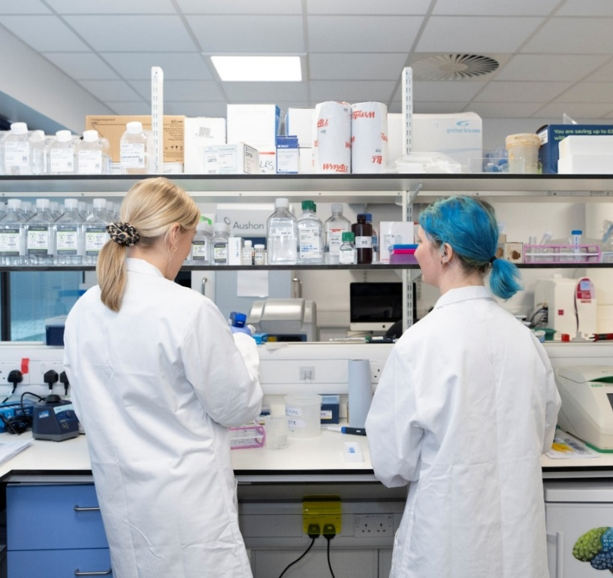
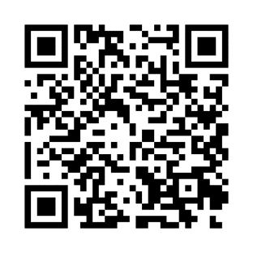



MB-PhD and BDS-PhD OPPORTUNITY 2026
In 2026, we expect to have up to 5 fully funded intercalated PhD positions available for highly motivated medical and dental students on completion of their intercalated BMedSci or in their third year who already hold a BSc. These will start on 1st August 2026. The CRUK TRACC programme has been designed to help develop the future leaders in cancer research by providing an early route to an academic career for highly promising students.
For the first time, students from Queen’s University Belfast are eligible to apply. Successful candidates will be closely mentored by senior academic staff, will be placed into top research laboratories of their choice (in either Edinburgh or Glasgow or across both Universities) and will complete a 3 year PhD before returning to the fourth year of their MBChB or BDS course. A full tax-free stipend and generous research consumables package (including funds ringfenced for personal development) will be provided. Post-doctoral support for research and electives are also available.
Who is eligible to apply?
MBChB and BDS students at Queen’s University Belfast who are in their third year in 2025-2026 and who previously completed an intercalated BSc/Masters degree
Postgraduate MBChB and BDS students at Queen’s University Belfast who are in their third year in 2025-2026 and who previously graduated with a full BSc
MBChB and BDS students in Queen’s University Belfast who are in their intercalated BSc or Masters year in 2025-2026
Key contacts
For friendly informal advice or to express an interest please contact:
Dr Catherine Hanna (QUB) Catherine.hanna@qub.ac.uk Prof Richard Wilson (TRACC+ programme) richard.h.wilson@glasgow.ac.uk
More information can be found on:
TRACC (CRUK Scotland Centre) website: https://www.crukscotlandcentre.ac.uk/training/tracc-programme-for-clinicians
TRACC (Institute of Genetics and Cancer) website:
https://edin.ac/4kmBIyc
Application deadline: Thursday 2nd April 2026, 23:59
Expected interview date (conducted remotely): Mid to late April 2026

