Slide 1
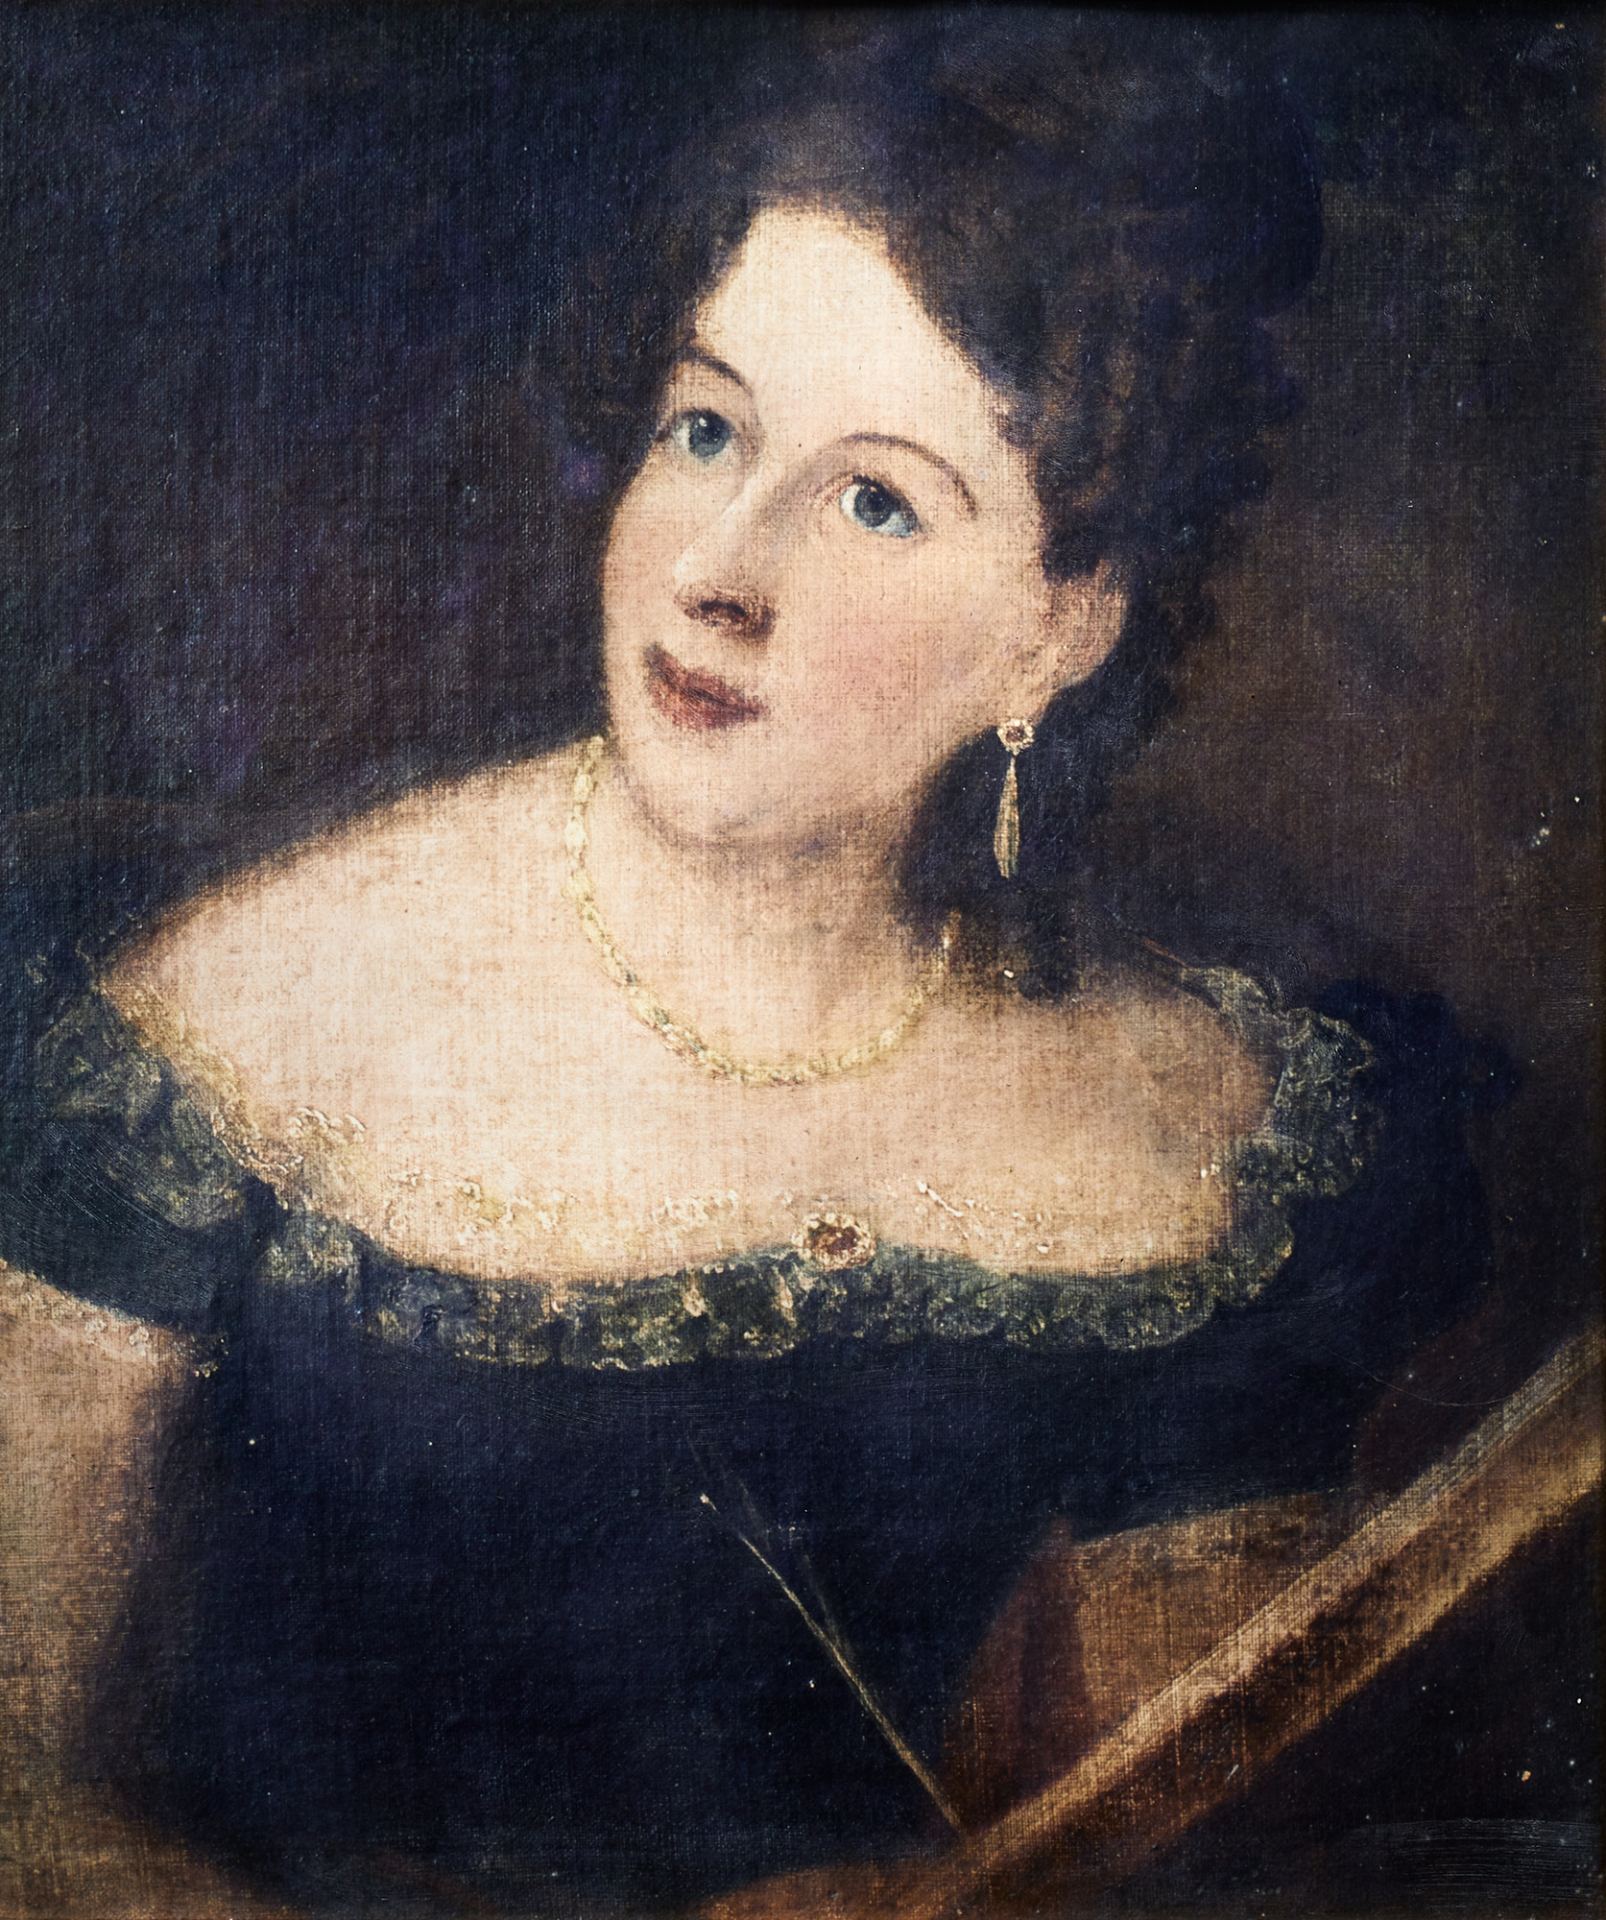
“Songs of an Exile”:
Sentiment and Violence in Eliza Hamilton Dunlop’s Irish and Australian Elegies, 1838-63
Professor Anna Johnston
The University of Queensland
Granting body: Australian Research Council FT130100625

Slide 2
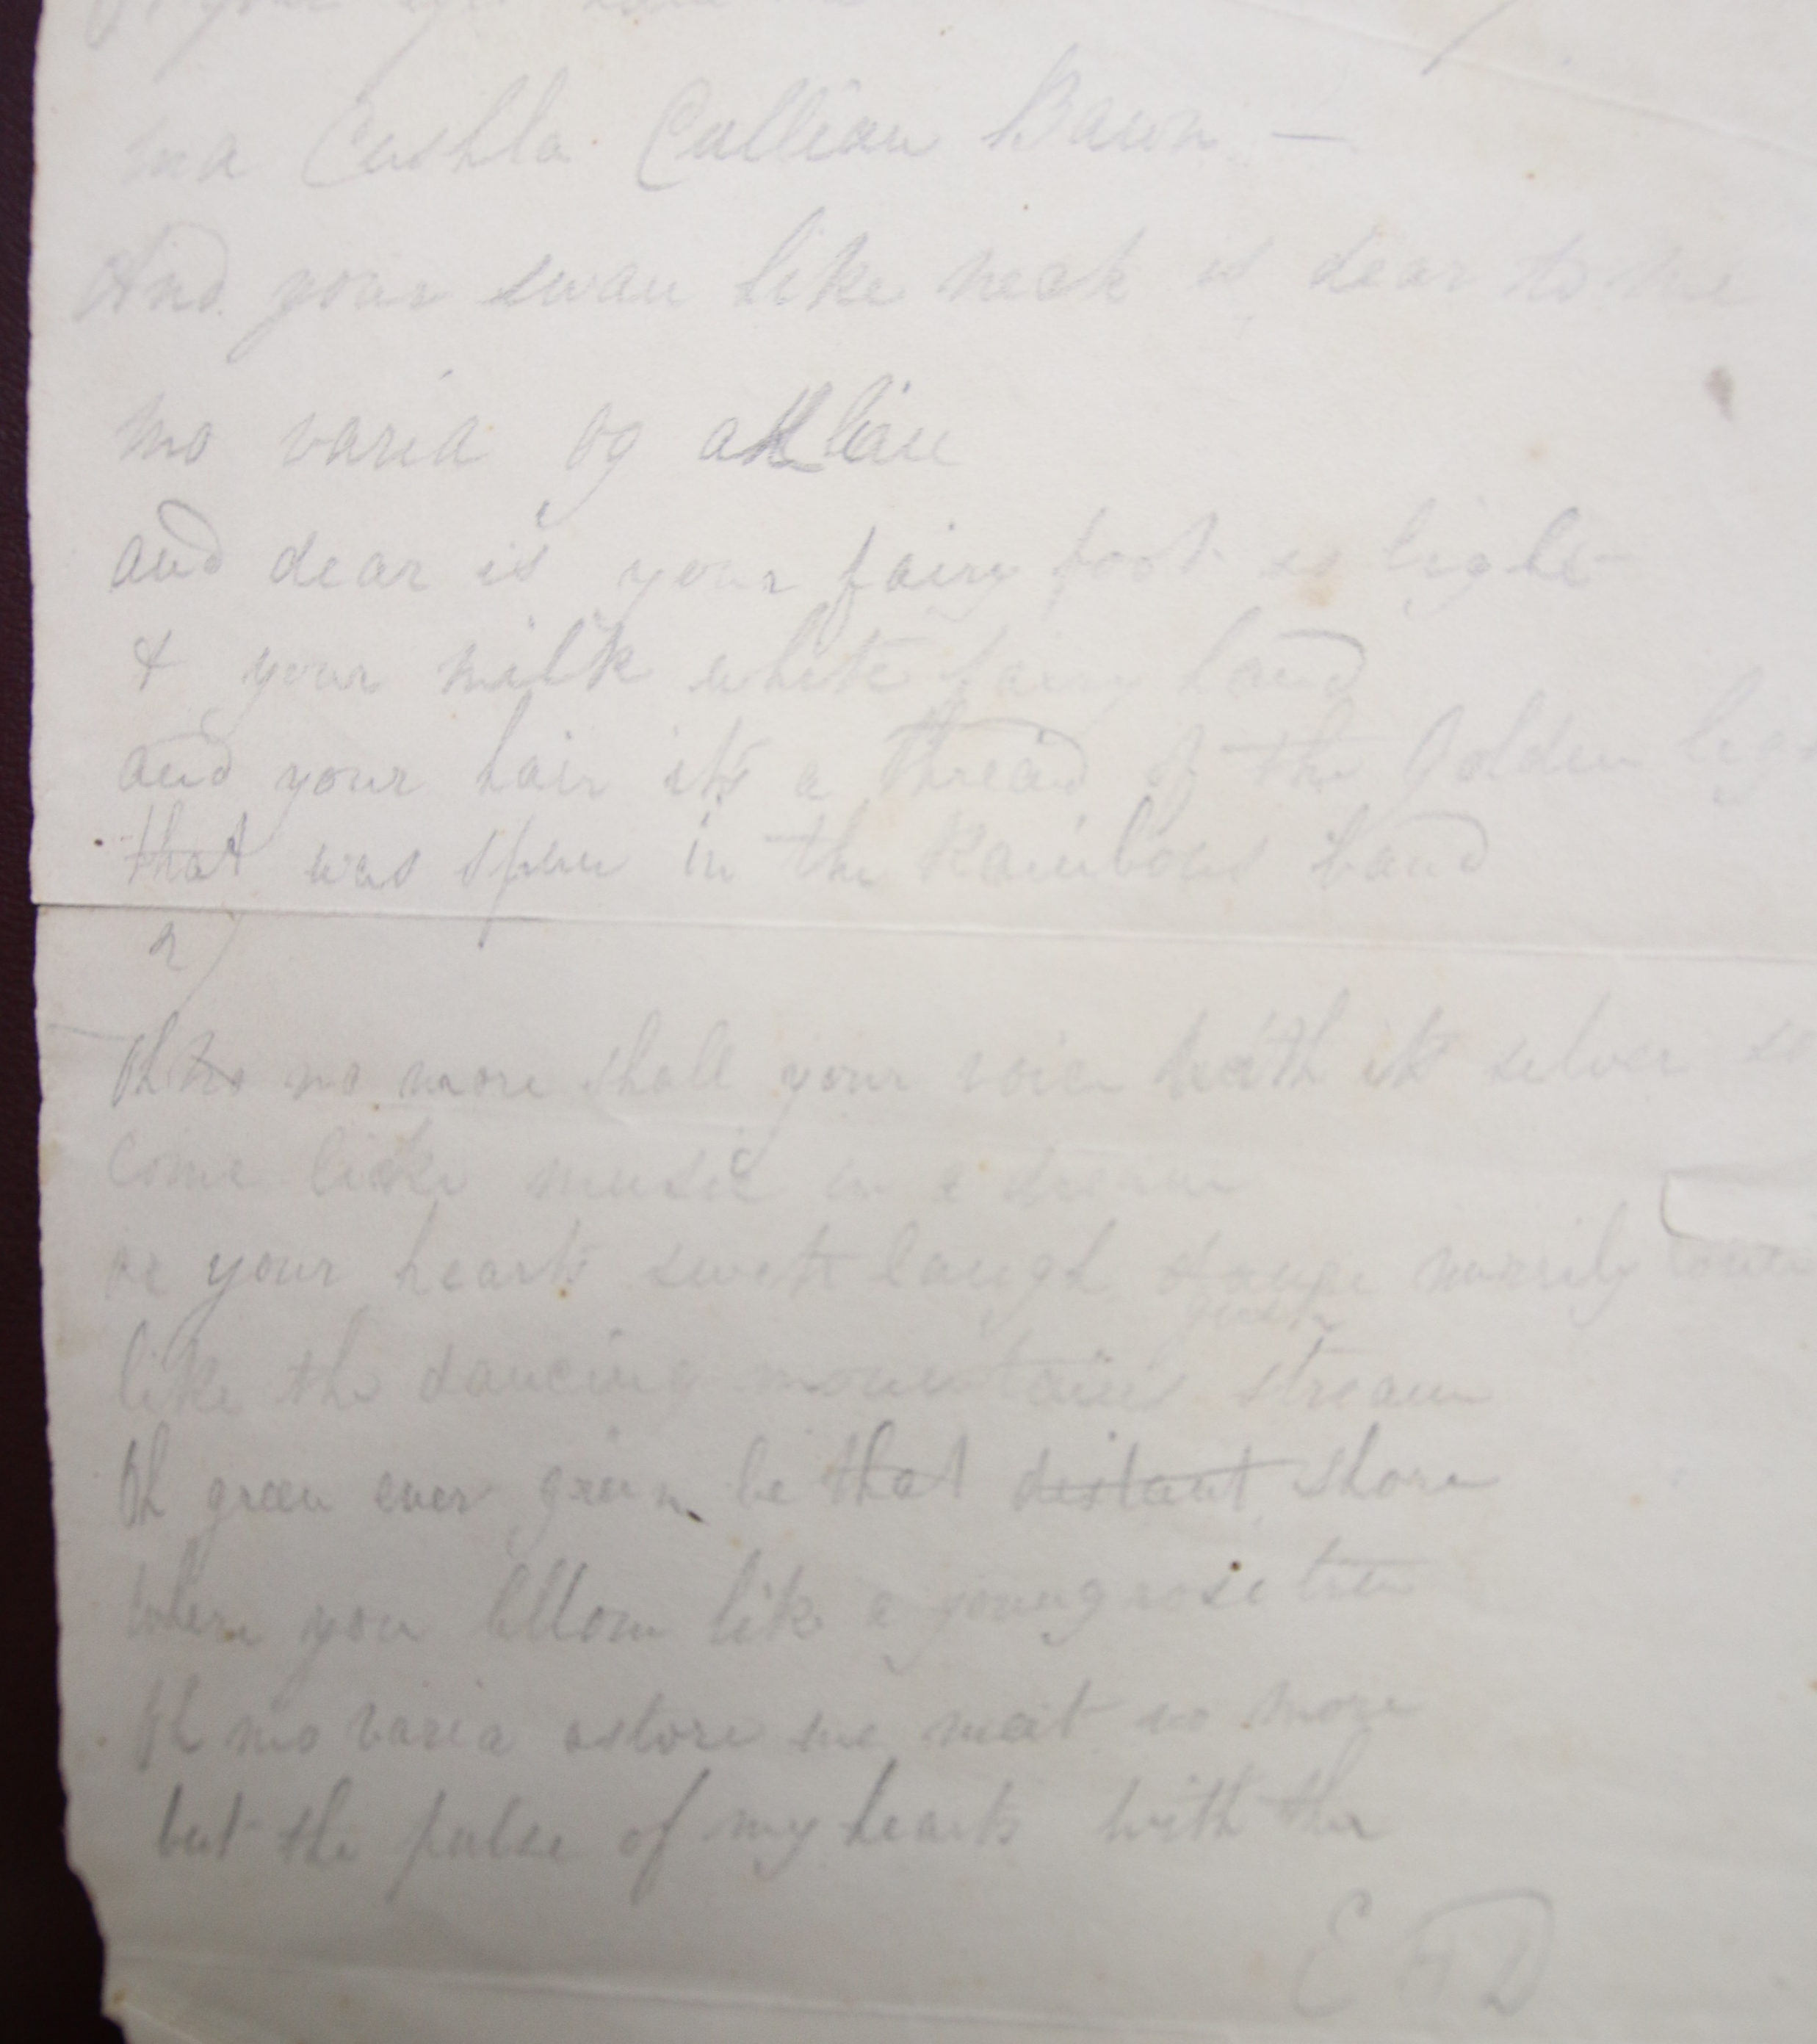
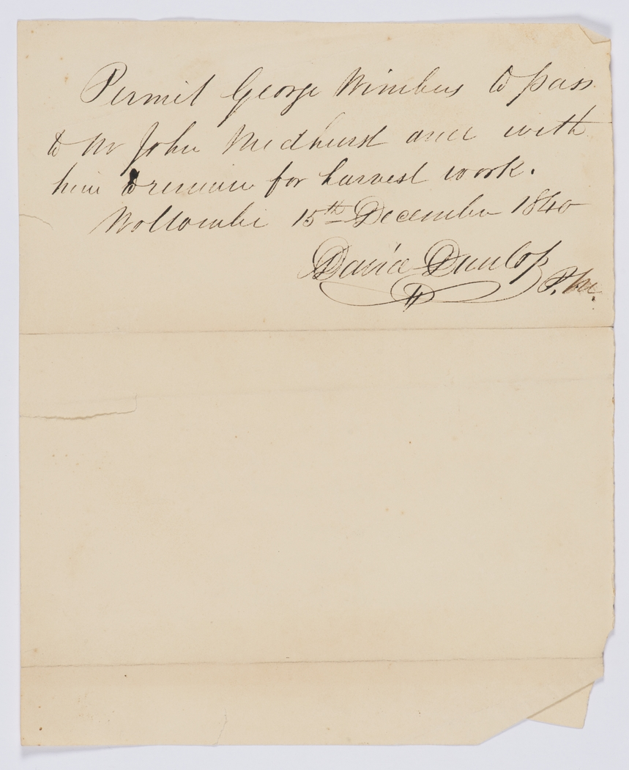
State Library of New South Wales, Mitchell Library MLMSS 9409_Box 14_Folder 7 Dunlop pass to George Nimbus

Slide 3
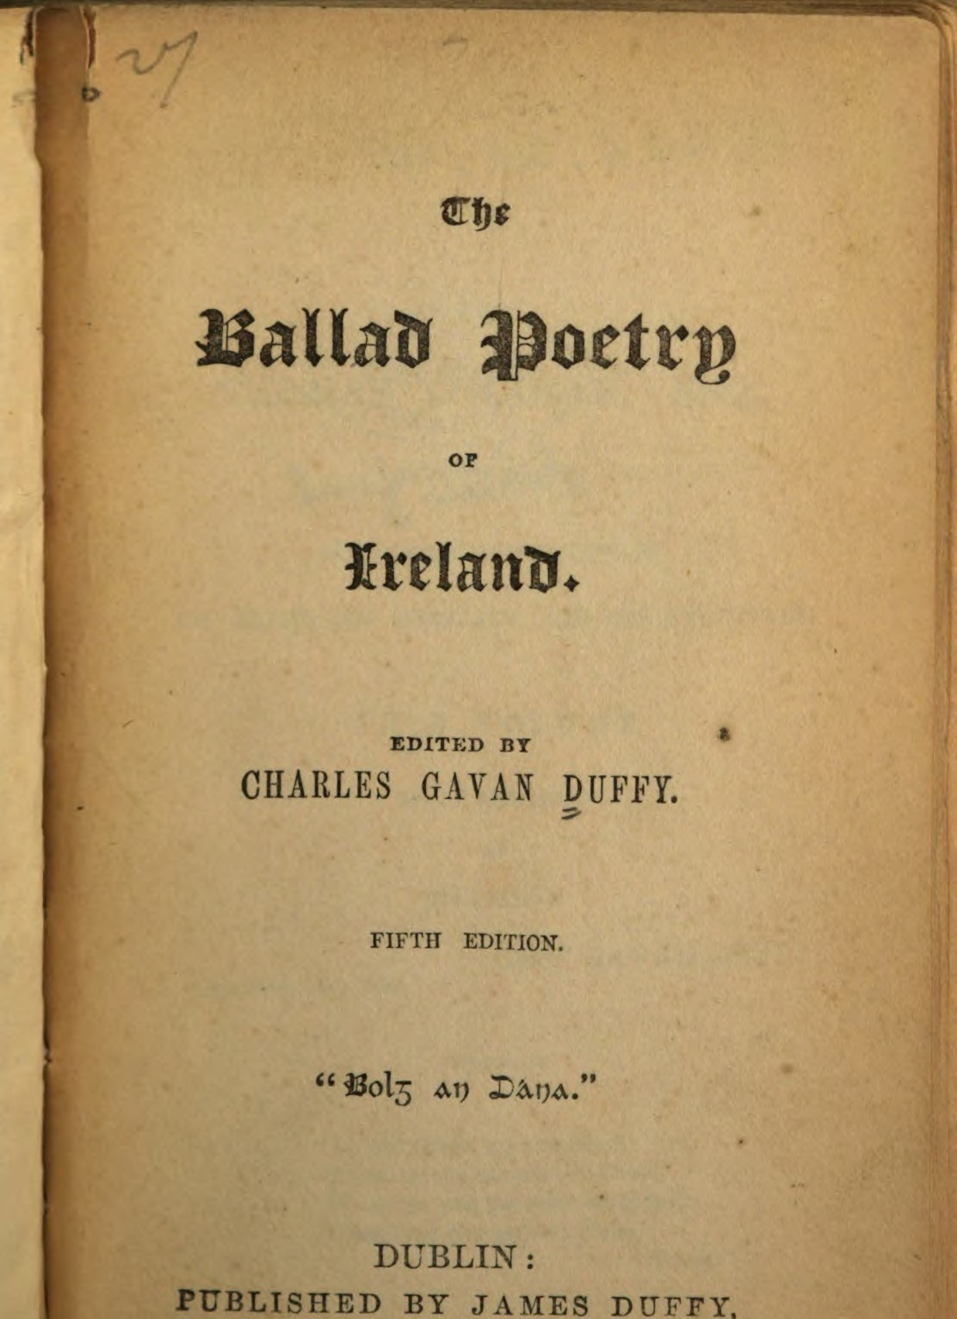
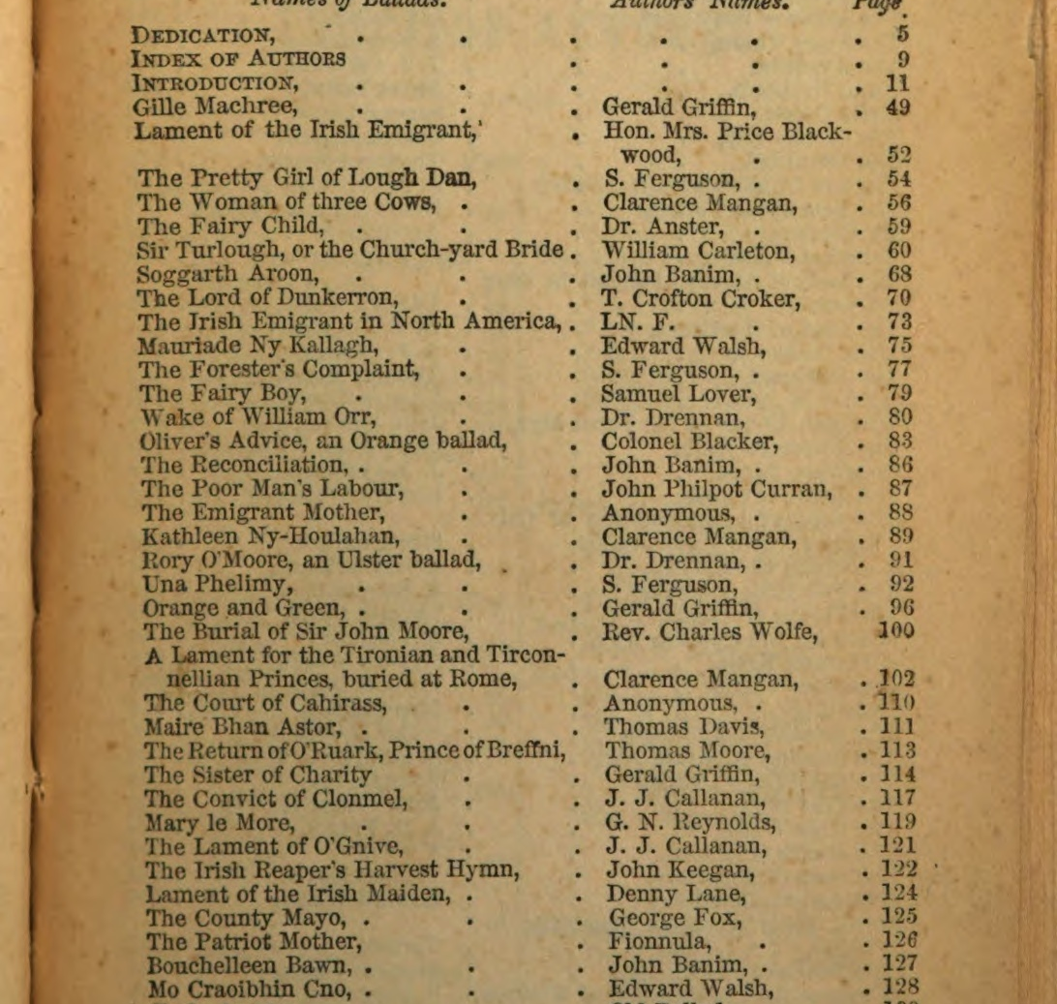
“The Emigrant Mother”
Duffy, Charles Gavan. The Ballad Poetry of Ireland. J. Duffy, 1845. Duffy's Library of Ireland.

Slide 4
Eliza Hamilton Dunlop
(1796–1880)

Slide 5
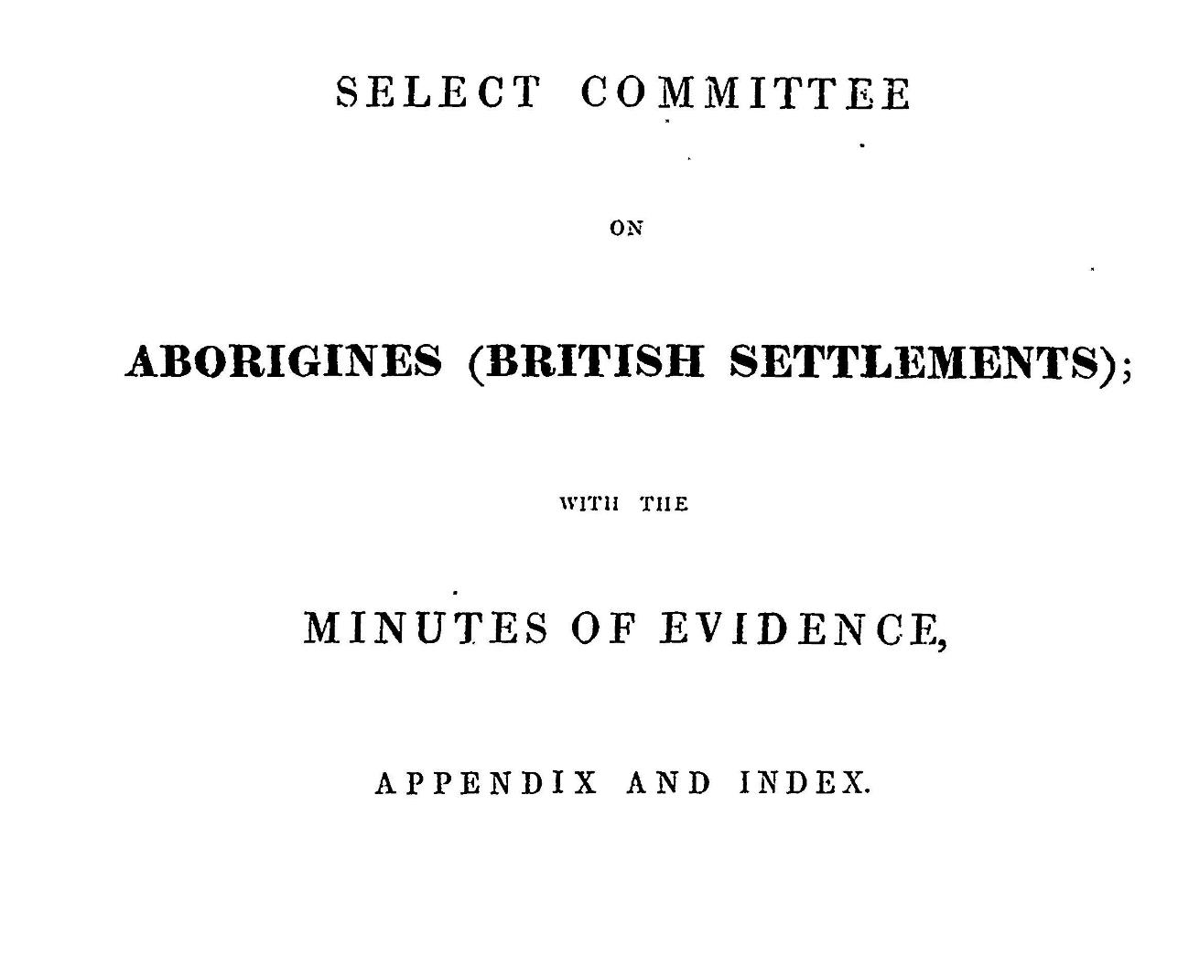
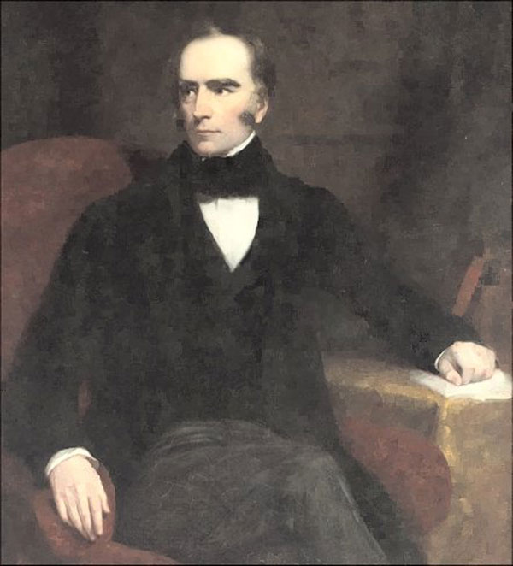
Sir George Gipps (1791–1847),
State Library of New South Wales, GPO 1 - 03763

Slide 6
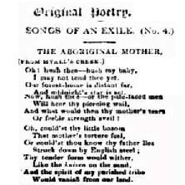
E.H.D. "Original Poetry: Songs of an Exile (No. 4.) The Aboriginal Mother." Australian, 13 December 1838, 4.

Slide 7
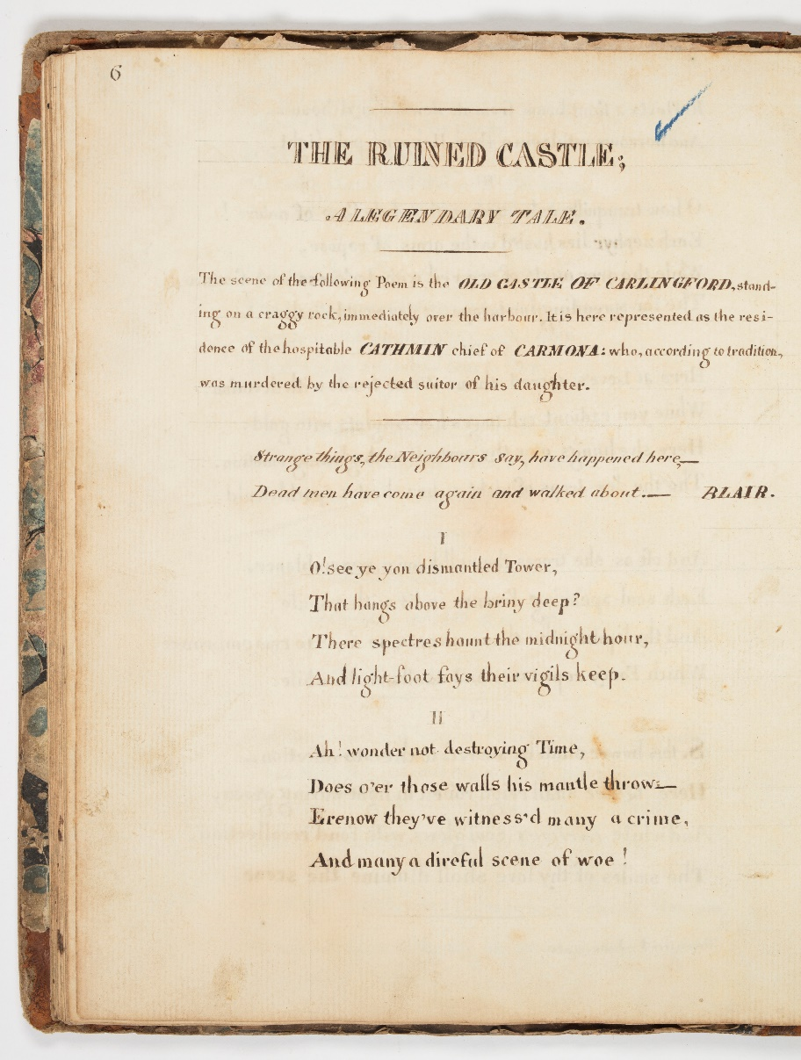
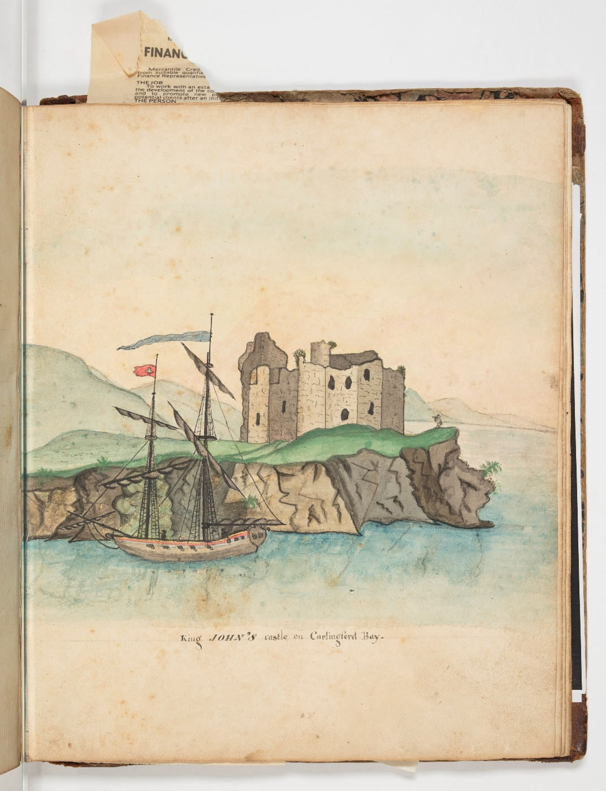
Evelina [Eliza Hamilton Dunlop], “The Ruined Castle: A Legendary Tale”; King John’s Castle at Carlingford Bay, SLNSW, MLMSS 7683.

Slide 8
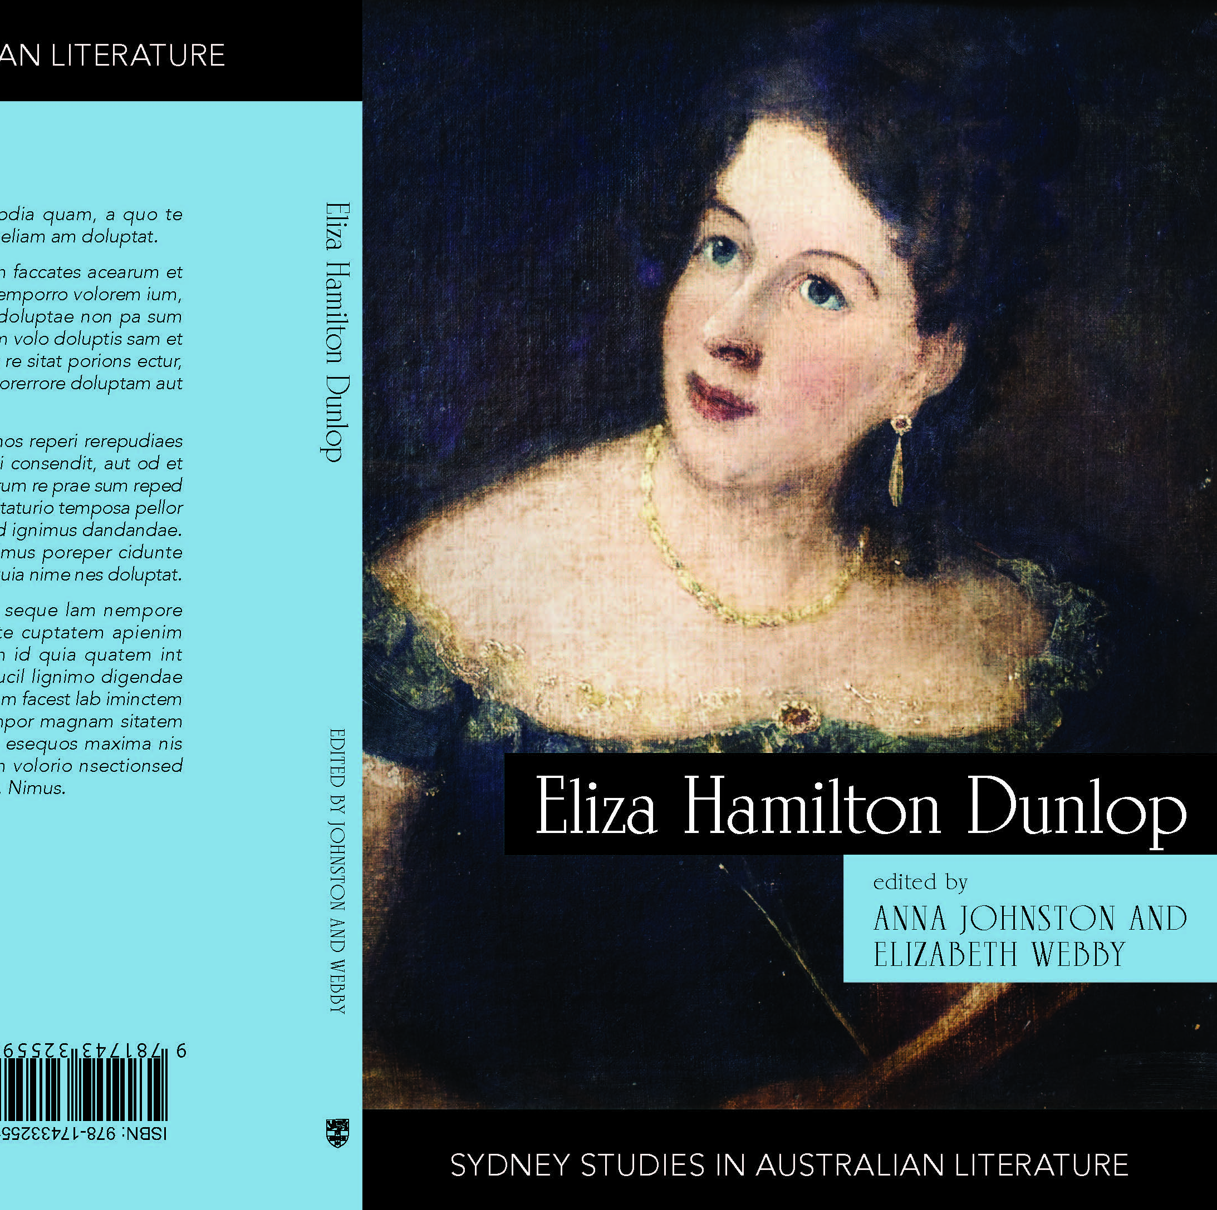
Eliza Hamilton Dunlop: Writing from the Colonial Frontier
(Sydney University Press, 2021)
Co-edited with Elizabeth Webby, who recovered some of Dunlop’s poetry in the 1960s & published a small Mulini Press edition in 1981. In the 2021 book, Elizabeth’s scholarly edition of over 20 poems showcases Dunlop’s writing across her life.

Slide 9
Part I
New South Wales

Slide 10
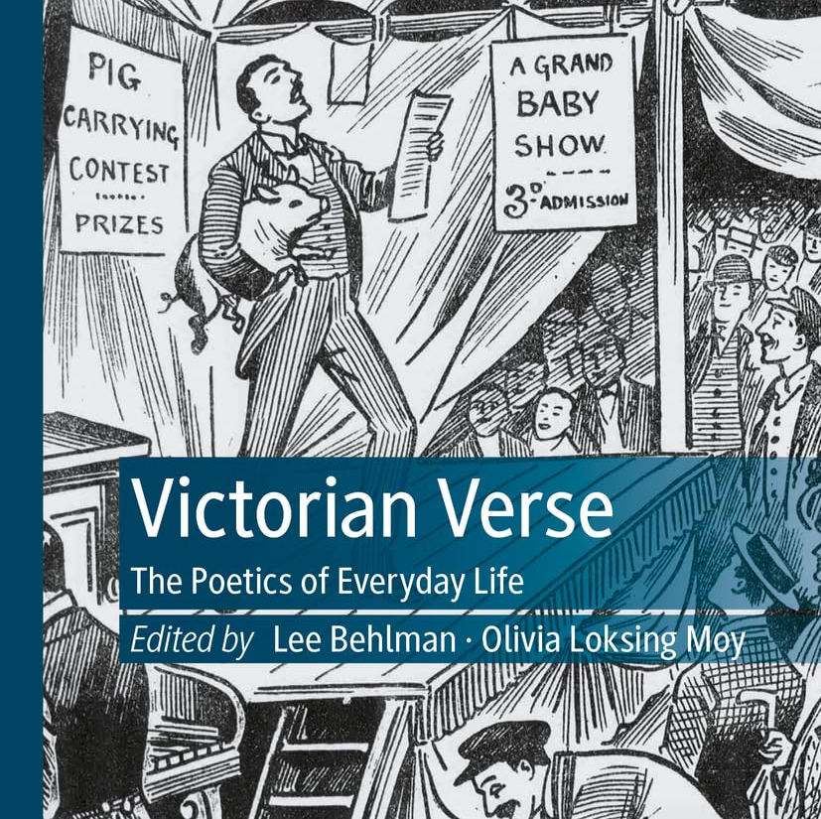
New book:
Lee Behlman and Olivia Loksing Moy, editors. Victorian Verse: The Poetics of Everyday Life. Palgrave, 2023.

Slide 11
THE ABORIGINAL MOTHER (From Myall’s Creek.)
Oh! hush thee—hush my baby,
I may not tend thee yet.
Our forest home is distant far,
And midnight’s star is set.
Now, hush thee—or the pale-faced men
Will hear thy piercing wail,
And what would then thy mother's tears
Or feeble strength avail!
Oh, could’st thy little bosom
That mother’s torture feel,
Or could’st thou know thy father lies
Struck down by English steel;
Thy tender form would wither,
Like the kniven on the sand,
And the spirit of my perished tribe
Would vanish from our land.
For thy young life, my precious,
I fly the field of blood,
Else had, I for my chieftain’s sake,
Defied them where they stood;
But basely bound my woman arm,
No weapon might it wield:
I could but cling round him I loved,
To make my heart a shield.
I saw my firstborn treasure
Lie headless at my feet,
The goro on this hapless breast,
In his life-stream is wet!
And thou! I snatch’d thee from their sword,
It harmless pass’d by thee!
But clave the binding cords—and gave,
Haply, the power to flee.
To flee! my babe—but whither?
Without my friend—my guide?
The blood that was our strength is shed!
He is not by my side!
Thy sire! oh! never, never,
Shall Toon Bakra hear our cry:
My bold and stately mountain-bird!
I thought not he could die.
Now who will teach thee, dearest,
To poise the shield, and spear,
To wield the koopin, or to throw
The boommerring, void of fear;
To breast the river in its height;
The mountain tracks to tread?
The echoes of my homeless heart
Reply—the dead, the dead!
And ever must their murmur
Like an ocean torrent flow:
The parted voice comes never back,
To cheer our lonely woe;
Even in the region of our tribe,
Beside our summer streams,
ʼTis but a hollow symphony—
In the shadow-land of dreams.
Oh hush thee, dear—for weary
And faint I bear thee on—
His name is on thy gentle lips,
My child, my child, he’s gone!
Gone o’er the golden fields that lie
Beyond the rolling cloud,
To bring thy people's murder cry
Before the Christian’s God.
Yes ! o’er the stars that guide us,
He brings my slaughter’d boy:
To shew their God how treacherously
The stranger men destroy;
To tell how hands in friendship pledged
Piled high the fatal pire;
To tell—to tell of the gloomy ridge;
And the stockmen’s human fire. E.H.D.

Slide 12
Part II
Elegies and Imperial Violence

Slide 13
Eliza Hamilton Dunlop, “Songs of An Exile” series, 1838-40
1838 | Songs of An Exile (No. 1) The Dream | The Australian (Sydney)
1838 | Songs of An Exile (No. 2) | The Australian (Sydney)
1838 | Songs of An Exile (No. 3) | The Australian (Sydney)
1838 | Songs of An Exile (No. 4) The Aboriginal Mother | The Australian (Sydney)
1839 | Stories of An Exile (No. 1) The Ford of Emu Plains | The Sydney Monitor and Commercial Advertiser (NSW)
1839 | Stories of An Exile (No. 1) The Ford of Emu Plains Concluded | The Sydney Monitor and Commercial Advertiser (NSW)
1839 | Songs of An Exile (No. 5) The Irish Mother | The Australian (Sydney)
1840 | Songs of An Exile (No. 7) For music | The Australian (Sydney)
1840 | Songs of An Exile (No. 8) Air "Peggy Barn" | The Australian (Sydney)
1840 | Songs of An Exile: Lights of the Past | The Australian (Sydney)
1840 | Songs of An Exile: Go Dia Leat Slan | The Australian (Sydney)

Slide 14
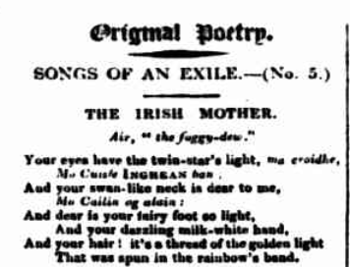
Songs of an Exile No. 5
“Oh! green be the fields” of my native shore
Where you bloom, like a young rose-tree;
Mo VARIA astore—we meet no more!
EHD. “Songs of an Exile (No. 5.): The Irish Mother." Australian 12 January 1839. https://trove.nla.gov.au/newspaper/article/36862585

Slide 15
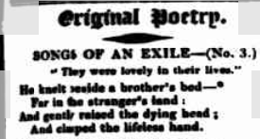
Songs of an Exile No. 3
“Wept o’er his dead !” oh not for those
Whom home and kindred cheers;
To taste, or tell the bitter source
Of a lone Exile’s tears.
Death, barbed his arrows to destroy—
To slay— “yet not divide”
A young—a fair—a noble boy
Sleeps by his brother’s side.
E.D.H. “Inscribed to the Memory of Two Brothers”. Belfast News-Letter, 3 January 1837
EDH. “Songs of an Exile (No. 3.)." Australian 29 Nov. 1838. http://nla.gov.au/nla.news-article36861886
“The Brothers” by Mrs E.H. Dunlop, The Atlas, 17 May 1845.

Slide 16
Part III
Reading Ireland through Dunlop

Slide 17
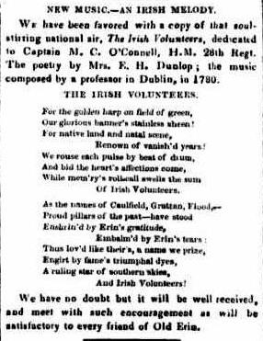
As the names of Caulfield, Grattan, Flood...
Proud pillars of the past-have stood
Enshrin’d by Erin’s gratitude.
Embalm’d by Erin’s tears:
Thus lov’d like their’s, a name we prize,
Engirt by fame’s triumphal dyes,
A ruling star of southern skies,
And Irish Volunteers!
Dunlop, Eliza Hamilton. "The Irish Volunteers." The Australasian Chronicle, vol. 4, 13 April 1843, p. 2. http://nla.gov.au/nla.news-article31739492.

Slide 18
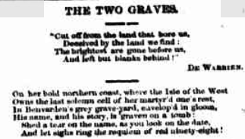
Left: E.H.D. "Original Poetry: Songs of an Exile (No. 4.) The Aboriginal Mother." Australianer 1838. https://trove.nla.gov.au/newspaper/article/36861275
Tombs parted as wide as the span of the sphere;
Yet father and son have had widowhood’s tear!
Predestined in life to bend “under the rod,”
“Through much tribulation” they passed to their God:
And star’s rays fall bright on the homes of their rest.
From the “Cross of the South,” and the “Lyre of the West.”
Dunlop, Eliza Hamilton. "The Two Graves." The Empire 15 April 1865. http://trove.nla.gov.au/newspaper/article/60569479
Dunlop, Eliza Hamilton. "The Two Graves " The Coleraine Chronicle 26 August 1865.

Slide 19
Evelina [Eliza Hamilton Dunlop], “The Ruined Castle: A Legendary Tale”; King John’s Castle at Carlingford Bay, SLNSW, MLMSS 7683.

Slide 20
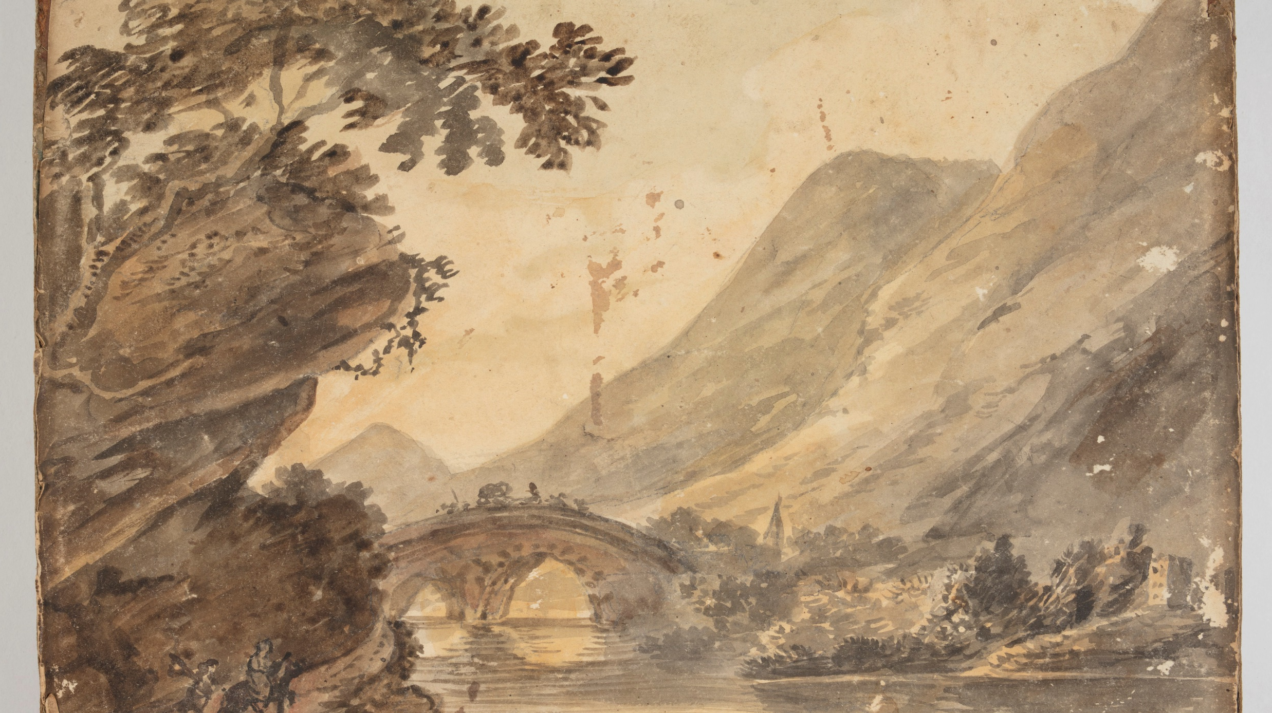

Slide 21
