Slide 1
The Republic of Letters Ireland and the World, 1919-1923
QUB Irish Studies Seminar
Dr. Darragh Gannon

Slide 2
Ireland’s ‘island story’, 1919-1923
British Pathé: the road to Irish Independence and Civil War

Slide 3
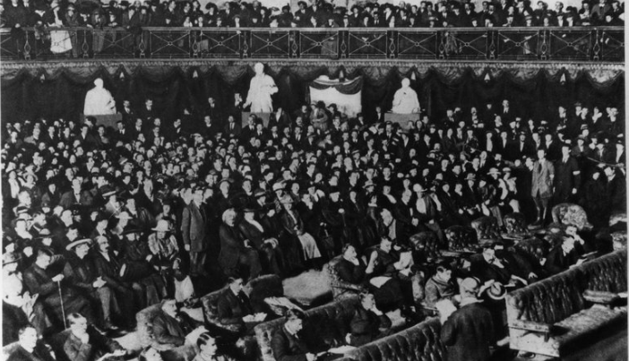
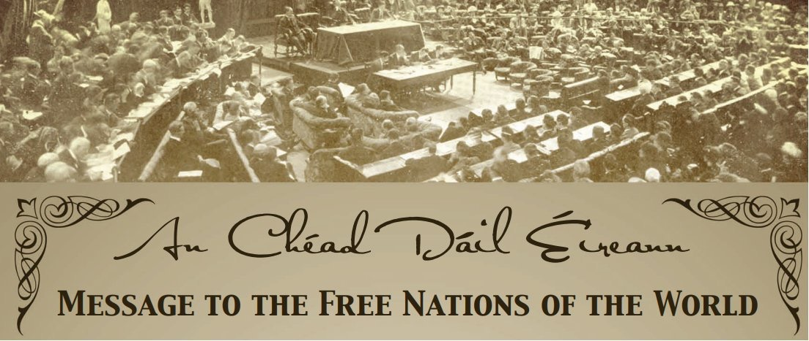
The First Dáil: a global reading
The first Dáil in session, Dublin (21/01/1919)
‘Message to the Free Nations of the World’

Slide 4
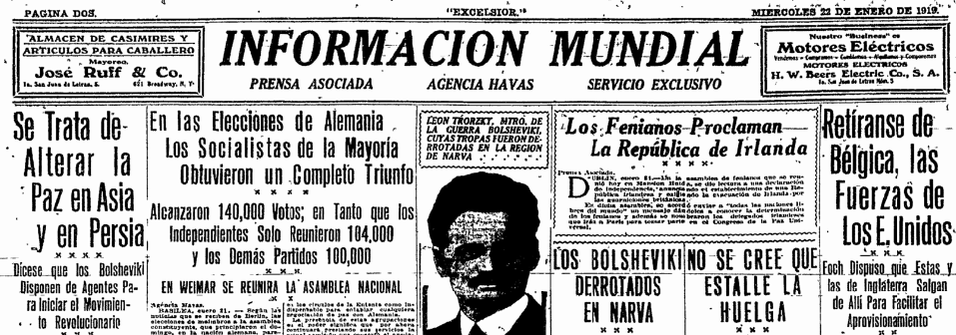
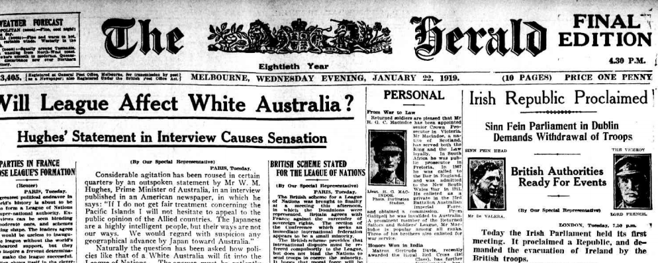
World Newspaper Archive

Slide 5
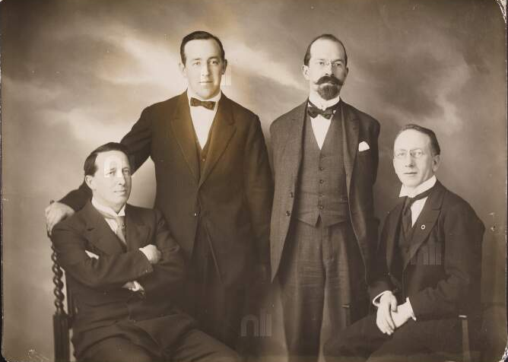
Dáil Éireann envoys (1919)
Left to right: Art O’Brien (London), Harry Boland (New York), George Gavan Duffy (Paris), Seán T. O’Kelly (Paris)

Slide 6
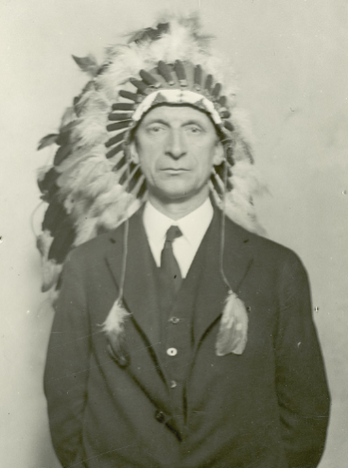
Reading the Revolution: literary exchange
‘I want to show you that though I am white, I am not of the English race…you say you are not free. Neither are we and I sympathise with you because we are making a similar fight. As a boy I read and understood of your slavery and longed to become one of you.’
Éamon de Valera at the Chippewa Reservation, Wisconsin (October 1919)

Slide 7
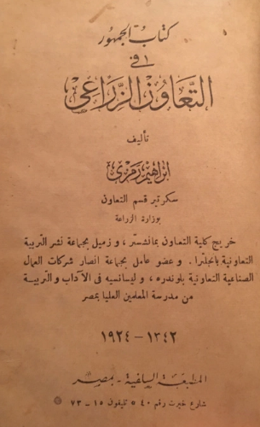
Reading the revolution: ‘foreign’ text
Transl., Ireland in rebellion
Transl. An Egyptian in Ireland

Slide 8
The Republic of Letters Ireland and the World, 1919-1923
QUB Irish Studies Seminar
Dr. Darragh Gannon

