Slide 1
Apps (& websites) R Us PART 5
Amanda Salt
Head of Spanish, Grosvenor Grammar School
asalt@grosvenorgrammarschool.org.uk
http://amandasalt.blogspot.com
@amandasalt

Slide 2
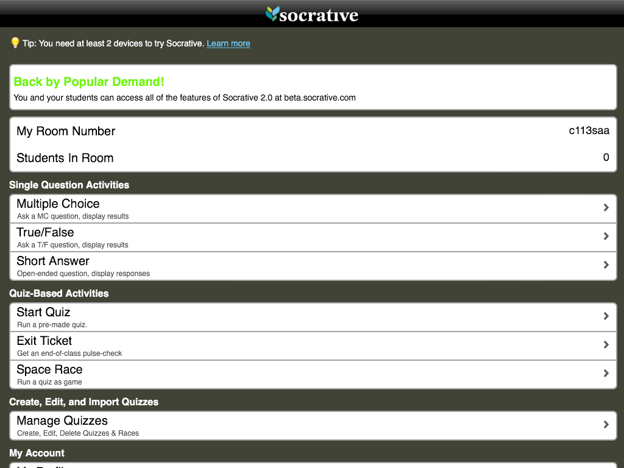
Socrative
Notes:
Socrative

Slide 3
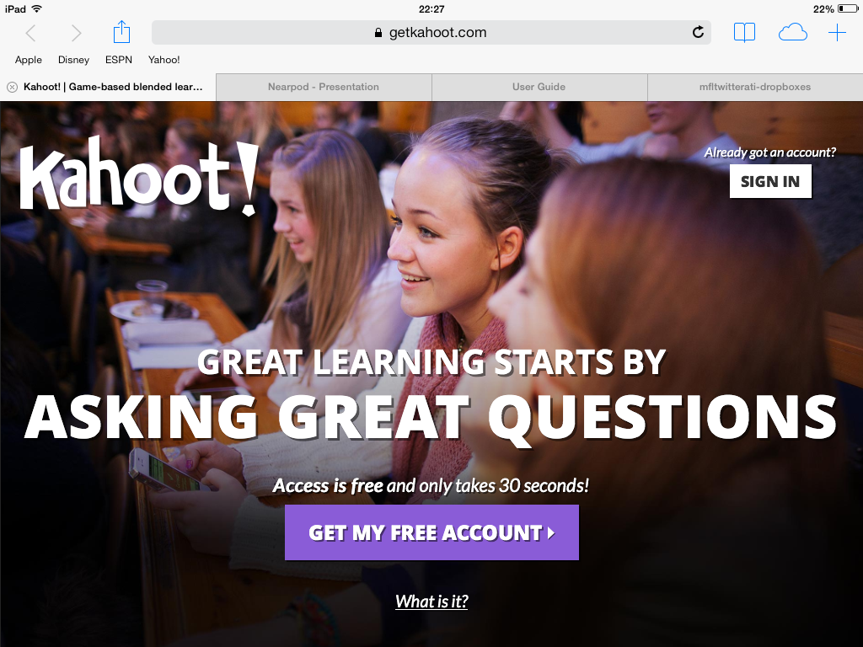
Kahoot
Notes:
Getkahoot

Slide 4
asalt@grosvenorgrammarschool.org.uk
@amandasalt
http://amandasalt.blogspot.com

