Slide 1
Progressing language learning through key stage 3 and 4: Maintaining motivation to GCSE
Steven Fawkes, ALL
@StevenFawkes

Slide 2
Authentic and creative
Steven Fawkes

Slide 3
Language is not predictable
Learners need more than vocabulary and scripts

Slide 4
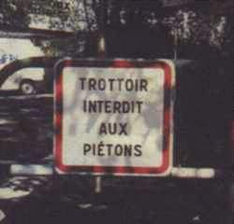

Slide 5
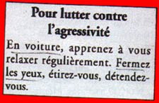

Slide 6
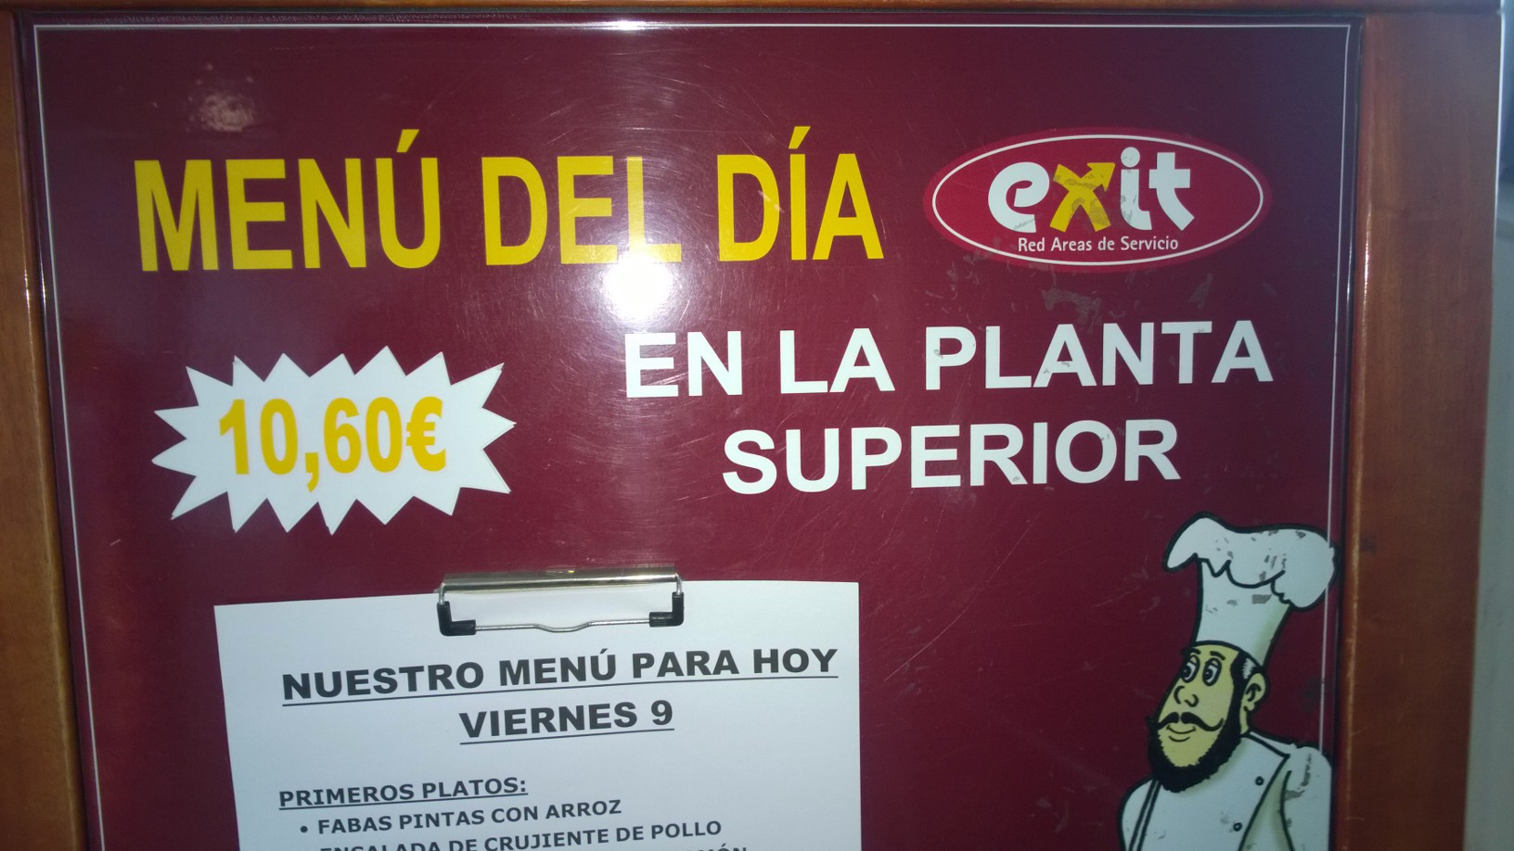

Slide 7
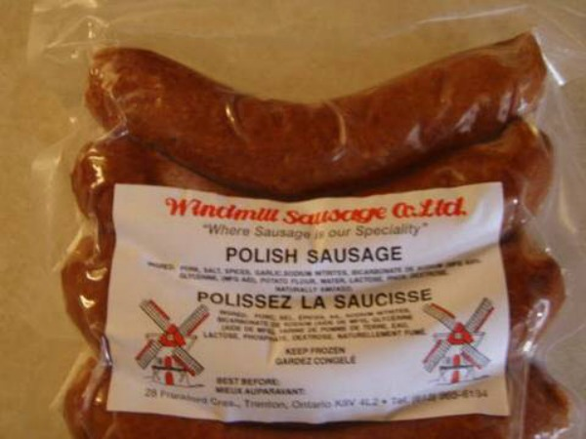

Slide 8
Language is full of surprises
Are these the cymbals of your Turkish milkman’s wife?
Notes:
8

Slide 9
Language can be a struggle
Upon arrival at Kimpo airport please wear your clothes
Good apperence please – no watermelon
Notes:
9

Slide 10
On a phone card:
1. Lift up receiver
2. Insert phone card
3. Dial 0999+number
4. Say hello
Notes:
10

Slide 11
On Ramganga river:
The river is inhabited by crocodiles
Swimming is prohibited
Survivors will be prosecuted

Slide 12
To call room service, please to open the door and call Room Service. Please call quiet, people may sleep.
No in the bedrooms.
Notes:
12

Slide 13
Challenge: How’s your Romanian?
Trezirea fortei
Episode VII Trezirea fortei
Star Wars Episode VII Trezirea fortei

Slide 14
Jocurile foamei

Slide 15


Slide 16
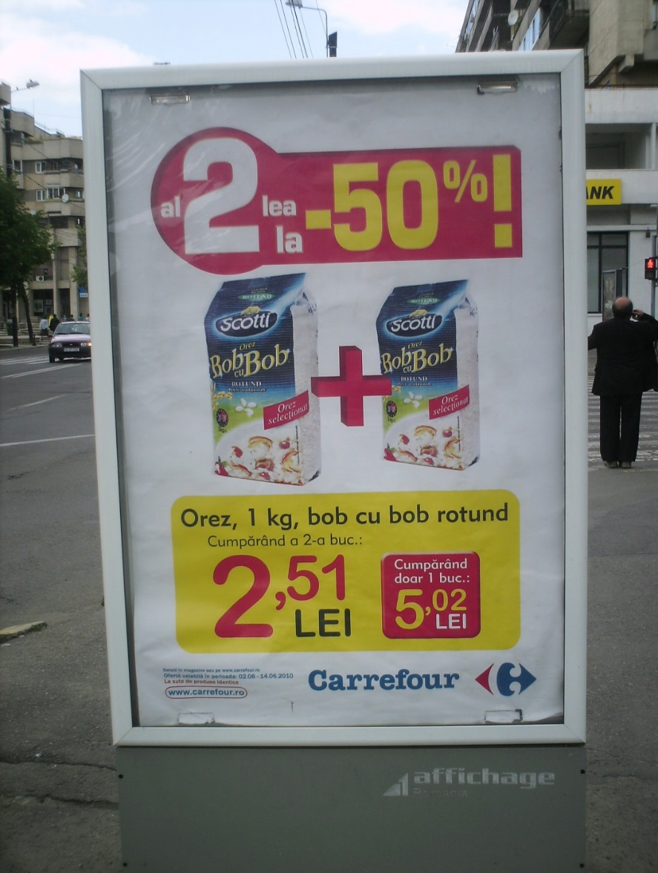
Great literature?

Slide 17
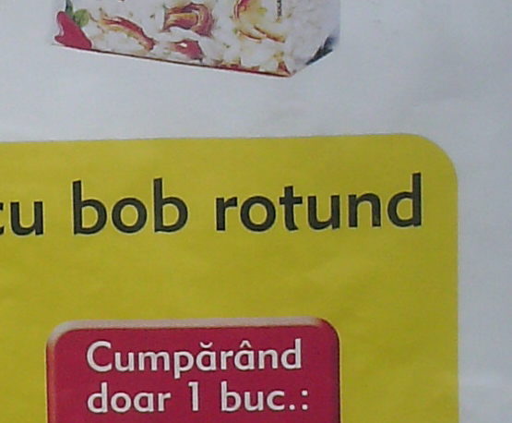

Slide 18
Real materials can..
Stimulate interest and cultural awareness
Increase motivation
Add variety and introduce different registers
Attune the ear to the flow of longer language
Act as a stimulus for spontaneous and creative work
Present a topic in a different aspect
develop awareness and understanding of x-speaking countries and communities
Notes:
18

Slide 19
Getting ready to perform
Memorising
Practising
Refining
Evaluating
Making mistakes, improving
Words, spelling?
Pronunciation, flow
Adding ideas
Listening to each other
Doing it again

Slide 20
High School Musical
http://www.youtube.com/watch?v=OMo1Qi5E4WU
Pronunciation
Intonation
Join in chorus

Slide 21
Chorus
Se provi a volare …….
ti accorgi che qualche stella sta lì per noi
e sfiorandole sei più libero
Se provi a volare
ti_accorgi che qualche stella sta lì per noi
e sfior-an-do-le sei più libero

Slide 22
What is a performance?
Talking
Singing
Dancing
Reading aloud
Presenting
Showing
Recording
Displaying
Writing
Scripting
Producing
for an audience

Slide 23
Authentic text
What is it for?
Stirring, frightening, amusing, informing, challenging, moving, enchanting, engaging, remembering
Even if it is not Great Literature a text may be worth using because
  Students like it
  Students respond to it
  It shows interesting things about language
  It helps people learn more about …

Slide 24
ALL Literature Project
http://ALL-Literature.wikidot.com
Examples of useful texts and their exploitation from other teachers
https://allconnectblog.wordpress.com/
Training resources on
  Literature
  Spontaneous Speaking
  Translation module
  Grammar module
  Extended Writing module
Linked wikis

Slide 25
ALL Literature Project
http://ALL-Literature.wikidot.com
Examples of useful texts and their exploitation from other teachers
Please join and add your own !
Strategies …

Slide 26
Recitation / reading aloud
can be about the sound / spelling system and the feel of the words in the mouth
Pronunciation
Intonation
‘Accent’
Challenge
https://www.youtube.com/watch?v=yanU4dFC7lU

Slide 27
Pablo Neruda
Puedo escribir los versos más tristes esta noche.
Escribir, por ejemplo: "La noche está estrellada,
y tiritan, azules, los astros, a lo lejos".
El viento de la noche gira en el cielo y canta.
Puedo escribir los versos más tristes esta noche.
Yo la quise, y a veces ella también me quiso.
En las noches como ésta la tuve entre mis brazos.
La besé tantas veces bajo el cielo infinito.
Ella me quiso, a veces yo también la quería.
Cómo no haber amado sus grandes ojos fijos.
Notes:
27

Slide 28
Work with a poem
Mood
Tone
Words we know
Sounds :
  rhymes
  phonemes and graphemes
  Letter frequency
  Onomatopeia
  Mood
Repeated lines / words
Guided reading
Prepare to perform (part or whole)
Parts of speech (nouns)
Repetitions
Meaning
Notes:
28
28

Slide 29
Playing with text
Extending
Transposing
Adapting
Performing
Interpreting / translating key bits
Recycling
Personalising
Notes:
29
29
29

Slide 30
Personalising
Read / View a blog item such as: http://www.n-punto.com/blog/ Gratitud
Invent your own
Notes:
30
30
30

Slide 31
Gratitud n-punto | Publicado: Lunes, 1 diciembre, 2014
Gracias por:
El aire que respiro
Por que puedo hablar
Por el techo donde vivo
Por el cuerpo
Por el trabajo
Por estar vivo
Por las amistades
…
Por Táyna Rivera Llavona / Especial para n-punto
Por que cada día tiene algo diferente
Por el sol
Por la lluvia
Por la naturaleza
Por los animales
Por la comida
Por lo que no tengo
Notes:
31
31
31
As a variant, a similar activity is described with a French text on the wiki under the title Voeux de bonne annee
1.31-1.33
31

Slide 32
Playing with text
Extending
Transposing
Adapting
Performing
Interpreting / translating key bits
Recycling
Personalising
Notes:
32
32
32

Slide 33
Fragen einer Ananas
Eine goldgelbe Ananas
Fragte sich einst:
Ei-die-was!
Was soll denn das?
Wieso bin ich eine Ananas
Wieso bin ich kein Haus,
kein Pfirsich, keine Maus?
Wieso bin ich nicht blau,
wieso heiße ich nicht Frau,
wieso nicht Auto oder Hund,
wieso bin ich gelb, wieso nicht bunt?
Wieso wachse ich und werde gegessen,
woher komme ich, wer bin ich,
hab ich alles vergessen?
Wer Antworten weiß
Auf alle meine Fragen,
der soll sie doch
gefälligst sagen!
Rosita Davidson

Slide 34
Fragen einer Ananas
Eine goldgelbe Ananas
Fragte sich einst:
Ei-die-was!
Was soll denn das?
Wieso bin ich eine Ananas
Wieso bin ich kein Haus,
kein Pfirsich, keine Maus?
Wieso bin ich nicht blau,
wieso heiße ich nicht Frau,
wieso nicht Auto oder Hund,
wieso bin ich gelb, wieso nicht bunt?
Wieso wachse ich und werde gegessen,
woher komme ich, wer bin ich,
hab ich alles vergessen?
Wer Antworten weiß
Auf alle meine Fragen,
der soll sie doch
gefälligst sagen!
Rosita Davidson

Slide 35
Playing with text
Extending
Transposing
Adapting
Performing
Interpreting / translating key bits
Recycling
Personalising
Notes:
35
35
35

Slide 36
La llave de Roma
https://www.youtube.com/watch?v=YlnpGDQhmwM
Training for Spontaneous Speaking
Memorising
Grammar
Writing?
Oral translating as you go along?

Slide 37
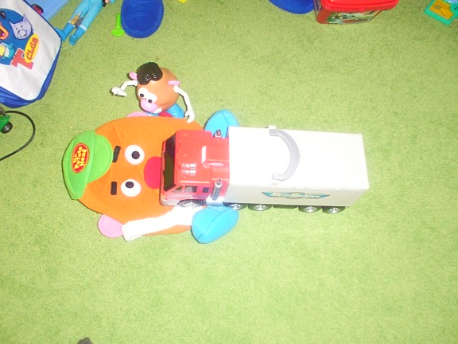
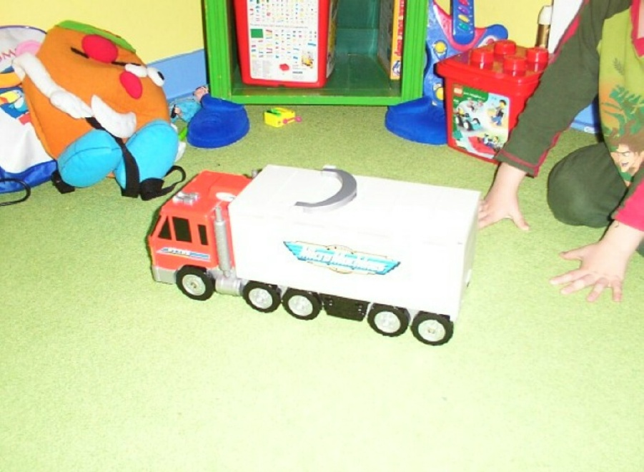
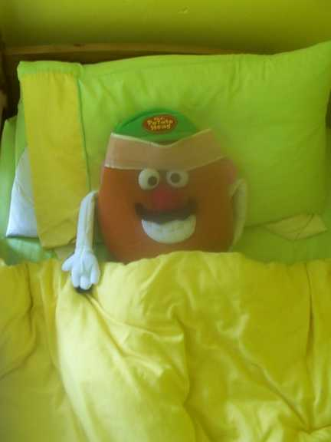

Slide 38
Speculate
Ask questions
Make suggestions
Context for using known language
And generating new ‘human’ language
Starter activity

Slide 39
Playing with text
Extending
Transposing
Adapting
Performing
Interpreting / translating key bits
Recycling
Personalising
Notes:
39
39
39

Slide 40

Interpreting / Translating
Chanson pour les enfants l'hiver – Jacques Prévert
Notes:
40
On the next screen is the ‘raw’ text – the words of the poem. Teachers of Languages other than French will need some guidance into the meaning.
Highlight for participants that , because this text is so widely known in Francophone countries there are many versions of it available; some examples follow.
Initially ask participants to brainstorm what they might ask learners to do with the text. This will probably include:
Spotting key words, translating sections or the whole, reading sections aloud, spotting the gist, comparing the French original with an English version
0.53-0.55
40

Slide 41
Dans la nuit de l'hiver
Galope un grand homme blanc.
C'est un bonhomme de neige
Avec une pipe en bois,
Un grand bonhomme de neige
Poursuivi par le froid.
Il arrive au village.
Voyant de la lumière
Le voilà rassuré.
Dans une petite maison
Il entre sans frapper,
Et pour se réchauffer,
S'assoit sur le poêle rouge,
Et d'un coup disparaît
Ne laissant que sa pipe
Au milieu d'une flaque d'eau,
Ne laissant que sa pipe
Et puis son vieux chapeau.
Notes:
41
This translation is fairly sound:
In the winter night
A big white man is galloping
It is a snowman
With a wooden pipe
A big snowman
Pursued by the cold
He arrives at the village
Seeing some light
he is reassured
In a little house
He enters without knocking
And to warm himself up again
He sits down on the red stove
And straightaway he vanishes
leaving only his pipe
In the middle of a pool of water
leaving only his pipe
And then his old hat
However online there are other inaccurate translations such as this one:
n the winter night
A big white man is walking
It is a snowman
With a pipe in his mouth
A big snowman
To follow the cold
He arrives at the village
He is travelling to the light
And he is reassured there
In a little house
He enters without knocking
And to heat himself up again
He places himself in front of the red fire
He does not leash his pipe
In the middle of a bottle of water
He does not leash his pipe
And then his life was brilliant
This creates a different Reading activity for learners – looking for flagrant inaccuracies – and highlights the risks of taking online information too trustingly!
What suggestions do participants have for exploiting this text?
It has many significant French graphemes in it, so could be useful for reading aloud
For purposeful reading with a more able class it might be useful to give the class the second section of the text in order to work out who the central character is
1.04-1.06
41

Slide 42
Translations
In the winter night
A big white man is galloping
It is a snowman
With a wooden pipe
A big snowman
Pursued by the cold
He arrives at the village
Seeing some light
he is reassured
In a little house
He enters without knocking
In the winter night
A big white man is walking
It is a snowman
With a pipe in his mouth
A big snowman
To follow the cold
He arrives at the village
He is travelling to the light
And he is reassured there
In a little house
He enters without knocking

Slide 43
And to warm himself up again
He sits down on the red stove
And straightaway he vanishes
leaving only his pipe
In the middle of a pool of water
leaving only his pipe
And then his old hat
And to heat himself up again
He places himself in front of the red fire
He does not leash his pipe
In the middle of a bottle of water
He does not leash his pipe
And then his life was brilliant

Slide 44
Superactivity
Fitting it all in / fitting it together
Notes:
44
44

Slide 45
Playing with text
Extending
Transposing
Adapting
Performing
Interpreting / translating key bits
Recycling
Personalising
Notes:
45
45
45

Slide 46
Un hombre sin cabeza
no puede usar sombrero.
Pero éste no es
su mayor problema:
no puede pensar,
no puede leer, ……..
Armando José Sequera

Slide 47
Superactivity
Listening
Understanding
Speaking
Grammar
Ideas / creative writing
Culture / authenticity
Notes:
47
47

Slide 48
Playing with text
Extending
Transposing
Adapting
Performing
Interpreting / translating key bits
Recycling
Personalising
Notes:
48
48
48

Slide 49
Anthologie poétique
http://www.weblettres.net/blogs/uploads/c/cdatabekian/anthologie6d/
Choose your poem
Type it up
Record a reading
Write why you chose it
Write what you think it is about
Say which is your favourite line and translate it
Notes:
49
49

Slide 50
Text type: story
Learners
… enact a scene from the story (Performing)
… predict the next event and write / narrate it (Extending)
… re-write / present in style of a news report (Transposing)
… use the structure to write a new account (Adapting)
… retell in their own words (Personalising)
… translate / interpret their favourite bit
… extract language they wish to use themselves (Recycling)
… offer opinions (with explanation if appropriate) about the text (Reviewing)
Notes:
50
These suggestions are not exclusive of course
Again you may wish to use the Curriculum Chrecklist to spot other possibilities of relevant activities
1.30-1.31
50

Slide 51
Playing with text
Extending
Transposing
Adapting
Performing
Interpreting / translating key bits
Recycling
Personalising
Notes:
51
51
51

Slide 52
Modernise the tongue twister
http://rapgenius.com/Soviet-suprem-rongrakatikatong-lyrics
https://www.youtube.com/watch?v=hmunf08BIzE
Notes:
52
52
This suggestion encourages a playful interaction with the humorously complex lyrics (on the next screen).
You may like to try the activity with the group, or simply describe it.
Firstly the learners work in pairs , or a small group, to meet the challenge of reading the verse aloud; they need to know it is a tonguetwister and does not make much sense; the teacher encourages them to consider pronunciation and intonation, but also to repeat the attempt in order to get faster – each pair / group identifies its fastest reader.
Next all of the fastest readers read aloud at the same time, to find the fastest (or two fastest) in the class. Thirdly the teacher plays the musical version of the text. Finally the two fastest readers read aloud (not sing) alongside the musical version to see who keeps up best.
So – look at the text first (next screen)
Then ask particpants to read along with the audio version (the second link on the screen)
This example is also on the wiki.
1.13-1.18
52

Slide 53
Ta tantine t'a quitté, t'es tout dégouté, tenté de te tuer, de tout oublier, de sauter du toit
Tu te tortures dans ta tuture, fais le tour de tes tares, pour savoir qui c'est qui qu'a tort
Si tu mérites que la tantine se tire avec tes tétards, un tantinet têtu tu voudrais savoir
Tu veux la test, la taire, la toaster en tutu, la retourner, lui faire tâter du tatami
Notes:
53
53
This text also introduces learners to some French slang (and some just weird French!) which might be interesting!
Once again the Curriculum Checklist may be used to focus on what is relevant learning activity; participants may have further relevant ideas for exploiting this style of resource
1.18-1.20
53

Slide 54
Why?
Pronunciation
Intonation
‘Accent’
Challenge
Foundations for Spontaneous Speaking
Not meaning!
Why not? I like it!

Slide 55
Confidence
A GCSE in French helps students to:
• develop their knowledge of and enthusiasm for language learning skills by providing opportunities for the practical use of French;
• develop the confidence to communicate effectively in French

Slide 56
Are your learners like this?
https://www.youtube.com/watch?v=O1D07dTILH0

Slide 57
Variety
Diverse themes / content?
Diverse approaches / activities?
Diverse directions / multiple sources?
Choice?

Slide 58
Marcus Sedgwick, Blood red, snow white
The typewriter was a marvel of miniaturization, made from steel and rubber and ivory. A simple enough thing, though to him, a miracle in itself, for in that box was the potential to write everything that could ever be written. Every word, every sentence, every thought that could ever be, was waiting to be made from the machine in the box. Every single idea ever was in there. And that in itself was a wonderful idea.

Slide 59
Join two phrases / words via an appropriate verb … for different effects
My Granny ………. in the bath
Write one in your TL and share it
manipulate the language

Slide 60
Similarities – Language awareness
A cat was trapped up a tree – Two cats ….
I go and fetch a ladder – I went ….
He’s lost his balance – She’s lost ….
Write one in your TL and share it

Slide 61
Jacques Brel, Litanies pour un retour
https://www.youtube.com/watch?v=hW_tjm82ZAE
Link to phonics / spelling
Using grammatical cues
Look at text with gaps – predict / Listen
Look at text and predict

Slide 62
Mon coeur ma mie mon âme
Mon ciel mon feu ma flamme
Mon puits ma source mon val
Mon miel mon baume mon Graal
Mon blé mon or ma terre
Mon soc mon roc ma pierre
Ma nuit ma soif ma faim
Mon jour mon aube mon pain
Ma voile ma vague mon guide ma voix
Mon sang ma force ma fièvre mon moi
Mon chant mon rire mon vin ma joie
Mon aube mon cri ma vie ma foi
Mon coeur ma mie mon âme
Mon ciel mon feu ma flamme
Mon corps ma chair mon bien
Voilà que tu reviens

Slide 63
Jacques Brel, Litanies pour un retour
https://www.youtube.com/watch?v=hW_tjm82ZAE
Link to phonics / spelling
Using grammatical cues
Look at text with gaps and predict a word that might fit – length / sound / meaning
Look at text and predict mon or ma or mes

Slide 64
Mon coeur ma mie m ? âme
Mon ciel mon feu m ? flamme
Mon puits ma source m ? val
Mon miel mon baume m ? Graal
Mon blé m ? or ma terre
Mon soc mon roc m ? pierre
Ma nuit m? soif ma faim
Mon jour mon aube m ? pain
Ma voile ma vague m ? guide m ? voix
Mon sang m ? force m ? fièvre mon moi
Mon chant mon rire m ? vin m ? joie
Mon aube mon cri m ? vie m ? foi

Slide 65
Mon coeur ma mie mon âme
Mon ciel mon feu ma voix
Mon puits ma source mon val
Mon miel mon baume mon Graal joie
Mon blé mon or ma terre flamme
Mon soc mon roc ma faim
Ma nuit ma soif ma pierre
Mon jour mon aube mon pain bien
Ma voile ma vague mon guide ma
Mon sang ma force ma fièvre mon moi
Mon chant mon rire mon vin ma
Mon aube mon cri ma vie ma foi
Mon coeur ma mie mon âme
Mon ciel mon feu ma flamme
Mon corps ma chair mon
Voilà que tu reviens

Slide 66
Barbara version
https://www.youtube.com/watch?v=r6nBEliPwnY

Slide 67
Todo está en su sitio
Los lobos en el monte,
los pollitos en el corral,
los peces en el agua,
los barcos en el mar.
Ya todo está en su sitio,
ya todo en su lugar.
Los niños en la escuela
y los patos a volar
Autora: Gloria Fuertes

Slide 68
Los lobos
los pollitos
los peces
los barcos
Los niños
los patos
el agua
a volar
el corral
la escuela
el mar
el monte

Slide 69
Generating something from what you know

Slide 70
http://www.youtube.com/watch?v=ngRq82c8Baw&feature=fvst
Say hello
Ask someone’s name
Tell someone your name
Ask the way to the toilet
Wish happy birthday
Ask the time
Say what you like
Say where you live
Say you have 2 bikes
Say thank you and you’re welcome
Ask someone’s age
Say ‘Just a moment, please’
Count to 10
Etc.

Slide 72
Ten good reasons to join ALL (+1)
www.ALL-languages.org.uk

Slide 73
Keep up to date: via high quality publications, a specialist website, a weekly email update
Keep in touch: through regional and national events, social networks or access to email and telephone support.
Evidence your professionalism: by being an active member and updating your subject/professional knowledge
Access high quality professional development & networking opportunities: including the annual Language World conference
Join a local branch or network to meet like-minded professionals, benefit from locally driven professional development and develop your own skills.

Slide 74
Join others in your specialist area: ALL has Committees interested in specific languages and active Special Interest Groups for ITET, World Languages, Primary Education, Adult Education, etc.
Be part of the International community of Language teachers
Connect with the research community
Make your voice heard in policy making: have your say in what new accreditations and curricula should look like; take part in government consultations and inform the decision-makers.
Access resources through projects ALL has run, now available online
+ 1 - Save money! Benefit from discounts on conference rates, and special offers from corporate members

Slide 75
Check out:
www.ALL-Languages.org.uk
E.g. Making the Case; you can join here too ☺
http://ALL-Literature.wikidot.com
https://allconnectblog.wordpress.com/

Slide 76
ALL Connect KS3
Freely usable Training resources on
  Literature
  Spontaneous Speaking
  Translation
  Grammar
  Extended Writing
Linked wikis
https://allconnectblog.wordpress.com/

Slide 78
Speaking spontaneously, writing extensively

Slide 79
Something to talk about:
Most visited cities in the World 2015
Antalya
Bangkok, Thailand
Hong Kong
Kuala Lumpur
London
Macau
NYC
Paris
Singapore
Shenzen
Hong Kong
Singapore
Bangkok, Thailand
London
Paris
Macau
NYC
Shenzen
Kuala Lumpur
Antalya
Notes:
79
79

Slide 80
What do we not mean by spontaneous speaking?
Language that has been rehearsed
Or scripted
Or structured
Or learnt as a text
Notes:
80
NB the word ‘not’ in the title. This is an obvious point but one worth making – that the Speaking element of some styles of exam etc. is based on rote learning and not communication / spontaneity.
The discussion that follows will lead into identification of our professional interpretation of the Programme of Study and identification of a Rationale participants can include in individual Departmental Handbook / Policies.
0.08-0.09

Slide 81
Buying an ice cream in Boulogne
I want my learners to be flexible and confident

Slide 82
Spontaneous Speaking
is based on confidence and knowledge of certain things
needs to be encouraged and cued

Slide 83
Implication
We need highly structured objective-driven learning activities
We need more than that
Sometimes we need less structured, more spontaneous, challenging, risky, (but supported) opportunities

Slide 84
6 seconds max.
Draw:
A person in your family / you know
Something to eat
An item of clothing
A piece of furniture
Notes:
84

Slide 85
Teach and test cards
  show your pictures to your partner one at a time and teach them the words in a language you choose (You are both allowed to ask questions!)
  Show all of your cards and say one of the words in your language for your partner to point at
Notes:
85

Slide 86
  Shuffle the 8 pictures together; turn them over one at a time and make a narrative (or dialogue)
  Do it again!
  • express information and narrate events
Notes:
86

Slide 87
Pupils need to know
Talking in the Target Language is real work
You can be good at talking even if you are not good at writing
There are specific skills involved, which mark your progress
Notes:
87
The profile of Spontaneous Speaking needs to be raised ; in other curriculum areas only the written work is seen to really count.
Ask participants how they think they could raise the profile of Spontaneous Speaking with the different year-groups in the key stage,
(They may suggest including it explicitly in Lesson Objectives : In this lesson I will learn how to talk about .. / say .. / ask .. etc.)
and who else they would need to raise awareness with.
(They may suggest Senior Management, Parents, other teachers)
Ask if anyone has a strategy for keeping records of pupils’ progress in Speaking. (Soundfiles? Video? Public event?)
Finally in preparation for a later screen, ask for suggestions of what the Skills are
These issues are bound to be revisited in the Action Plan and Piloting of curriculum development.
Schemes of work are very busy, and teachers are wary of adding ‘extra things’ so please underline that a focus on spontaneous speaking can fit with any content, any theme, any topic and need not take up much time in a lesson.
The next screen is an interactive classroom activity included to make the session more dynamic, and to illustrate that different aspects of the curriculum can be blended together. This one is linked to the curriculum requirements about authentic resources; it is in German, but there is a gloss for teachers of other languages. You may wish to play just a taster of the clip to show how it works.
0.24-0.27

Slide 88
Read aloud in 30 seconds
Boulogne
Marseille
Lyon
Clermont-Ferrand
Paris
Reims
Caen
Dresden
Wien
Aachen
Muenchen
Schleswig-Holstein
Basel
Karlsruhe
Salamanca
Leon
Zaragoza
Barcelona
Sevilla
Jerez de la Frontera
Valladolid
Notes:
88
The three languages are included as examples
Having taught and practised the key phonemes of the language of study this sort of short timed activity reinforces the points, offers some challenge, and contains potentially some cultural information also.
Pupils could of course be encouraged to research some other challenging place names from the Target Language speaking world.
Ask: What other sort of words could teachers use to recycle the principle of this activity? (Any proper nouns – Writers, Singers, Sportspeople, film stars, names of cities in other countries, place names, famous people, historical events, people in the news and their job-titles etc.)
To remind pupils that when they are speaking their Target Language they need to adjust their mindset and mouth movements the next screen is a variant on this
1.11-1.12

Slide 89
How would they say ..?
Knaresbrough
Birmingham
Aberdare
Warwick
Gloucester
Gillingham
Shrewsbury
Scunthorpe
Notes:
89
The challenge here is to ‘take off the English–speaking hat’ and think like a speaker of another language.
The video clip on the next slide illustrates the perceived impressiveness of someone who ‘sounds’ as though they are speaking a language well. This young woman is actually uttering just nonsense. The point of using it is to highlight that ‘a good accent’ and good intonation are useful and impressive skills.
1.12-1.13

Slide 90
Photos
Ask questions (I have taught), offer opinions e.g. about a photo
Is that you?
Who is …?
.. on the left?
Where is it?
When was that?
Have you been ..?

Slide 91
Did you really have dark hair?
What are you doing?
How embarrassing!

Slide 92
Photo talk
What can we train them
… to say?
… to add?
… to ask?
… to comment?

Slide 93
Repertoire : Tell them what you mean
High value words?
Tienes hermanos?
Si, tengo un hermano
Anything VALUABLE?
Highlight!
Recycle!

Slide 94
Be spontaneous! Tell them what you mean
Exclamations!
Questions?
Hesitaaaaations
Inter jec tions
‘Opinions’
?Clarifications
!Suggestions

Slide 95
Conchita Wurst tribute: Eurovision
In Gruppen von 4
Wählt ein Land
Jede Gruppe hat
  8 Punkte
  5 Punkte
  3 Punkte
  1 Punkt
auszugeben
Hört zu!
Macht Notizen!
Dann …
besprecht!
Notes:
95
In groups of 4
Pupils think of/are given a country to represent
Each group has points to allocate 8, 5, 3 and 1 according to their preferences
Pupils listen to the clips, make brief notes to jog their memory and then discuss allocation of the points
The teacher emphasises that the discussion will be short , and will be in the Target Language, and then circulates to check.
The resulting scores are collated by the teacher to identify the class favourite of the clips.
0.27-0.28

Slide 96
Best German Songs 2014 Deutschsprachige Lieder
https://www.youtube.com/watch?v=YqGSWHz9zu4&src_vid=AC_DCCHJs74&feature=iv&annotation_id=annotation_2260985527
Notes:
96
This activity is featured in the ALL Literature wiki http://ALL-Literature.wikidot.com
You may like to play c 1 minute of the compilation
Of course teachers cannot be certain that all of the pupils will be sticking to the target language throughout the discussion; that is why it is short. By limiting the amount of language needed to do the activity there is a chance that they can be encouraged to use it, and the following screen allows the teacher to celebrate their speaking and plan for future language needs.
0.28-0.30

Slide 97
Plenary
What German / target Language
would you need / want to know
in order to talk about the songs?
What grammar is involved?
Would you therefore ‘teach’ it?
Notes:
97
The point of this screen is to highlight that after an activity where pupils are talking in groups it is useful to have a plenary to discuss any new language they might want to use and any issues they had in using the target language.
If pupils can be engaged in identifying future language needs there is some sense of ownership of the progression they will make.
If pupils have strong views about these clips they could be encouraged to research some other music for a future lesson.
Ask participants to suggest a few examples of the Language pupils would need.
0.30-0.32

Slide 98
Be spontaneous! Tell them what you mean
• improve their communication skills by learning how to express their viewpoint and ask questions;
• participate in discussions, debates and interviews; …
group work and shared tasks;
• present reasons and justify opinions
Exclamations!
Questions?
Hesitaaaaations
Inter jec tions
‘Opinions’
?Clarifications
!Suggestions

Slide 99
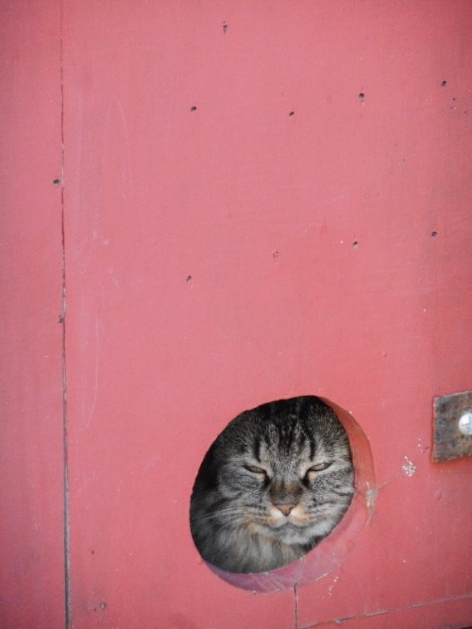
Something to be Spontaneous about

Slide 100
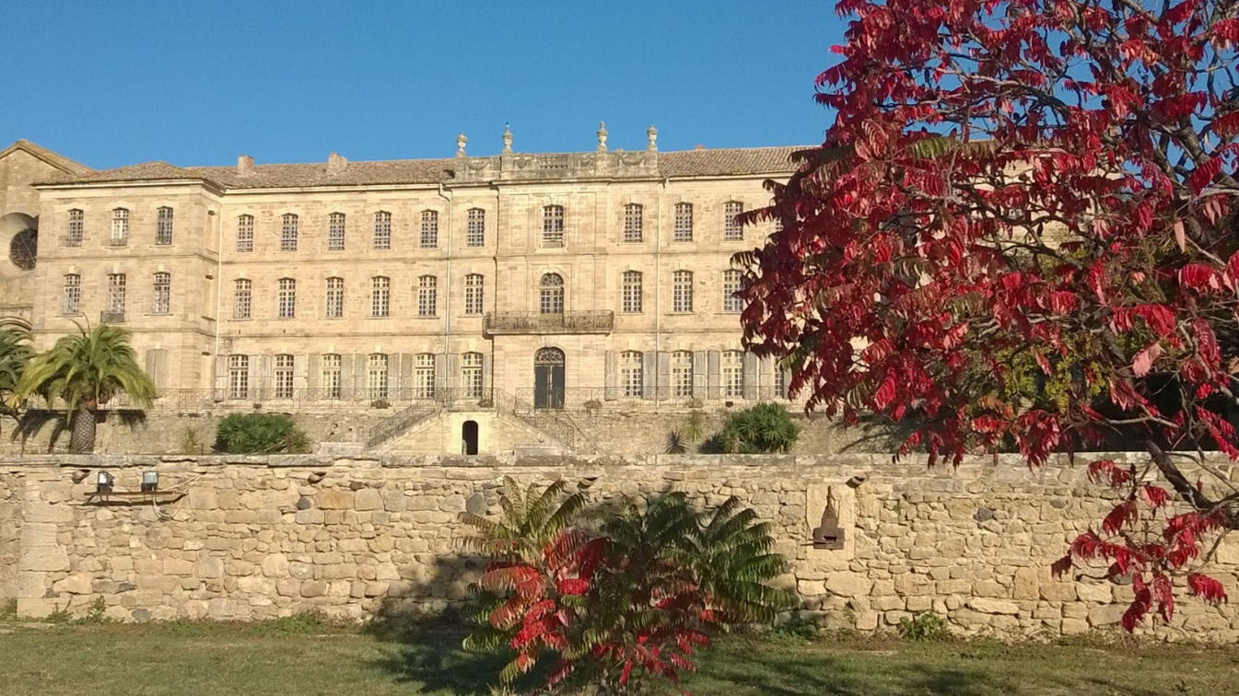

Slide 101
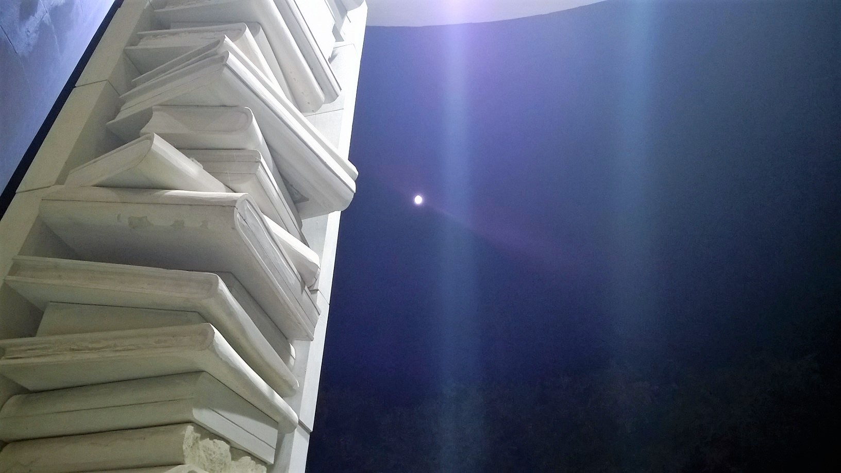

Slide 102
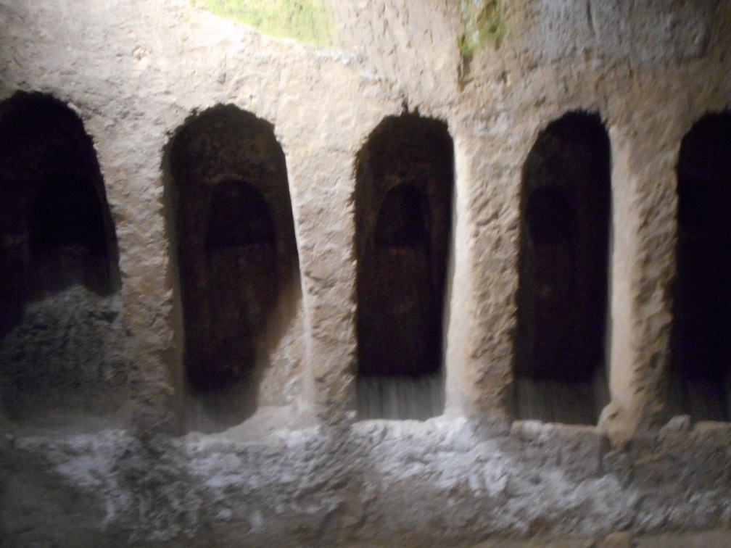
What is this for?

Slide 103
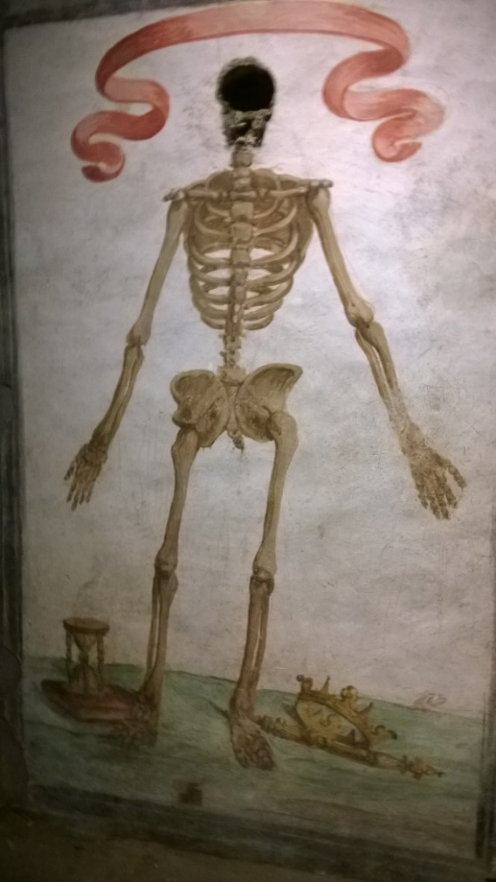

Slide 104
Change context
Using language you know with a different intent
  Possibilities for playful activity recycling (i.e. revising) language
  Variants on I went to market …

Slide 105
I went on e-bay and I bought ...
A piece of string
an Aston Martin
A Theresa May mask
500 bottles of champagne

Slide 106
Creating language learners
Interest in words
Interest in people
Interest in communication
Interest in culture
Have our recent systems encouraged this?
Can we make our new systems do so?

