Slide 1
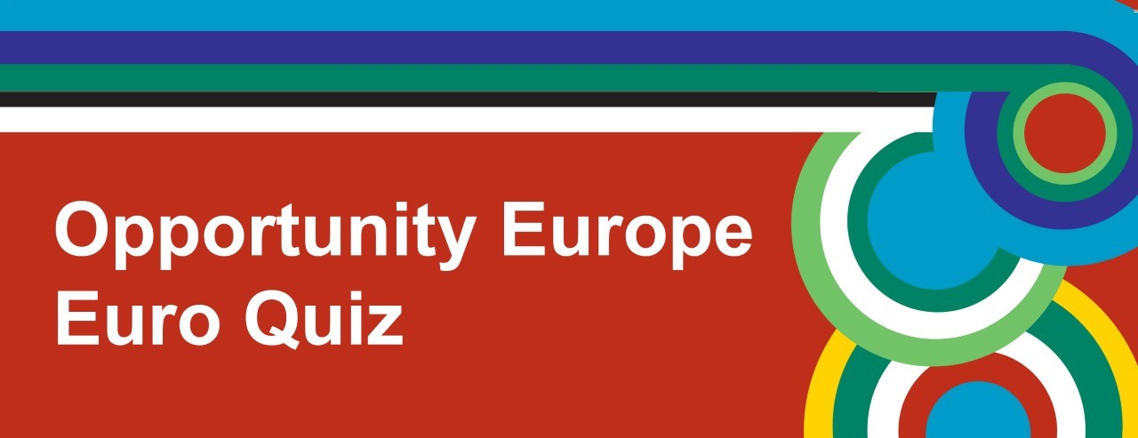
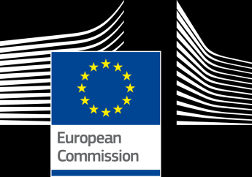

Slide 2
Round 1
Geography

Slide 3
1. What is the only EU Member State to have the same name as its capital city?
Luxembourg
Slovakia
Estonia

Slide 4
2. Which country does NOT have a shoreline on the Mediterranean sea?
Slovenia
Spain
Italy

Slide 5
3. Which country became the newest Member State of the EU when it joined in July 2013?
Slovenia
Croatia
Portugal

Slide 6
4. The UK has over 6,000 islands; what European country has over 175,000?
Finland
Greece
Sweden

Slide 7
5. Which of the following countries has a capital city which is not actually its largest city?
Malta
Latvia
Denmark

Slide 8
6. Europe’s hottest ever temperature was recorded at 48° C. Where did this happen?
Greece
Spain
Norway

Slide 9
Round 2
Music

Slide 10
1. This is the national anthem of which EU Member State?
England
France
Germany

Slide 11
2. Which European language is Shakira singing in?
Portuguese
Dutch
Spanish

Slide 12
3. What is the name of this Irish instrument?
Uilleann pipes
Bagpipes
Panpipes

Slide 13
4. What country does this famous reality show judge and singer come from?
Wales
Scotland
Ireland

Slide 14
5. ‘The Planets’ is by a famous classical composer from where?
Norway
Sweden
England

Slide 15
6. What is the name of this type of Spanish music?
Tango
Salsa
Flamenco

Slide 16
Round 3
Daily Life and Culture

Slide 17
1. Hallowe’en is a pagan festival which originated in which country?
Scotland
England
Ireland

Slide 18
2. What is the usual time to eat dinner in Spain?
3pm
5.30pm
10pm

Slide 19
3. Many Irish family names start with “Mac” or “O’...”, but what do they mean?
Daughter and son of...
Grandfather and grandmother of...
Grandson of and descended from...

Slide 20
4. In which country does the ‘Bundesliga’ take place?
Germany
Italy
Denmark

Slide 21
5. The Velvet Revolution is traditionally associated with which two former communist EU Member States?
Czech Republic and Slovakia
Poland and Hungary
France and Spain

Slide 22
6. The Magyar people originate from which EU Member State?
Hungary
Lithuania
Spain

Slide 23
Round 4
Faces and Places

Slide 24
Faces and Places
Include the following on answer sheets:
School Name
Name of celebrity / famous landmark AND
Name of EU Member State they come from / can be found in

Slide 25
1.

Slide 26
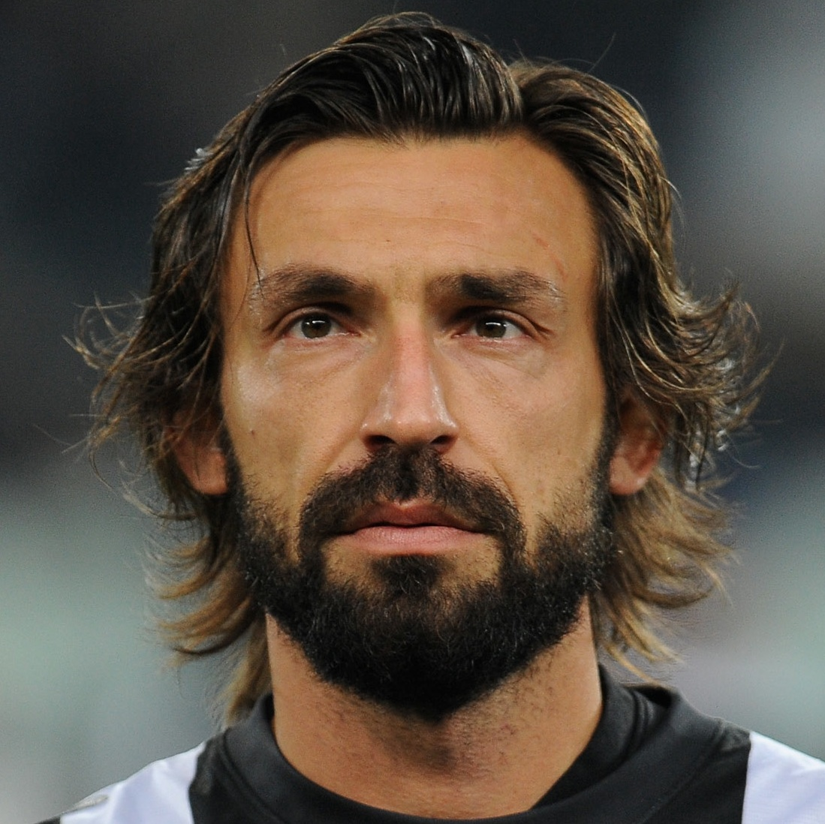
2.

Slide 27
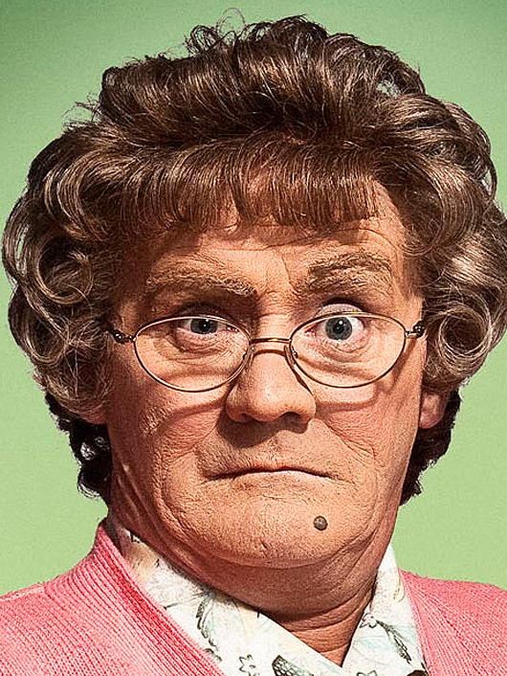
3.

Slide 28
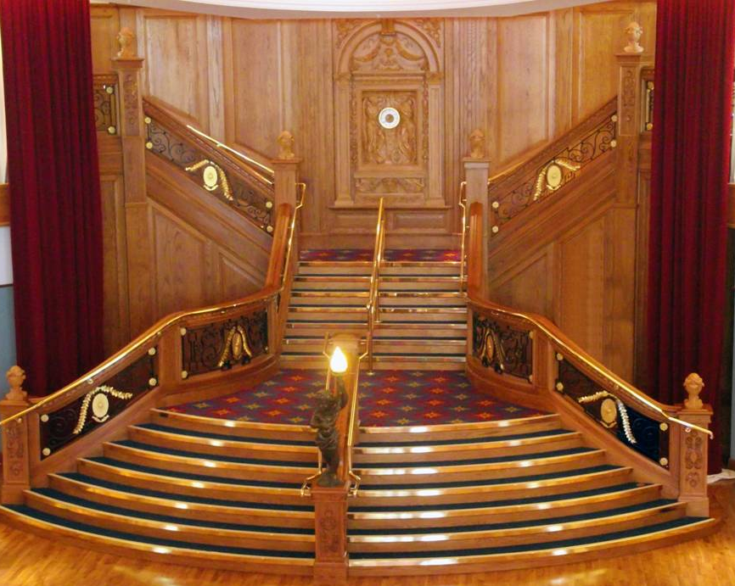
4.

Slide 29
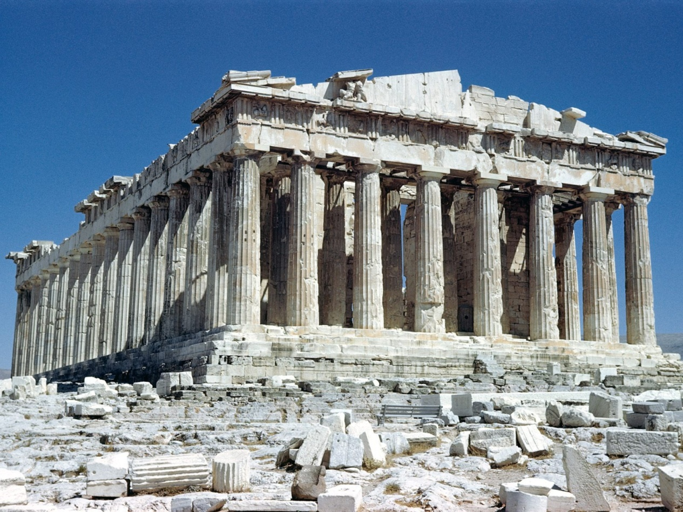
5.

Slide 30
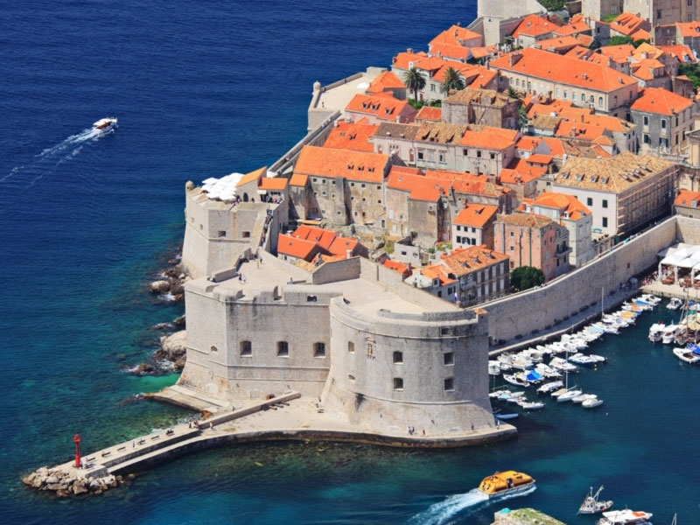
6.

Slide 31
Round 5
Languages

Slide 32
1. How many official and working languages are there today in the European Union?
20
24
30

Slide 33
2. Which language is the most widely spoken mother tongue or native language in the European Union?
English
Spanish
German

Slide 34
3. The phrase ‘Parlo tre lingue’ is in a Romance language and means ‘I speak 3 languages’, but which language is it?
Italian
Romanian
Portuguese

Slide 35
4. In which language is ‘Dzień dobry’ the phrase for ‘good morning’?
Latvian
Polish
Russian

Slide 36
5. J K Rowling, the author of the Harry Potter books, is fluent in which European language?
French
German
Spanish

Slide 37
6. In which two countries might you hear people speaking Basque?
France and Spain
Hungary and Austria
Latvia and Estonia

Slide 38
Round 6
Food and Drink

Slide 39
1. ‘Bratwurst’ is a type of sausage made in which EU Member State?
Belgium
Germany
France

Slide 40
2. ‘Fenkata’ is a type of stew found in Malta. What is its main ingredient?
Pork
Beef
Rabbit

Slide 41
3. ‘Piri piri’ is a type of sauce from which country?
Portugal
Finland
UK

Slide 42
4. Which of the following is NOT a typical French food?
Snails
Shark fin soup
Frogs legs

Slide 43
5. Bramley apples, from Northern Ireland, have protected status within Europe. What county are they from?
Down
Armagh
Antrim

Slide 44
6. In which EU Member State might you find ‘turrón’, a nougat made with honey and almonds?
Romania
Spain
Malta

Slide 45
TIE BREAK QUESTIONS
Which company is Italy's largest employer?
Fiat
Dolce and Gabbana
Alitalia

Slide 46
TIE BREAK QUESTIONS
2. How many clogs are produced in Holland each year?
1 million
2 million
3 million

Slide 47
TIE BREAK QUESTIONS
How many Member States are there in the European Union?
A: 25
B: 26
C: 28

Slide 48
TIE BREAK QUESTIONS
Who is the current President of the European Commission?
A: Donald Tusk
B: Jean-Claude Juncker
C: Jose Manuel Barroso

