Slide 1
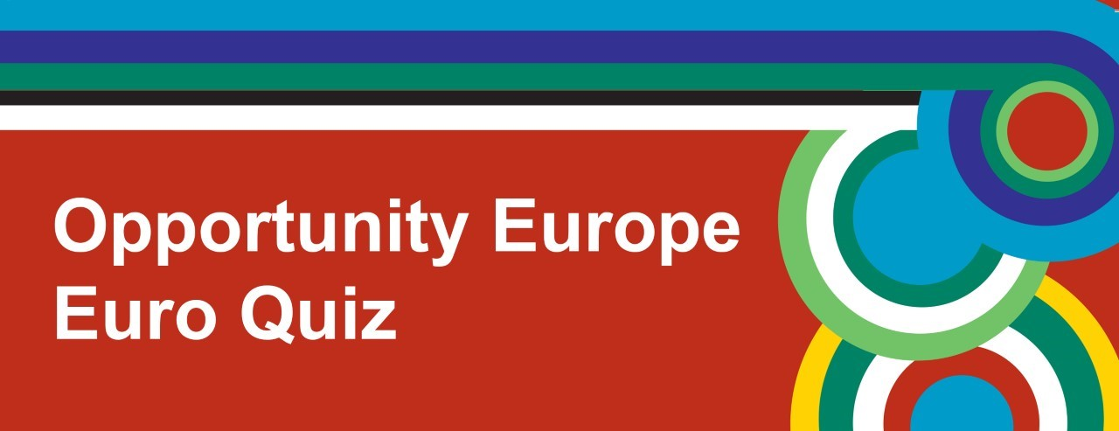




Slide 2
Round 1
Geography

Slide 3
1. How many countries formed the original EEC?
6
10
12

Slide 4
2. Which countries joined the EU in 1973?
Ireland, Denmark and the UK
Greece, Spain and Portugal
Malta, Croatia and Sweden

Slide 5
3. In which EU Member State is Auschwitz-Birkenau?
Poland
Czech Republic
Germany

Slide 6
4. Which of the following EU Member States have land borders with Russia?
Poland, Romania and Hungary
Estonia, Latvia and Finland
Czech Republic, Slovenia and Romania

Slide 7
5. What are the largest and smallest EU Member States, in terms of population?
Germany and Malta
France and Slovenia
Italy and Luxembourg

Slide 8
6. What are the largest and smallest EU Member States in terms of land area?
Germany and Slovenia
France and Malta
Spain and Luxembourg

Slide 9
7. What do you call the Dutch speaking area of Northern Belgium?
    A. Wallonia
    B. Brussels
    C. Flanders

Slide 10
8. The river Rhine, which rises in Switzerland, runs through which three EU Member States?
A. Luxembourg, Belgium and Austria
B. The Netherlands, France and Germany
C. Belgium, Italy and Luxembourg

Slide 11
Round 2
Music

Slide 12
1. This song won the Eurovision Song Contest in 2014. Which EU Member State did it represent? https://www.youtube.com/watch?v=SaolVEJEjV4
The Netherlands
Austria
Latvia

Slide 13
2. Which famous German composer wrote the music to "Ode to Joy"? https://www.youtube.com/watch?v=-kcOpyM9cBg
Wagner
Handel
Beethoven

Slide 14
3. This song, by Hozier, was nominated for Best Song at the 2014 European Music Awards. Where does Hozier come from? https://www.youtube.com/watch?v=PVjiKRfKpPI
A. Ireland
B. Denmark
C. England

Slide 15
4. Edith Piaf was a famous singer from which EU Member State? https://www.youtube.com/watch?v=t6wjCcWC2aE
Poland
Bulgaria
France

Slide 16
5. In which year did the Belgian inventor, Adolphe Sax, design the Saxophone? https://www.youtube.com/watch?v=G7Gp9gzIHU8
1841
1891
1941

Slide 17
6. This is a song by Calvin Harris.
Which country in the UK does he come from? https://www.youtube.com/watch?v=ebXbLfLACGM
Scotland
England
Wales

Slide 18
7. This song is by Abba. Which EU Member State do they come from? https://www.youtube.com/watch?v=xFrGuyw1V8s
A. Holland
B. Denmark
C. Sweden

Slide 19
8. This music is being played on a Stradivarius violin. Where do these violins originate from? https://www.youtube.com/watch?v=s7W3qbng4t0
A. Czech Republic
B. Italy
C. Romania

Slide 20
Round 3
Daily Life and Culture

Slide 21
1. In which EU Member State would you find "La Liga"?
Spain
Italy
France

Slide 22
2. In which EU Member State would you celebrate "Hogmanay"?
UK
Ireland
Norway

Slide 23
3. Which EU Member State does Count Dracula come from?
  Romania
  Bulgaria
  Hungary

Slide 24
4. The Diary of Anne Frank is about a young Jewish girl hiding from the Nazis during WWII. In which EU Member State was she hiding?
Germany
France
The Netherlands

Slide 25
5. In which EU Member State is the musical "The Sound of Music", featuring the Von Trapp family, set?
Germany
Austria
Italy

Slide 26
6. The Irish word ‘Gaeltacht’ is used to describe an area in Ireland where the Irish language ……. ?
  A. Is still widely spoken
  B. Has never been spoken
  C. Has completely died out

Slide 27
7. At which Italian landmark is it said that if you throw in a coin, you will be sure to return to that city?
A. Trevi Fountain
B. The Spanish Steps
C. The Colosseum

Slide 28
8. In which EU Member State is “El País" a daily newspaper?
    Spain
    Luxembourg
    France

Slide 29
Round 4
Languages

Slide 30
1. Which EU Member State has the highest percentage of people who can speak more than one language?
Luxembourg
Sweden
The Netherlands

Slide 31
2. Which is the most widely spoken language in the EU?
French
German
English

Slide 32
3. Which is the most widely spoken language in Switzerland?
French
Italian
German

Slide 33
4. What is another way of saying "multilingual" – being able to speak many languages?
Bilingual
Polyglot
Monolingual

Slide 34
5. Which European alphabet begins with the letters "alpha", "beta" and "gamma"?
Russian
Turkish
Greek

Slide 35
6. From which language do the English words "brogues" and "smithereens" originate from?
Irish
French
German

Slide 36
7. The language called "Silbo Gomero" -which people use to communicate across ravines and valleys by whistling - is used in which set of islands?
A. The Channel Islands
B. The Canary Islands
C. The Hebrides

Slide 37
8. Polish, Czech and Russian belong to which set of European languages?
    Romance
    Slavic
    Germanic

Slide 38
Round 5
Food and Drink

Slide 39
1. ‘Polenta’ is a popular food in Italy. Is it made with .…?
Fruit
Cheese
Cornmeal

Slide 40
2. Portugal is the largest exporter of which food product?
Tomato Purée
Olive Oil
Orange Juice

Slide 41
3. ‘Moussaka’ is a popular meal from which EU Member State?
Croatia
Spain
Greece

Slide 42
4. "Bigos" or Hunter’s Stew is the national dish of which EU Member State?
Malta
Poland
Spain

Slide 43
5. Edam cheese is produced in which EU Member State?
France
Bulgaria
The Netherlands

Slide 44
6. "Kinnie" is a popular soft drink in Malta. What is it made from?
Oranges and herbs
Strawberries and kiwi fruit
Lemons and limes

Slide 45
7. What is unusual about "tarte tatin"?
    It is salty
    It has holes in it
    It is upside down

Slide 46
8. "Churro" is a sweet doughnut like snack. In which EU Member State would you find it?
    Poland
    Sweden
    Spain

Slide 47
Round 6
Faces and Places

Slide 48
Faces and Places
Please answer
Name of celebrity / famous landmark AND
Name of EU Member State they come from / can be found in

Slide 49
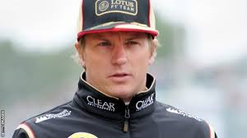
1.

Slide 50
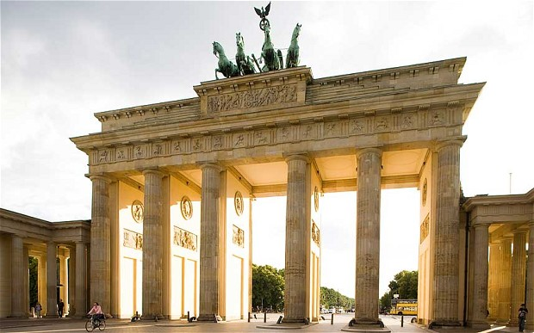
2.

Slide 51
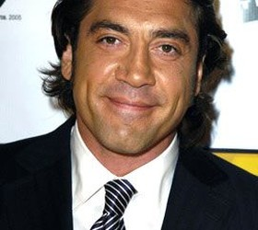
3.

Slide 52
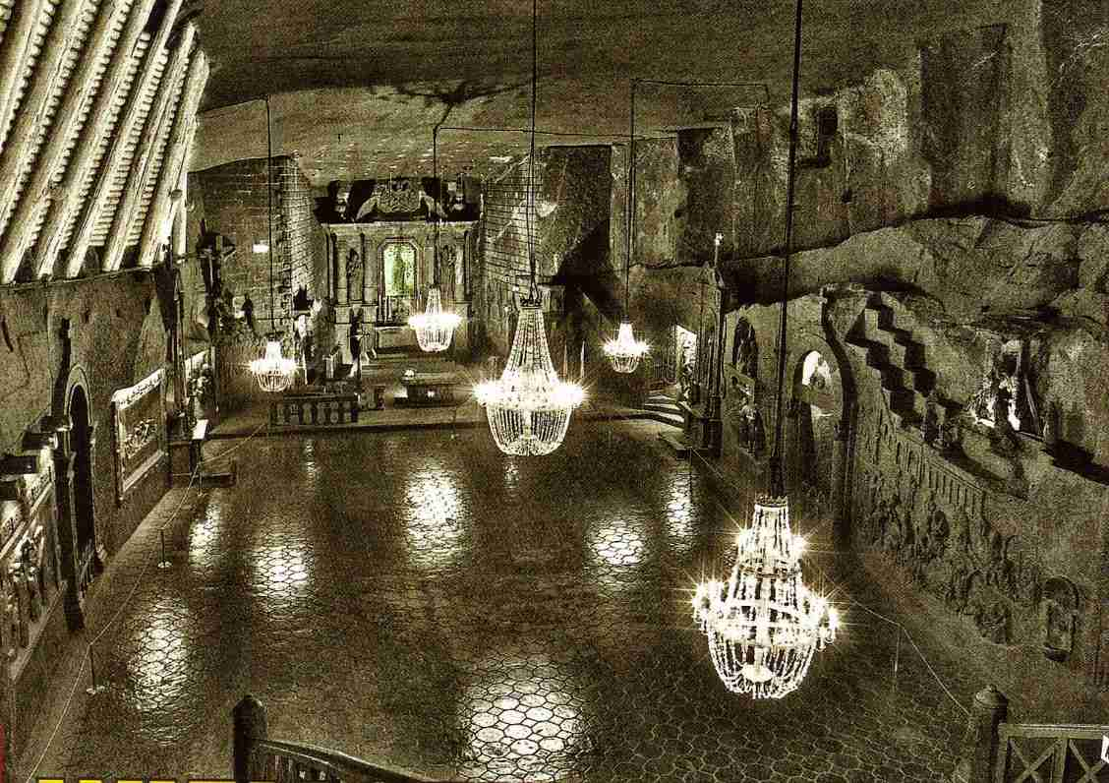
4.

Slide 53
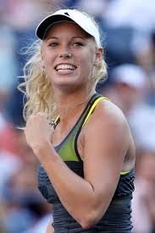
5.

Slide 54
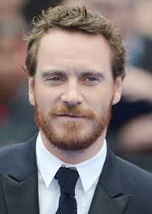
6.

Slide 55
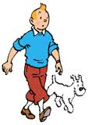
7.
Bonus point for name of the Dog

Slide 56
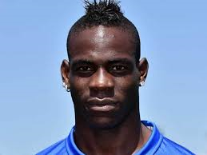
8.

Slide 57
TIE BREAK QUESTIONS
  How many EU Member States use the euro as their currency?
  A: 19
  B: 21
  C: 28

Slide 58
TIE BREAK QUESTIONS
What was the last country to join the European Union?
A: Lithuania
B: Croatia
C: Malta

Slide 59
TIE BREAK QUESTIONS
How many European Commissioners are there?
A: 29
  B: 28
  C: 30

