Slide 1
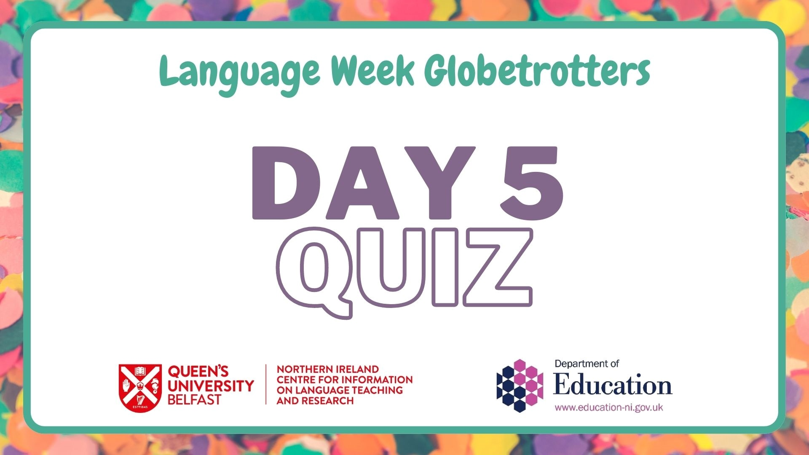

Slide 2
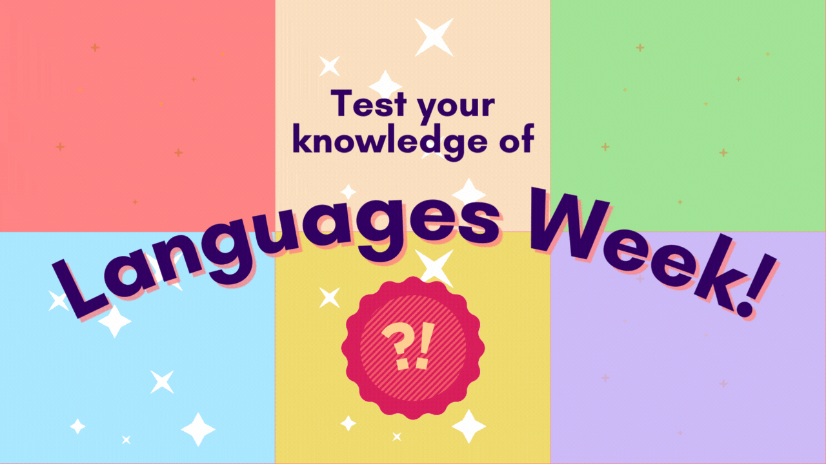


Slide 3
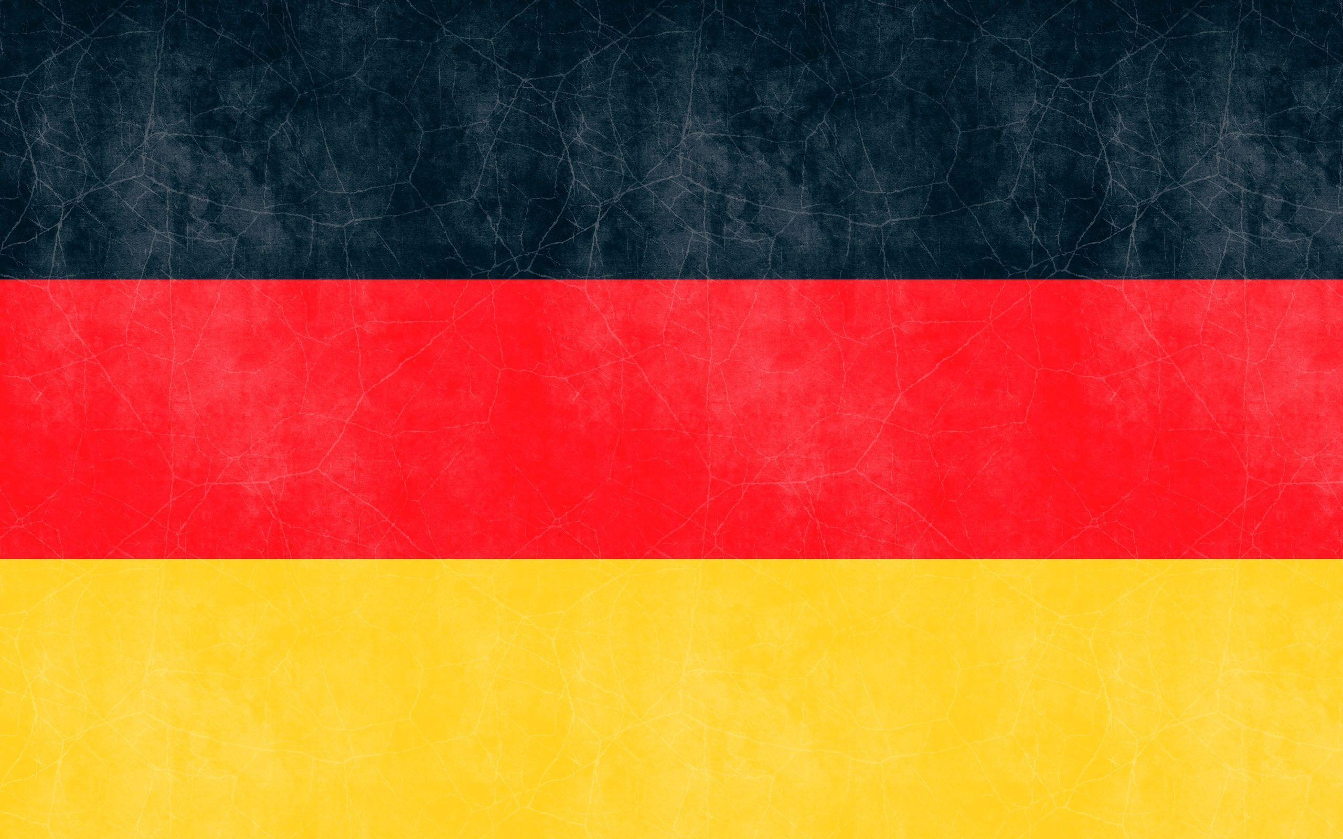
What is the capital of Germany?
A) Munich
B) Berlin
C) Hamburg
D) Frankfurt

Slide 4
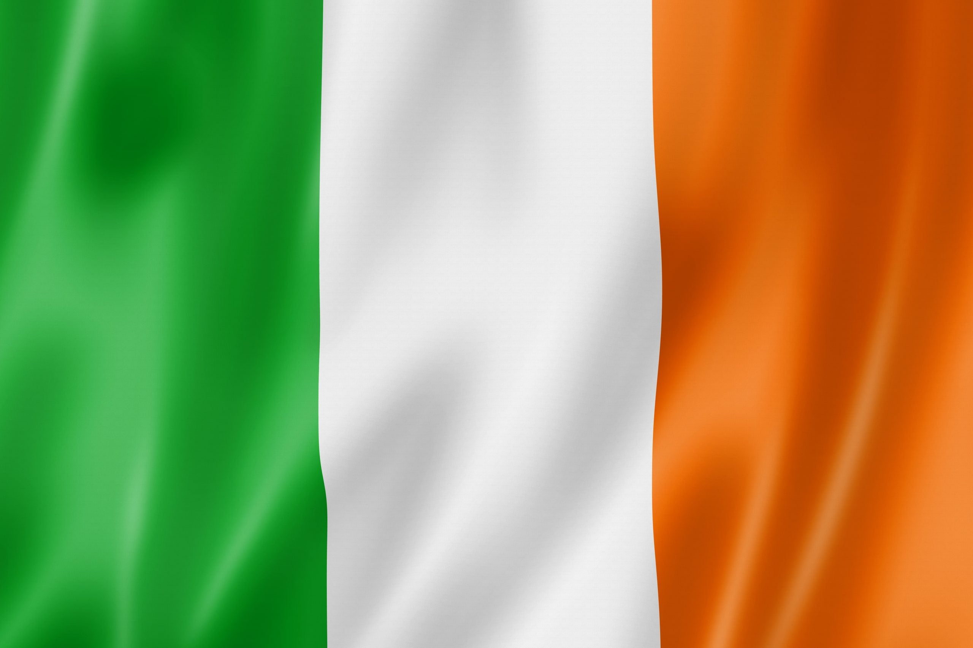
‘Gaeltacht’ is used to describe the regions in Ireland in which Irish is the primary spoken language.
True
Or
False

Slide 5
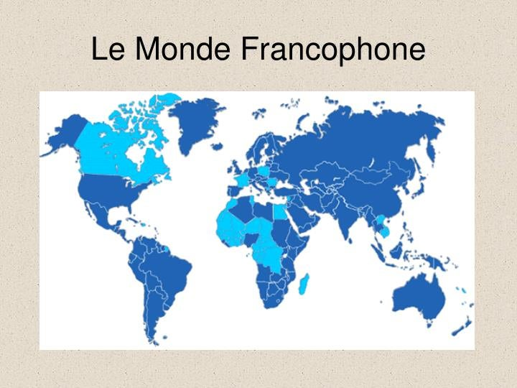
More than 320 million people speak French in the world.
True
Or
False

Slide 6
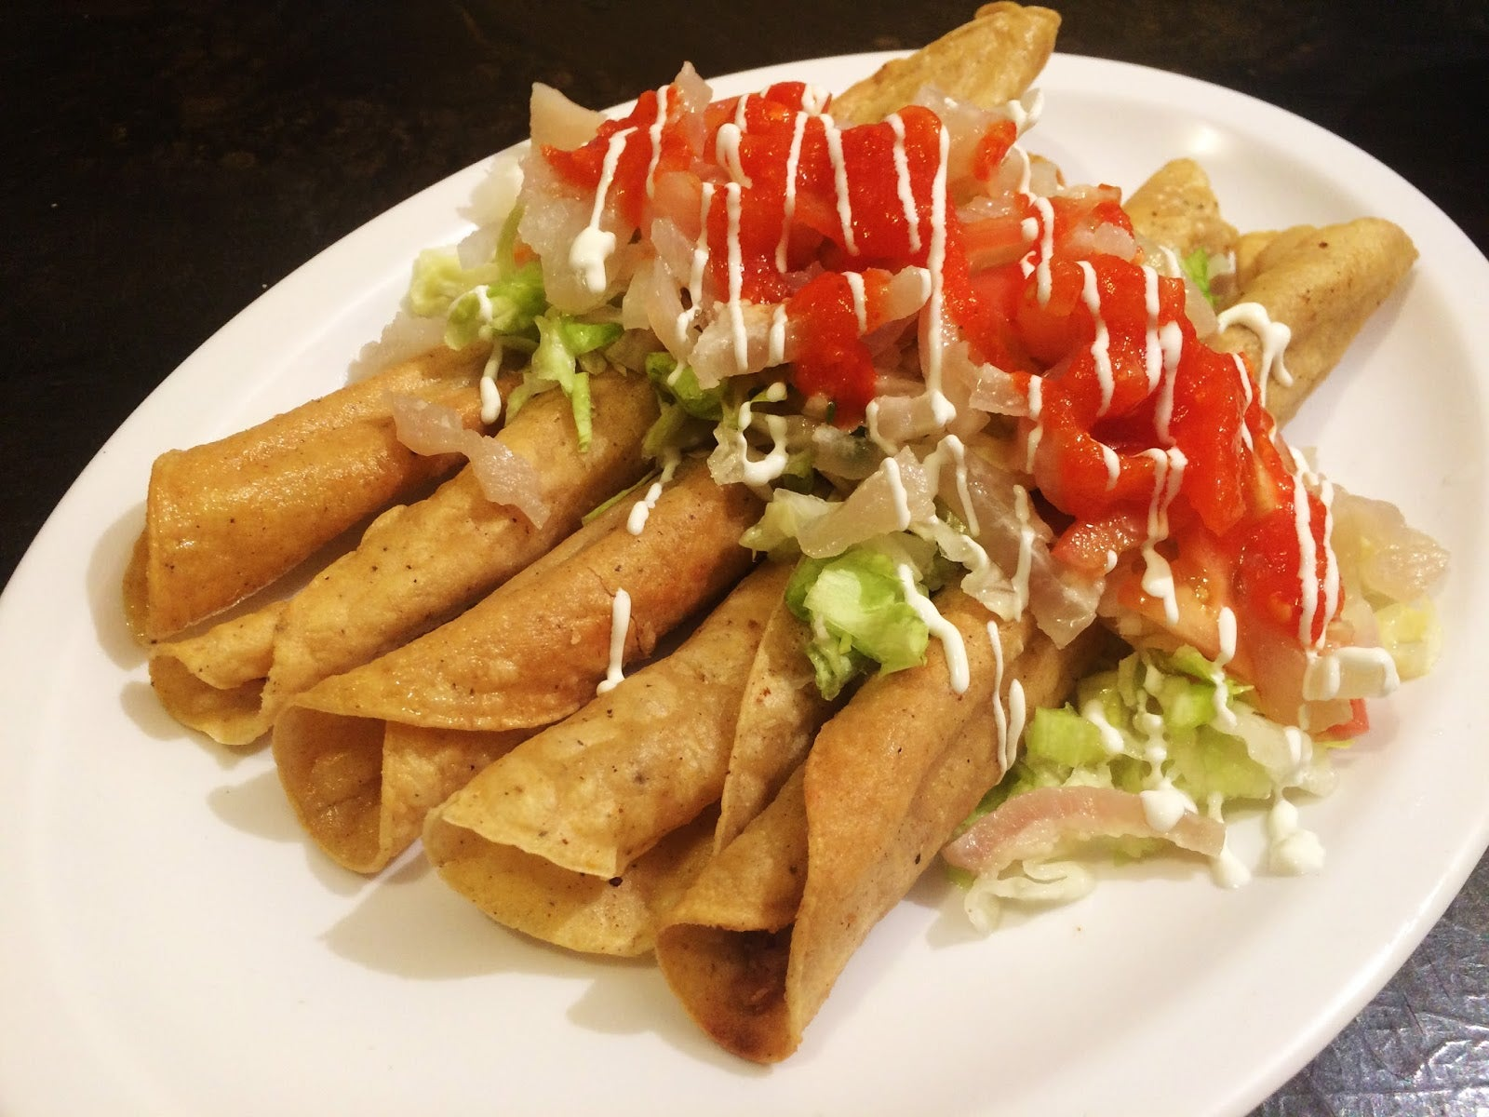
'Flautas', a Mexican dish, is Spanish for 'flutes'.
True
Or
False

Slide 7
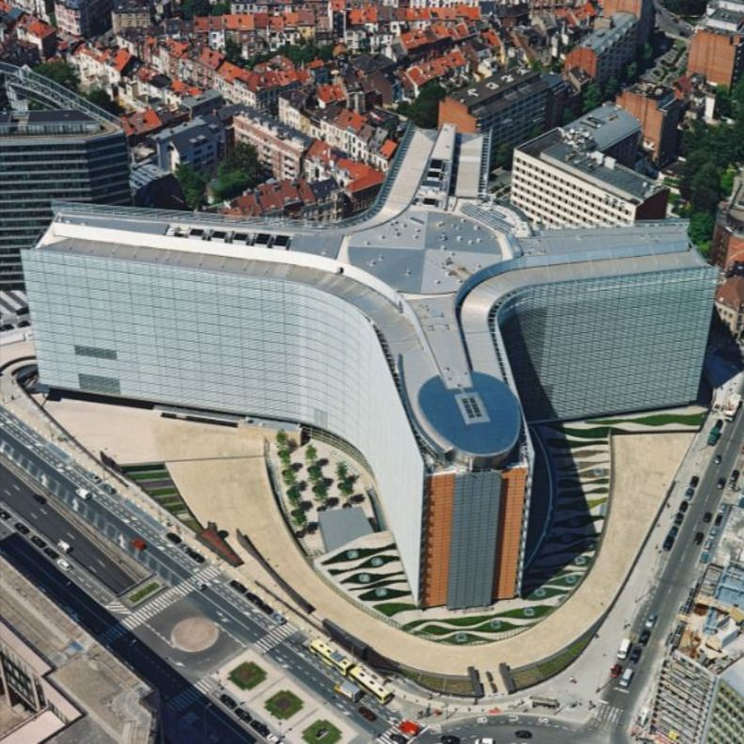
What French-speaking country is home to the Berlaymont (EU Commission HQ)?
A) Belgium
B) Canada
C) Luxembourg
D) Algeria

Slide 8
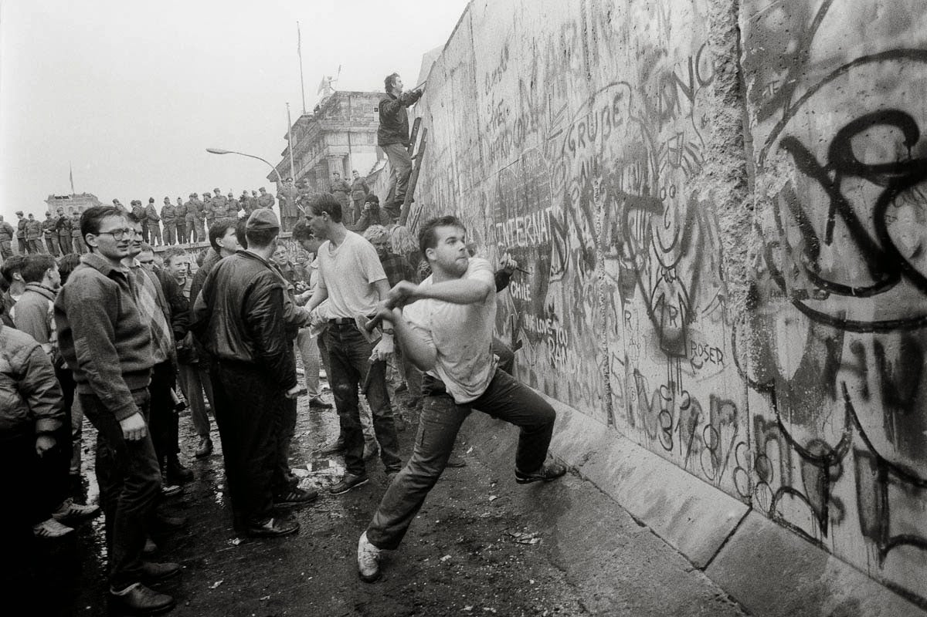
The Berlin Wall fell in 1989.
True
Or
False

Slide 9
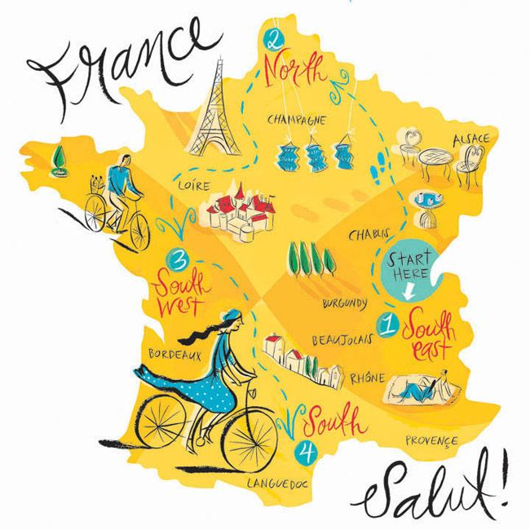
France is sometimes referred to as the 'Pentagon'.
True
Or
False
France is sometimes called the 'hexagon' due to its shape.

Slide 10
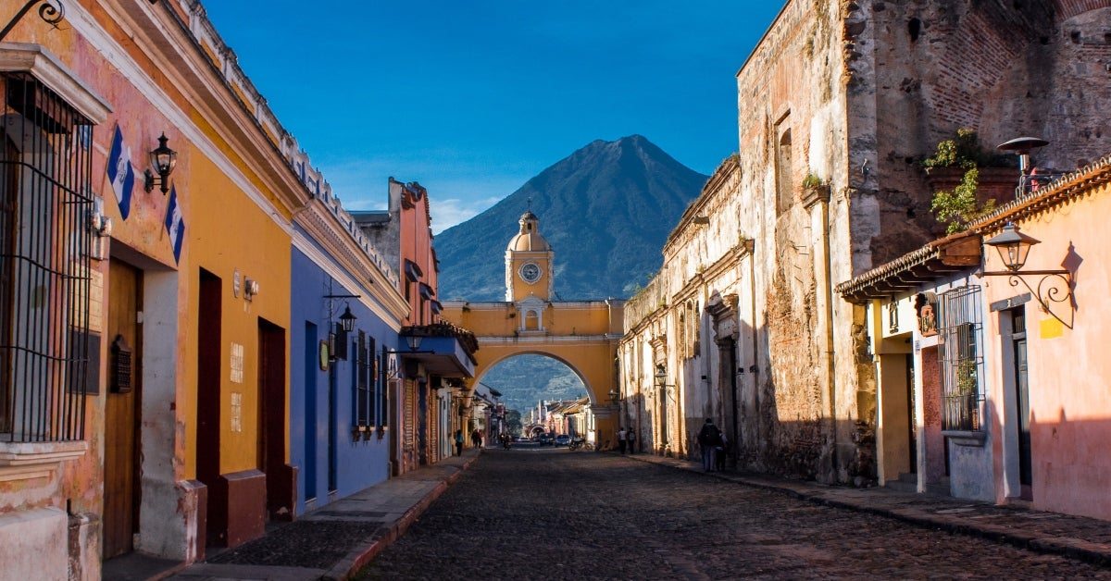
Spanish is not the official language of Guatemala.
True
Or
False

Slide 11
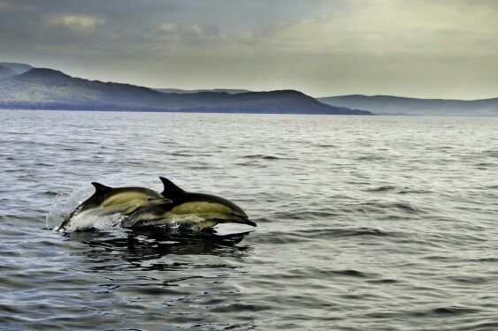
What is Irish for dolphin?
A) cloch
B) teach solais
C) bóthar
D) deilf

Slide 12

What is German for 'red'?
A) Rouge
B) Rojo
C) Rot
D) Rosso

Slide 13
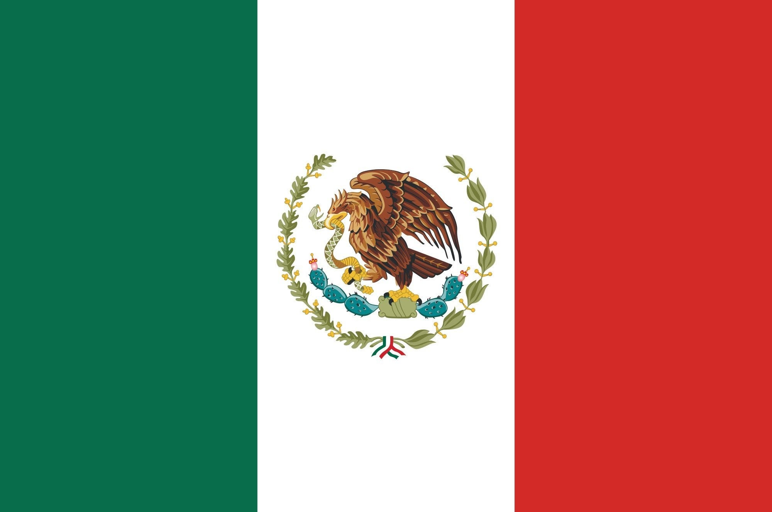
Which Spanish-speaking country does this flag represent?
A) Cuba
B) Mexico
C) Argentina
D) Costa Rica

Slide 14
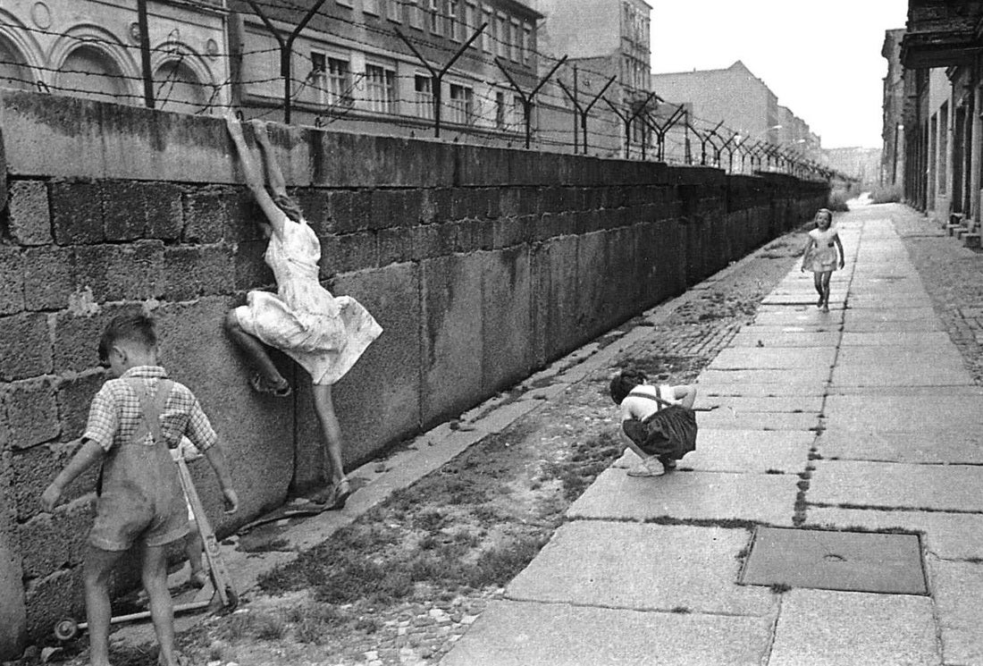
5,000 people made it over the Berlin Wall from 1961 to 1989.
True
Or
False

Slide 15
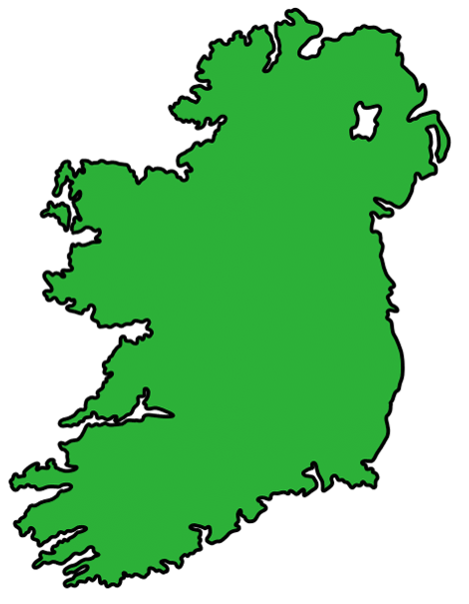
Where is the largest Irish-speaking community?
A) Cork
B) Donegal
C) Galway
D) Kerry

Slide 16
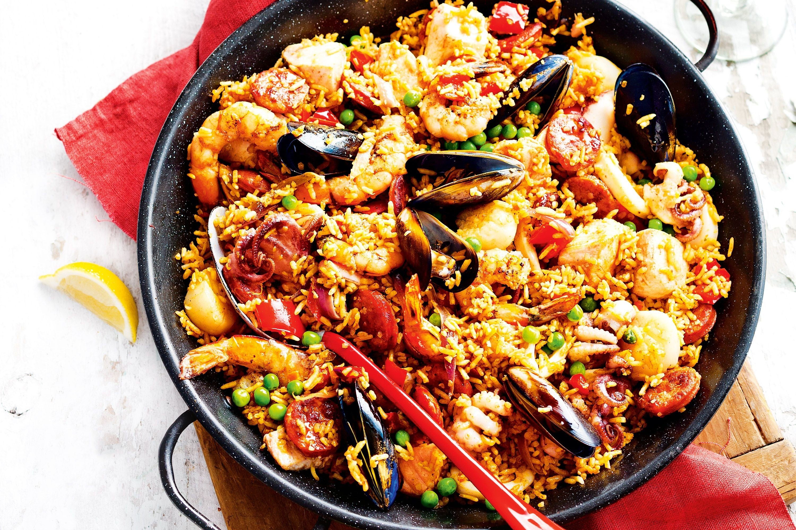
What spice gives paella its yellow colour?
A) Saffron
B) Cumin
C) Turmeric
D) Paprika

Slide 17
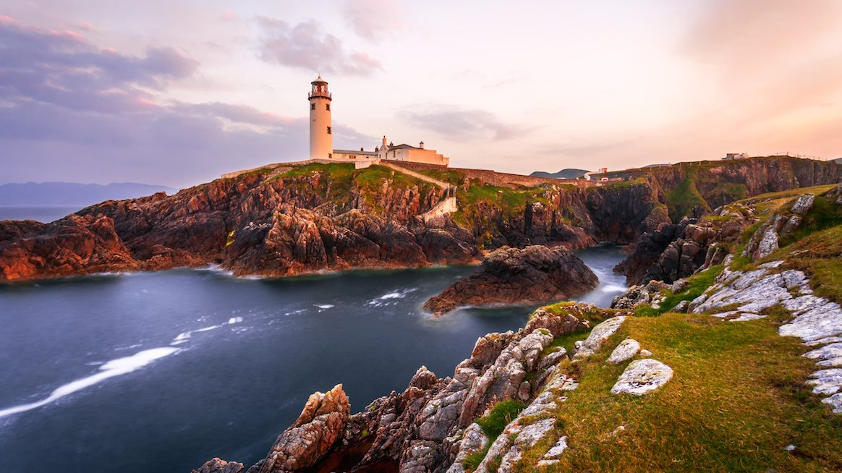
There are 17,132 native Irish-speakers in Donegal.
True
Or
False

Slide 18
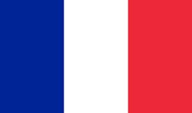
What country does this flag represent?
A) Belgium
B) Switzerland
C) France
D) Luxembourg

