Slide 1
Apps (& websites) R Us PART 1
Amanda Salt
Head of Spanish, Grosvenor Grammar School
asalt@grosvenorgrammarschool.org.uk
http://amandasalt.blogspot.com
@amandasalt

Slide 2
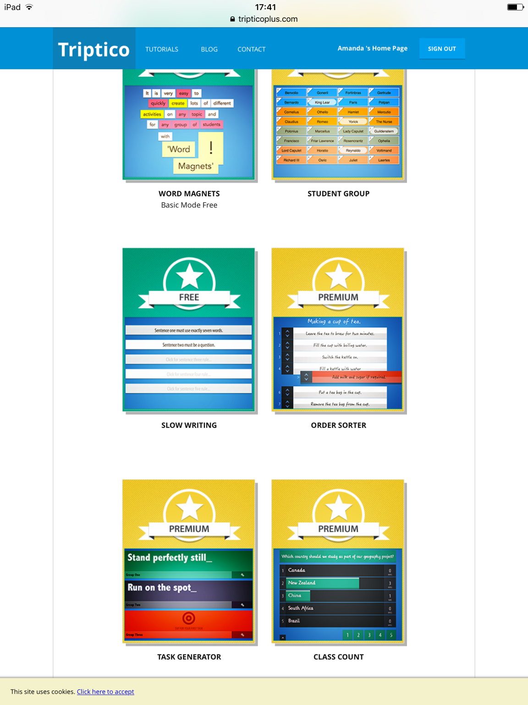
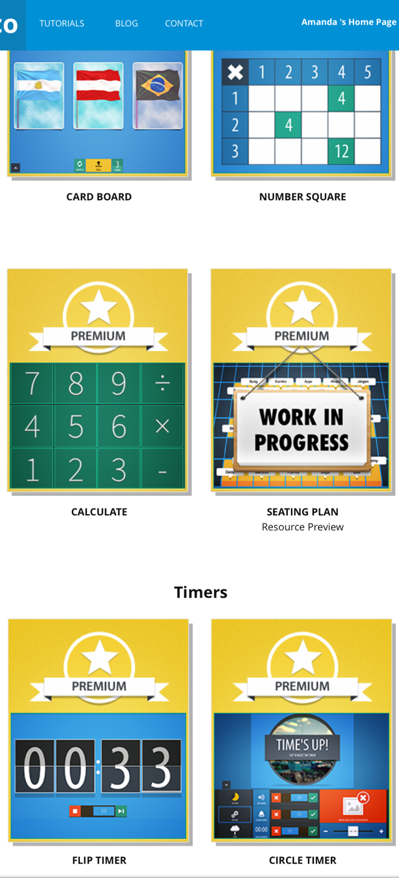
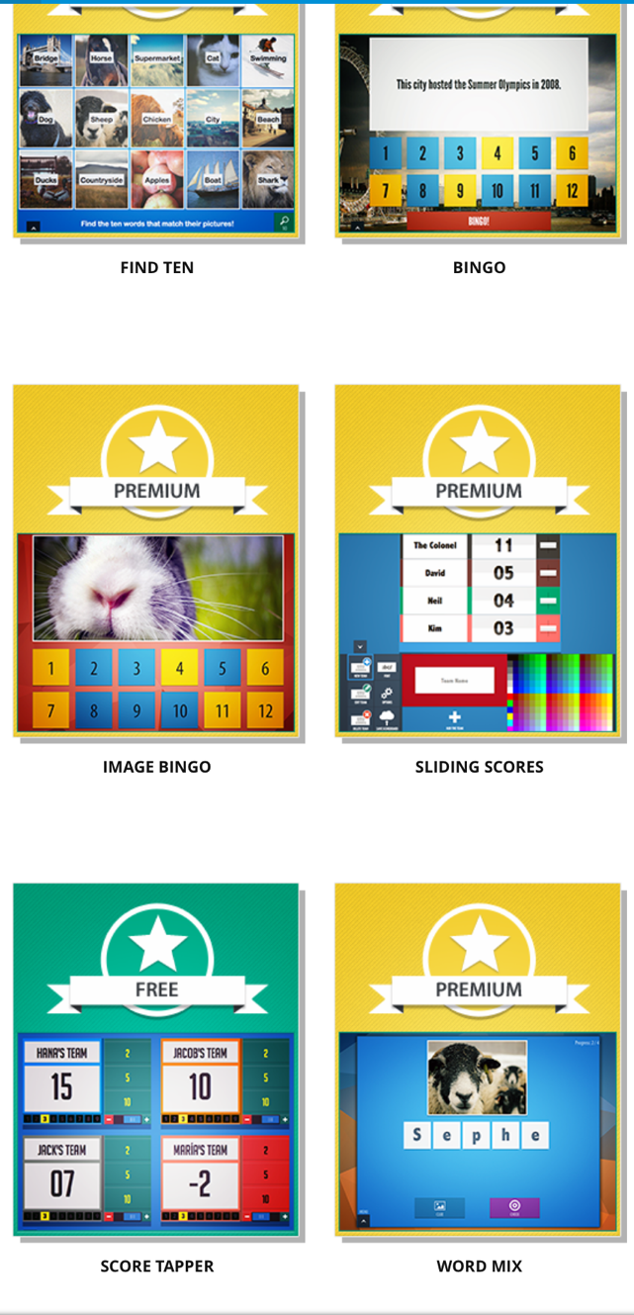
TRIPTICO

Slide 3
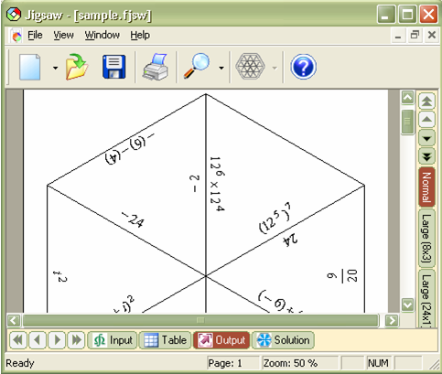
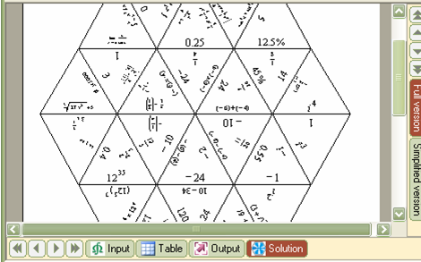
FORMULATOR TARSIA

Slide 4
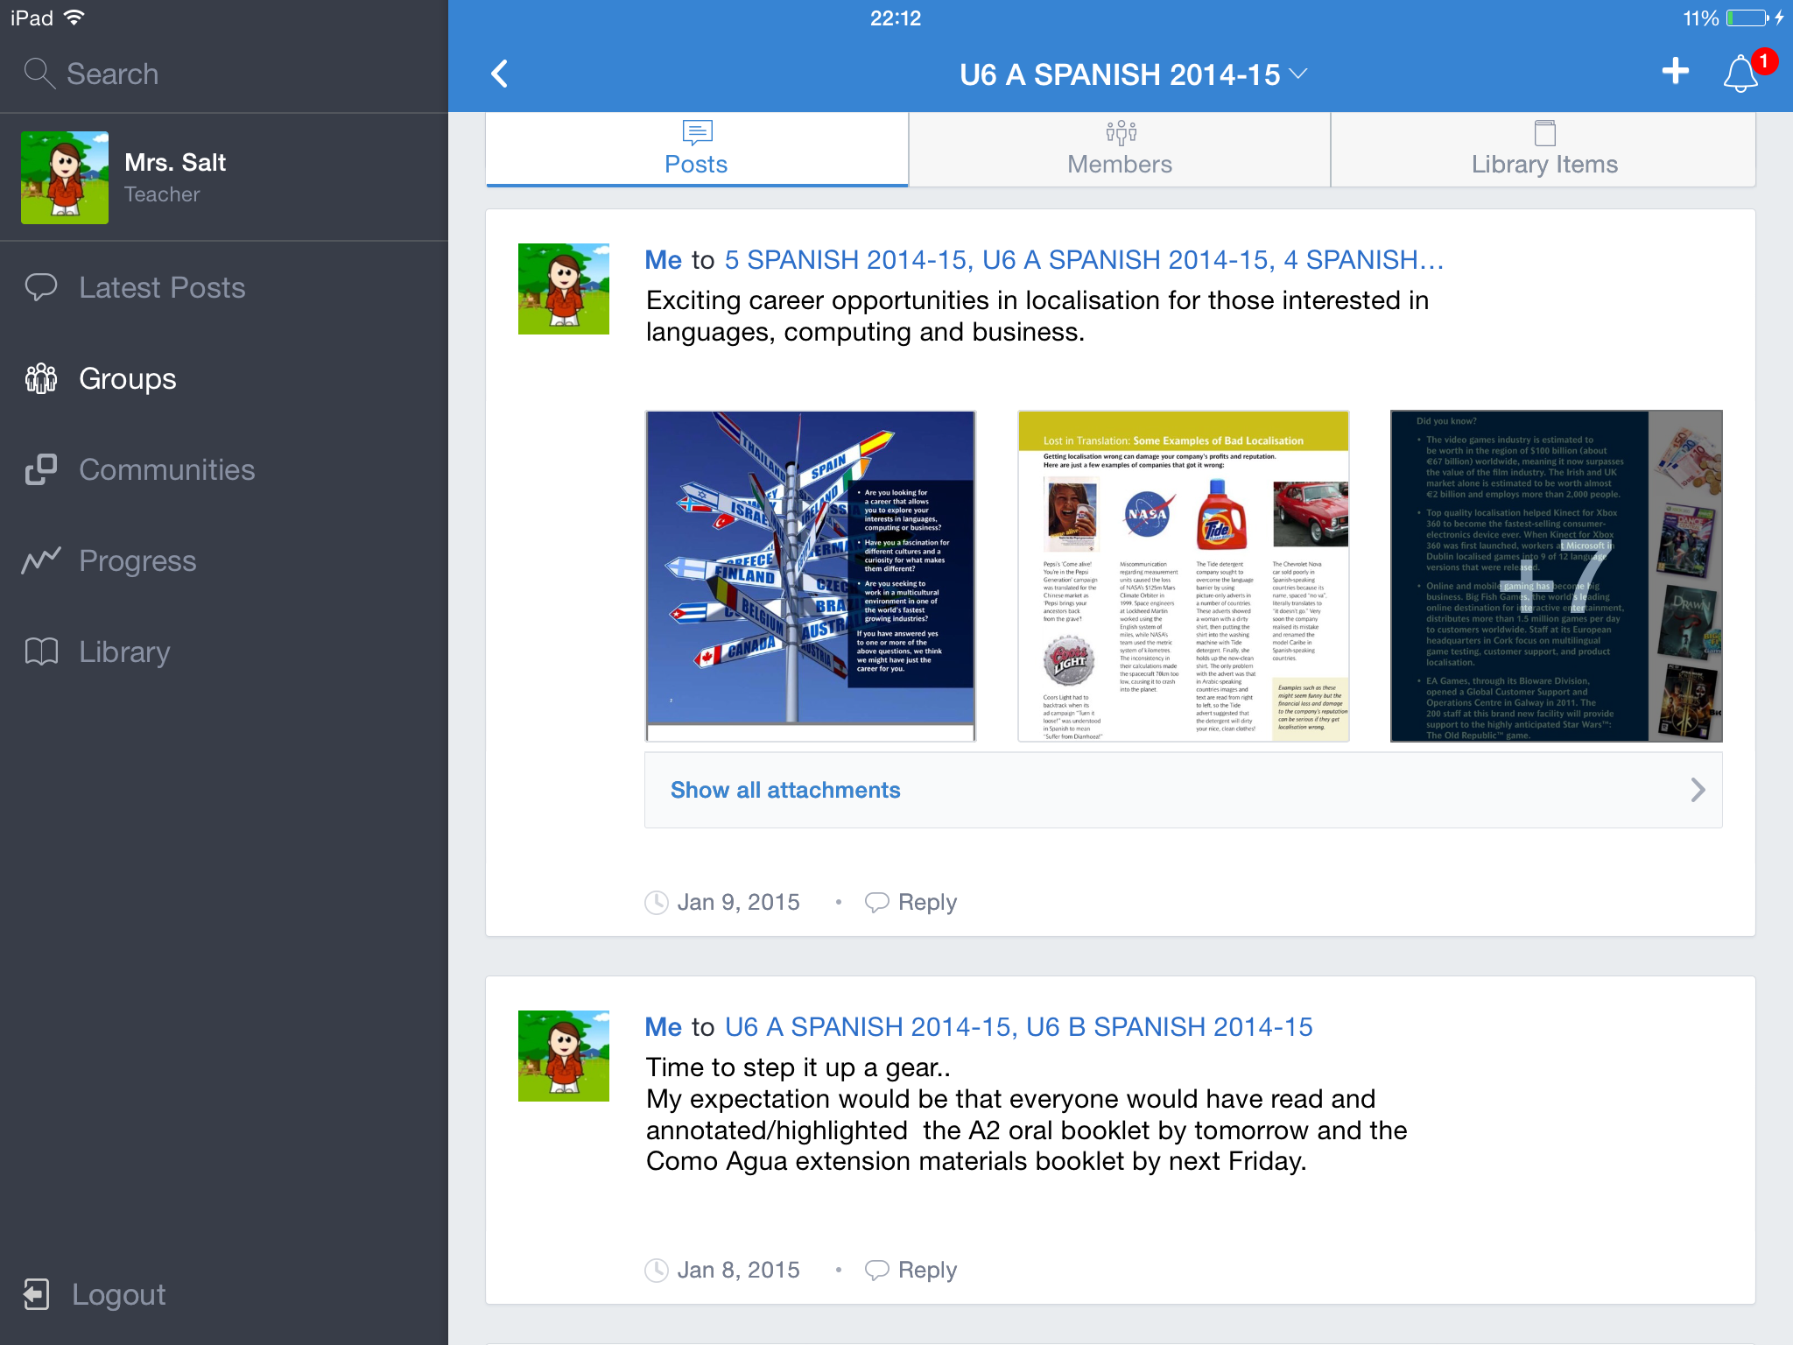
EDMODO
Notes:
Core of iPad use in my classroom. How I share links and info with pupils, how they send work to me and submit via iPads or at home

Slide 5
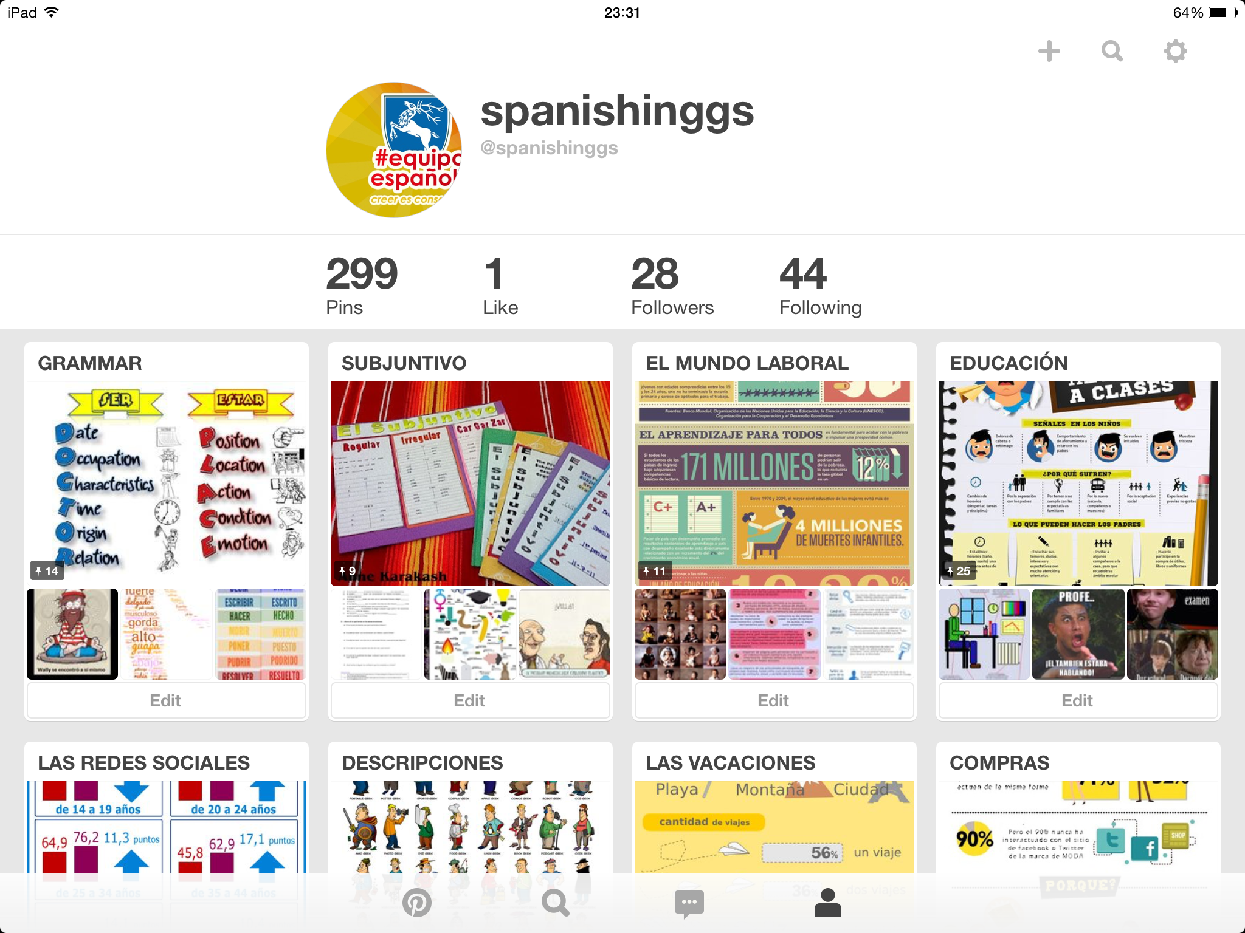
PINTEREST
Notes:
Dept account
Tag resources of interest
Starters in class

Slide 6
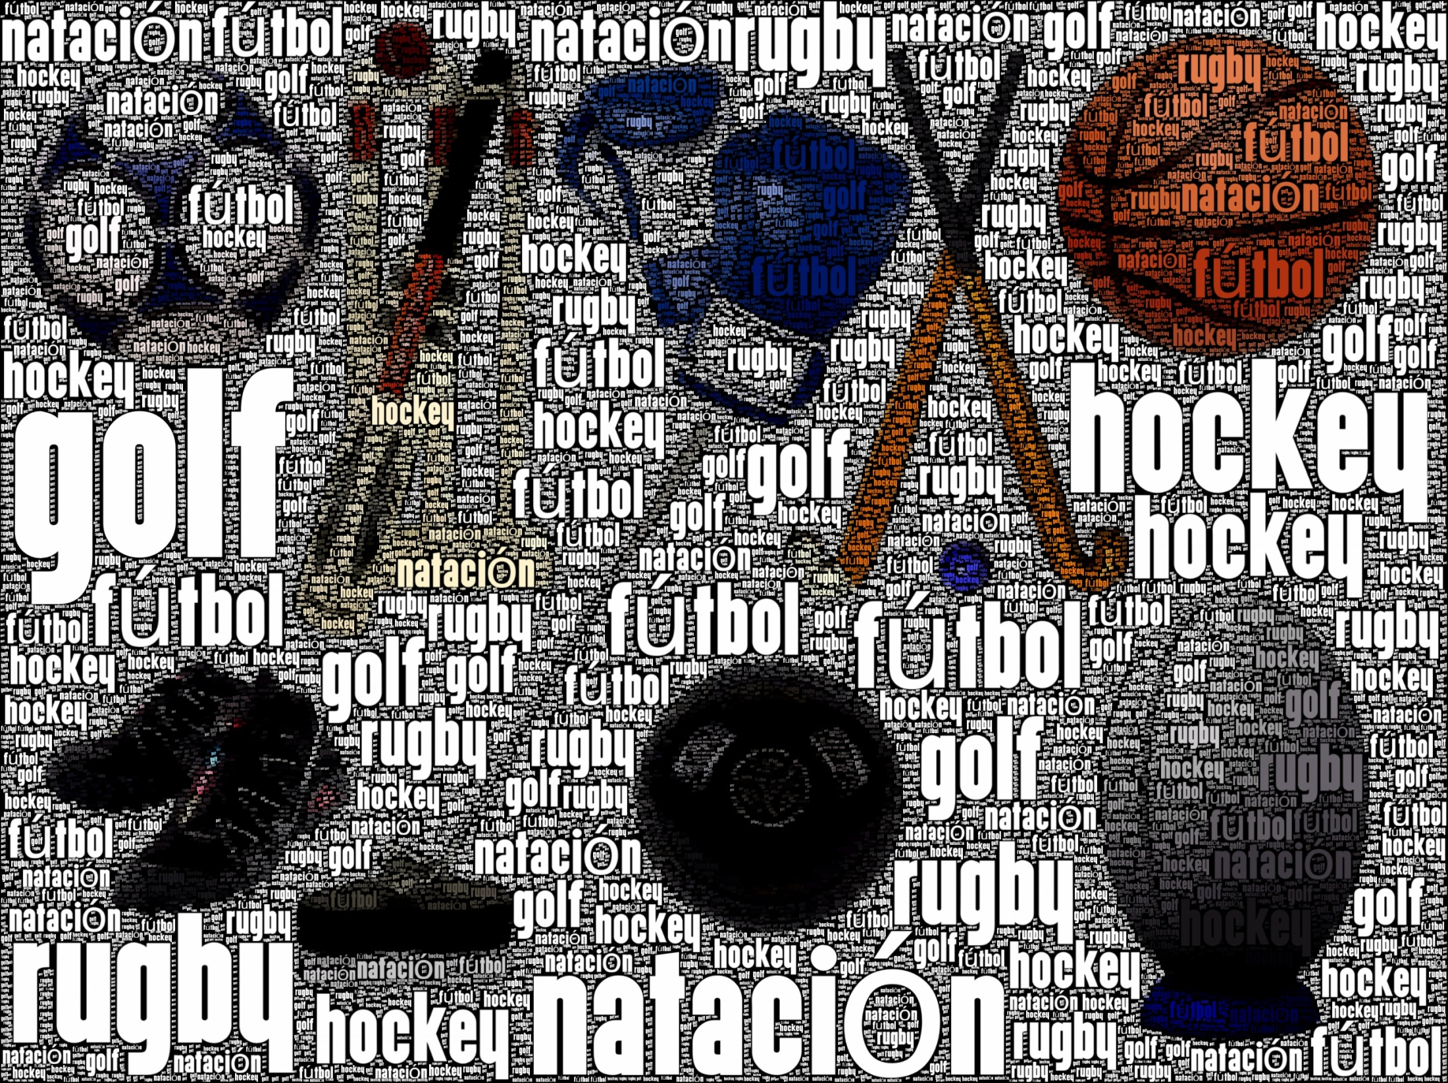
Wordfoto
Notes:
Wordfoto

Slide 7



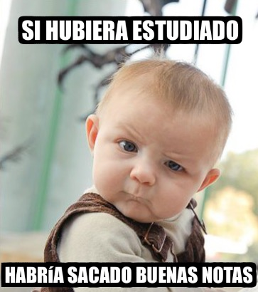
MemeGenerator
Notes:
Wordfoto

Slide 8

http://bighugelabs.com/
Notes:
Wordfoto

Slide 9
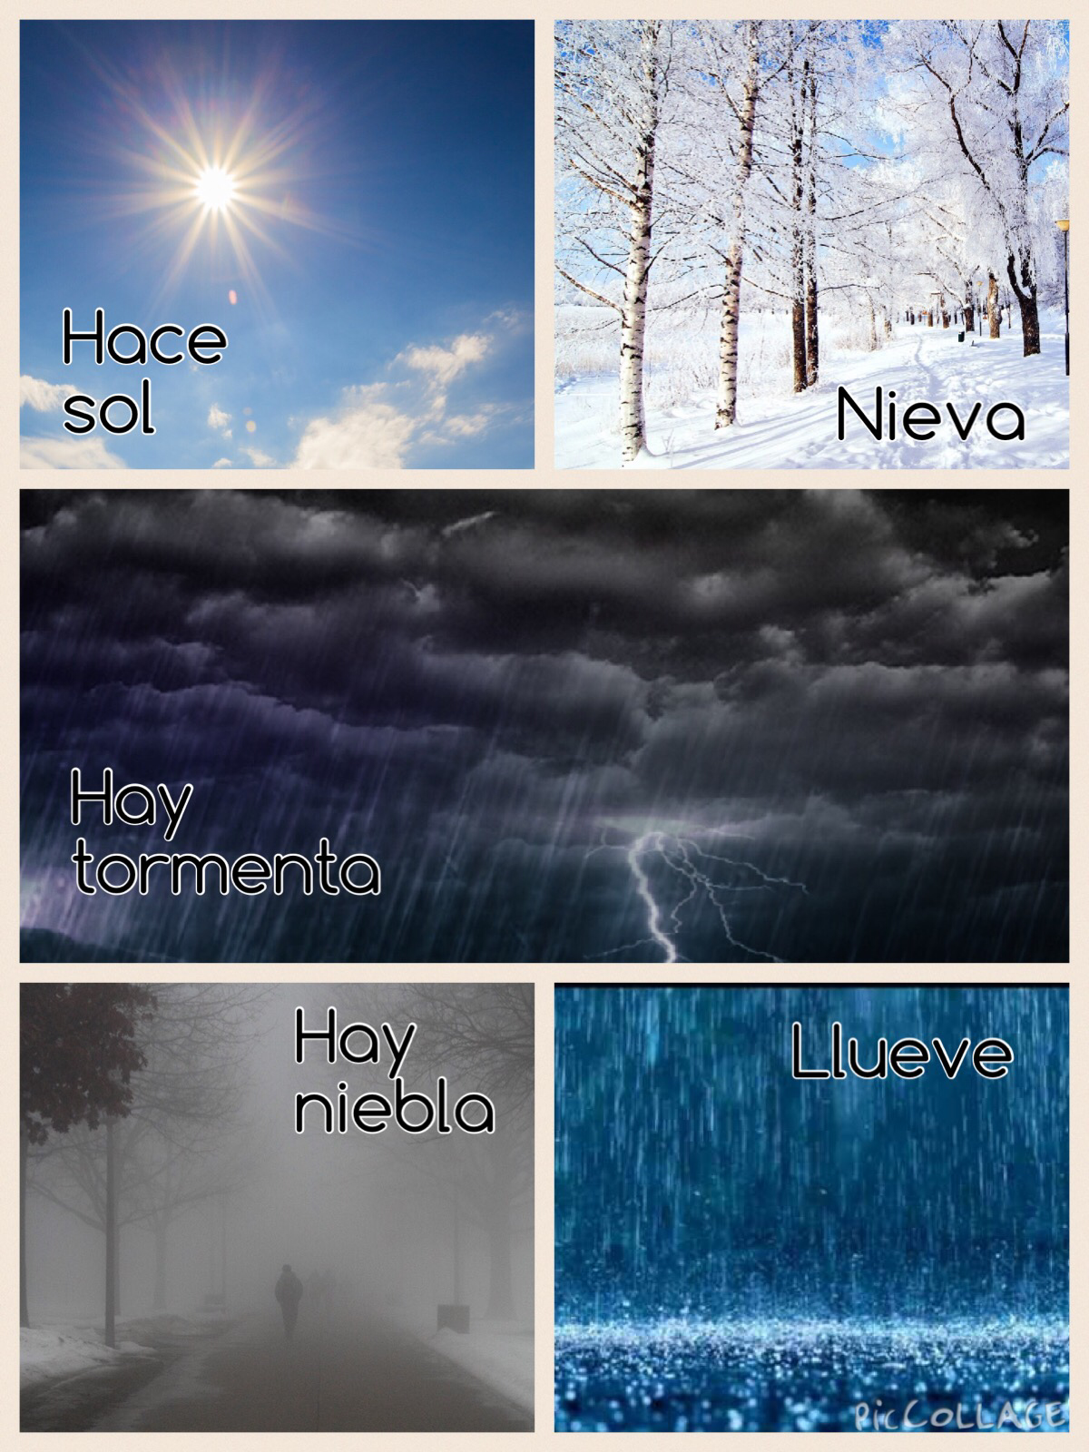
Pic Collage
Notes:
Pic Collage

Slide 10
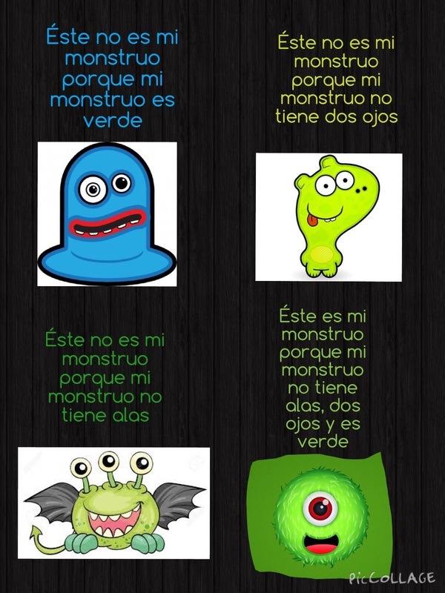
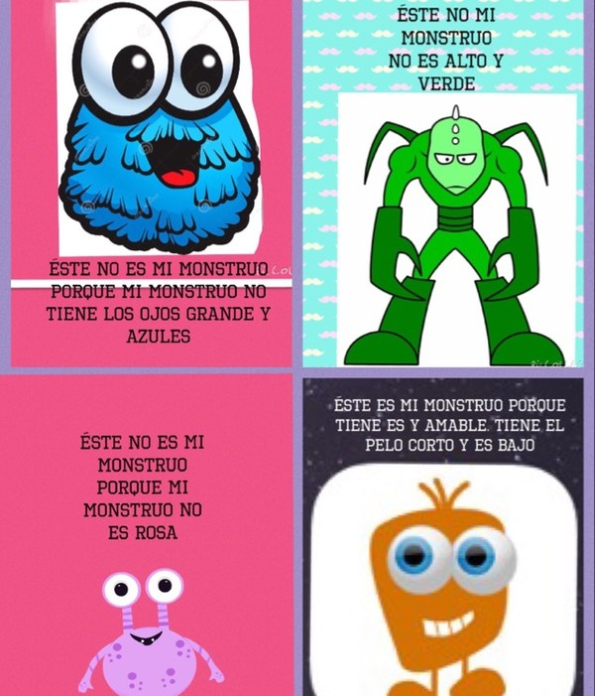
Pic Collage That’s not my monster
Notes:
Tooncamera

Slide 11
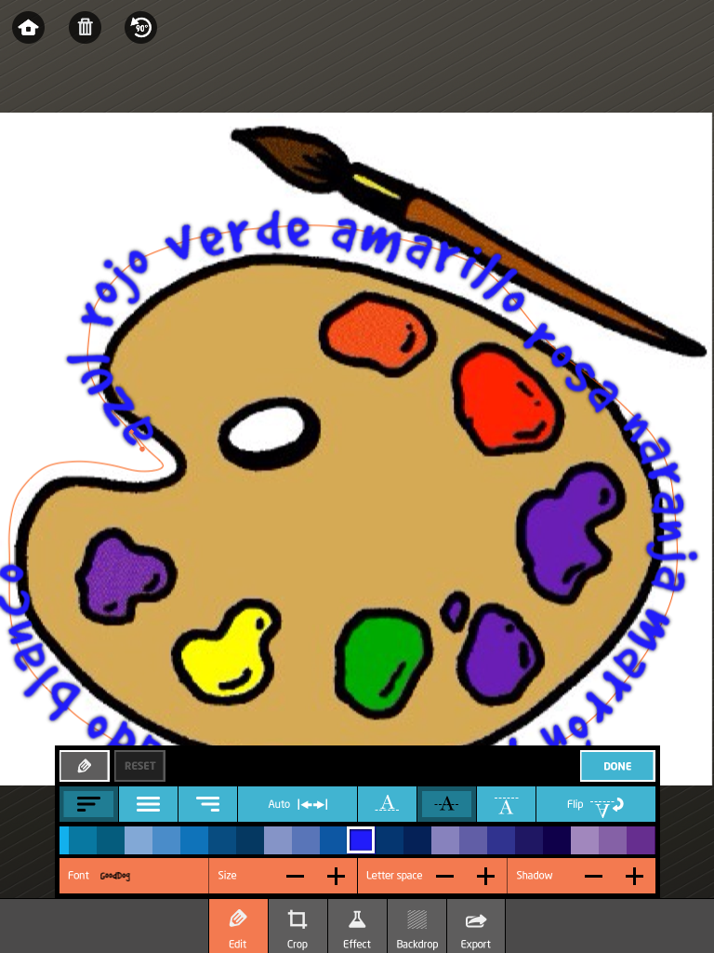
Path on
Notes:
Path On

Slide 12
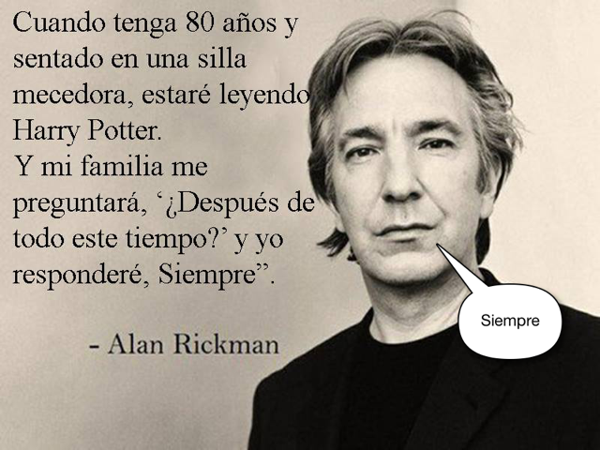
Ballon + stickies
Notes:
Tooncamera

Slide 13
asalt@grosvenorgrammarschool.org.uk
@amandasalt
http://amandasalt.blogspot.com

