Slide 1
Apps (& websites) R Us
PART 2
Amanda Salt
Head of Spanish, Grosvenor Grammar School
asalt@grosvenorgrammarschool.org.uk
http://amandasalt.blogspot.com
@amandasalt

Slide 2

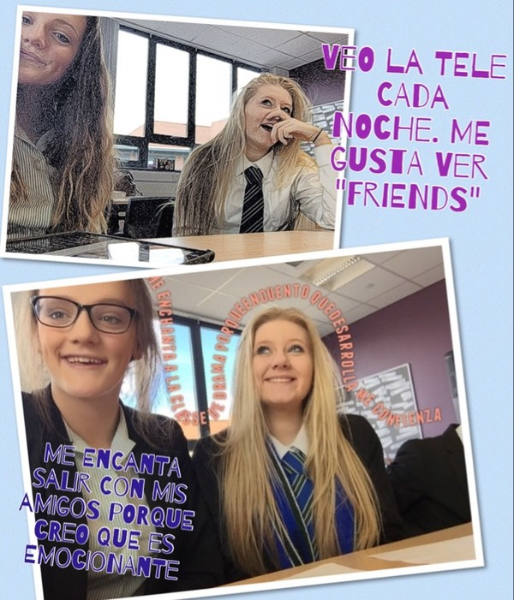
App smashing (Path On & Pic Collage, uploaded to Edmodo)
Notes:
Tooncamera

Slide 3
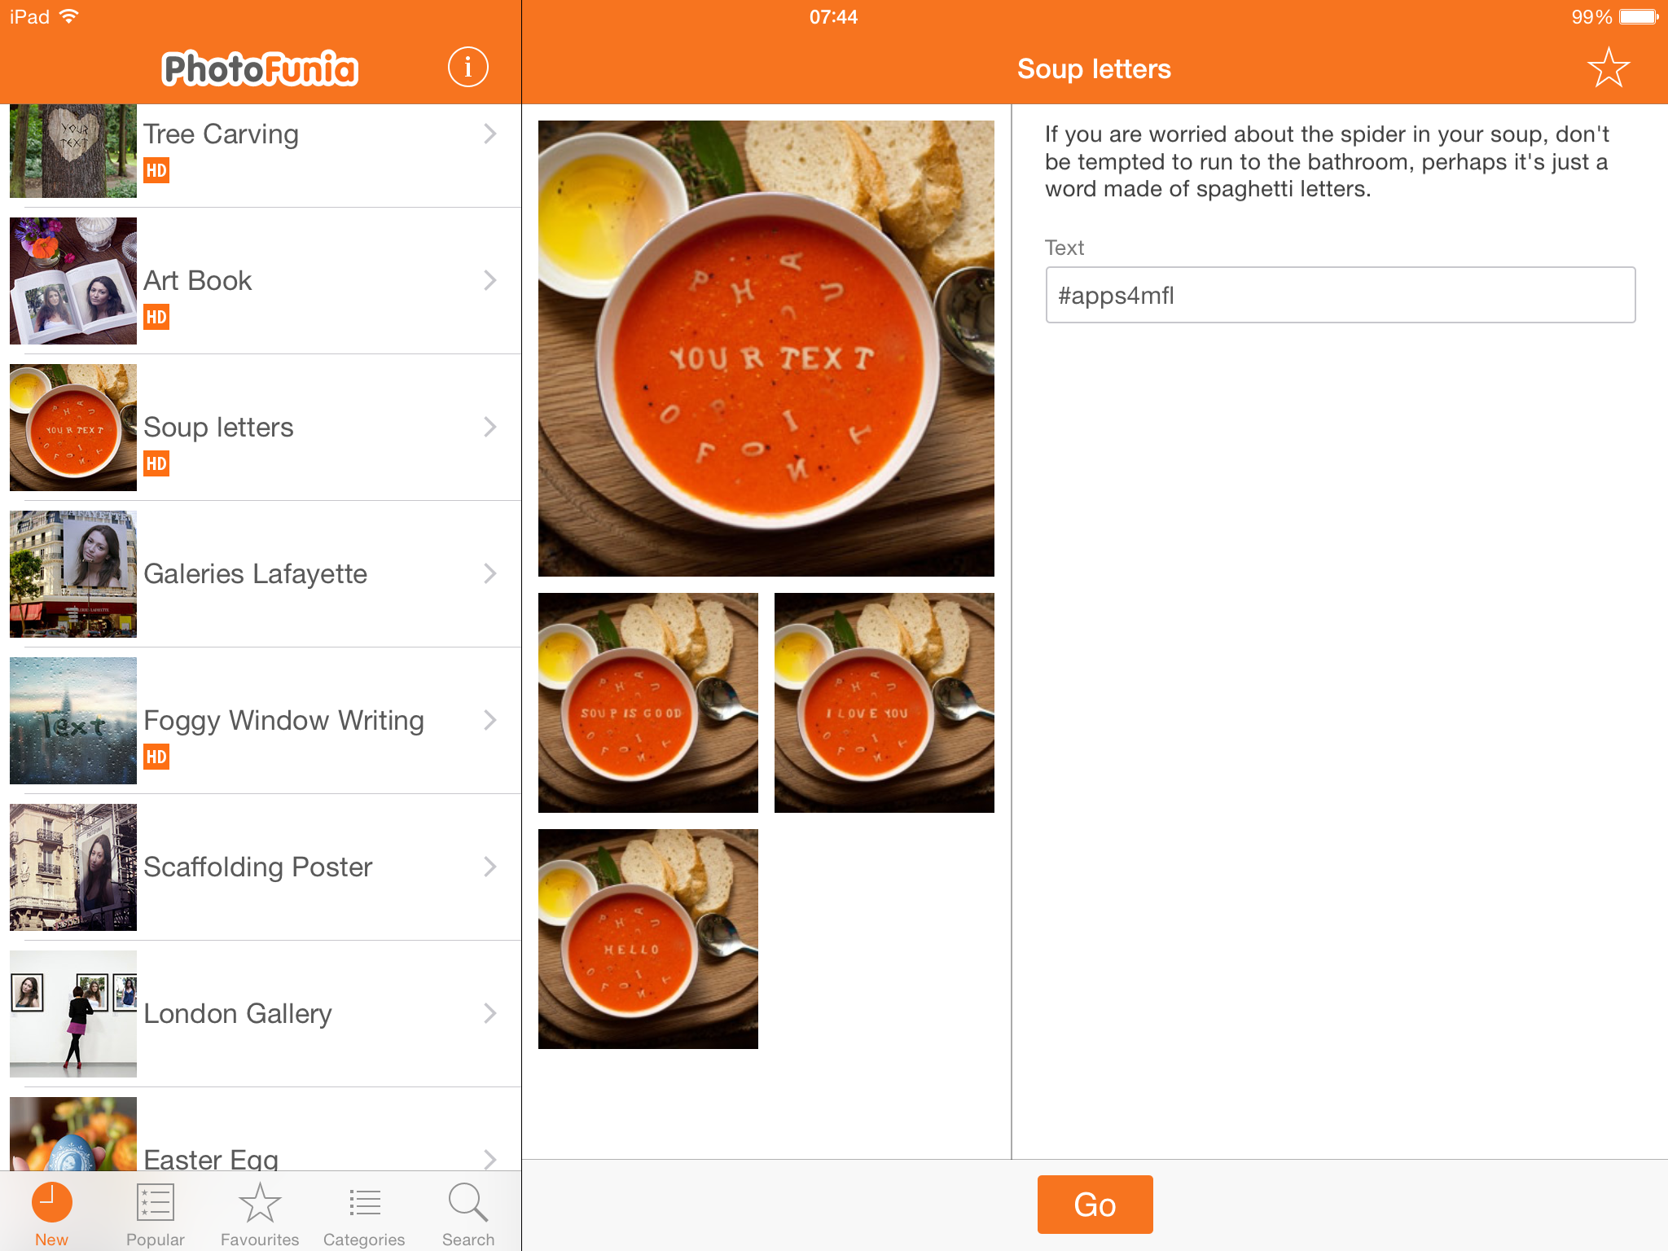
PhotoFunia
Notes:
Tooncamera

Slide 4
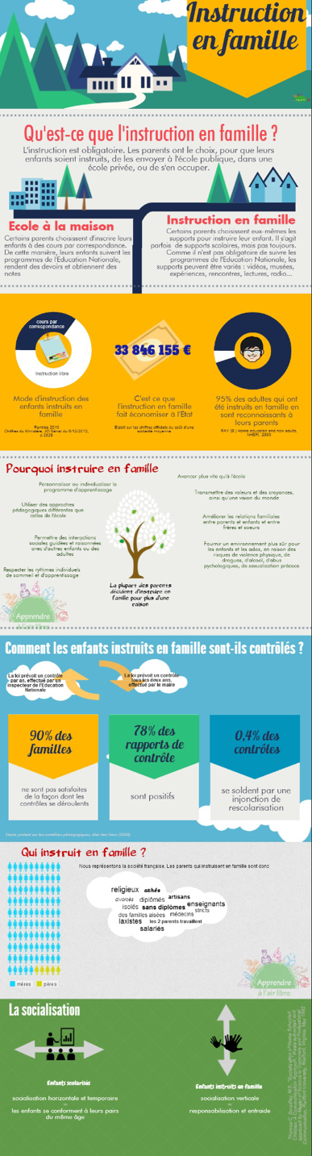
Piktochart
Notes:
Tooncamera

Slide 5

Newsbooth
Notes:
Tooncamera

Slide 6
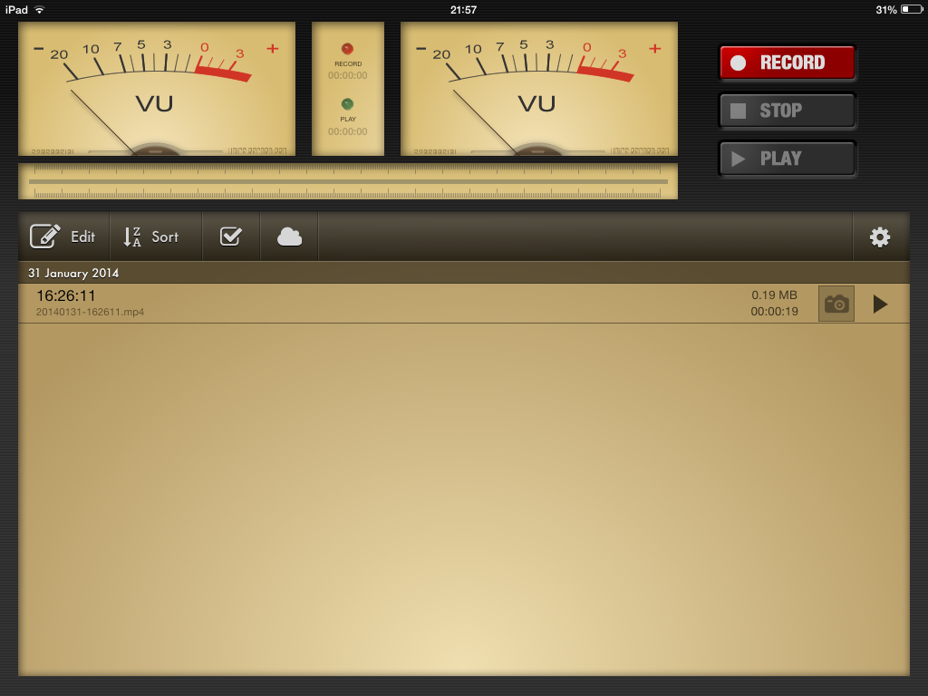
Voice Record Pro

Slide 7
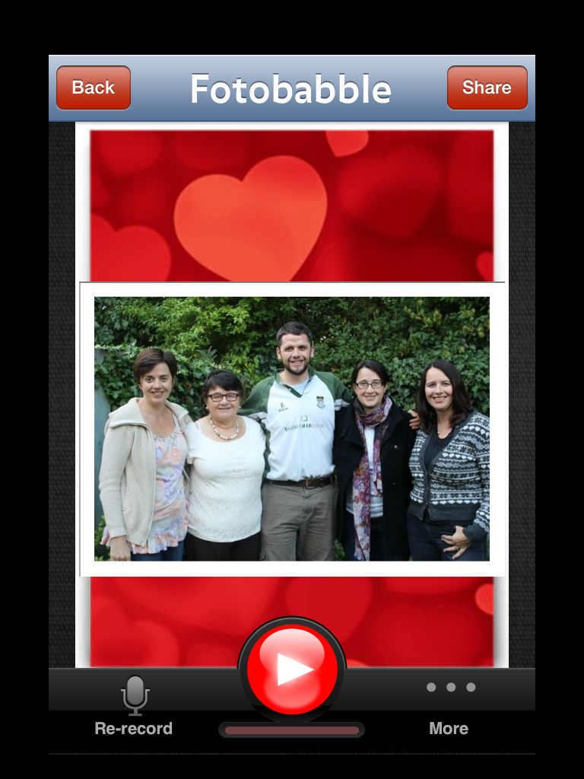

Slide 8
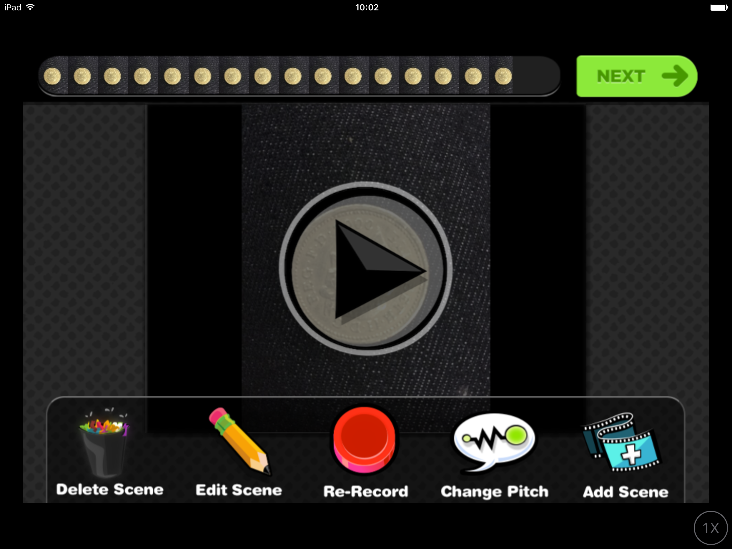
Yakit Kids

Slide 9

Decide Now
Notes:
Decide Now!

Slide 10

Heads Up!

Slide 11
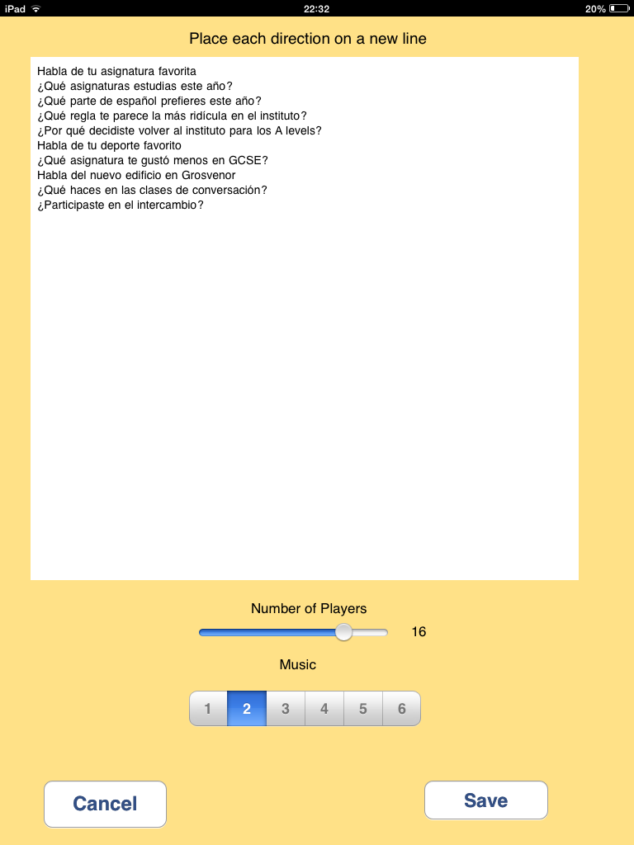
Pass the parcel
Notes:
Pass the Parcel

Slide 12
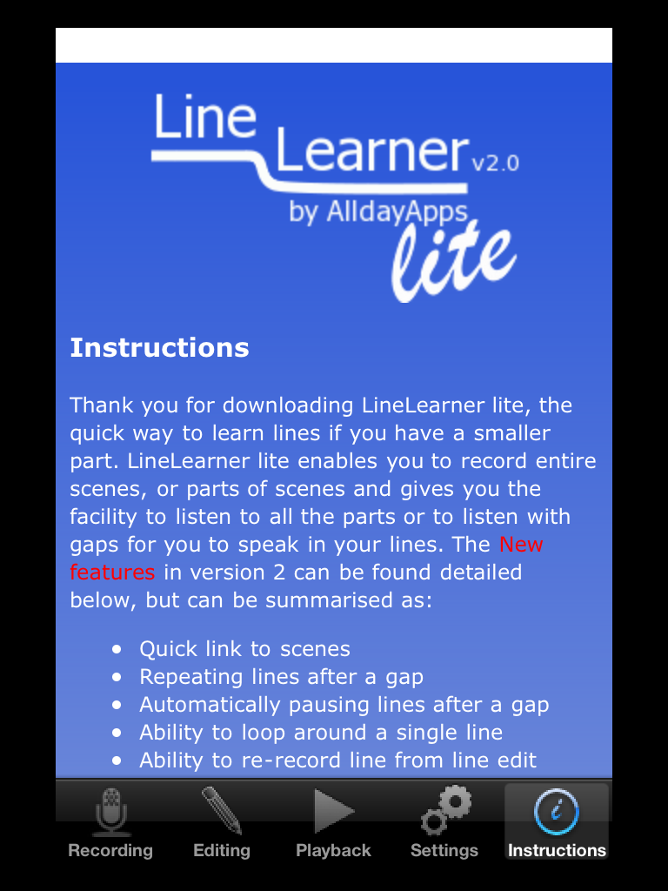

Slide 13
asalt@grosvenorgrammarschool.org.uk
@amandasalt
http://amandasalt.blogspot.com

