Slide 1
Apps (& websites) R Us PART 3
Amanda Salt
Head of Spanish, Grosvenor Grammar School
asalt@grosvenorgrammarschool.org.uk
http://amandasalt.blogspot.com
@amandasalt

Slide 2
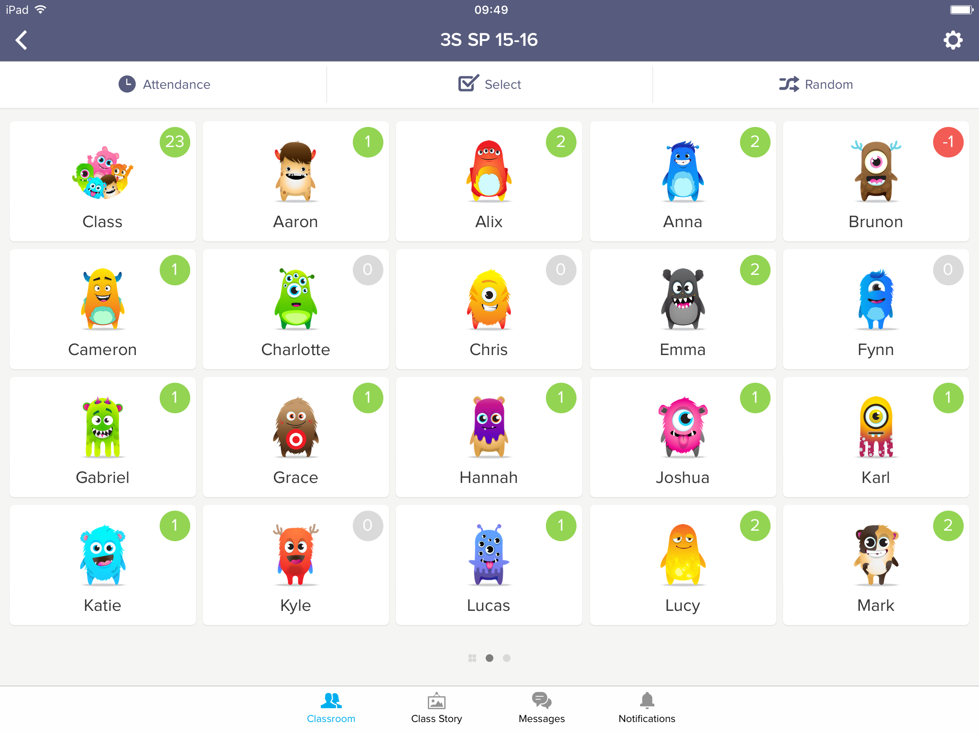
Class Dojo
Notes:
Popplet

Slide 3

Tap Roulette
Notes:
Tap Roulette

Slide 4
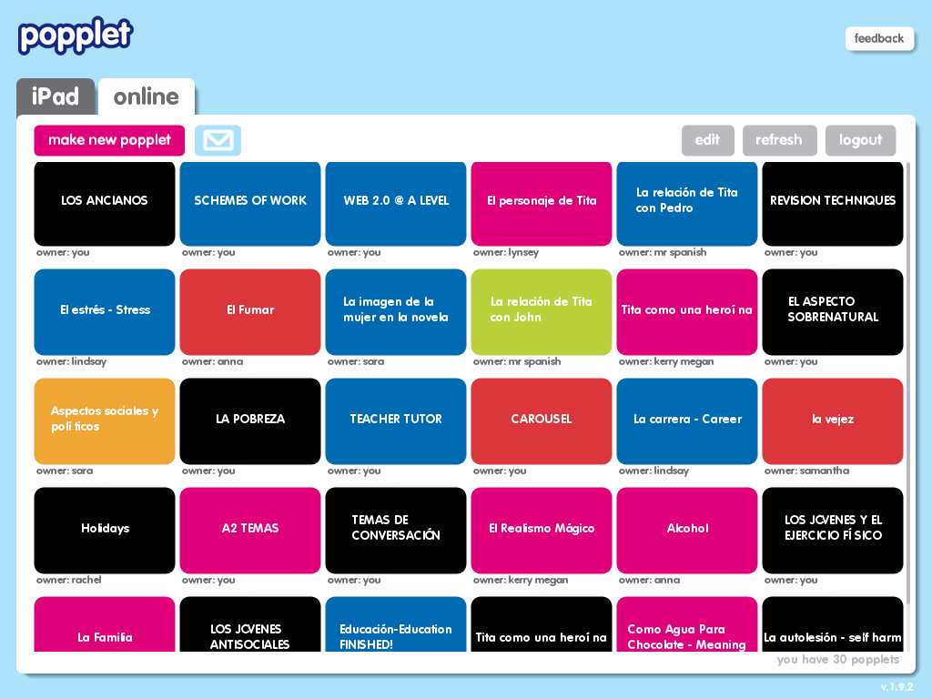
Notes:
Popplet

Slide 5
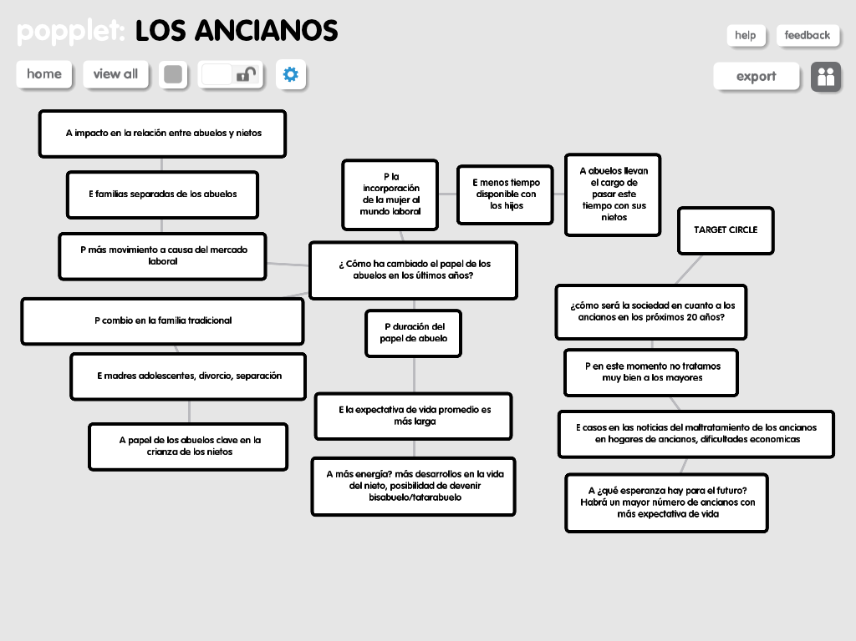
Notes:
Popplet for essay planning

Slide 6
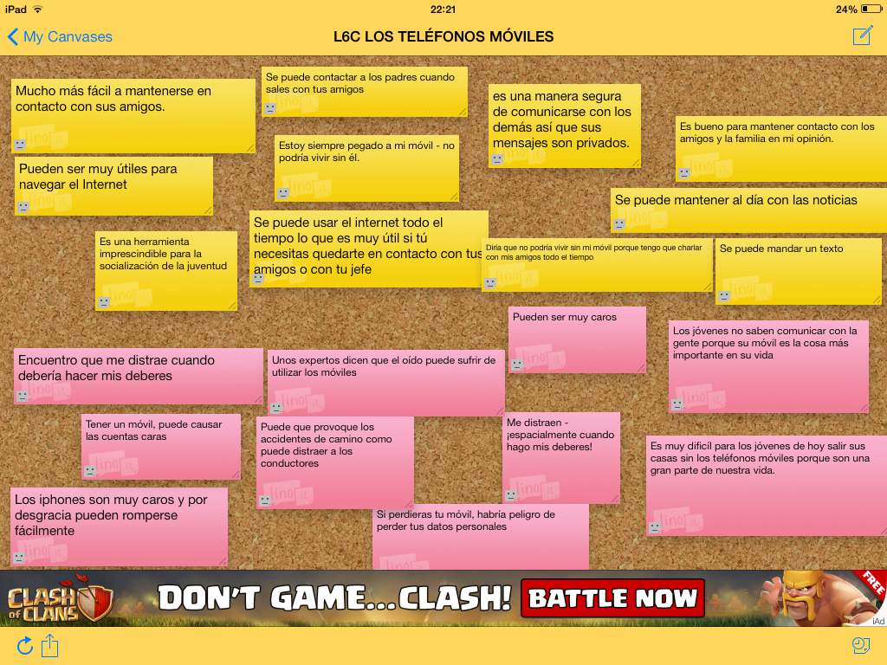
Linoit

Slide 7
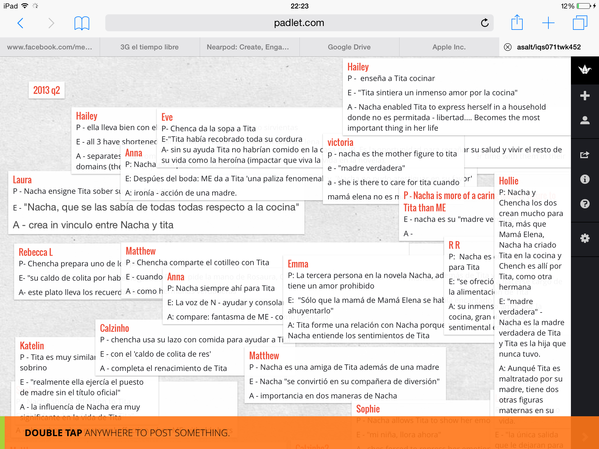
Padlet
Notes:
Popplet for essay planning

Slide 8
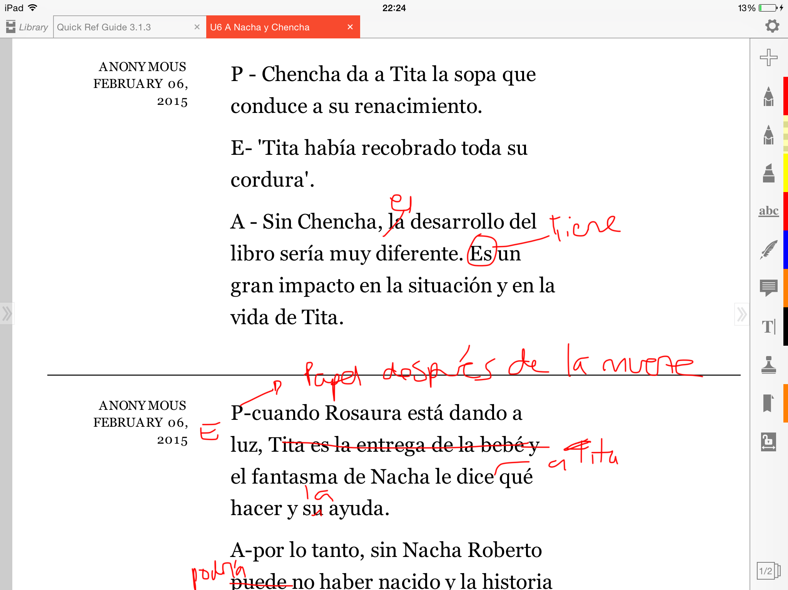
iAnnotate
Notes:
Popplet for essay planning

Slide 9
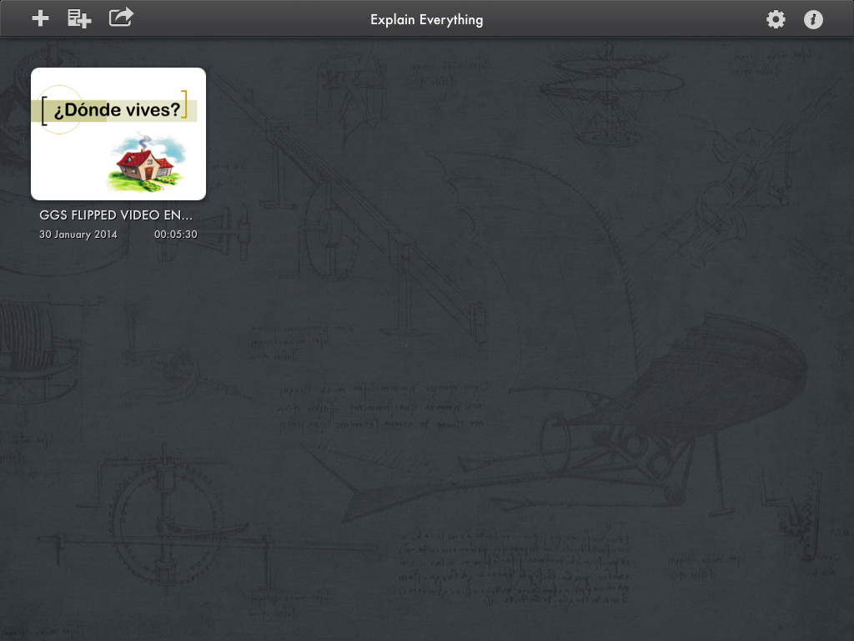
Explain Everything
Notes:
Explain Everything

Slide 10
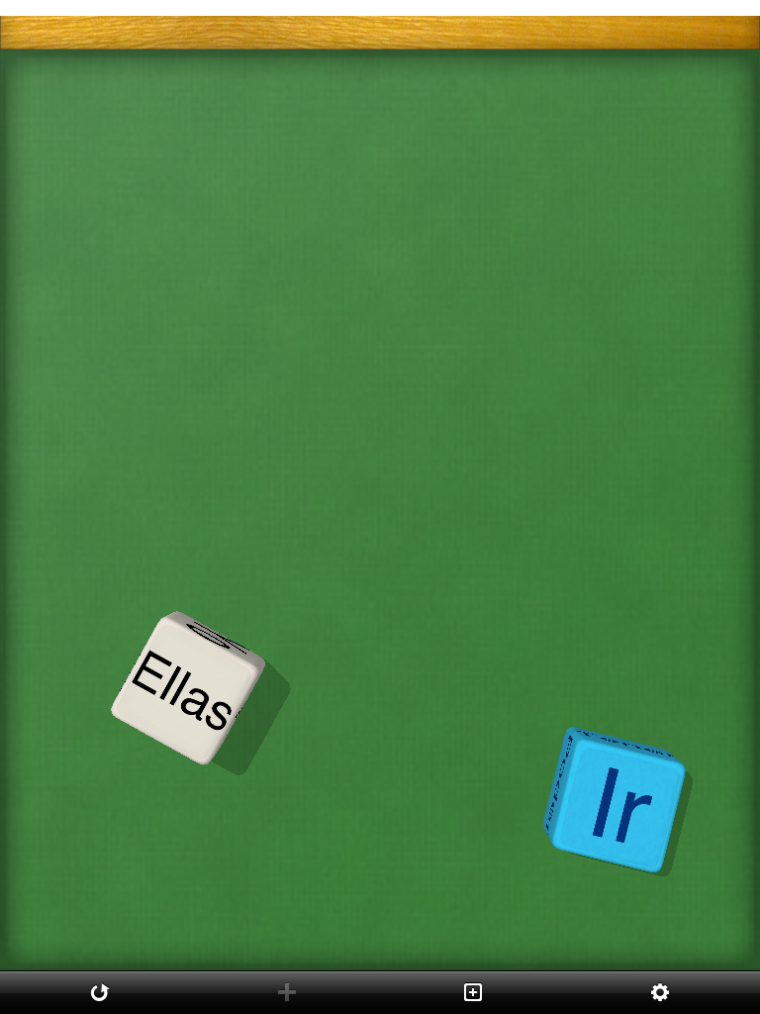
Make Dice Lite
Notes:
Make Dice Lite

Slide 11


Slide 12
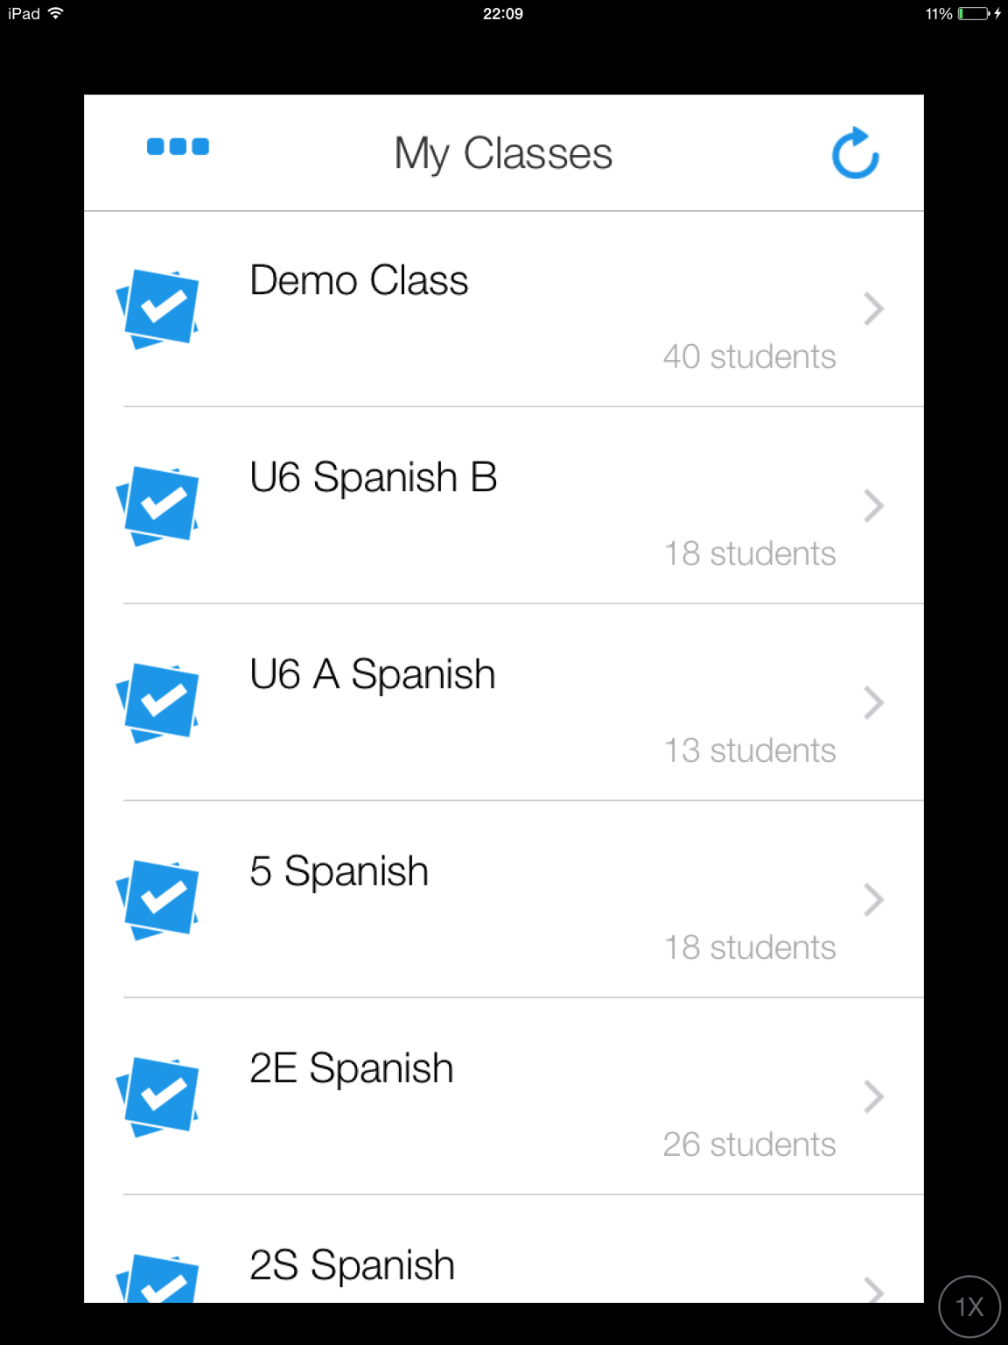
Plickers
Notes:
Self assessment
Pupil voice

Slide 13
asalt@grosvenorgrammarschool.org.uk
@amandasalt
http://amandasalt.blogspot.com

