Slide 1
Apps (& websites) R Us
PART 4
Amanda Salt
Head of Spanish, Grosvenor Grammar School
asalt@grosvenorgrammarschool.org.uk
http://amandasalt.blogspot.com
@amandasalt

Slide 2
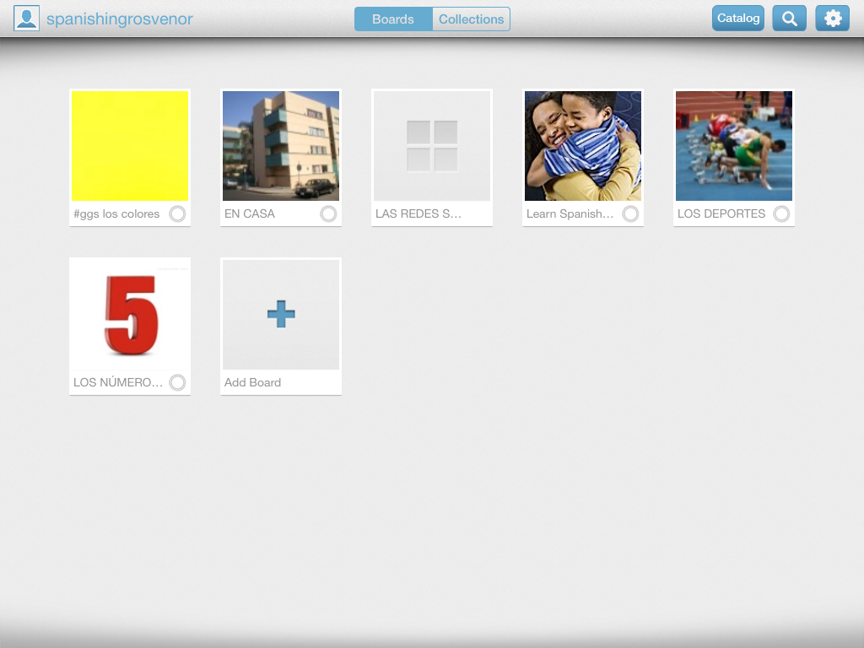
Bitsboard

Slide 3
asalt@grosvenorgrammarschool.org.uk
@amandasalt
http://amandasalt.blogspot.com

