Slide 1
Apps (& websites) R Us
PART 6
Amanda Salt
Head of Spanish, Grosvenor Grammar School
asalt@grosvenorgrammarschool.org.uk
http://amandasalt.blogspot.com
@amandasalt

Slide 2
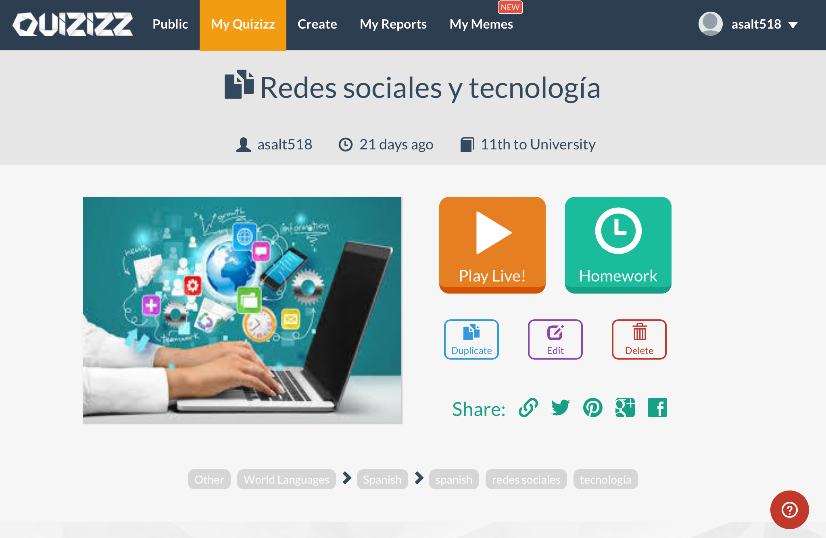
quizizz.com
Notes:
Getkahoot

Slide 3
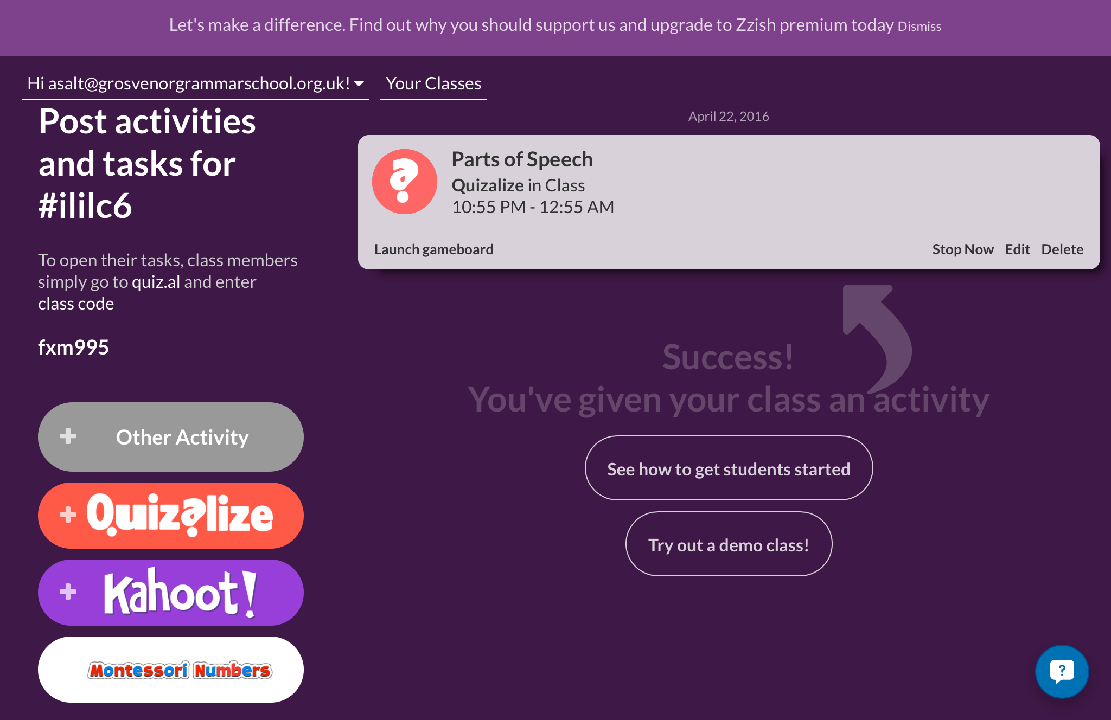
quizalize.com
Notes:
Getkahoot

Slide 4
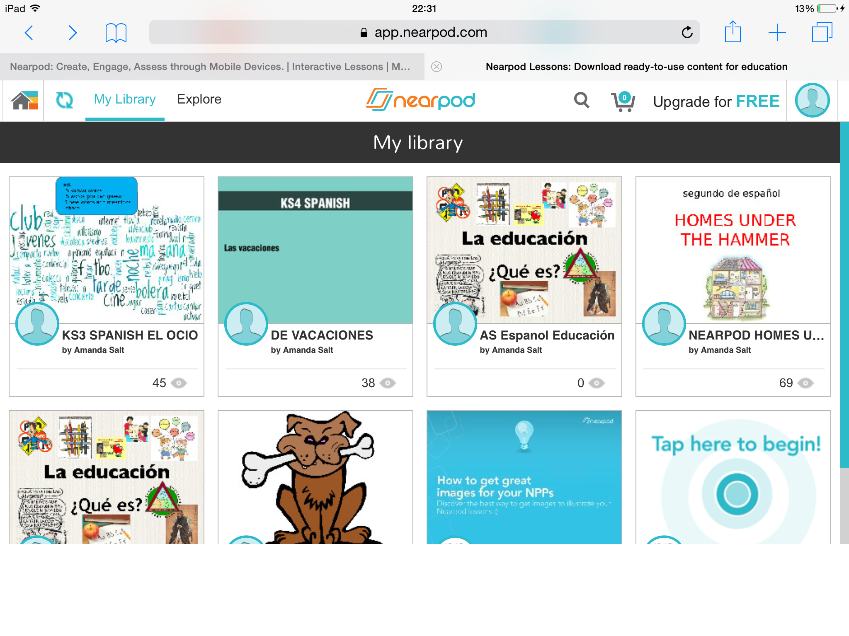
Nearpod
Notes:
Nearpod

Slide 5
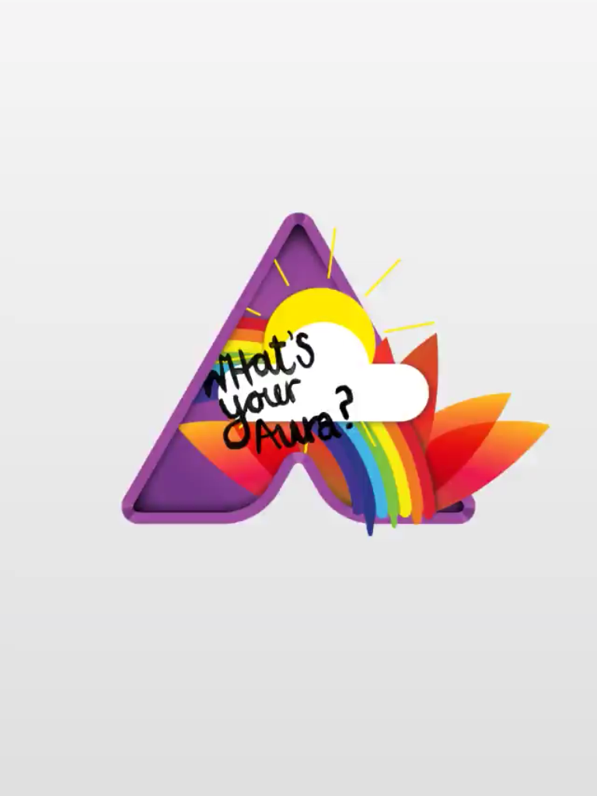
Aurasma
Notes:
Aurasma

Slide 6
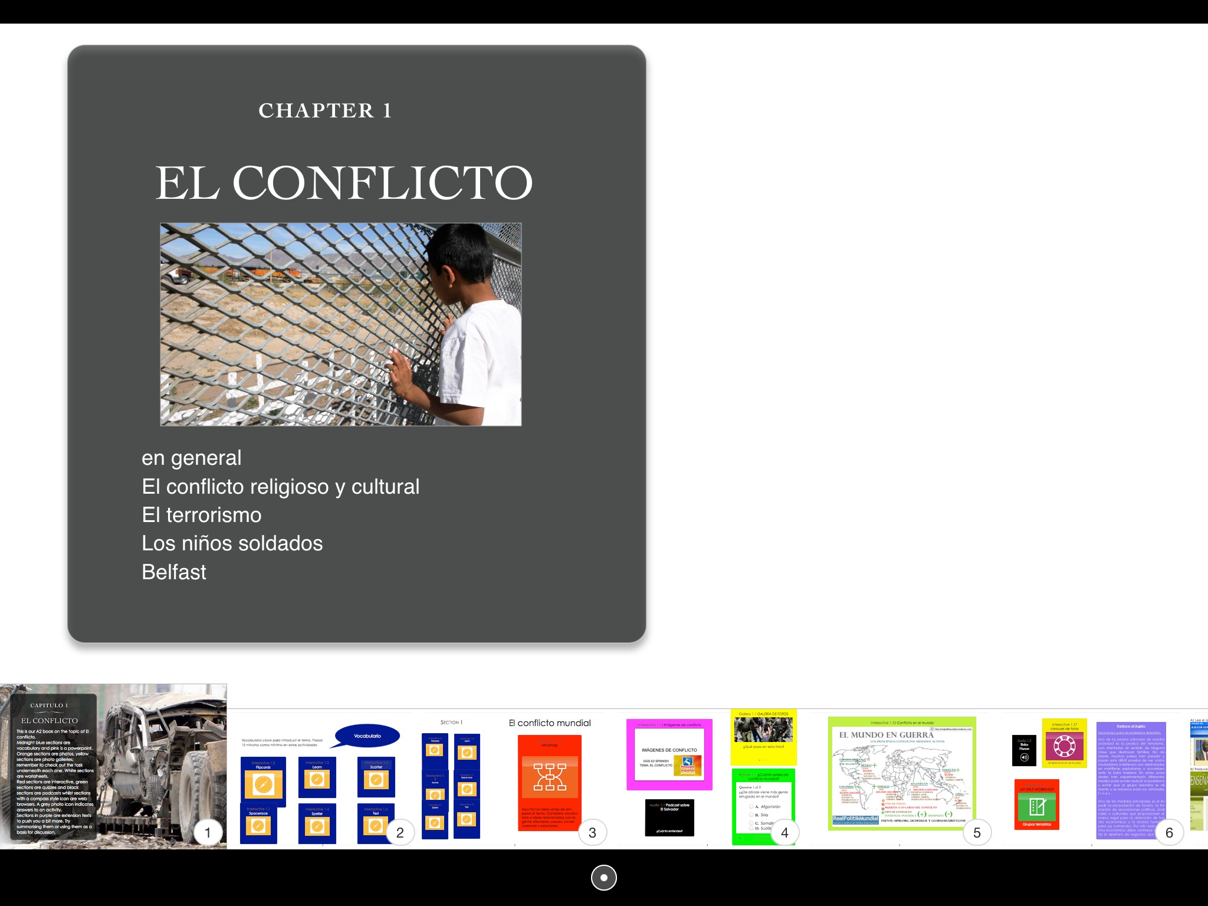
iBooks
iBooks Author
Notes:
The next level
1:1 best and preferably their own – highlighting etc

Slide 7
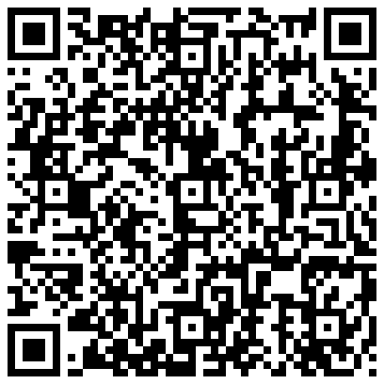
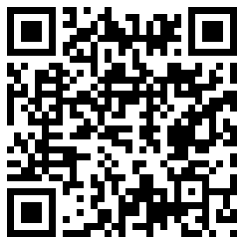
MFL APPS GOOGLE DOC
APPS & WEBSITES LIVEBINDERS

Slide 8
asalt@grosvenorgrammarschool.org.uk
@amandasalt
http://amandasalt.blogspot.com

