Slide 1
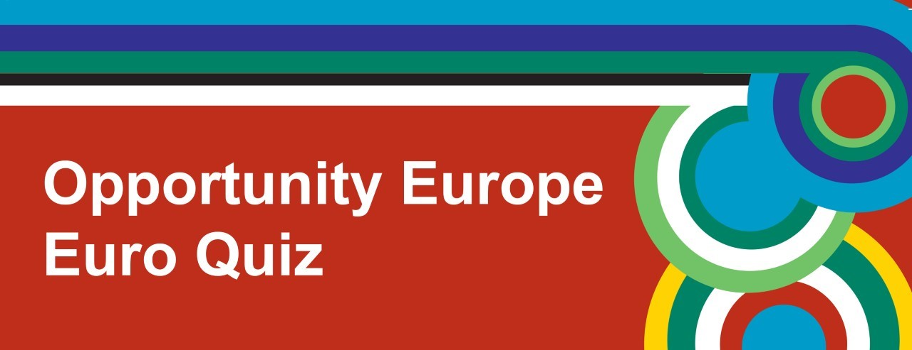




Slide 2
Questions & Answers (Includes links to music online)

Slide 3
Round 1
Geography

Slide 4
1. What is the only EU Member State to have the same name as its capital city?
Luxembourg
Slovakia
Estonia

Slide 5
2. Which country does NOT have a shoreline on the Mediterranean sea?
Slovenia
Spain
Italy

Slide 6
3. Which country became the newest Member State of the EU when it joined in July 2013?
Slovenia
Croatia
Portugal

Slide 7
4. The UK has over 6,000 islands; what European country has over 175,000?
Finland
Greece
Sweden

Slide 8
5. Which of the following countries has a capital city which is not actually its largest city?
Malta
Latvia
Denmark

Slide 9
6. Europe’s hottest ever temperature was recorded at 48° C. Where did this happen?
Greece
Spain
Norway

Slide 10
Round 2
Music

Slide 11
1. This is the national anthem of which EU Member State? https://www.youtube.com/watch?v=5g4fhqCSdLQ
England
France
Germany

Slide 12
2. Which European language is Shakira singing in? https://www.youtube.com/watch?v=a8Rwz6zBJSE
Portuguese
Dutch
Spanish

Slide 13
3. What is the name of this Irish instrument? https://www.youtube.com/watch?v=Mwxga8udIio
Uilleann pipes
Bagpipes
Panpipes

Slide 14
4. What country does this famous reality show judge and singer come from? https://www.youtube.com/watch?v=kWvbJsB0OBc
Wales
Scotland
Ireland

Slide 15
5. ‘The Planets’ is by a famous classical composer from where? https://www.youtube.com/watch?v=Isic2Z2e2xs
Norway
Sweden
England

Slide 16
6. What is the name of this type of Spanish music? https://www.youtube.com/watch?v=E3EpPROnl6w
Tango
Salsa
Flamenco

Slide 17
Round 3
Daily Life and Culture

Slide 18
1. Hallowe’en is a pagan festival which originated in which country?
Scotland
England
Ireland

Slide 19
2. What is the usual time to eat dinner in Spain?
3pm
5.30pm
10pm

Slide 20
3. Many Irish family names start with “Mac” or “O’...”, but what do they mean?
Daughter and son of...
Grandfather and grandmother of...
Grandson of and descended from...

Slide 21
4. In which country does the ‘Bundesliga’ take place?
Germany
Italy
Denmark

Slide 22
5. The Velvet Revolution is traditionally associated with which two former communist EU Member States?
Czech Republic and Slovakia
Poland and Hungary
France and Spain

Slide 23
6. The Magyar people originate from which EU Member State?
Hungary
Lithuania
Spain

Slide 24
Round 4
Faces and Places

Slide 25
Faces and Places
Include the following on answer sheets:
School Name
Name of celebrity / famous landmark AND
Name of country they come from / can be found in

Slide 26
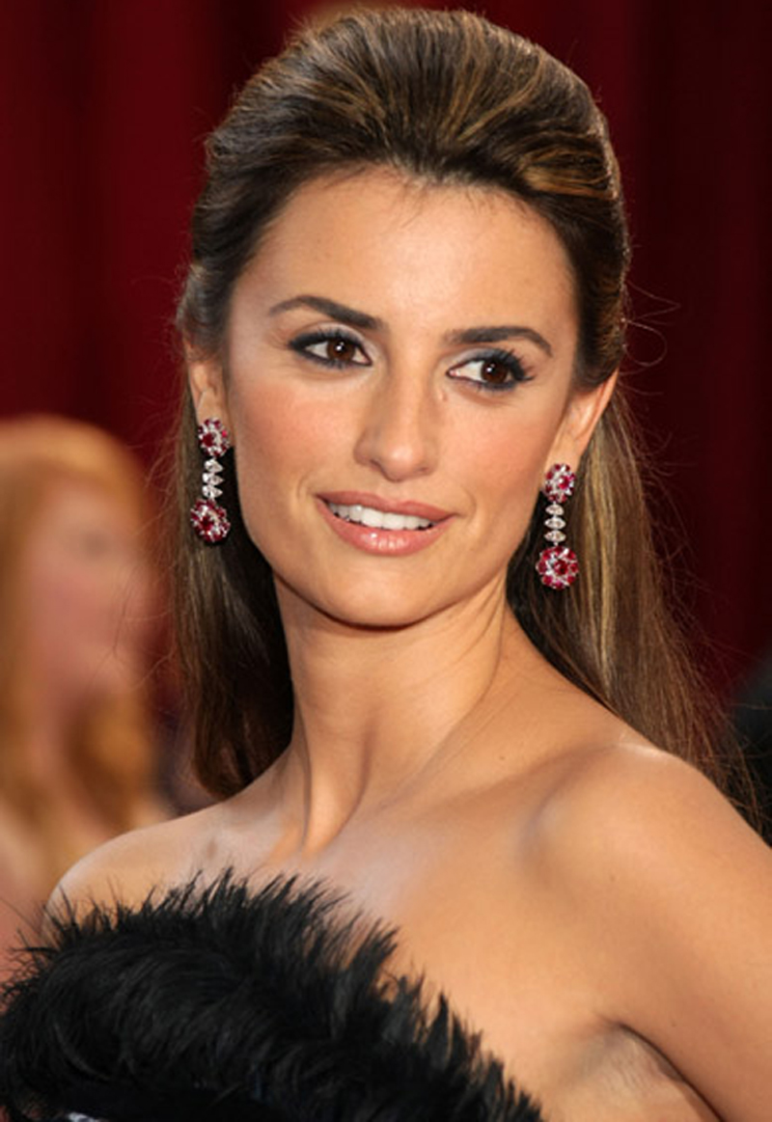
Penélope Cruz
1.
Spain

Slide 27
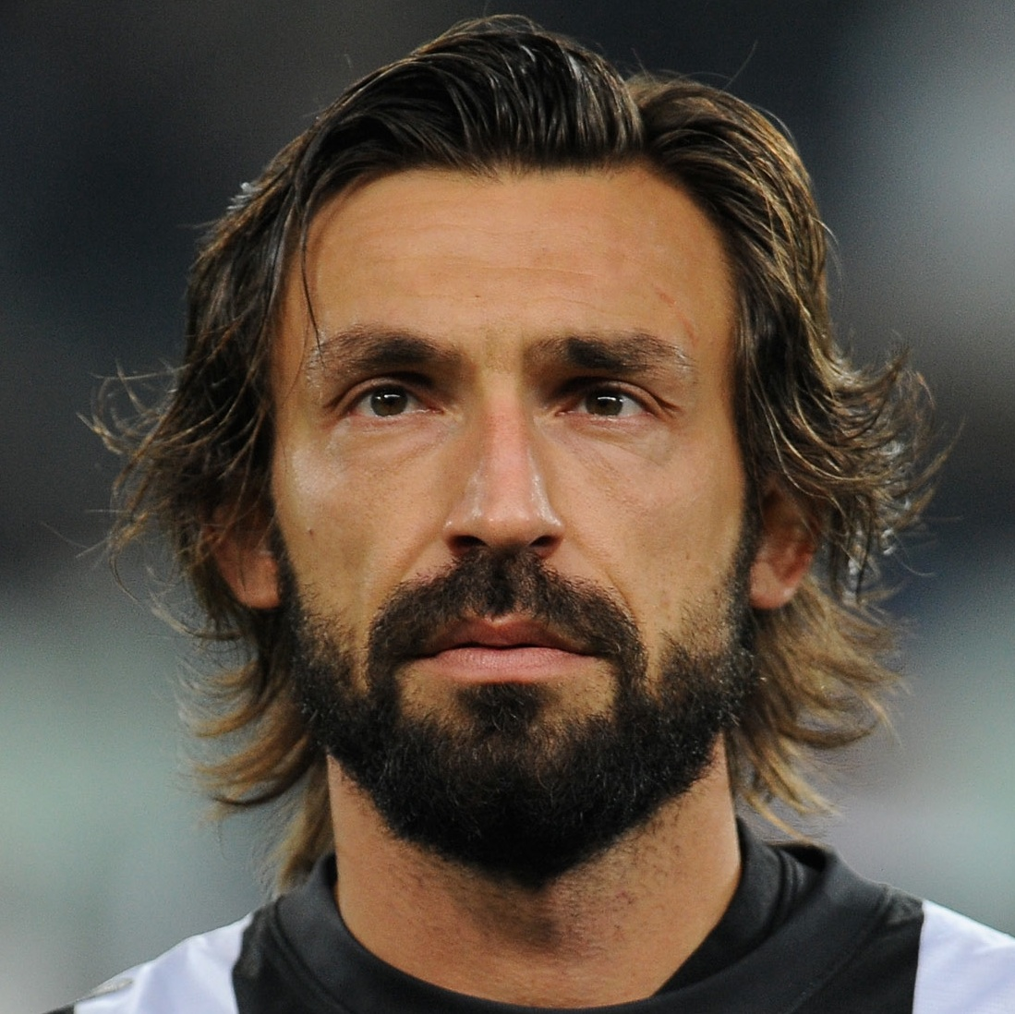
2.
Andrea Pirlo
Italy

Slide 28
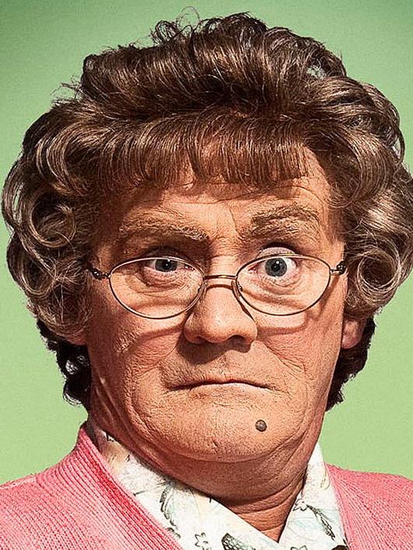
3.
Mrs Agnes Brown (Brendan O'Carroll)
Ireland

Slide 29
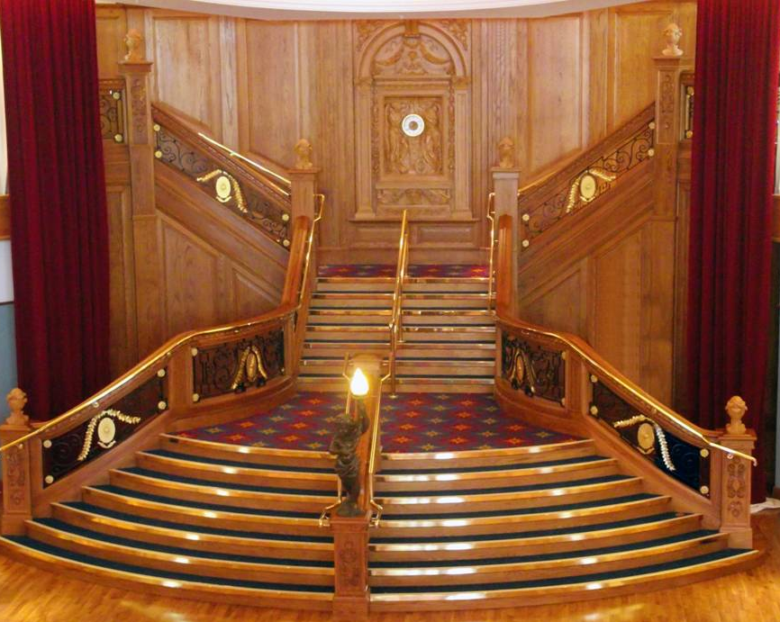
4.
Titanic Staircase
Belfast, UK

Slide 30
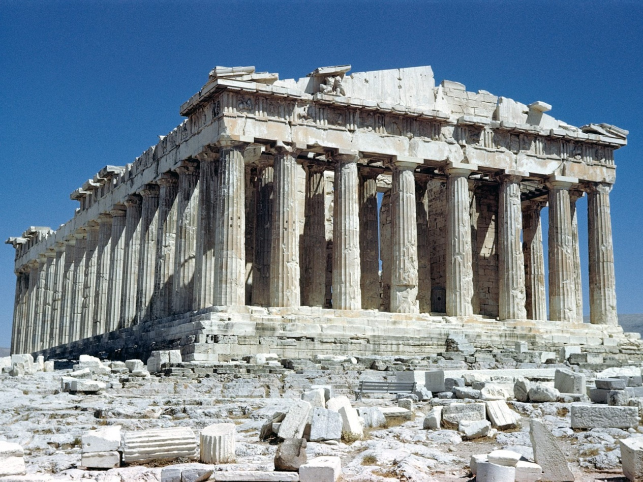
5.
Greece
Parthenon

Slide 31
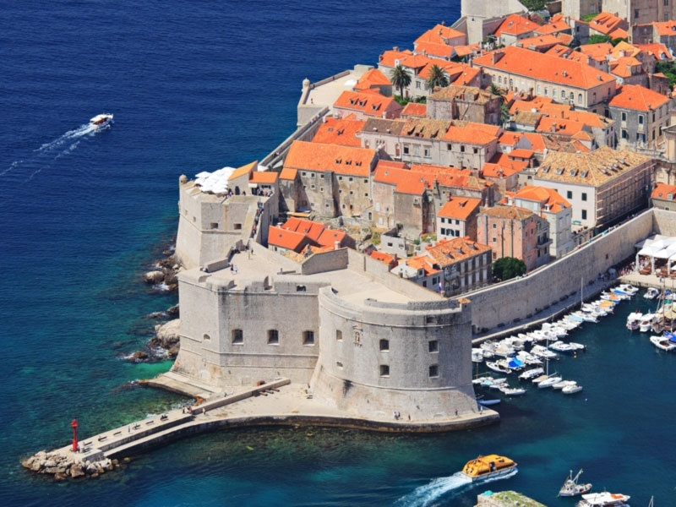
6.
Dubrovnik Croatia

Slide 32
Round 5
Languages

Slide 33
1. How many official and working languages are there today in the European Union?
20
24
30

Slide 34
2. Which language is the most widely spoken mother tongue or native language in the European Union?
English
Spanish
German

Slide 35
3. The phrase ‘Parlo tre lingue’ is in a Romance language and means ‘I speak 3 languages’, but which language is it?
Italian
Romanian
Portuguese

Slide 36
4. In which language is ‘Dzień dobry’ the phrase for ‘good morning’?
Latvian
Polish
Russian

Slide 37
5. J K Rowling, the author of the Harry Potter books, is fluent in which European language?
French
German
Spanish

Slide 38
6. In which two countries might you hear people speaking Basque?
France and Spain
Hungary and Austria
Latvia and Estonia

Slide 39
Round 6
Food and drink

Slide 40
1. ‘Bratwurst’ is a type of sausage made in which EU Member State?
Belgium
Germany
France

Slide 41
2. ‘Fenkata’ is a type of stew found in Malta. What is its main ingredient?
Pork
Beef
Rabbit

Slide 42
3. ‘Piri piri’ is a type of sauce from which country?
Portugal
Finland
UK

Slide 43
4. Which of the following is NOT a typical French food?
Snails
Shark fin soup
Frogs legs

Slide 44
5. Bramley apples, from Northern Ireland, have protected status within Europe. What county are they from?
Down
Armagh
Antrim

Slide 45
6. In which EU Member State might you find ‘turrón’, a nougat made with honey and almonds?
Romania
Spain
Malta

Slide 46
TIE BREAK QUESTIONS
Which company is Italy's largest employer?
Fiat
Dolce and Gabbana
Alitalia

Slide 47
TIE BREAK QUESTIONS
2. How many clogs are produced in Holland each year?
1 million
2 million
3 million

Slide 48
TIE BREAK QUESTIONS
How many Member States are there in the European Union?
A: 25
B: 26
C: 28

Slide 49
TIE BREAK QUESTIONS
Who is the current President of the European Commission?
A: Donald Tusk
B: Jean-Claude Juncker
C: Jose Manuel Barroso

