Slide 1
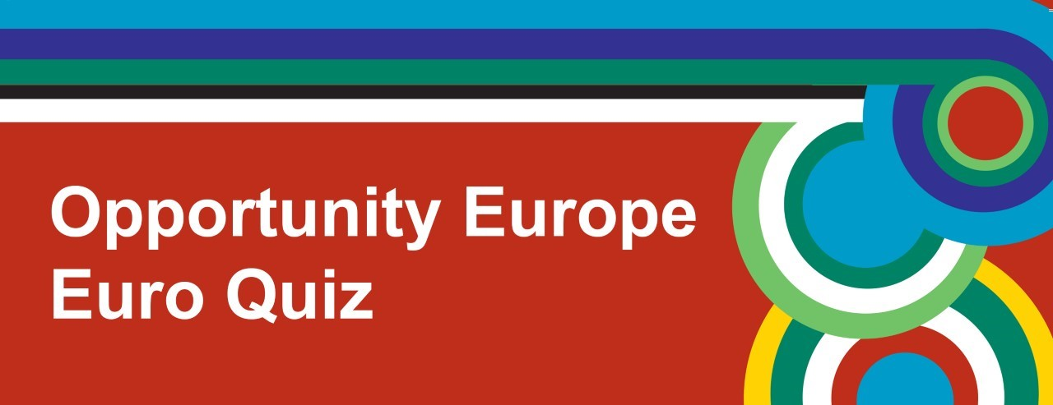



Slide 2
Round 1
Geography

Slide 3
1. Which of the following cities is situated furthest north in the EU?
Copenhagen
Vilnius
Edinburgh

Slide 4
2. What is the name of the river you see from the Eiffel Tower?
The Liffey
The Seine
The River Tyne

Slide 5
3. What is the capital city of Romania?
Bucharest
Budapest
Zagreb

Slide 6

4. Italy, Netherlands, France, Belgium, Germany and which other country were the founding members of the EU?
United Kingdom
Luxembourg
Austria

Slide 7
5. Which of the following European cities is not a national capital?
Zurich
Brussels
Vienna

Slide 8
6. Which of the following European countries is not a member of the EU?
Slovenia
Portugal
Norway

Slide 9
7. Tallin is the capital city of which Eastern European country?
A. Estonia
B. Latvia
C. Belarus

Slide 10
8. Which of these European countries does not have a border with Germany?
A. Czech Republic
B. Italy
C. Denmark

Slide 11
Round 2
Music

Slide 12

1. Which European DJ recorded this piece of classical music?
Hardwell
Tiesto
Oliver Heldens

Slide 13
2. Which Irish boy band is celebrating 25 years in the music business this year?
Westlife
Jedward
Boyzone

Slide 14
3. The EU anthem "Ode to Joy" is from a symphony by which composer?
Johann Strauss
Ludwig Van Beethoven
Johann Sebastian Bach

Slide 15
4. Which country won the Eurovision Song Contest in 2017 with this song?
Portugal
Ireland
Sweden

Slide 16
5. Which European singer is this?
Olly Murs
Niall Horan
Ed Sheeran

Slide 17
6. Which artist recently recorded this song?
Harry Styles
Liam Payne
Zayn Malik

Slide 18
7. From which European country does this traditional instrument originate?
Italy
Greece
Spain

Slide 19
8. Who recorded this 2017 track?
Scooter
Cascada
Robin Schulz

Slide 20
Round 3
Daily Life and Culture

Slide 21
1. Leonardo da Vinci's Mona Lisa is located in which famous European museum?
The Rijksmuseum
Le Louvre
Le Musée d'Orsay

Slide 22
2. What was the name of the currency used in Spain before the euro?
Franc
Lira
Peseta

Slide 23
3. What is the European Emergency Services Number?
999
112
118-118

Slide 24
4. The Spanish Civil War began in which year?
1934
1935
1936

Slide 25
5. A euro is made up of 100 what?
Eurines
Cents
Centimes

Slide 26
6. The European festival "Carnival" is traditionally celebrated in which month?
January
February
August

Slide 27
7 . In which European country might you take part in a feis?
France
Ireland
Italy

Slide 28
8. On which day of the year do the French stick a fish on someone's back?
A. 1st April
B. 14th July
C. 25th December

Slide 29
Round 4
Food and Drink

Slide 30
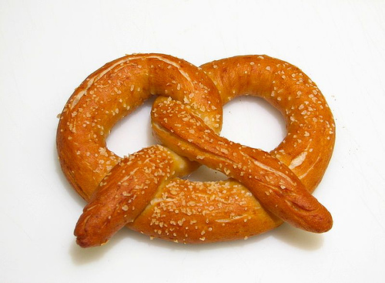
1. From which EU country does the pretzel originate?
Romania
Germany
Ireland

Slide 31
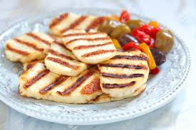
2. What is the national cheese of Cyprus?
Emmental
Halloumi
Mozzarella

Slide 32
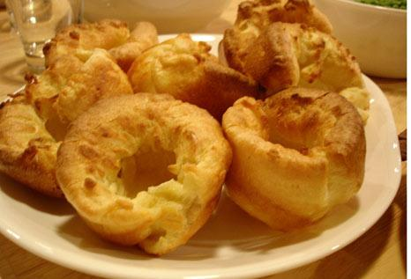
5. This accompaniment to roast beef and gravy originated in which UK county?
Aberdeenshire
Lancashire
Yorkshire

Slide 33
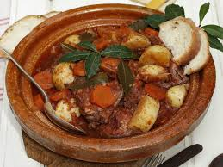
4. Fenek, or stewed rabbit, is the national dish of which EU country?
Malta
Latvia
Hungary

Slide 34
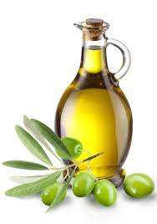
5. Which Spanish region uses the most olive oil in its dishes?
A. Canary Islands
B. Andalusia
C. Catalonia

Slide 35
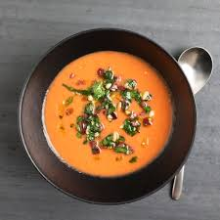
6. In which EU country was Thursday known as "soup day" as maids once had a half day off, and soup was easy to prepare in advance?
Croatia
Greece
Sweden

Slide 36
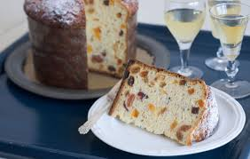
7. This is a sweet bread loaf with dried fruit traditionally eaten at Christmas and New Year in which EU country?
A. Portugal
B. Italy
C. Greece

Slide 37
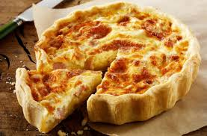
8. What are the two extra ingredients in a Quiche Lorraine which make it special?
A. Cheese and bacon
B. Prawns and parsley
C. Tomatoes and spinach

Slide 38
Round 5
Languages

Slide 39
1. What is the meaning of the French expression "C'est la vie"?
Live and let live
That's life
C. What will be will be

Slide 40
2. How do you say "I love you" in Italian?
Je t'aime
Te quiero
Ti amo

Slide 41
3. The phrase "déjà vu" comes from what language?
French
Greek
Polish

Slide 42
4. Which of these is the official language spoken in Brazil?
Brazilian
Portuguese
Spanish

Slide 43
5. If you hear the phrase "Achtung Bitte" in a train station, what language is this?
German
Dutch
Latvian

Slide 44
6. How many official languages are there in the European Union?
23
24
25

Slide 45
7. What are the procedural languages of the European institutions?
A. French, English and German
B. French English and Spanish
C. Spanish, French and German

Slide 46
8. Willkommen, Bemvindo, Benvenuto, Fáilte are all ways of saying what?
A. Hello
B. Welcome
C. Goodbye

Slide 47
Round 6
Faces and Places

Slide 48
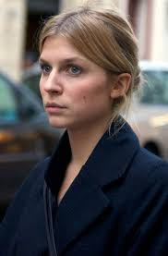
1. Who is this famous French actress who starred in some of the Harry Potter films?
A. Clémence Poésy
B. Marion Cotillard
C. Juliette Binoche

Slide 49
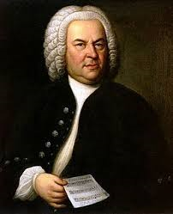
2. Where was this famous classical composer, Johann Sebastian Bach, born?
Denmark
Germany
Austria

Slide 50
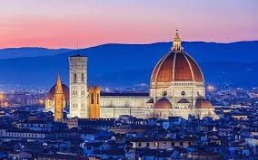
3. In which European country would you find this building?
A. Croatia
B. Sweden
C. Italy

Slide 51
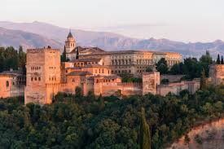
4. What is this building in Granada in southern Spain?
A. A Moorish or Arabic palace
B. A Christian church
C. A Spanish parador or luxury hotel

Slide 52
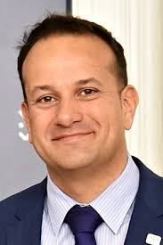
5. This is the Prime Minister of which EU member state?
A. Greece
B. Spain
C. Ireland

Slide 53
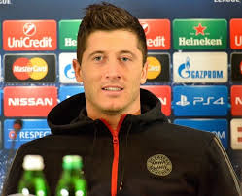
6. Which European national team does this footballer play for?
A. Poland
B. Germany
C. Belgium

Slide 54
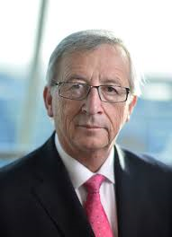
7. Which European country is this EU president from?
Hungary
Luxembourg
Slovenia

Slide 55
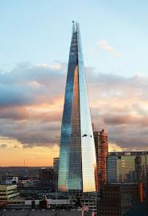
8. In which European capital would you find this building?
A. London
B. Dublin
C. Paris

Slide 56
Round 7
Sport

Slide 57
1. Which country won the first gold medal at the 2018 Winter Olympics?
Germany
Norway
Sweden

Slide 58
2. In which country is the major football league known as "Eredivisie"?
Italy
The Netherlands
Portugal

Slide 59
3. In which European country did Curling originate?
Scotland
Latvia
Norway

Slide 60
4. In which EU member state was boxing invented?
England
Spain
Greece

Slide 61
5. Who won the 2017 Wimbledon Women's Singles title?
Caroline Wozniacki
Garbiñe Muguruza
Johanna Konta

Slide 62
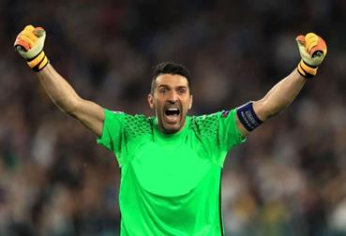
6. Who is this famous footballer?
A. Gianluigi Buffon
B. Iker Casillas
C. Claudio Bravo

Slide 63
7. Where was the 2017 Women's Rugby World Cup held?
France
Wales
Ireland

Slide 64
8. Which of these major cycling events started from Northern Ireland in 2014?
Le Tour
The Giro
La Vuelta

Slide 65
Round 8
Name that country

Slide 66
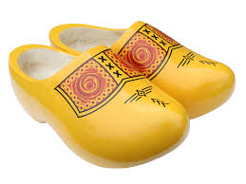
1. This traditional wooden footwear is from which EU country?
A. Hungary
B. The Netherlands
C. Ireland

Slide 67

2. This is the flag of which EU country?
A. Turkey
B. Bosnia &
Herzegovina
C. Albania

Slide 68
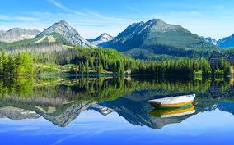
3. Bratislava is the capital of which EU country?
Slovakia
Hungary
Latvia

Slide 69
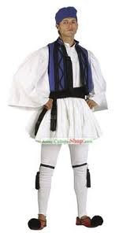
4. This is the traditional men's dance costume of which EU country?
A. Greece
Portugal
Bulgaria

Slide 70
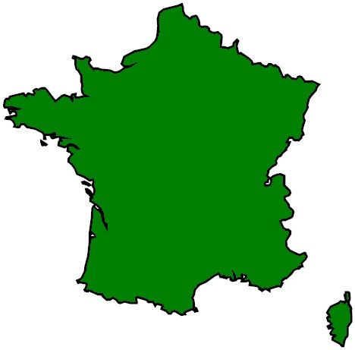
5. Which EU member state is this?
Belgium
France
Ireland

Slide 71
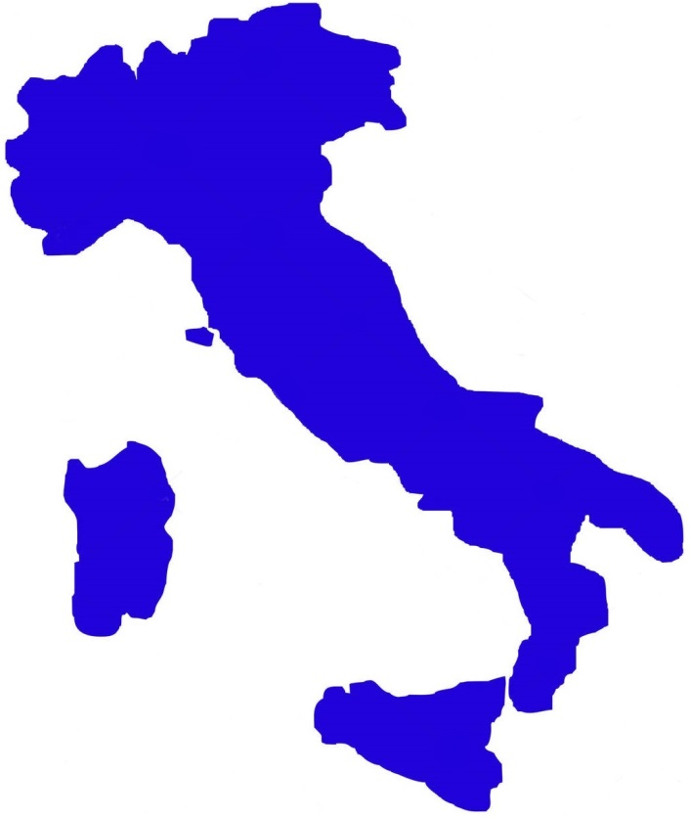
6. Which EU member state looks like a boot?
Denmark
Sweden
Italy

Slide 72
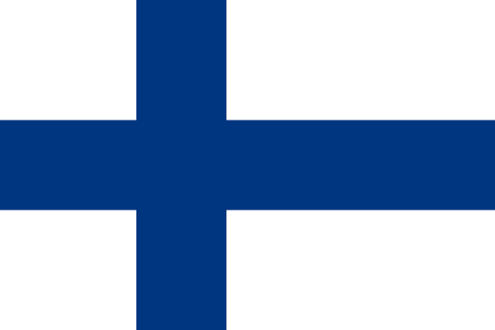
7. This is the flag of which European country?
Czech Republic
Slovenia
Finland

Slide 73
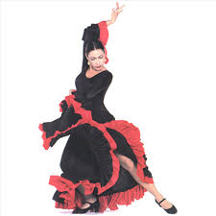
8. This is the traditional female dance costume of which European country?
A. United Kingdom
B. Estonia
C. Spain

Slide 74
TIE - BREAK QUESTIONS

Slide 75
In which year did the former Eastern European countries of Poland and Latvia join the European Union?
2002
2003
2004

Slide 76
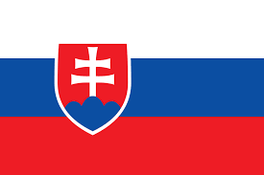
What country does this flag belong to?
Slovenia
Slovakia
Italy

Slide 77
What is the total population of the European Union?
A. 508 million
B. 480 million
C. 700 million

