Slide 1
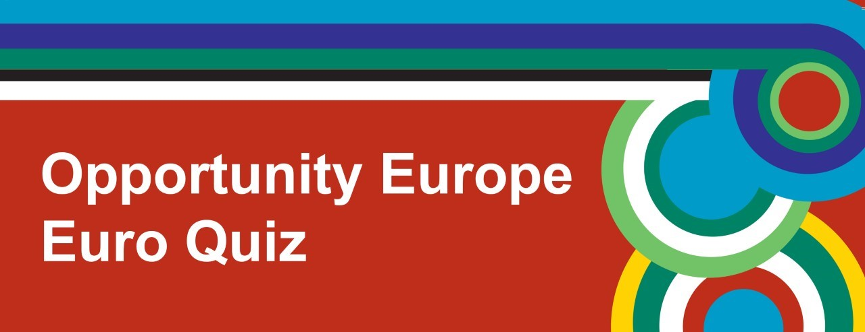
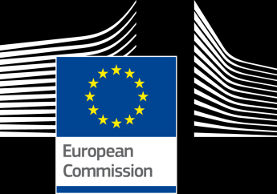


Slide 2
Round 1
Geography

Slide 3
1. How many Member States are there in the EU – including the UK?
28
26
40

Slide 4
2. Which of these countries is NOT an EU Member State?
Norway
Slovenia
Ireland

Slide 5
3. In which European country would you find the islands Kefalonia, Crete and Rhodes?
Greece
Bosnia and Herzogovina
Croatia

Slide 6
4. The islands of Sicily and Sardinia belong to which European country?
Italy
France
Denmark

Slide 7
5. Which EU Member State has the largest surface area?
Spain
France
Germany

Slide 8
6. What is the capital of Slovenia?
Rome
Bucharest
Ljubljana

Slide 9
Round 2
Music

Slide 10

1. Which EU member state does this female singer come from?
United Kingdom
Sweden Zara Larsson
Denmark

Slide 11
2. Which European DJ produced this 2014 hit?
Calvin Harris
Lost Frequencies Are you with me?
Avicii

Slide 12
3. This was a hit in 2013 for a famous DJ. Which EU member state does he come from?
France
Italy
Holland Aaron van Buuren

Slide 13
4. Which European singer is this?
Zayn Malik
Niall Horan Everything comes back to you
Sam Smith

Slide 14
5. Which European singer had a hit with this song in 2009?
Jess Glynne
Katie B
Cascada – Evacuate the dance floor

Slide 15
6. This hit by a famous European DJ was a chart success in 2014. Which EU member state does he come from?
Spain
Italy
France David Guetta Shot me down

Slide 16
Round 3
Daily Life and Culture

Slide 17
1. What currency is used in Sweden?
Euro
Franc
Krona

Slide 18
2. What is France's most popular sport?
Football
Rugby
Basketball

Slide 19
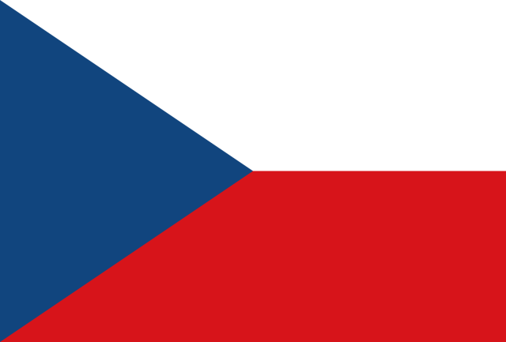
3. What country does this flag belong to?
Malta
Czech Republic
Spain

Slide 20
4. What nationality was Christopher Columbus?
Portuguese
Spanish
Italian

Slide 21
5. In which country was Donald Trump's wife, Melania Trump, born?
Slovakia
Poland
Slovenia

Slide 22
6. Which of the following clothing brands is NOT from Spain?
Zara
H & M
Mango

Slide 23
Round 4
Food and Drink

Slide 24
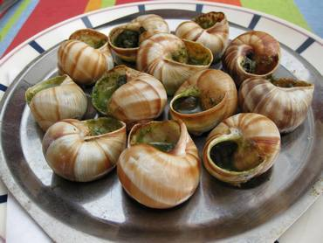
1. In which EU member state would you find these?
France
Holland
Belgium

Slide 25
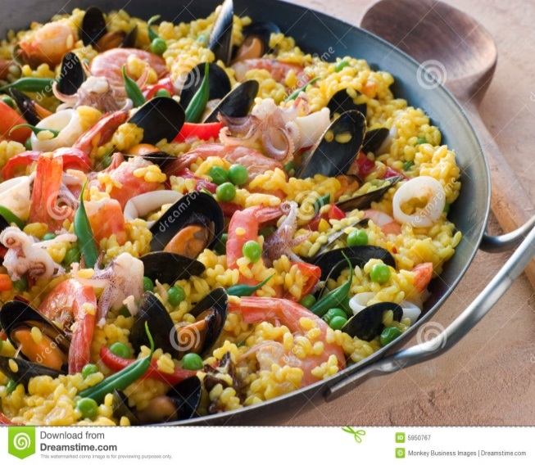
2. What is this typical European dish made of rice?
Risotto
Spanakorizo
Paella

Slide 26
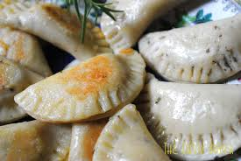
3. In which European country might you find these?
Latvia
Bulgaria
Poland

Slide 27
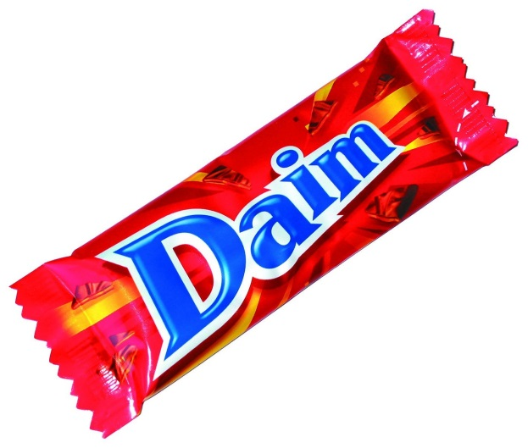
4. In which EU member state was this famous chocolate bar created?
Sweden
Denmark
Lithuania

Slide 28
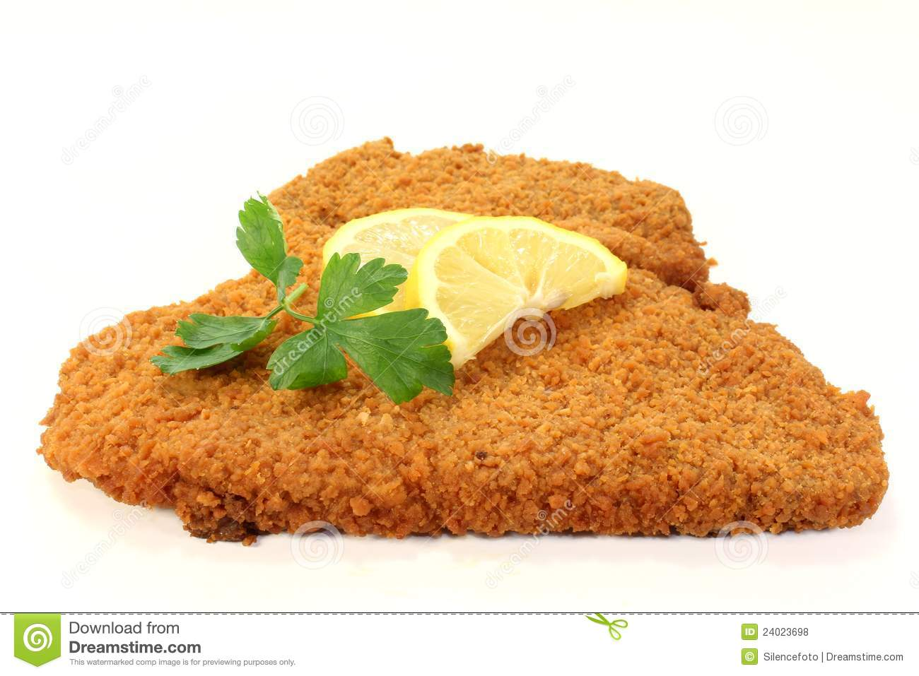
5. From which EU member state does this famous European dish originate?
Austria
Germany
Slovakia

Slide 29
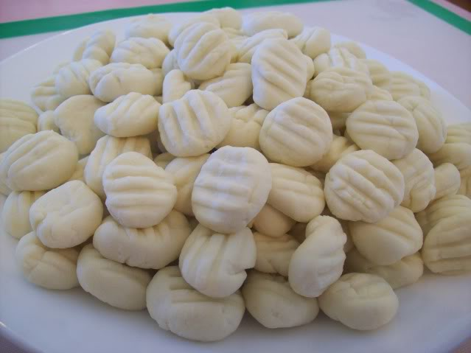
6. What is the correct name for this typical Italian dish?
Ravioli
Penne
Gnocchi

Slide 30
Round 5
Languages

Slide 31
1. Which of the following official EU languages has the largest number of native speakers?
German
English
French

Slide 32
2. What are Romance languages?
Languages that evolved from Latin
Languages that are coupled together
Languages that sound romantic

Slide 33
3. Which of the following is NOT an official regional language in Spain?
Catalan
Breton
Galician

Slide 34
4. What exactly is a "polyglot"? Someone who speaks ……………
Only one language
Two languages
Multiple languages

Slide 35
5. How many official languages does Belgium have?
One
Two
Three

Slide 36
6. If you were to buy a "gelato" in Italy, what would you be getting?
Jelly
Ice cream
Fish

Slide 37
Round 6
Faces and Places

Slide 38
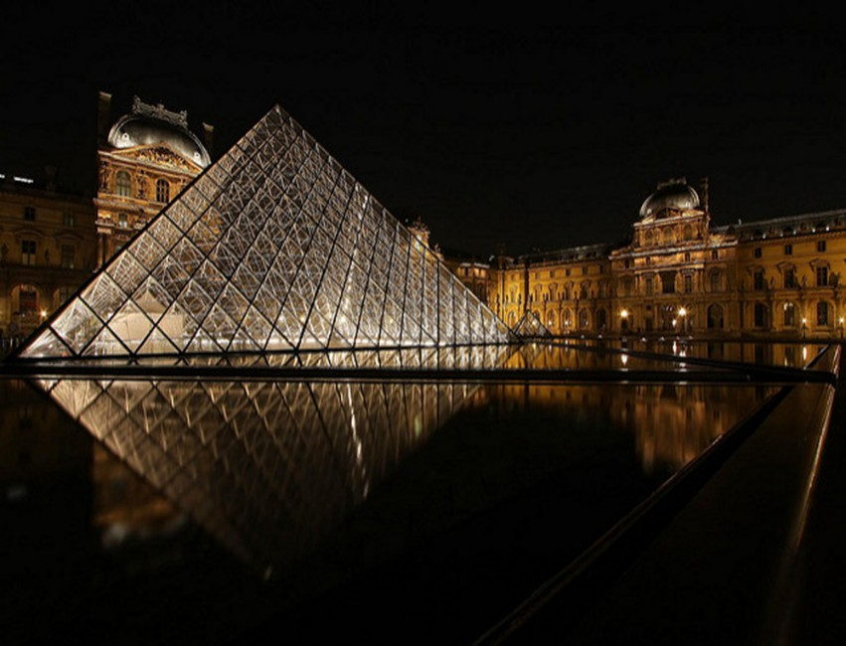
1. In which European city would you find this landmark?
A. Budapest
B. Paris
C. Copenhagen

Slide 39
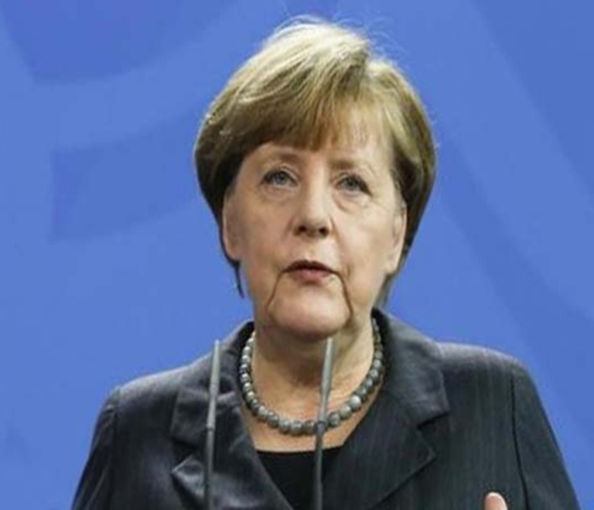
2. Who is this famous European politician?
Marine le Pen
Nicola Sturgeon
Angela Merkel

Slide 40
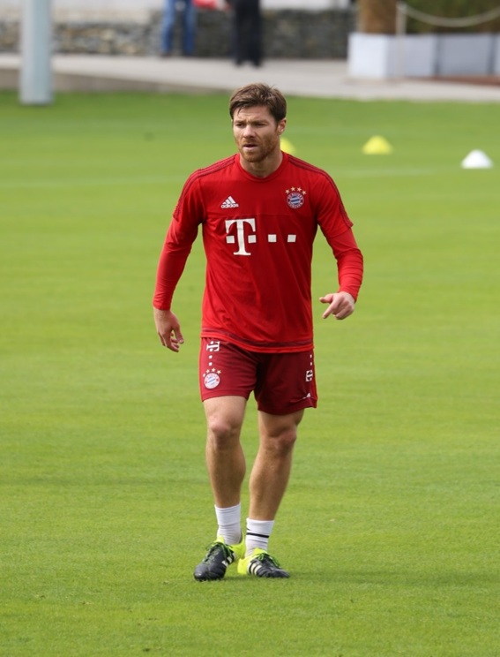
3. Who is this famous Spanish footballer?
A. Gerard Piqué
B. Sergio Ramos
C. Xabi Alonso

Slide 41
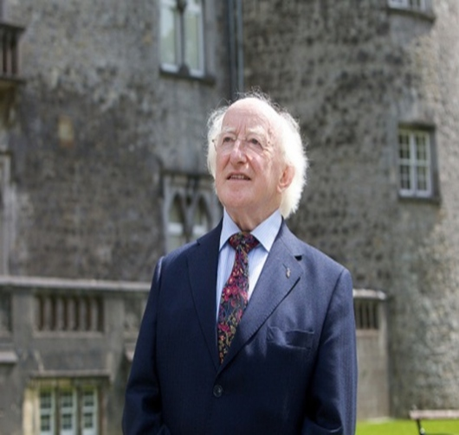
4. Who is this European President?
A. François Hollande
B. Michael D Higgins
C. Sergio Mattarella

Slide 42
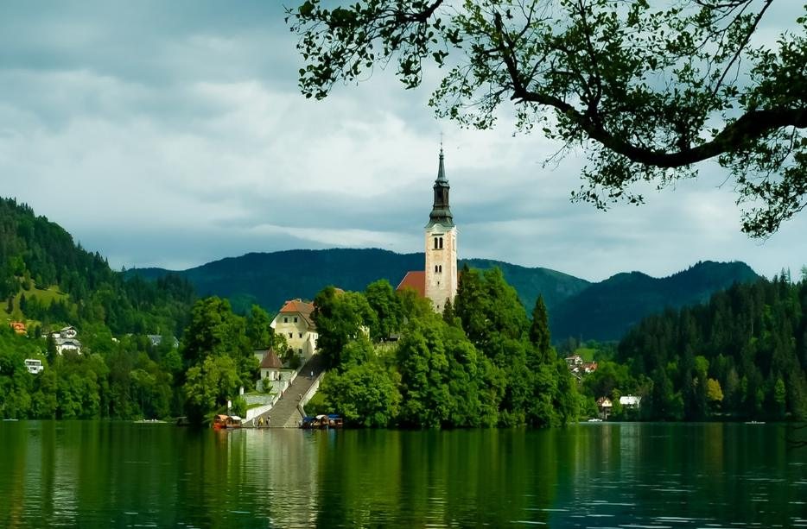
5. In which EU member state would you find this beautiful lake?
A. Sweden
B. Norway
C. Slovenia

Slide 43
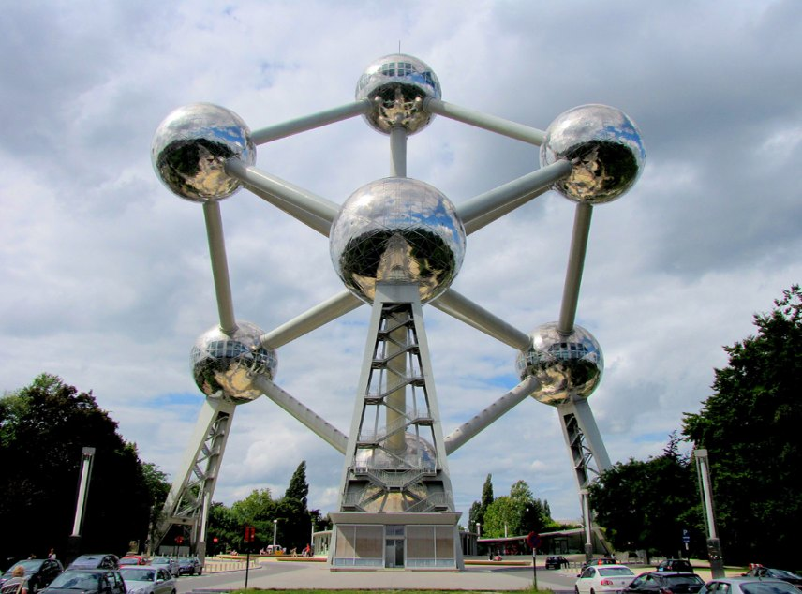
6. In which European capital would you find this landmark?
A. Paris
B. Brussels
C. Athens

Slide 44
TIE BREAK QUESTIONS

Slide 45
Which of the following EU countries do NOT use the euro as their official currency?
A. Germany
B. Belgium
C. Hungary

Slide 46
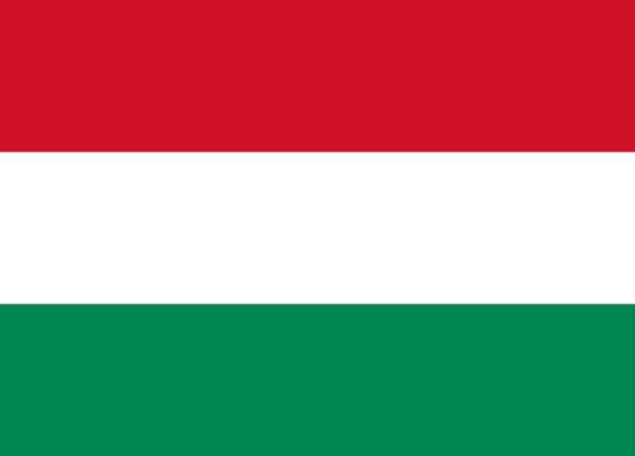
What country does this flag belong to?
Slovenia
Hungary
Italy

Slide 47
Which two countries are the largest and the smallest within the EU?
A. France and Malta
B. Germany and Luxemburg
C. France and Cyprus

Slide 48
In which year were Euro banknotes officially launched?
1998
2002
2004

