Slide 1
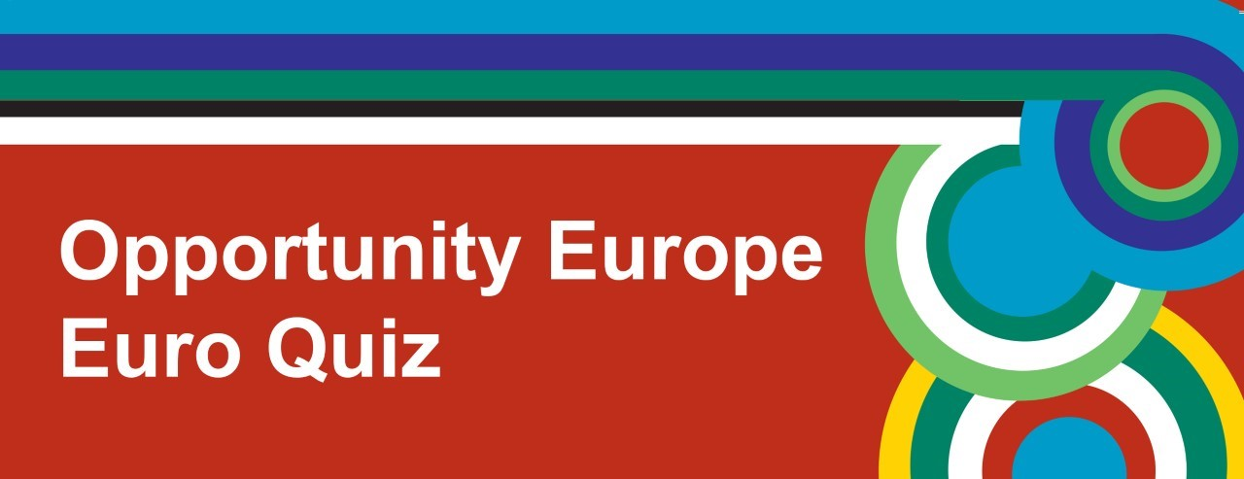
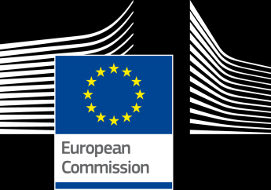


Slide 2
Round 1
Geography

Slide 3
1. With which other continent does Europe share a land mass?
Asia
Antarctica
Africa

Slide 4
2. Of which member state is Ljubljana the capital?
Denmark
Belgium
Slovenia

Slide 5
3. What is the longest river in Europe?
Volga
Lagan
Rhine

Slide 6
4. Andorra is a Principality situated between which two member states?
Portugal & Spain
France & Spain
Germany & Poland

Slide 7
5. Hungary shares borders with how many other member states?
9
7
5

Slide 8
6. The Canaries are a group of Spanish Islands. Which is the largest island?
Gran Canaria
Tenerife
Lanzarote

Slide 9
7. "Sliabh Liag" are the highest sea cliffs in Europe. In which Irish county are they?
A. Mayo
B. Wicklow
C. Donegal

Slide 10
8. Which member state has the largest population?
A. Germany
B. France
C. United Kingdom

Slide 11
Round 2
Music

Slide 12

1. In which EU capital city was this famous DJ born?
Berlin
Amsterdam
Stockholm

Slide 13
2. Which style of traditional Irish dance would you associate with this music?
Reel
Hornpipe
Jig

Slide 14
3. This is the National Anthem of which member state?
Austria
Belgium
Germany

Slide 15
4. Which member state performed this song at the 2018 Eurovision Song Contest?
Ireland
United Kingdom
Malta

Slide 16
5. This is the national instrument of which member state?
Italy
Spain
France

Slide 17
6. This music features the national dance of which member state?
Romania
Latvia
Netherlands

Slide 18
7. Which famous European pop group will release new music for the first time in 35 years later this year?
Spice Girls
Abba
Queen

Slide 19
8. This piece was composed by Antonín Dvořák In which member state was he born?
Czech Republic
Germany
Austria

Slide 20
Round 3
Daily Life and Culture

Slide 21
1. If a Frenchman tells you to keep your “sang-froid”, what does he mean?
Keep your hat on
Stay calm
Mind your own business

Slide 22
2. How do Germans refer to the tube or underground?
Metro
Bahnhof
U-Bahn

Slide 23
3. Who is the patron saint of Portugal?
St. George
St. Andrew
St. Patrick

Slide 24
4. Which company is Italy's largest employer?
Alitalia
Dolce & Gabbana
Fiat

Slide 25
5. What does “Real” mean in the name of the football team “Real Madrid”?
Great
Royal
Real

Slide 26
6. This year's Eurovision Song Contest was held in which member state capital city?
Lisbon
Paris
Nicosia

Slide 27
7 . If you go to buy a newspaper with a “Złoty”, which member state are you in?
Romania
Bulgaria
Poland

Slide 28
8. Who brings Lithuanian children their Easter Eggs?
A. Easter Granny
B. Easter Mummy
C. Easter Bunny

Slide 29
Round 4
Food and Drink

Slide 30
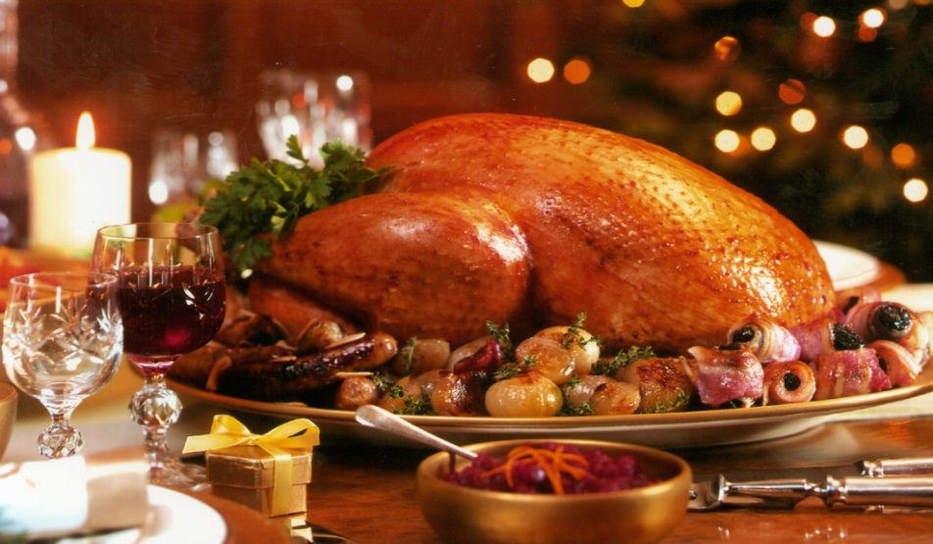
1. In the latter part of which century did turkey become a popular Christmas dish in the UK?
16th Century
19th Century
12th Century

Slide 31
2. What is the national dish of Denmark?
Fried chicken with mustard sauce
Crispy pork with parsley sauce
Roast beef with gravy

Slide 32
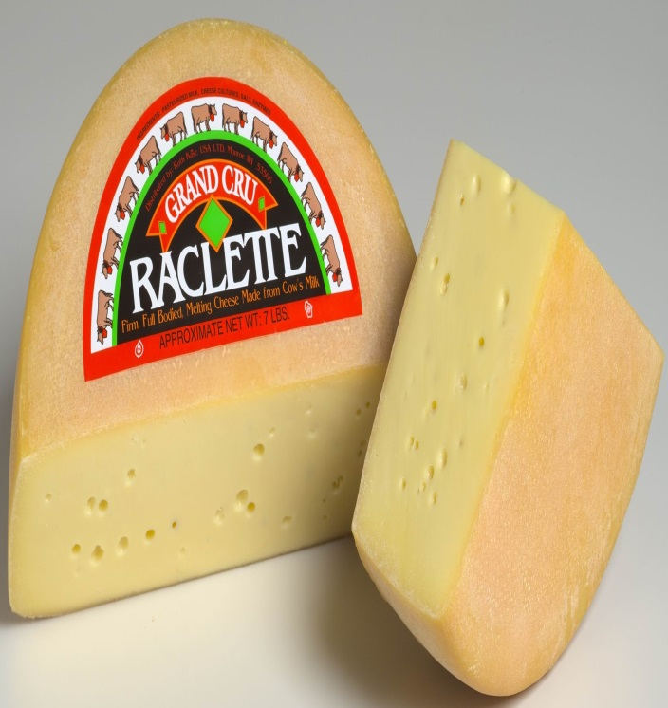
3. This famous Swiss cheese is called “Raclette”. How is it usually served?
Cooked on a special grill
Diced up in a salad
Cold, with crackers

Slide 33
4. What exactly is an “Hors d’oeuvre”?
A type of dessert
A type of bread
An appetiser

Slide 34
5. What exactly is "Welsh Rarebit”?
A. Roasted Rabbit
B. Cheese on toast
C. Stew

Slide 35
6. “Cannelloni” is a type of Italian pasta, but what shape is it?
Long, thin strips
Short, thin tubes
Long, broad tubes

Slide 36
7. "Baklava" is a typical Greek dish, but what exactly is it?
A. Flaky pastry dessert
B. Salad
C. Stuffed vine leaves

Slide 37
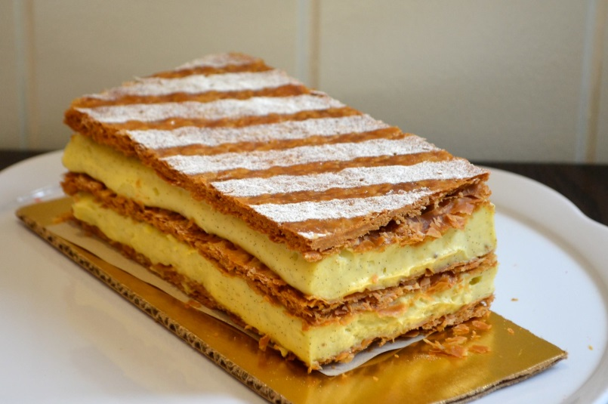
8. The French cream and pastry bun, “Mille-Feuille”, is also known by the name of which French leader?
A. King Henri XIII
B. François Mitterrand
C. Napoleon

Slide 38
Round 5
Languages

Slide 39
1. Which of these countries has the largest number of Spanish speakers?
Brazil
Spain
C. Mexico

Slide 40
2. In which of these countries is French not an official language?
France
Spain
Belgium

Slide 41
3. How many people speak English as their first language in the world?
360 Million
200 Million
1 Million

Slide 42
4. From which European languages does the word bicycle originate?
Irish & Welsh
Greek & English
French & Flemish

Slide 43
5. “Basque” is a language primarily spoken in which European country?
France
Italy
Spain

Slide 44
6. When would you say “Gesundheit!” ?
When someone sneezes
When someone burps
When someone coughs

Slide 45
7. What does the phrase “Je suis fils unique” translate as ?
A. I have a brother
B. I have a sister
C. I am an only child

Slide 46
8. How would you say “Thank you” in Italian?
A. Per favore
B. Grazie
C. Prego!

Slide 47
Round 6
Faces and Places

Slide 48
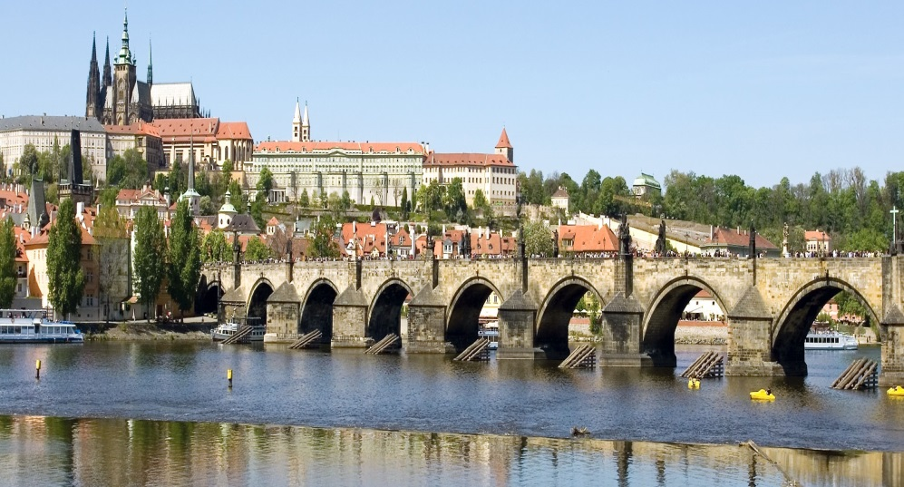
1. In which European capital would you find this bridge, known as the “Charles Bridge”?
A. Prague
B. Riga
C. Warsaw

Slide 49
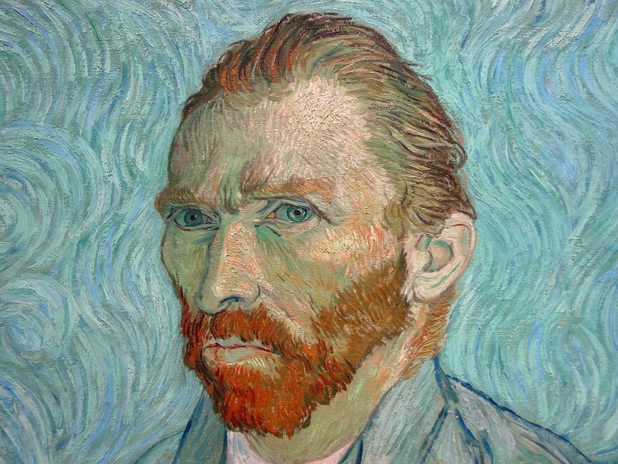
2. Who is the famous European artist in this self-portrait?
Leonardo da Vinci
Pablo Picasso
Vincent van Gogh

Slide 50
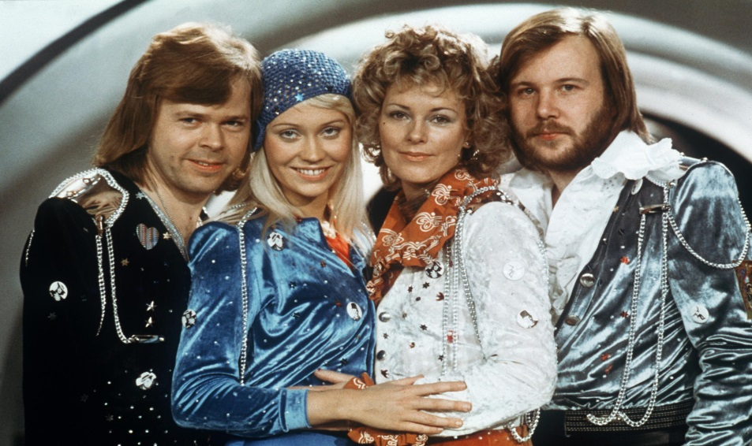
3. This famous pop group from the 1970’s came from which EU member state?
A. Spain
B. Sweden
C. Poland

Slide 51
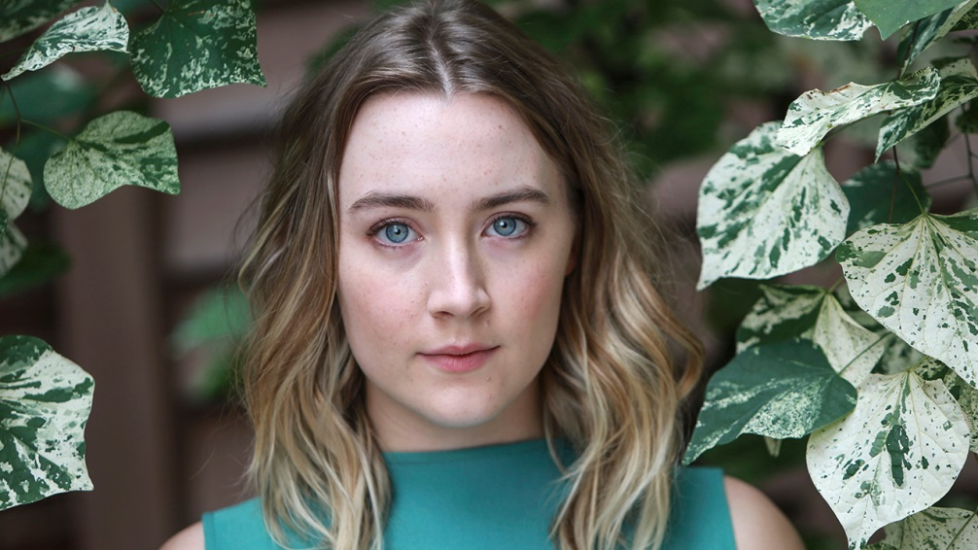
4. This famous actress comes from which EU member state?
A. Ireland
B. Germany
C. Denmark

Slide 52
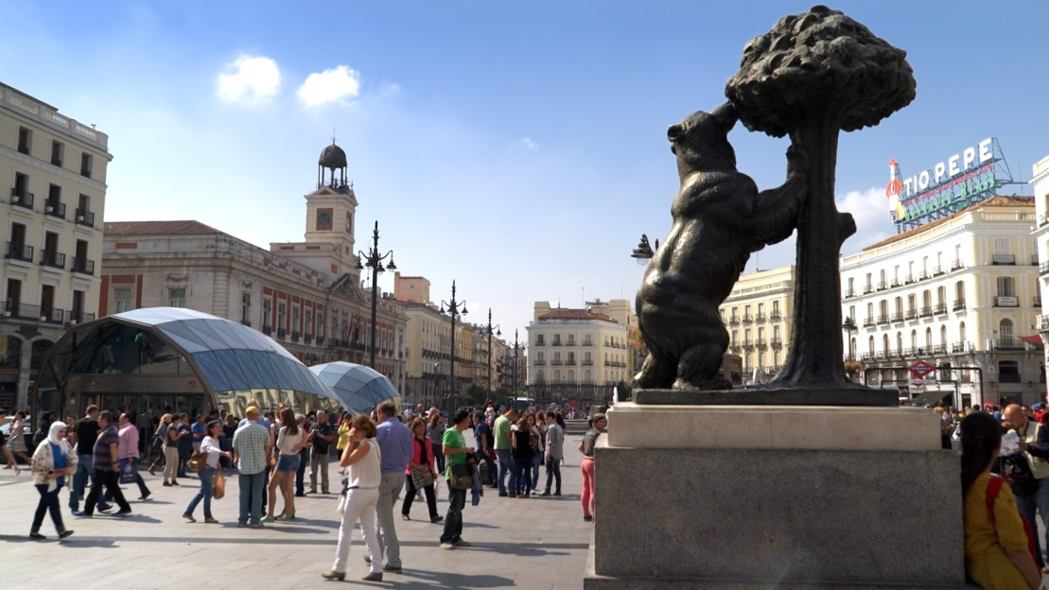
5. In which European capital would you find this square?
A. Berlin
B. London
C. Madrid

Slide 53
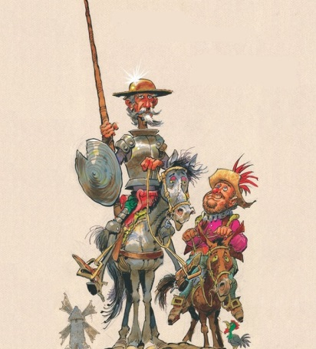
6. Who is this famous character from a book of the same name by Cervantes?
A. Don Quixote
B. Phileas Fogg
C. Ebenezer Scrooge

Slide 54
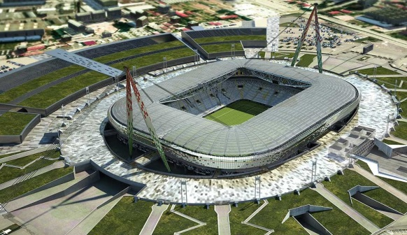
7. This is the Allianz Stadium. In which Italian city is it located?
Florence
Turin
Rome

Slide 55
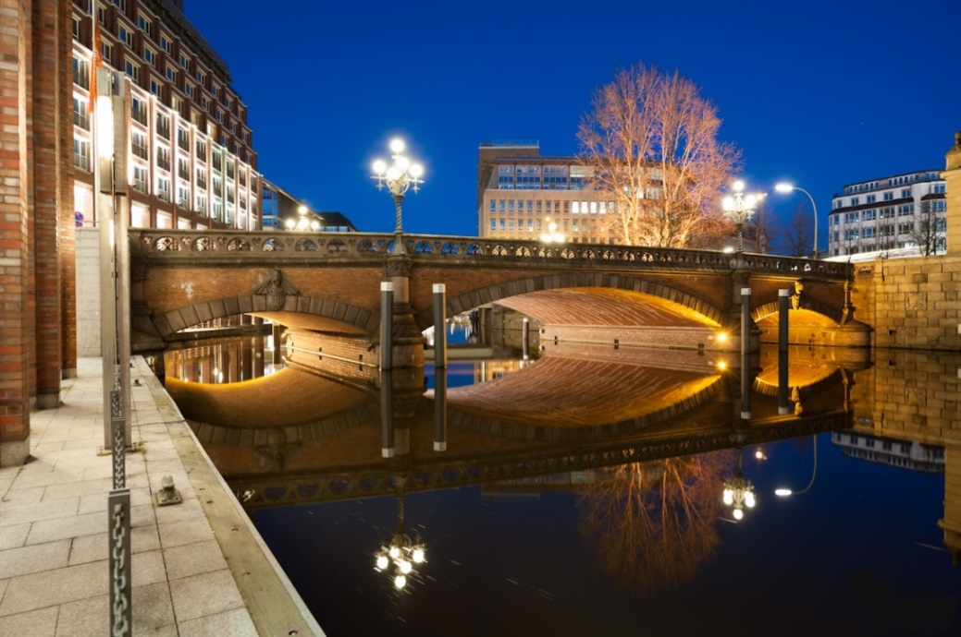
8. Which European city has the most bridges?
A. Hamburg
B. Venice
C. Amsterdam

Slide 56
Round 7
Sport

Slide 57
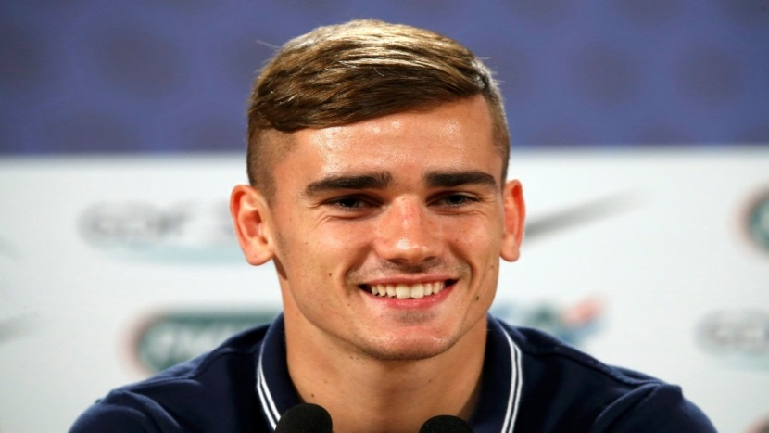
1. Who is this famous footballer?
A. Andrés Iniesta
B. Antoine Griezmann
C. Arjen Robben

Slide 58
2. Which is the only Irish province to have won the European Rugby Challenge Cup?
Munster
Ulster
Leinster

Slide 59
3. Who won the 2018 Women's Australian Open Tennis title?
Caroline Wozniacki
Simona Halep
Maria Sharapova

Slide 60
4. Which European country won the netball gold medal at the 2018 Commonwealth Games?
Wales
Scotland
England

Slide 61
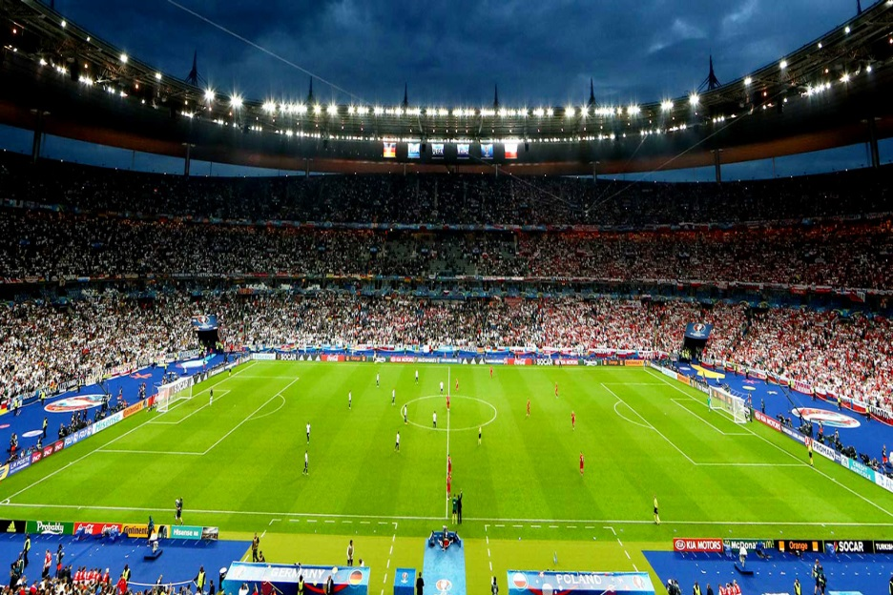
5. In which EU capital city would you find this famous stadium?
A. Warsaw
B. Paris
C. Berlin

Slide 62
6. Northern Ireland's only Commonwealth Games gold medal was won in which event?
Men's Pommel Horse
Men's Parallel Bar
Men's Rings

Slide 63
7. Which European country will compete at its first FIFA World Cup this year?
Estonia
Latvia
Iceland

Slide 64
8. What is the national sport of Romania?
Baseball
Football
Basketball

Slide 65
Round 8
Name that country

Slide 66
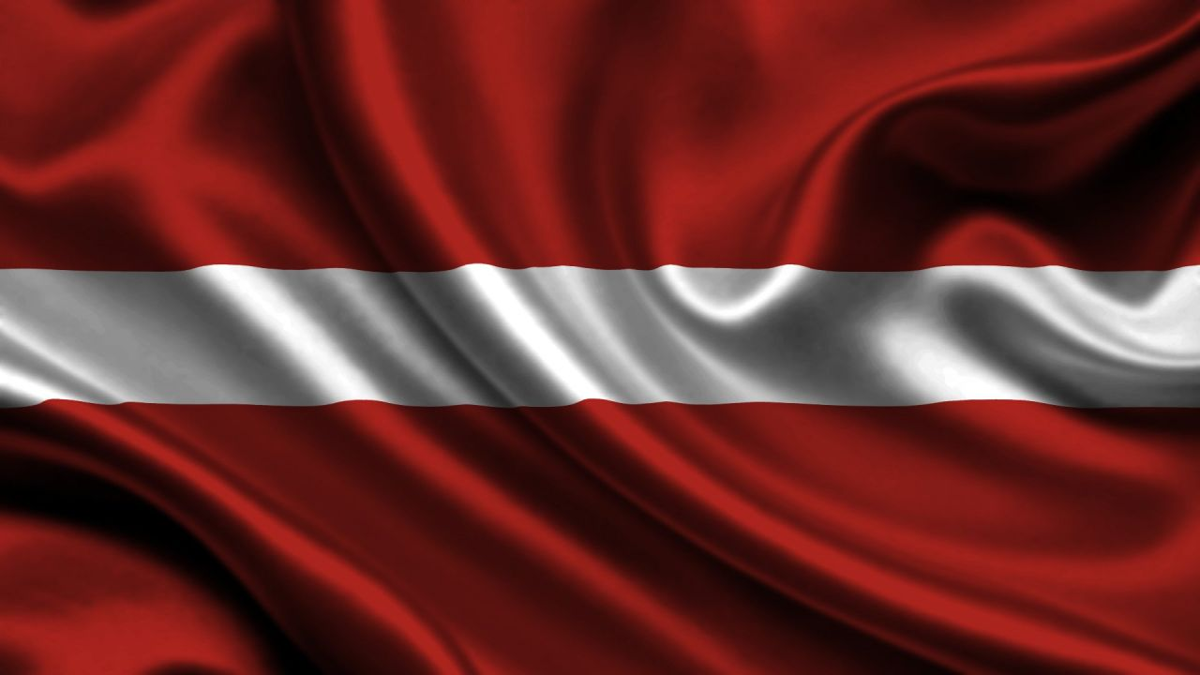
1. This is the national flag of which member state?
A. Slovenia
B. Estonia
C. Latvia

Slide 67
2. Zagreb is the capital of which member state?
A. Malta
B. Croatia
C. Slovenia

Slide 68
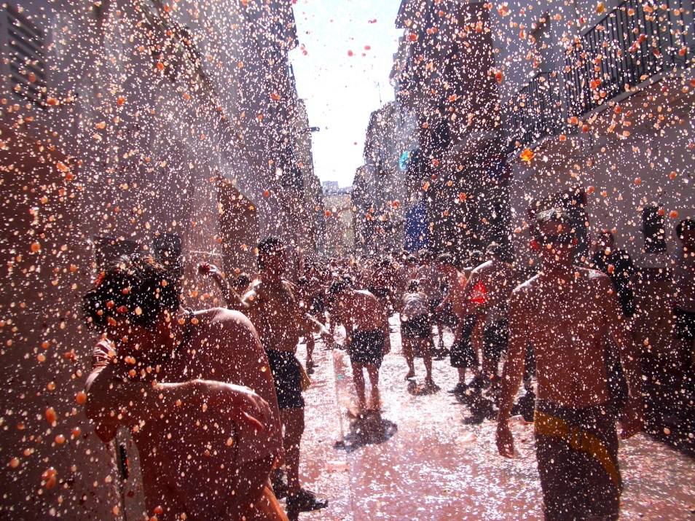
3. The “Tomato-fight” festival takes place in which member state?
Spain
Belgium
France

Slide 69
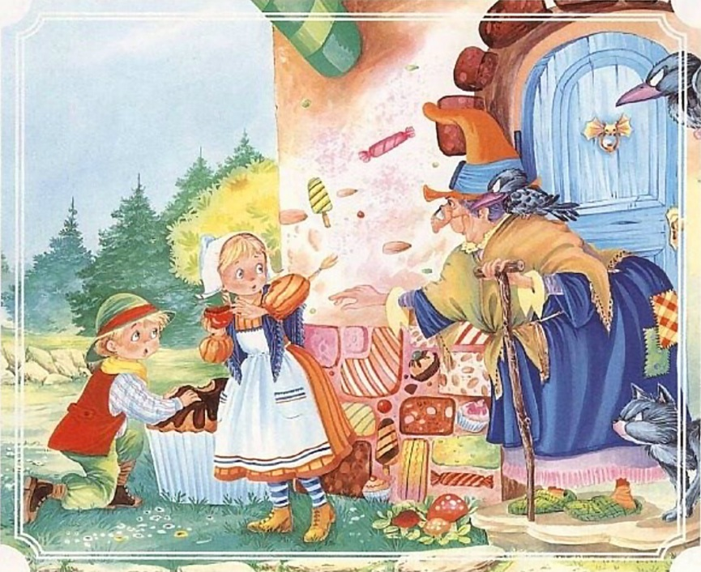
4. These characters are from a famous children’s story from which member state?
A. Austria
Luxembourg
Germany

Slide 70
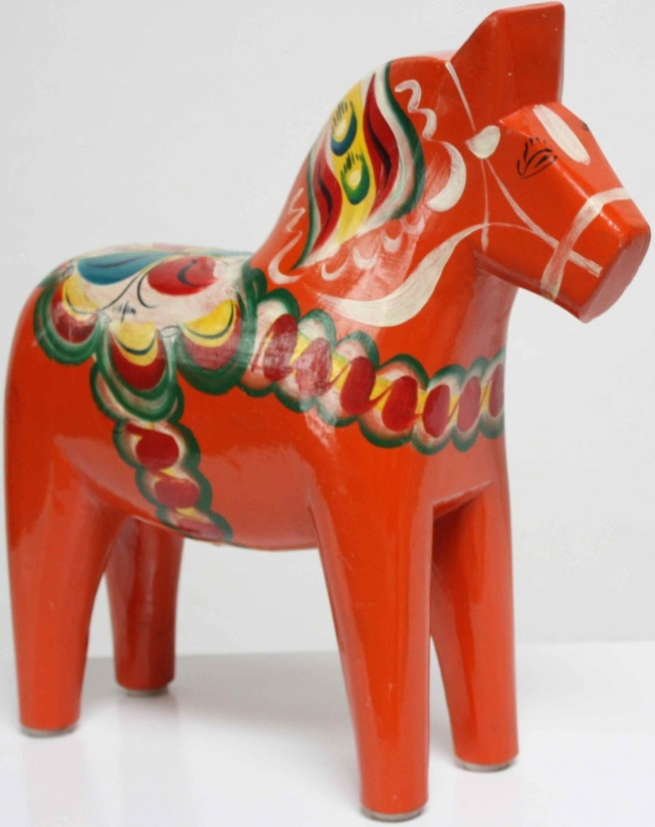
5. This ornament might be a typical gift bought in which member state?
Sweden
Finland
Denmark

Slide 71
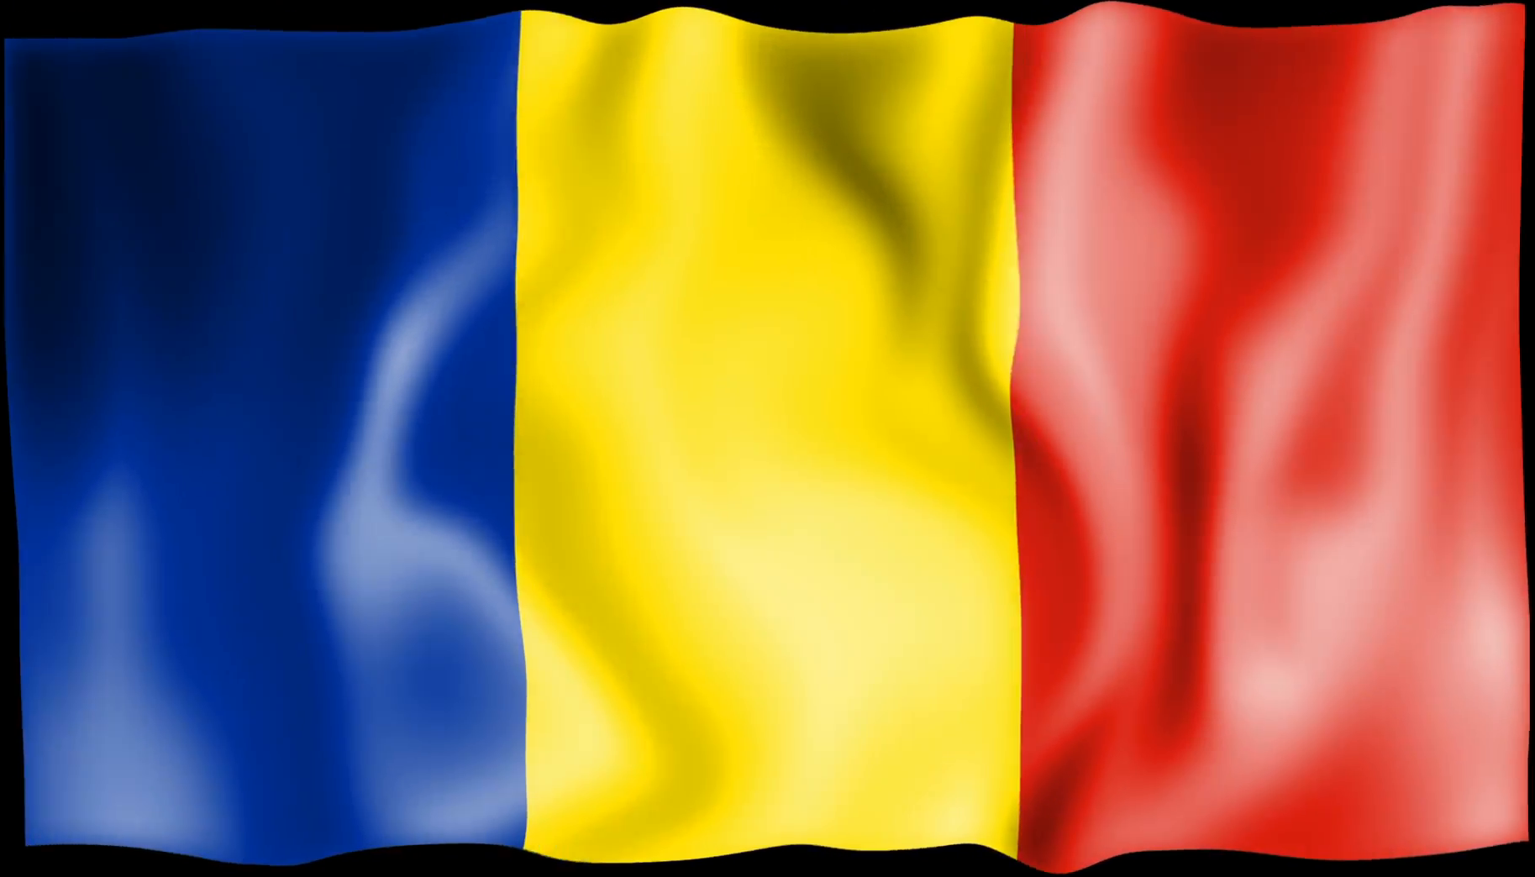
6. This is the national flag of which member state?
Lithuania
Hungary
Romania

Slide 72
7. Which EU member state has the smallest population?
Malta
Luxembourg
Cyprus

Slide 73
8. The ancient philosophers Aristotle, Archimedes & Pythagoras all came from which member state?
A. Portugal
B. Greece
C. Italy

Slide 74
TIE - BREAK QUESTIONS

Slide 75
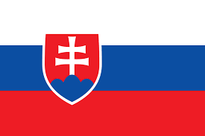
What country does this flag belong to?
Slovenia
Slovakia
Italy

Slide 76
What is the total population of the European Union?
A. 508 million
B. 480 million
C. 700 million

