Slide 1
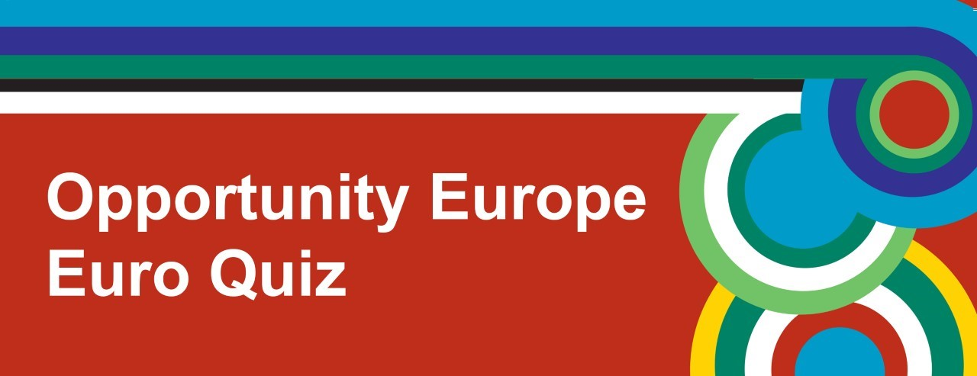



Slide 2
Round 1
Geography

Slide 3
1. In which EU member state would you find the Black Forest?
Romania
Poland
Germany - Black Forest Gateau

Slide 4
2. Name the sea which lies between the east coast of Italy and Croatia?
The Mediterranean Sea
The Tyrrhenian Sea
The Adriatic Sea

Slide 5
3. Vienna is the capital of Austria, but what is the country's second city?
Graz
Linz
Salzburg

Slide 6
4. Liechtenstein is situated in the heart of Europe. What type of state is it?
Kingdom
Principality
Republic

Slide 7
5. The Hungarian capital, Budapest, is split into two parts by which river?
The Danube
The Rhine
The Elbe
Notes:
The River Danube begins in the Black Forest region of Germany and runs through 10 countries (Germany, Austria, Slovakia, Hungary, Croatia, Serbia, Romania, Bulgaria, Moldova and Ukraine) on its way to the Black Sea.

Slide 8
6. What is the name of the high speed train service from London to Paris and beyond?
Eurotrain
Eurospeed
Eurostar Departs from St Pancras International station in London

Slide 9
7. Guadeloupe and Martinique, in the Caribbean, are overseas territories of which EU member state?
Spain
France
United Kingdom

Slide 10
8. Carrauntoohil is the highest mountain in Ireland. In which county would you find it?
Cork
Tipperary
Kerry Highest mountain in EU is Mont Blanc – in the Alps

Slide 11
Round 2
Music

Slide 12
1. Name the 2017 Portuguese winner of the Eurovision Song Contest? https://www.youtube.com/watch?v=Qotooj7ODCM
Kristian Kostov
SunStroke Project
Salvador Sobral
The title of the song 'Amar Pelos Dois' means 'love for both of us'

Slide 13
2. Which EU member state does this artist originate from? https://www.youtube.com/watch?v=XDBJVgIVPcs
Sweden
France
Belgium The artist is Petite Mellor & the song is Baby Love

Slide 14
3. Name this artist from the United Kingdom? https://www.youtube.com/watch?v=s-xd3NuWQI0
The Kooks
The Fratellis
Paolo Nutini The song is Pencil Full of Lead

Slide 15
4. Which EU member state is this DJ from? https://www.youtube.com/watch?v=ginBV6aeVlc
Denmark
Sweden
Netherlands The artist is Martin Jensen & the track is Solo Dance

Slide 16
5. Which EU member State is this former Eurovision Song Contest winning artist from? https://www.youtube.com/watch?v=5sGOwFVUU0I
Austria
Czech Republic
Sweden The artist is Mans Zelmerlow and the song is Heroes

Slide 17
6. Which European state does this 80’s band come from? https://www.youtube.com/watch?v=djV11Xbc914
UK
Norway The band is called A-Ha & the song is Take on Me
Denmark

Slide 18
7. Name this famous French DJ? https://www.youtube.com/watch?v=94Rq2TX0wj4
Martin Garrix
Martin Jensen
Martin Solveig The track is called Intoxicated
It was produced in collaboration with GTA - a Miami music duo

Slide 19
8. This song is by the singer/songwriter Gotye. Where was he born? https://www.youtube.com/watch?v=8UVNT4wvIGY
France
Belgium The song is called Someone that I used to know
Netherlands

Slide 20
Round 3
Daily Life and Culture

Slide 21
1. What do Socrates and Leonardo da Vinci have in common?
A. The Socratic problem
B. EU learning programmes are named after them C. Leonardo da Vinci was one of Socrates' students

Slide 22
2. France has recently elected a new President. What is his name?
Henri Macron
Emmanuel Macron
Pierre Macron

Slide 23
3. If you can see the 'Reichstag' from your hotel window, which German city are you in?
Berlin The Reichstag is the meeting place of the German Parliament – the Bundestag
Munich
Frankfurt

Slide 24
4. What is the national sport of Lithuania?
Golf
Basketball
Cricket

Slide 25
5. What currency is used in Denmark?
The Euro
The Dollar
The Krone The Krone is also used in Norway

Slide 26
6. The artist Vincent Van Gogh has a museum named after him in which Dutch city?
Rotterdam
Amsterdam one of his famous paintings is Sunflowers
The Hague

Slide 27
7. What day was proclaimed 'European Day of Languages' by the Council of Europe?
23rd September
26th September
29th September

Slide 28
8. What is the name of the National Parliament of Ireland?
The Taoiseach
The Liffey
The Oireachtas The Oireachtas consists of the Dail and the Seanad

Slide 29
Round 4
Food and Drink

Slide 30
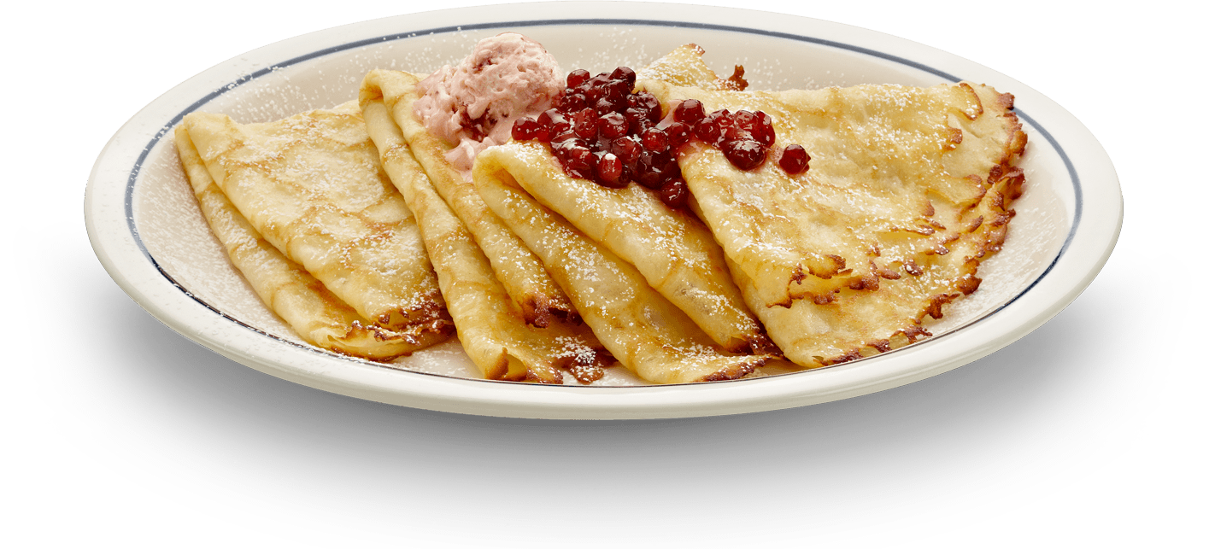
1. From which EU member state does this dish originate?
France
Spain
Belgium
Crepes – or pancakes–originated in Brittany in France

Slide 31
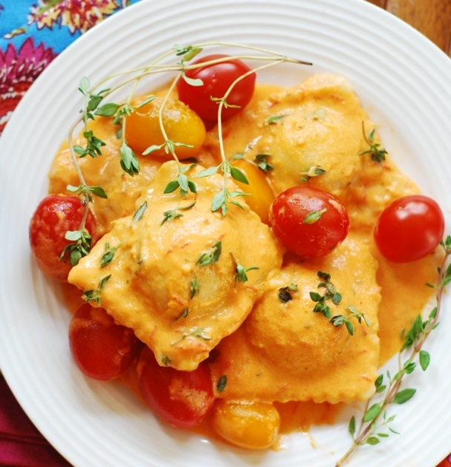
2. Where does this dish originate from?
Portugal
Spain
Italy Ravioli – pasta parcels
containing meat, cheese
or vegetables with sauce

Slide 32
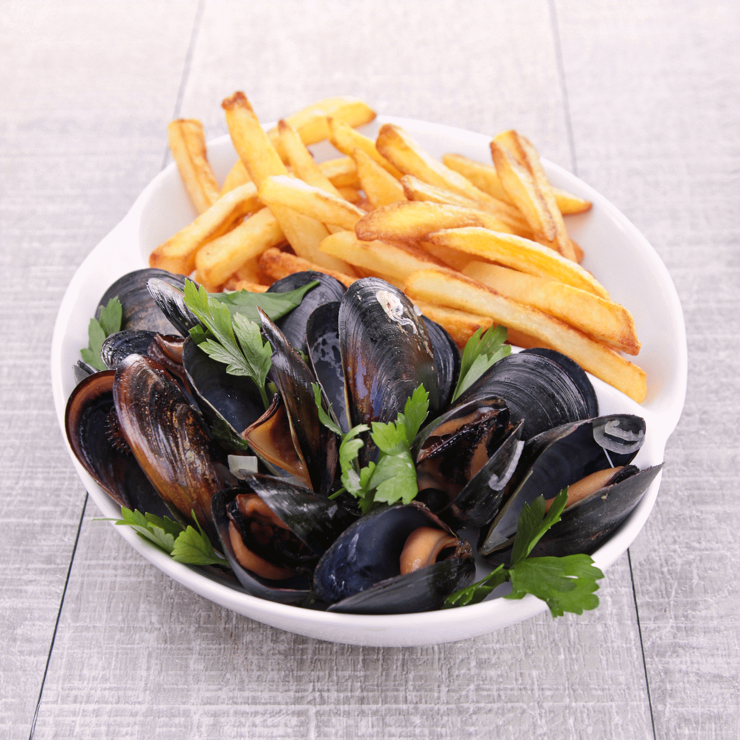
3. In which EU member state might you find these?
Latvia
Belgium
Luxembourg
This dish is 'Moules Frites' or 'Mussels and
Chips''

Slide 33
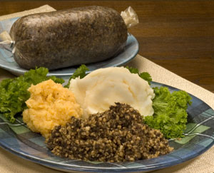
4. In which country is this dish very popular?
England
Wales
Scotland
Haggis, usually eaten with
'tatties and neeps'

Slide 34
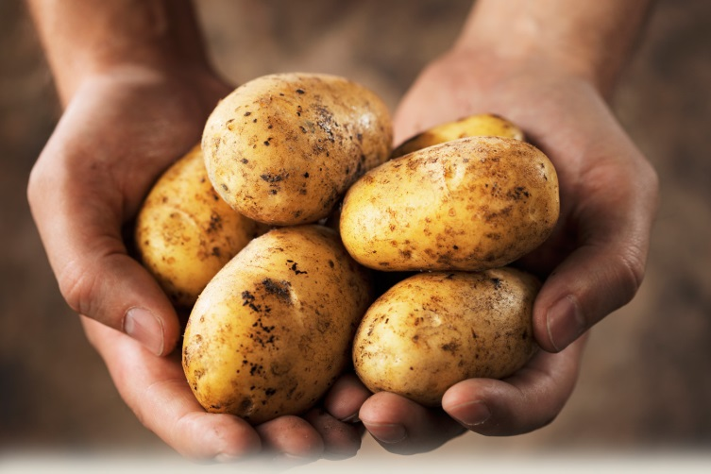
5. From which EU member state did potatoes arrive in Ireland?
Poland
Spain
Portugal
Brought to Ireland in 1589 by
Sir Walter Raleigh

Slide 35
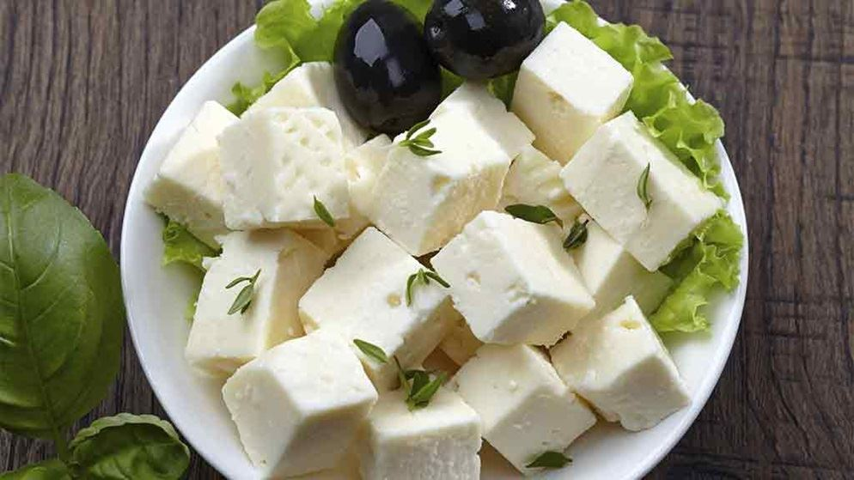
6. This cheese comes from which EU member state?
Portugal
France
Greece
Feta - cheese made from goats milk or sheep & goat's milk

Slide 36
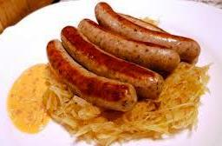
7. In which EU member state would you find this popular dish?
Latvia
Germany
Italy
Bratwurst and Sauerkraut' –
sausage with pickled or fermented cabbage

Slide 37
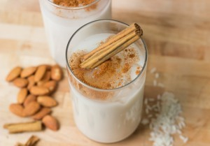
8. This sweet drink served cold is popular in which EU member state?
France
United Kingdom
Spain
' Horchata ' is usually made from almonds

Slide 38
Round 5
Languages

Slide 39
1. How many official languages does the EU have?
23
24
25

Slide 40
2. Which EU country is known as 'Suomi' in its own language?
Sweden
Cyprus
Finland

Slide 41
3. If you hurt your 'rodilla' on holiday in Spain, what part of your body is sore?
Wrist
Shin
Knee

Slide 42
4. What are the official 'working languages‘ of the EU?
French, English and Spanish
French, English and German
English, German and Spanish

Slide 43
5. What language would you speak if you lived in Riga?
Latvian
Estonian
Polish

Slide 44
6. The slogan 'parce que je le vaux bien' in France advertises what brand of products?
Sephora
L'Oréal
Rimmel

Slide 45
7. You see 'Baile Átha Cliath' on a vehicle number plate. Which county in Ireland is the vehicle from?
Donegal
Dublin
Waterford

Slide 46
8. Which of these language groups is not European?
Germanic
Semitic
Romance

Slide 47
Round 6
Faces and Places

Slide 48
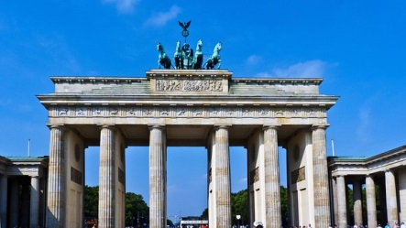
1. In which European city would you find this famous landmark?
A. Paris
Berlin
Madrid
Brandenburg Gate

Slide 49

2. Who was this famous European artist?
Rembrandt
Vincent Van Gogh
Salvador Dali
famous Spanish Surrealist painter

Slide 50
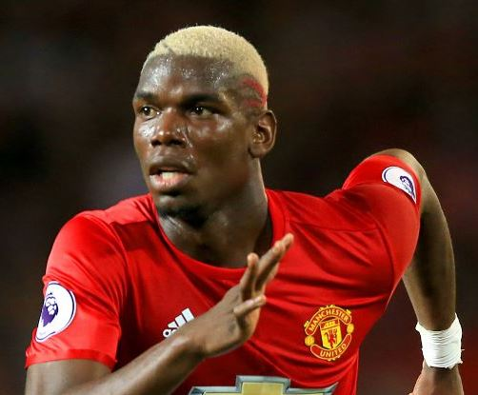
3. Who is this famous French footballer?
A. Patrice Evra
B. Thierry Henry
C. Paul Pogba
played for Juventus before joining Manchester United
Notes:
played for Juventus before joining Manchester United

Slide 51
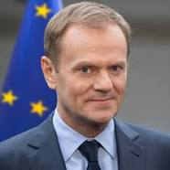
4. Who is this EU President?
A. Donald Tusk
B. Jean-Claude Juncker
C. Antonio Tajani
Donald Tusk is President of the Council of the European Union
Jean-Claude Juncker is President of the European Commission
Antonio Tajani is President of the European Parliament

Slide 52
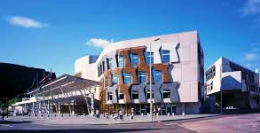
5. In which European city would you find this Parliament building?
A. Hamburg
B. Edinburgh
C. Lisbon
- the home of the Scottish Parliament

Slide 53
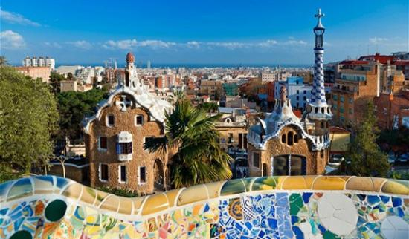
6. In which Spanish city would you find this famous park?
A. Madrid
B. Barcelona
C. Seville
Parc Güell, by the Spanish architect
Antoni Gaudi

Slide 54
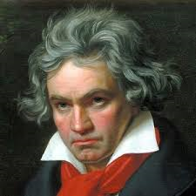
7. Who is this famous German composer?
A. Ludwig Van Beethoven
B. Johann Sebastian Bach
C. Richard Wagner
The EU anthem "Ode to Joy" comes from his 9th Symphony

Slide 55
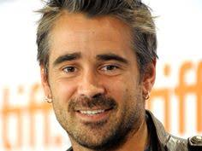
8. Who is this well known Irish actor?
A. Colin Morgan
B. Colin Farrell
C. Colin Firth
Recent films include ' Lobster ', 'Saving Mr Banks' & ' Fantastic Beasts and Where to find them '

Slide 56
TIE BREAK QUESTIONS

Slide 57
Which of the following EU countries does NOT use the euro as its official currency?
A. Estonia
B. Latvia
C. Poland

Slide 58
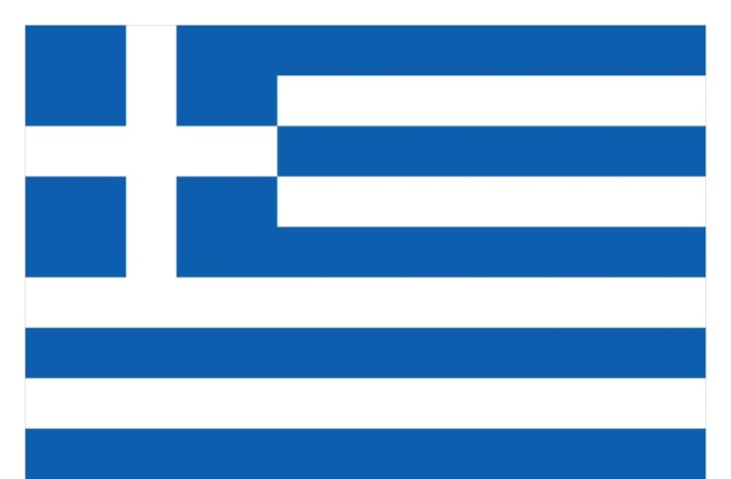
What country does this flag belong to?
Malta
Greece
Sweden

Slide 59
Which two countries are the largest and the smallest within the EU?
A. France and Malta
B. Germany and Luxembourg
C. France and Cyprus

Slide 60
In which year were Euro banknotes officially launched?
1998
2002
2004

