Slide 1

BSc (Hons) Psychology
Dr Martin Dempster
Director of Education

Slide 2
Welcome to Psychology at Queen’s?
Give you an opportunity to learn more about the Psychology degree
Hear from our students
Opportunity to speak to our staff and find out about our research

Slide 3
BSc (Hons) Psychology Year 1
Foundations of Psychology | Introduction to Methods in Psychology | Using Psychology in Everyday Life
Introduction to: Cognitive, Developmental, Social, Psychobiology, Individual differences | Historical and conceptual issues Research methods in psychology Data analysis | Criminal profiling Body language Bilingualism Hypnosis Binge drinking Magic Dementia

Slide 5
BSc (Hons) Psychology Year 2
Core Psychology I | Core Psychology II | Psychological Methods
Historical and conceptual issues Social Psychology Individual differences Perception | Developmental Psychology Cognitive Psychology Psychobiology Applied psychology and employability | Research methods Qualitative analysis Statistical analysis

Slide 6
BSc (Hons) Psychology with Professional Placement Year 3
Existing students can transfer to the four year programme after completing stage 2, on an optional basis.
This placement year will be salaried
Must secure placement
Full time – about 37 hours/week
At least 40 weeks (including holidays)

Slide 7
Final Year
Psychology Thesis | Optional Modules
Research dissertation Application of psychology | Example Options: Placement module Psychopharmacology Serial Killers Developmental Disorders Sport and exercise psychology Psychology of music

Slide 8
Placement Providers
Adoreboard
Belfast Education & Library Board
Student Welfare
Carecall
QUB Disability Services
Hughes Insurance
Linking Generations NI
Co-Operation Ireland
Now Group
Rainbow Project
HMRC
Marie Curie
NSPCC
Praxis Care
YMCA
Guide Dogs NI
Stepping Stones
Action Cancer
Child Brain Injury Trust
Axiom
Belfast City Council

Slide 9

Professional recognition
Accredited by the British Psychological Society (BPS)
Provides the BPS Graduate Basis for Chartership
Eligibility to apply for membership of the BPS (MBPsS)

Slide 10
Support
Adviser of Studies – help with academic choices
Personal Tutors – promote reflection on learning
Lecturers / module co-ordinators
We provide excellent pastoral and academic support

Slide 11


Your future career
Clinical Psychology
Educational Psychology
Health Psychology
Forensic Psychology
Sports Psychology
Occupational Psychology
Counselling Psychology
Management
Insurance
HR / L&D
Marketing & sales
Teaching
Social services
Research

Slide 12
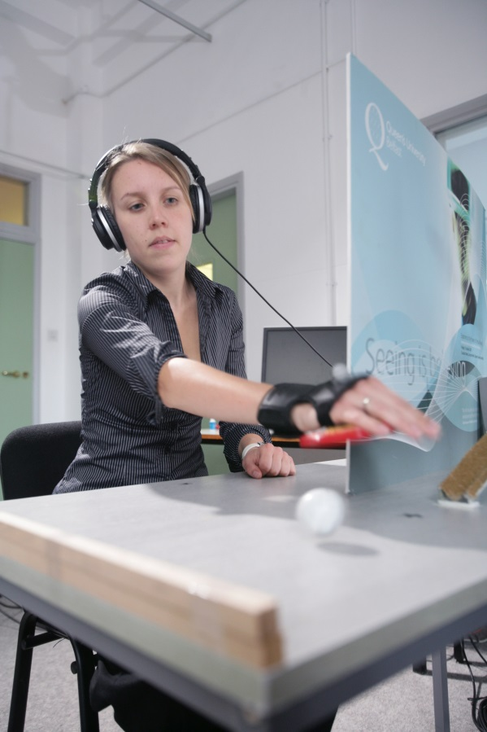
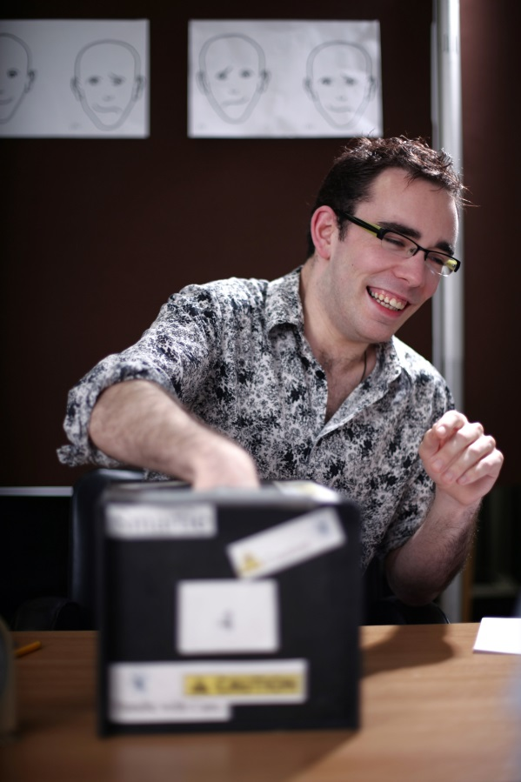
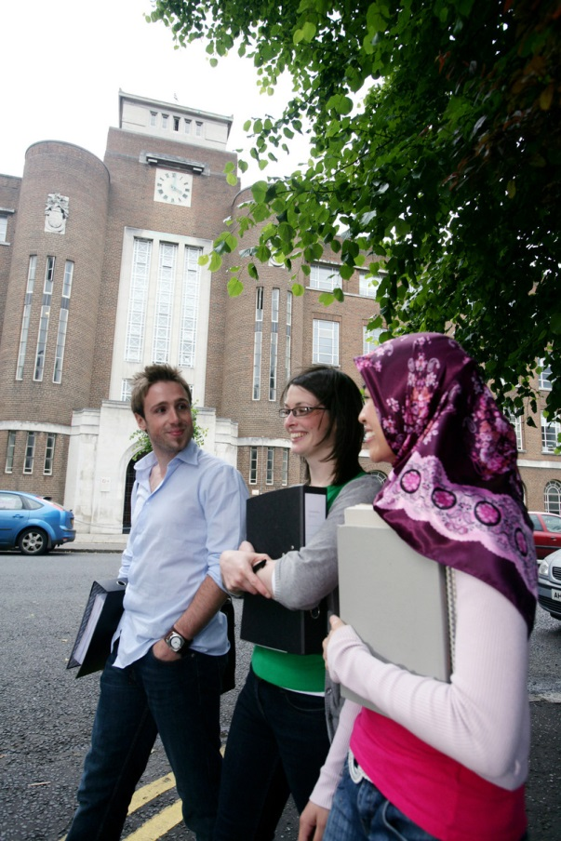
Any questions?

