Slide 1




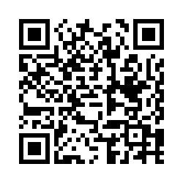
Take part in our research!
ONLINE RESEARCH OPPORTUNITY FOR KIDS
What is it?
We are in need of some young participants (aged 5 to 6 years old) to help us with our research into emotions.
How to help?
Listen to fun and interactive stories at home through online video chat with a Queen’s scientist!
Why take part?
Contribute to science and listen to fun stories from the comfort of your own home!
INTERESTED?
Visit our website and fill in a contact survey
https://tinyurl.com/ydengsp9
Or scan the QR code (just point your phone camera)
Any questions? Contact mjohnston69@qub.ac.uk

