Slide 1
iABC WP2
Miquel Ekkelenkamp

Slide 2
WP2: objectives
Pre-clinical development BAL for inhalation
  Formulation development
  Device development
  Pre-clinical toxicology
  In-vitro efficacy
  Efficacy in animal model
Scientific objectives:
  Breakpoint development emerging pathogens / inhaled antibiotics
  Genetic analysis of pathogenic strains in CF and BE
  Advancement of animal model of chronic infection
  Advancement of biofilm model of CF-infection

Slide 3
WP2: objectives / deliverables

Slide 4
Work package 2
Partners:
  RUG: Erik Frijlink, Marcel Hoppentocht, Doetie Gjaltema
  ITEM: Clemens Dasenbrock, Gerhard Pohlmann, Rainer Fuhst
  UMCU: Miquel Ekkelenkamp, Ad Fluit, Judith Vlooswijk, Juma Bayjanov
  SERMAS-HURYC: Rafael Cantón, María Diez Aguilar, Maria Isabel Morosini
  QUB: Beckie Ingram, Jaime Lindsay, Michael Tunney, Deirdre Gilpin
  Basilea: Salim Jarri, Mark Jones, Stefanie Sämann, Stephen Keech, Patrice Larger, Anne Santerre
  Novartis

Slide 5
Susceptibility testing
MICs 1000 CF / BE pathogens
Resistance induction
Mutant prevention
Biofilm growth inhibition
Biofilm growth prevention
Isolates chosen based on MICs

Slide 6
WP2 microbiology UMCU
Susceptibility: +/-
  500 P. aeruginosa
  70 H. influenzae
  120 Burkholderia
  100 Achromobacter
  100 Stenotrophomonas
  40 Ralstonia / Pandoraea
  70 Enterobacteriaceae
Whole genome sequencing
  Genetics of resistance
-Spanish collection at SERMAS
-UMCU, Erasmus and CWZ Nijmegen
-QUB collection
-Australian strains

Slide 7
P. aeruginosa 500 strains, MICs
PRELIMINARY DATA!
MIC₅₀
MIC₉₀

Slide 8
P. aeruginosa, 500 strains MICs
PRELIMINARY DATA!
S
R
MIC₅₀
MIC₉₀

Slide 9
P. aeruginosa
PRELIMINARY DATA!
S
R
MIC₅₀
MIC₅₀
MIC₉₀
MIC₉₀
MIC₅₀
S
MIC₅₀
S
R
R
MIC₉₀
MIC₉₀

Slide 10
Burkholderia species (n=99)
PRELIMINARY DATA!
MIC₉₀
MIC₅₀
MIC₅₀
MIC₉₀
MIC₅₀
MIC₉₀
MIC₅₀
MIC₉₀

Slide 11
Burkholderia species
PRELIMINARY DATA!
MIC₅₀
MIC₉₀
MIC₅₀
MIC₉₀

Slide 12
Achromobacter xylosoxidans
PRELIMINARY DATA!

Slide 13
Stenotrophomonas maltophilia
PRELIMINARY DATA!
MIC₅₀
MIC₉₀
MIC₉₀
MIC₅₀
MIC₅₀
MIC₉₀

Slide 14
Pandoraea species (n=10)
PRELIMINARY DATA!

Slide 15
Ralstonia species (n=9)
PRELIMINARY DATA!

Slide 16
Next steps microbiology iABC, UMCU
Round up MIC testing and analysis of data
Resistance induction
WGS-analysis
  Genetic resistance
  W/ resistance induction
  Genetic diversity and clonal spread

Slide 17
Next steps microbiology iABC, SERMAS
Analysis of MIC data
Choice of strains for:
  Biofilm analysis Calgary system
  Biofilm analysis Bioflux system
  MICs with additives
  Mutant prevention
Further development open biofilm system
Breakpoint development

Slide 18

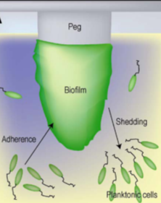
In-vitro activity BAL30072 (UMCU / SERMAS-HURYC)
SUSCEPTIBILITY OF BAL30072 TESTED IN BIOFILM MODELS
In vitro activity in biofilms
CLOSED SYSTEMS
OPEN SYSTEMS
Differences in the effect of most antibiotics when acting on planktonic or biofilm bacteria
1-CLOSED SYSTEM: “CALGARY BIOFILM DEVICE”
MIC Results
50 P. aeruginosa + 50 other CF pathogens
BAL30072, TOBRAMYCIN, COLISTIN, AZTREONAM
ADVANTAGES
Simplicity and applicability in high-throughput analysis
Determination of PD parameters which establish the antibiotic activity on biofilms
Notes:
Determination of different parameters which establish the antibiotic activity on biofilms:

Slide 19
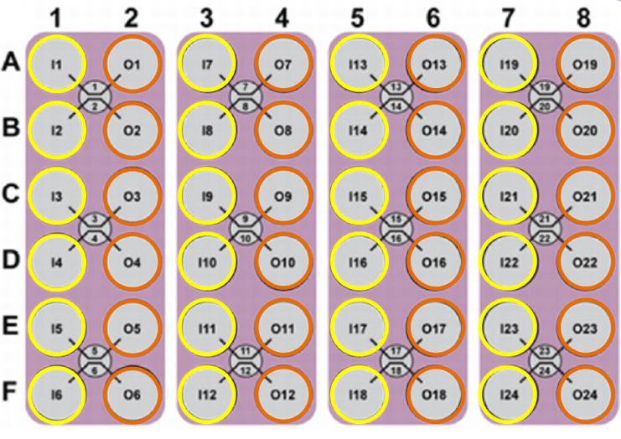
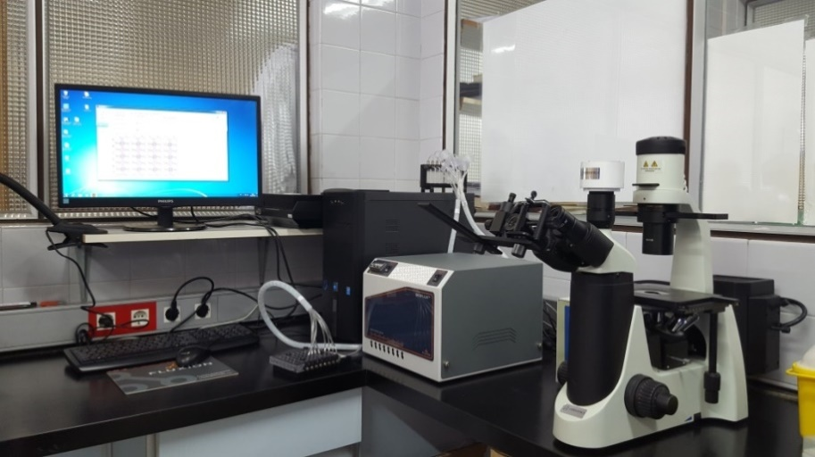
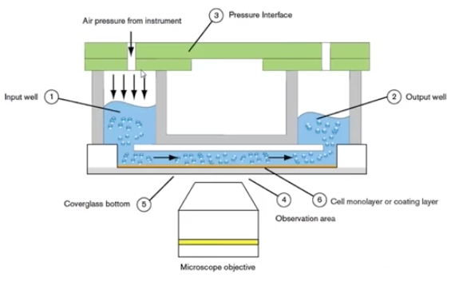
In-vitro activity BAL30072 (UMCU / SERMAS-HURYC)
SUSCEPTIBILITY OF BAL30072 TESTED IN BIOFILM MODELS
2-OPEN SYSTEM: BIOFLUX-FLUXION BIOSCIENCES Microfluidic channels
Inlet wells
Outlet wells
ADVANTAGES
Replicates the in vivo conditions
Control of:
nutrient delivery
flow
temperature

Slide 20
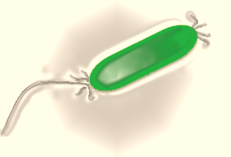
In-vitro activity BAL30072 (UMCU / SERMAS-HURYC)
SUSCEPTIBILITY OF BAL30072 TESTED IN BIOFILM MODELS
EXPERIMENTS WITH TOBRAMYCIN- CF P. aeruginosa
6 P. aeruginosa (+ATCC 27853) strains from cystic fibrosis patients
 | MORFOTYPE | MIC TOBRAMYCIN (mg/l) | BIC TOBRAMYCIN (mg/l) | Type of infection | Age
Pab1 | MUCOID | 1 | 8 | Primoinfection | 21
Pab2 | SMOOTH | 1 | 32 | Primoinfection | 15
Pab3 | SMOOTH | 2 | 32 | Chronic | 45
Pab4 | MUCOID | 1 | 8 | Chronic | 22
Pab5 | SMOOTH | 4 | 16 | Chronic | 22
Pab6 | SMALL COLONY | 4 | - | Chronic | 26
ATCC 27853 | - | 0.5 | 2 | - | -
Diferent morphotypes
(mucoid, smooth, small colony…)
Tobramycin MICs: (susceptible)
0.5-4 mg/l
Tobramycin BICs:
2-32 mg/l
Chronic infection
Primoinfection
Age (15-45 years old)

Slide 21



















In-vitro activity BAL30072 (UMCU / SERMAS-HURYC)
EXPERIMENTS WITH TOBRAMYCIN- CF P. aeruginosa-BIOFLUX RESULTS
Pab1
Pab2
Pab3
INOCULUM 24H
TOBRAMYCIN MIC
TOBRAMYCIN BIC
Pab4
Pab5
ATCC 27853
Pab6
INOCULUM 24H
TOBRAMYCIN MIC
No biofilm formation
TOBRAMYCIN BIC

Slide 22

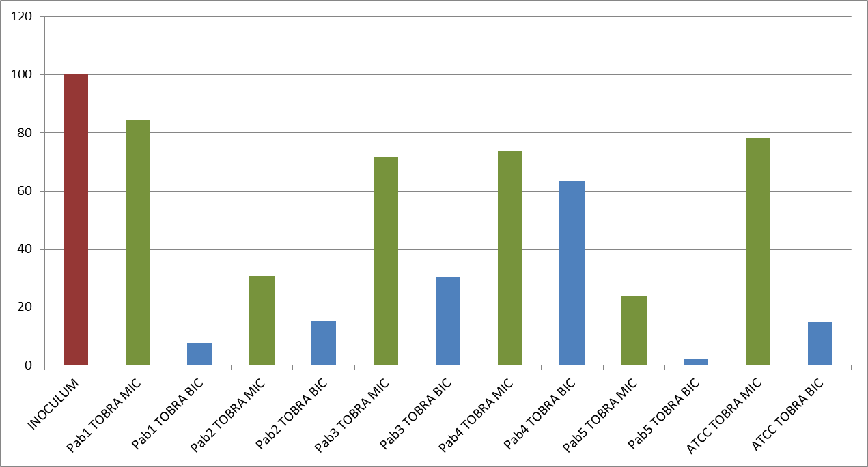
In-vitro activity BAL30072 (UMCU / SERMAS-HURYC)
SUSCEPTIBILITY OF BAL30072 TESTED IN BIOFILM MODELS
BIOFLUX SOFTWARE
ANALYSIS OF IMAGES
INTENSITY OF COLOR-PIXELS
= 0
= 255
VALUE = media of the intensity of the selected area in the microchanel
% BIOFILM
Mann–Whitney test
TOBRA MIC | TOBRA BIC
0.0547 | 0.0065
p<0.01

Slide 23
In-vitro activity BAL30072 (UMCU / SERMAS-HURYC)
Coming next…
Calgary
Biofilm activity of BAL30072, comparators
Bioflux
Fluorescence: dead/alive cells after antibiotic exposure
Confocal images
Polymicrobial cultures
interspecies interactions
Drugs alone and in combination

Slide 24
Beckie Ingram

Slide 25
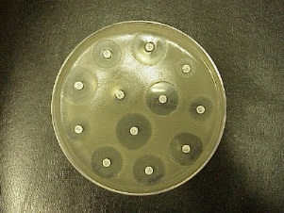
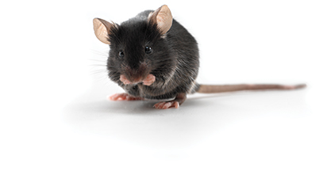
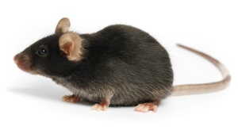
iABC murine infection models
Pharmacokinetic experiments
Validation in βENaC mice – Acute infection
* Nebulised delivery
Acute infection model (WT) – Tobramycin / BAL30072
P.aeruginosa
√ Sensitive to both BAL30072 & Tobramycin
Develop Burkholderia
co-infection model
Chronic Infection model - βENaC mice
Tobramycin / BAL30072
Comparison of each pre-clinical model and how informative they are for clinical trial outcome
Co-infection model

Slide 26
Pharmacokinetics
Use WT mice (n=3/group, 51 mice total)
A control anhydrous NaHCO₃ alone will be used.
BAL30072 will be administered using the sireq inExpose nose-only exposure tower (Emka, France) – 0.25 and 2.5mg/mouse.
Mice will be administered with a terminal dose of ketamine HCl at 5mins, 15 mins, 30 mins, and 1, 2, 4 ,8 and 24h time points.
Blood will be collected by cardiac puncture (500 - 1000μL / group)
Lungs will be perfused and harvested
Plasma and lungs will be snap frozen and stored at -80°C until shipping to Basilea.

Slide 27
Nebulised v’s dry powder delivery
Currently, in vivo experiments will utilise nebulised delivery of products.
If required we can purchase a dry powder aerosoliser generator to attach onto the inExpose tower – this may make an interesting adjunct study?

Slide 28


The formulation of BAL30072 into dosage forms for inhalation
iABC WP2A: Formulation
Consortium meeting June 2016
M Hoppentocht, J Spronk, D Gjaltema and HW Frijlink
Department of Pharmaceutical Technology and Biopharmacy
University of Groningen

Slide 29
Aims of the project
To develop suitable methods for in vitro evaluation of the newly developed BAL30072 formulations.
  A beta-lactam lab (room 3213.122)
  HPLC method (for analysis)
  Implement equipment (like laser diffractometer)
Nebulisation solution containing 10 mg/mL and 20 mg/mL of BAL30072
  10, 20, 30, 40 and 100 mg/mL
DPI containing 25 mg and 50 mg BAL30072

Slide 30
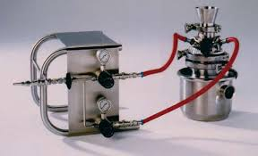
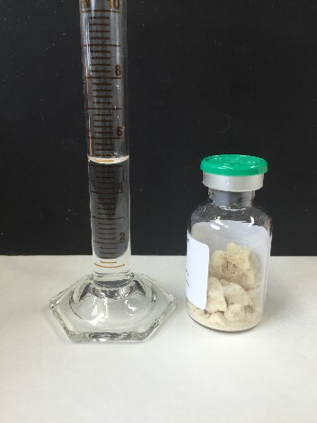
Selection of used methods
Particle preparation
  Desired range for inhalation 1-5 microns
  Alpine 50 AS spiral jet mill
Multiple characterisation techniques
  DVS, DSC, TGA, SEM
Solutions for nebulisation
  500 mg BAL30072 vials for injection
  Dissolved in 5 mL demineralised water
Notes:
The methods used…......

Slide 31
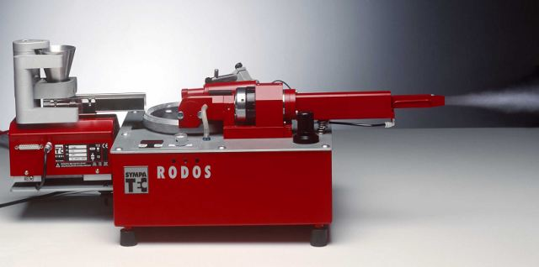
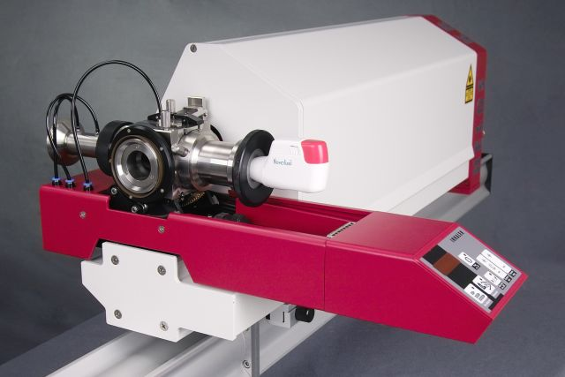
Selection of used methods
Laser diffraction analysis with a Sympatec HELOS BF
  RODOS disperser
  INHALER 2000
Inhaler retention
  Gravimetrically
  HPLC
  Effect of lactose sweeper crystals
High performance liquid chromatography
  Fast method for inhaler retention
  Basilea method implemented for stability
Notes:
The methods used…......

Slide 32
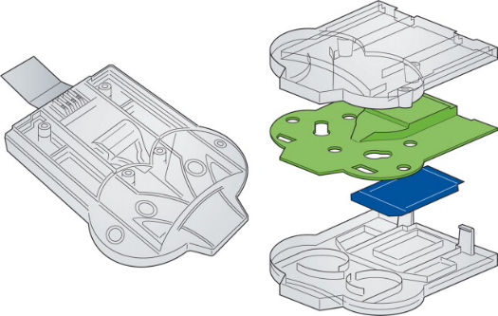
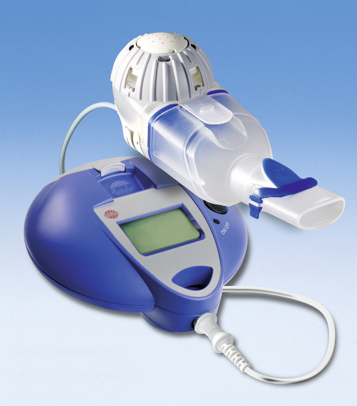
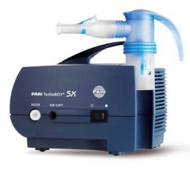
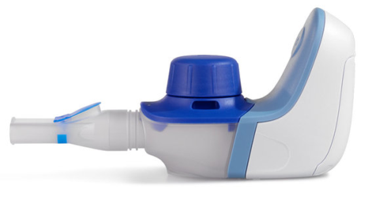
Inhalers (DPIs and nebulisers)
DPIs
  Twincer®
  Cyclops
Nebulisers
Pari Velox
Pari eFlow
Pari LC Sprint + Turboboy

Slide 33
Effect of the dose on the dispersion efficiency
 | X₅₀ | Fpf < 5 µm | Retention (%)
25 mg | 2.39 | 84.82 | 12.21
30 mg | 2.57 | 77.52 | 14.45
40 mg | 3.22 | 64.39 | 14.4
50 mg | 5.36 | 52.87 | 12.49
Effect of the dose on the dispersion efficiency of micronised BAL30072 with 2 mg of lactose sweeper crystals (150-200 µm) at 4 kPa pressure drop compared with RODOS 3 bar.

Slide 34
Effect of the pressure drop on the dispersion efficiency
 | X₅₀ | Fpf < 5 µm | Retention (%)
2 kPa | 3.01 | 76.28 | 24.41
4 kPa | 2.39 | 84.82 | 12.21
6 kPa | 2.24 | 88.82 | 6.96
Effect of the pressure drop on the dispersion efficiency of 25 mg of micronised BAL30072 with 2 mg of lactose sweeper crystals (150-200 µm) compared with RODOS 3 bar.

Slide 35
Effect of the pressure drop on the dispersion efficiency
 | X₅₀ | Fpf < 5 µm | Retention (%)
2 kPa | 3.49 | 60.18 | 25.98
4 kPa | 3.22 | 64.39 | 14.4
6 kPa | 2.81 | 67.52 | 14.97
Effect of the pressure drop on the dispersion efficiency of 40 mg of micronised BAL30072 with 2 mg of lactose sweeper crystals (150-200 µm) compared with RODOS 3 bar.

Slide 36
Conclusions on DPI development
Micronisation seems a suitable method to produce inhalable powders of BAL30072.
Administration with the Twincer® seems feasible.
The dispersion efficiency worsens with increasing the dose, whereas the inhaler retention is very constant at different doses and only increases at 2 kPa pressure drop.
On going work on DPI development
Force control agents
Spray drying
Other inhalers

Slide 37
Nebuliser performances with 20 mg/mL BAL30072
Fine particle fractions at different flow rates for the Pari Velox, Pari LC Sprint and Pari eFlow nebulisers. The Fine particle fraction is the fraction of the droplets smaller than 5.0 µm.

Slide 38
Velox performance with different concentrations
Droplet size distributions of different BAL30072 concentrations at a flow rate of 30 L/min from the Velox.

Slide 39
eFlow performance with different concentrations
Droplet size distributions of different BAL30072 concentrations at a flow rate of 30 L/min from the eFlow.

Slide 40
LC Sprint performance with different concentrations
Droplet size distributions of different BAL30072 concentrations at a flow rate of 30 L/min from the LC Sprint.

Slide 41
Nebuliser retention
Average retention values of all measurements for each nebuliser with 10, 20 and 100 mg/mL BAL30072 in 5 mL demineralised water.

Slide 42
Nebulisation time

Slide 43
Conclusions on nebulisation solution development
Nebulisation seems a suitable method to administer BAL30072 to the respiratory tract
100 mg/mL BAL30072 nebulisation solution performs best
The eFlow performs best when the FPF, retention and nebulisation times are all considered
However, the performance of the Velox is not much worse and this device is more patient friendly
Ongoing work on nebulisation solution development
Stability of BAL30072 in solution and during nebulisation
Characterisation of BAL30072 solution for nebulisation

Slide 44
Acknowledgements
University of Groningen
  Juliëtte Spronk
  Doetie Gjaltema
  Paul Hagedoorn
  Erik Frijlink
Basilea Pharmaceutica
  Stefanie Sämann
  Sofyen Riahi
  Salim Jarri
All other members of WP2

Slide 45
Thank you for your attention
Any Questions?

Slide 46
PSDs of micronised BAL30072 batches determined by laser diffraction analysis using a HELOS BF laser diffractometer and a RODOS dry powder disperser operated at 3 bar.
Batch | Internal code | X10 (µm) | St.dev. | X50 (µm) | St.dev. | X90 (µm) | St.dev. | FPF < 5 µm (%)
44A | micro151127 | 0.65 | 0.01 | 1.4 | 0.04 | 2.94 | 0.05 | 100
46A | micro160218 | 0.79 | 0.00 | 1.88 | 0.01 | 3.55 | 0.01 | 99.26
47A | micro160219 | 0.74 | 0.00 | 1.74 | 0.00 | 3.36 | 0.01 | 99.68
47A | micro160223 | 0.67 | 0.00 | 1.48 | 0.01 | 2.98 | 0.01 | 100
46A | micro160304 | 0.70 | 0.00 | 1.62 | 0.01 | 3.39 | 0.00 | 96.55
44A | micro160314 | 0.77 | 0.00 | 1.89 | 0.00 | 3.75 | 0.01 | 96.81
46A | micro160317 | 0.82 | 0.02 | 1.93 | 0.03 | 3.58 | 0.02 | 99.22
44A | micro160323 | 0.62 | 0.00 | 1.19 | 0.01 | 2.53 | 0.01 | 100
44A | micro160404 | 0.62 | 0.00 | 1.20 | 0.01 | 2.55 | 0.01 | 100
46A | micro160405 | 0.66 | 0.01 | 1.46 | 0.03 | 3.16 | 0.07 | 97.42
47A | micro160407 | 0.66 | 0.01 | 1.47 | 0.01 | 3.19 | 0.03 | 98.72
46A+2%LL | micro160408 | 0.63 | 0.00 | 1.23 | 0.00 | 2.57 | 0.00 | 100
44A+2%LL | micro160421 | 0.63 | 0.00 | 1.22 | 0.01 | 2.55 | 0.02 | 100
47A+2%LL | micro160429 | 0.62 | 0.00 | 1.17 | 0.00 | 2.45 | 0.01 | 100
47A+2%MgSt | micro160503 | 0.61 | 0.00 | 1.09 | 0.00 | 2.24 | 0.00 | 100

Slide 47
Batch | Internal code | Temp. during milling (C) | RH during milling (%) | Water content before (%) | Water content after (%) | Milling duration (min.) | Yield (%)
44A | micro151127 | 17 | 44 | 7.7 | 12.5 | 90 (2.8 g) | 50
46A | micro160218 | 17 | 33 | 6.3 | 7.0 | 30 (2.8 g) | 50
47A | micro160219 | 16 | 36 | 4.7 | 8.8 | 30 (2.8 g) | 44
47A | micro160223 | 16 | 36 | 4.3 | 7.5/9.8 | 15 (2.7 g) | 47
46A | micro160304 | 16 | 35 | 6.3 | 8.1 | 37 (2.8 g) | 49
44A | micro160314 | 17 | 35 | 7.7 | 7.2 | 45 (3.0 g) | 59
46A | micro160317 | 16 | 35 | 6.3 | 8.7 | 37 (2.8 g) | 53
44A | micro160323 | 17 | 45 | 7.7 | 8.5 | 180 (3.8 g) | 53
44A | micro160404 | 19-23 | 47-52 | 7.7 | 10.7 | 62 (2.8 g) | 65
46A | micro160405 | 19-21 | 47-52 | 6.4 | 10.9 | 35 (2.3 g) | 58
47A | micro160407 | 18-19 | 37-40 | 4.1 | 9.6 | 27 (2.6 g) | 35
46A+2%LL | micro160408 | 18-19 | 41-42 | 6.4 | 9.5 | 16 (1.5g) | 28
44A+2%LL | micro160421 | 19 | 33 | 7.7 | 8.4 | 19 (1.9g) | 34
47A+2%LL | micro160429 | 16-17 | 42 | 4.1 | 10.3 | 25 (3.5g) | 63
47A+2%MgSt | micro160503 | 18-20 | 40-45 | 4.1 | 9.8 | 31 (3.8g) | 64
47A+2%MgSt* | micro160520 | 19 | 55 |  |  | 18 (1.7g) | 48
47A* | micro160523 | 19 | 60 |  |  | 15 (1.3g) | 38
46A+2%LL | micro160524

Slide 48
Questions?

