Slide 1


The formulation of BAL30072 into dosage forms for inhalation
iABC WP2A: Formulation
Consortium meeting June 2016
M Hoppentocht, J Spronk, D Gjaltema and HW Frijlink
Department of Pharmaceutical Technology and Biopharmacy
University of Groningen

Slide 2
Aims of the project
To develop suitable methods for in vitro evaluation of the newly developed BAL30072 formulations.
  A beta-lactam lab (room 3213.122)
  HPLC method (for analysis)
  Implement equipment (like laser diffractometer)
Nebulisation solution containing 10 mg/mL and 20 mg/mL of BAL30072
  10, 20, 30, 40 and 100 mg/mL
DPI containing 25 mg and 50 mg BAL30072

Slide 3
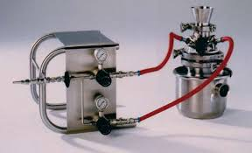
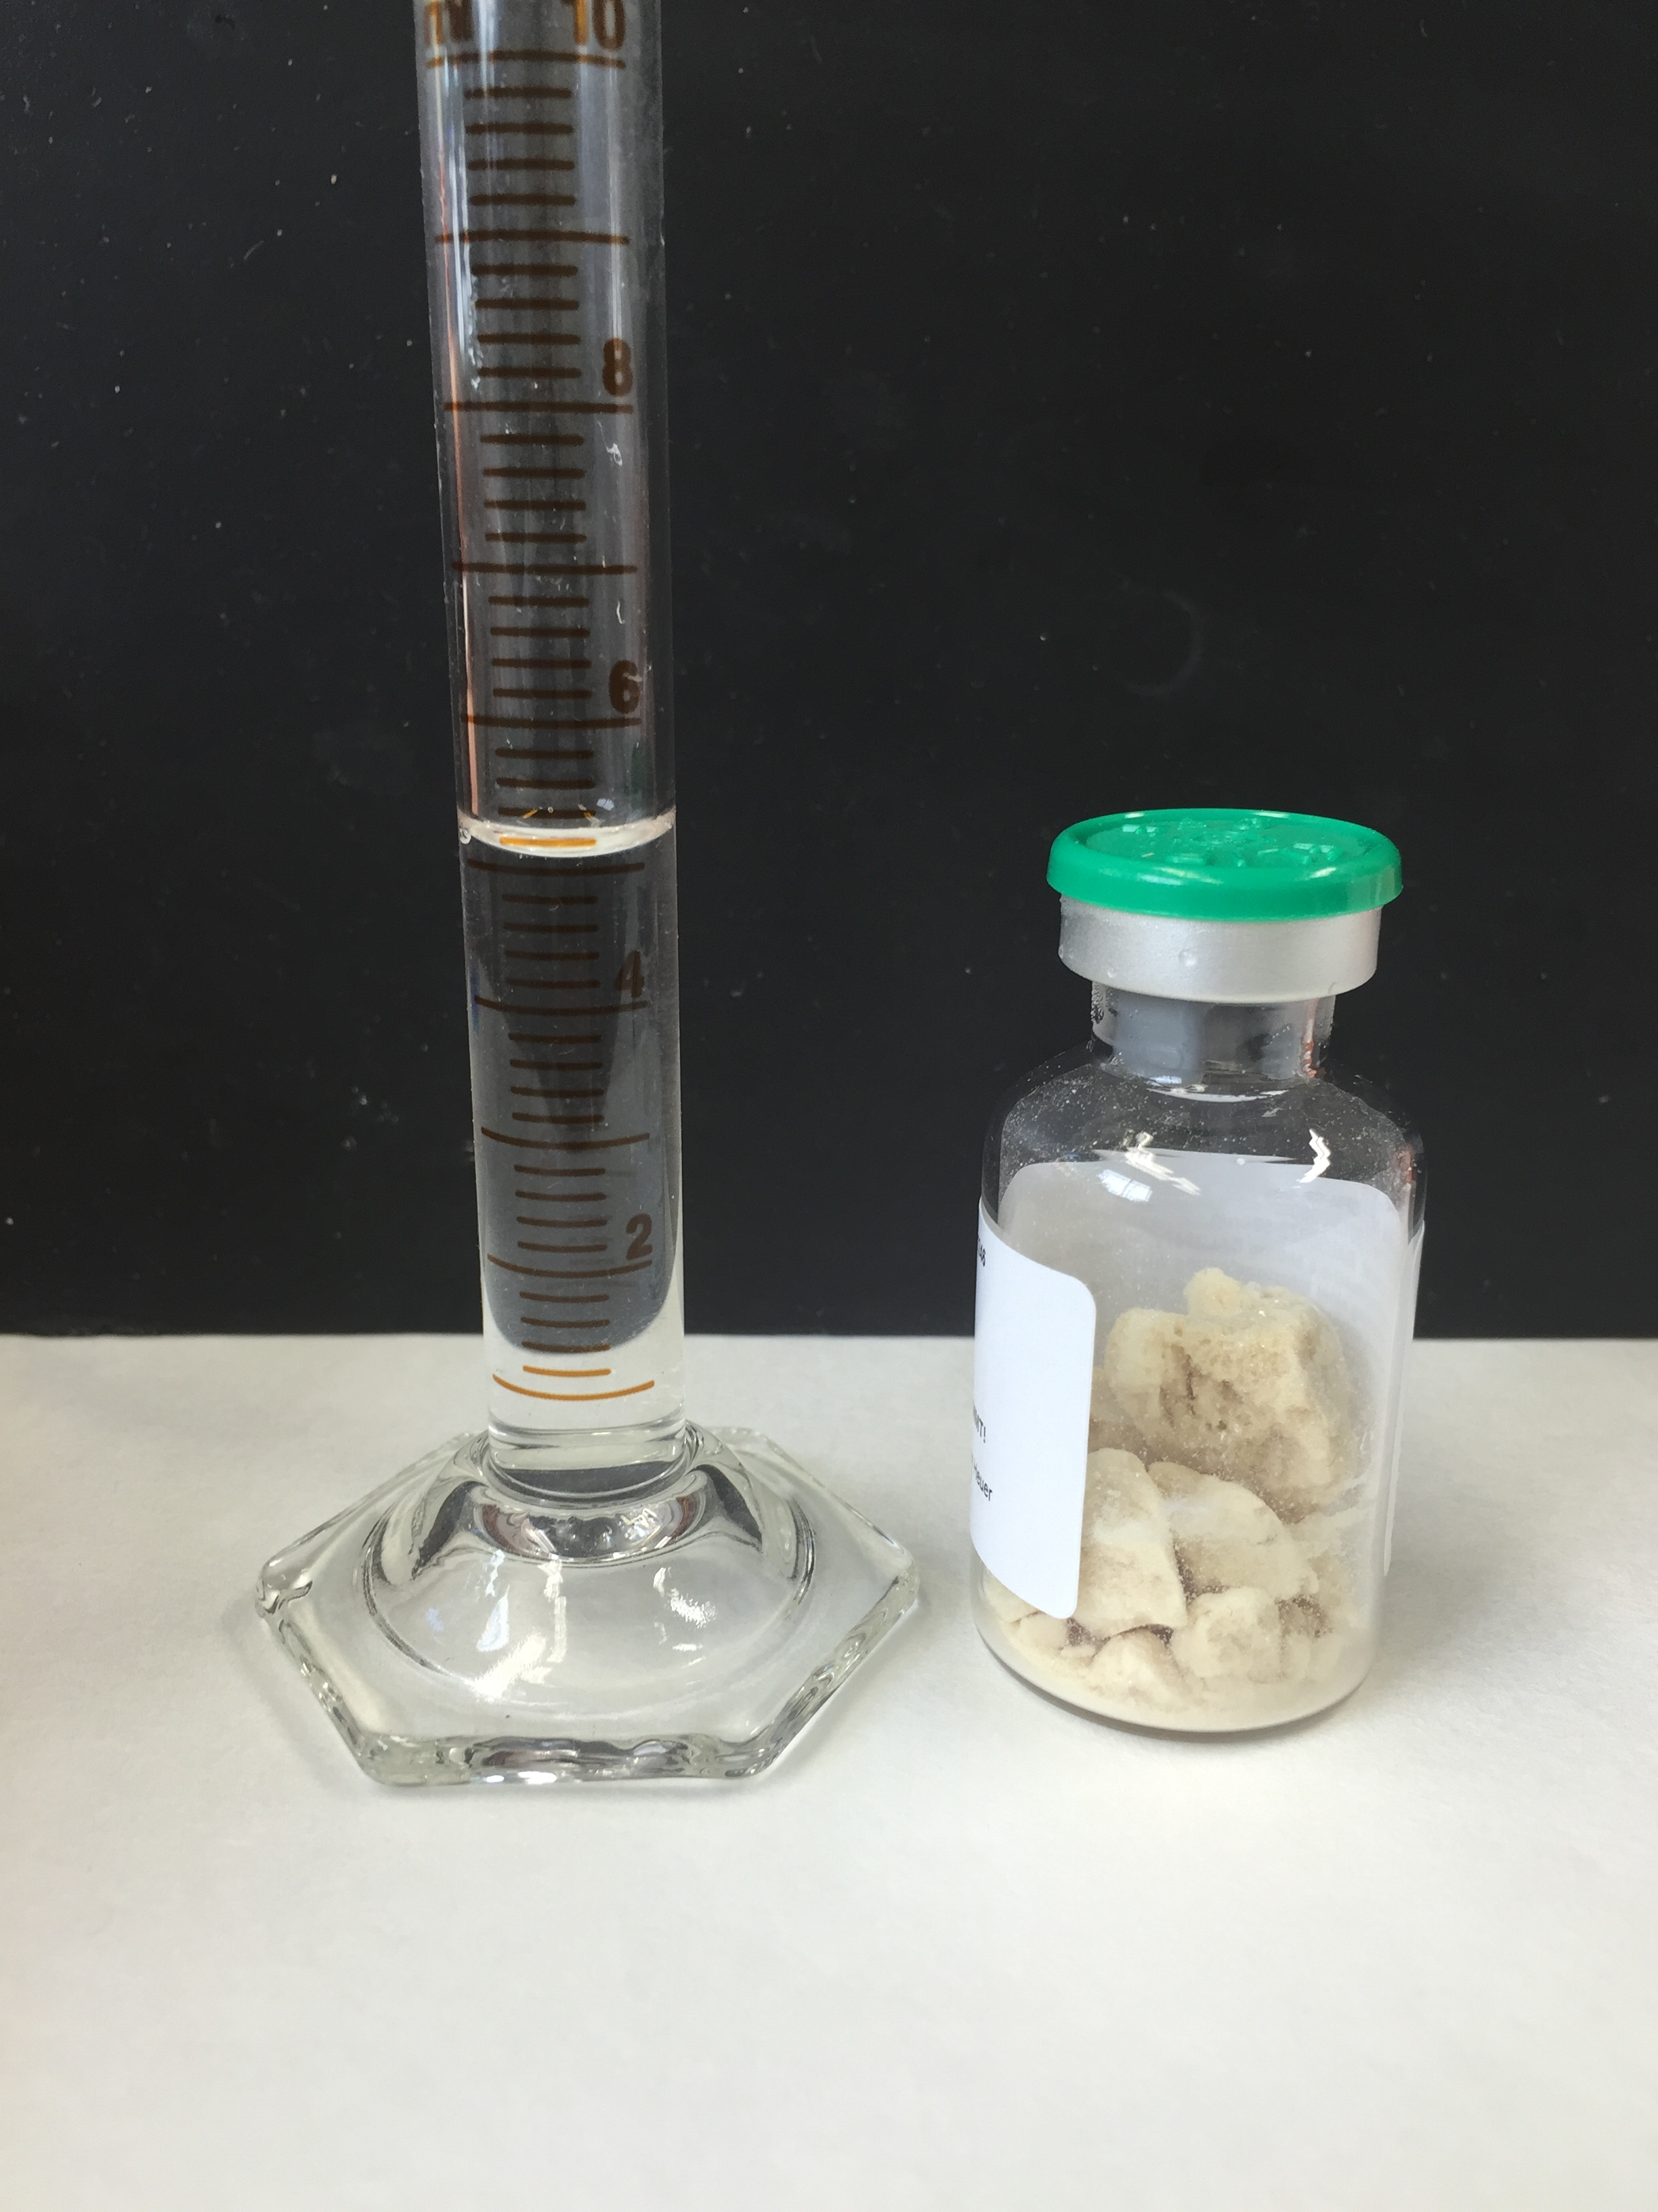
Selection of used methods
Particle processing
  Desired range for inhalation 1-5 microns
  Alpine 50 AS spiral jet mill
Multiple characterisation techniques
  DVS, DSC, TGA, SEM
Solutions for nebulisation
  500 mg BAL30072 vials for injection
  Dissolved in 5 mL demineralised water
Notes:
The methods used…......

Slide 4
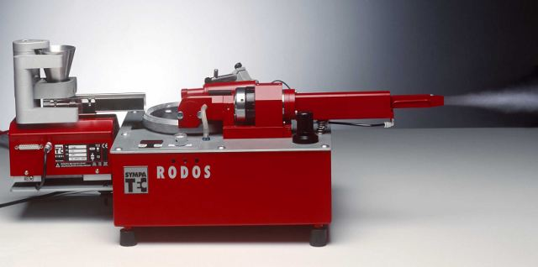
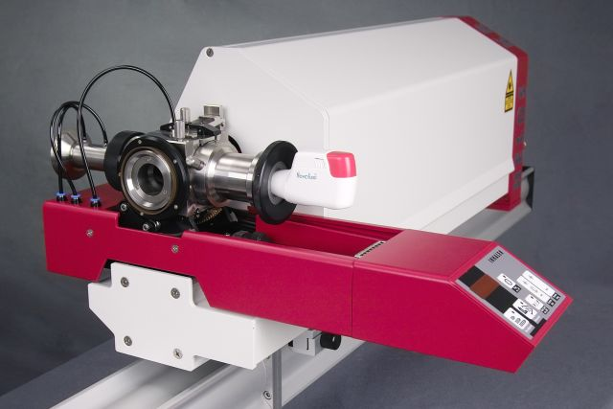
Selection of used methods
Laser diffraction analysis with a Sympatec HELOS BF
  RODOS disperser
  INHALER 2000
Inhaler retention
  Gravimetrically
  HPLC
  Effect of lactose sweeper crystals
High performance liquid chromatography
  Fast method for inhaler retention
  Basilea method implemented for stability
Notes:
The methods used…......

Slide 5
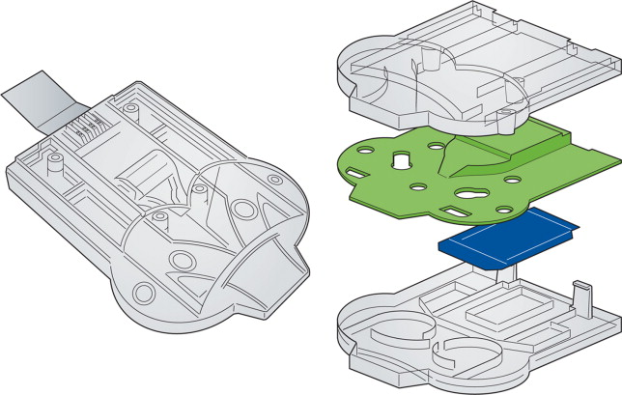
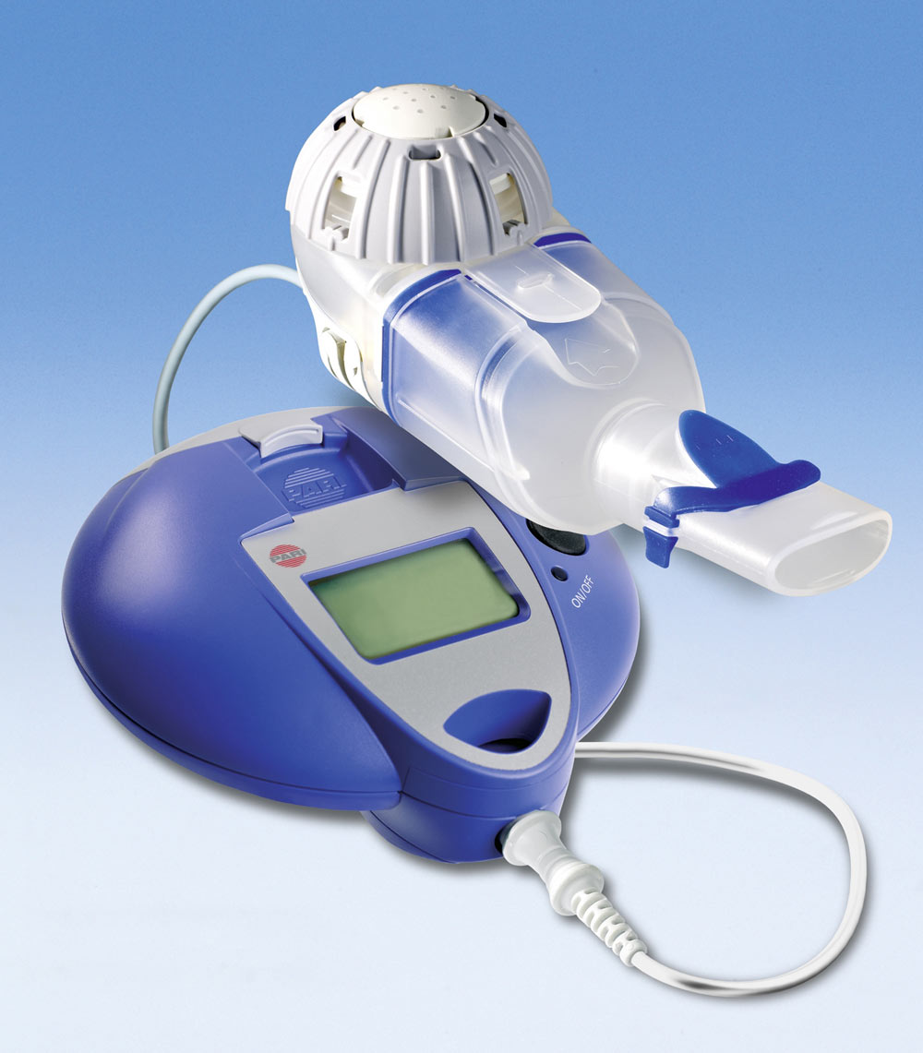
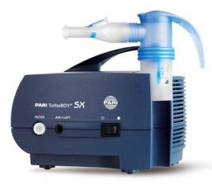
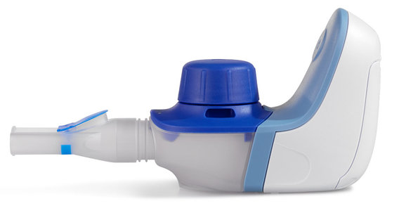
Inhalers (DPIs and nebulisers)
DPIs
  Twincer®
  Cyclops
Nebulisers
Pari Velox
Pari eFlow
Pari LC Sprint + Turboboy

Slide 6
Effect of the dose on the dispersion efficiency
 | X₅₀ | Fpf < 5 µm | Retention (%)
25 mg | 2.39 | 84.82 | 12.21
30 mg | 2.57 | 77.52 | 14.45
40 mg | 3.22 | 64.39 | 14.4
50 mg | 5.36 | 52.87 | 12.49
Effect of the dose on the dispersion efficiency of micronised BAL30072 with 2 mg of lactose sweeper crystals (150-200 µm) at 4 kPa pressure drop compared with RODOS 3 bar.

Slide 7
Effect of the pressure drop on the dispersion efficiency
 | X₅₀ | Fpf < 5 µm | Retention (%)
2 kPa | 3.01 | 76.28 | 24.41
4 kPa | 2.39 | 84.82 | 12.21
6 kPa | 2.24 | 88.82 | 6.96
Effect of the pressure drop on the dispersion efficiency of 25 mg of micronised BAL30072 with 2 mg of lactose sweeper crystals (150-200 µm) compared with RODOS 3 bar.

Slide 8
Effect of the pressure drop on the dispersion efficiency
 | X₅₀ | Fpf < 5 µm | Retention (%)
2 kPa | 3.49 | 60.18 | 25.98
4 kPa | 3.22 | 64.39 | 14.4
6 kPa | 2.81 | 67.52 | 14.97
Effect of the pressure drop on the dispersion efficiency of 40 mg of micronised BAL30072 with 2 mg of lactose sweeper crystals (150-200 µm) compared with RODOS 3 bar.

Slide 9
Conclusions on DPI development
Micronisation seems a suitable method to produce inhalable powders of BAL30072.
Administration with the Twincer® seems feasible.
The dispersion efficiency worsens with increasing the dose, whereas the inhaler retention is very constant at different doses and only increases at 2 kPa pressure drop.
On going work on DPI development
Force control agents
Spray drying
Other inhalers

Slide 10
Nebuliser performances with 20 mg/mL BAL30072 (FPF < 5 μm)
Fine particle fractions at different flow rates for the Pari Velox, Pari LC Sprint and Pari eFlow nebulisers. The Fine particle fraction is the fraction of the droplets smaller than 5.0 µm.

Slide 11
Velox performance with different concentrations
Droplet size distributions of different BAL30072 concentrations at a flow rate of 30 L/min from the Velox.

Slide 12
eFlow performance with different concentrations
Droplet size distributions of different BAL30072 concentrations at a flow rate of 30 L/min from the eFlow.

Slide 13
LC Sprint performance with different concentrations
Droplet size distributions of different BAL30072 concentrations at a flow rate of 30 L/min from the LC Sprint.

Slide 14
Nebuliser retention
Average retention values of all measurements for each nebuliser with 10, 20 and 100 mg/mL BAL30072 in 5 mL demineralised water.

Slide 15
Nebulisation time

Slide 16
Conclusions on nebulisation solution development
Nebulisation seems a suitable method to administer BAL30072 to the respiratory tract
100 mg/mL BAL30072 nebulisation solution performs best
The eFlow performs best when the FPF, retention and nebulisation times are all considered
However, the performance of the Velox is not much worse and this device is more patient friendly
Ongoing work on nebulisation solution development
Stability of BAL30072 in solution and during nebulisation
Characterisation of BAL30072 solution for nebulisation

Slide 17
Acknowledgements
University of Groningen
  Juliëtte Spronk
  Doetie Gjaltema
  Paul Hagedoorn
  Erik Frijlink
Basilea Pharmaceutica
  Stefanie Sämann
  Sofyen Riahi
  Salim Jarri
All other members of WP2

Slide 18
Thank you for your attention
Any Questions?

Slide 19
PSDs of micronised BAL30072 batches determined by laser diffraction analysis using a HELOS BF laser diffractometer and a RODOS dry powder disperser operated at 3 bar.
Batch | Internal code | X10 (µm) | St.dev. | X50 (µm) | St.dev. | X90 (µm) | St.dev. | FPF < 5 µm (%)
44A | micro151127 | 0.65 | 0.01 | 1.4 | 0.04 | 2.94 | 0.05 | 100
46A | micro160218 | 0.79 | 0.00 | 1.88 | 0.01 | 3.55 | 0.01 | 99.26
47A | micro160219 | 0.74 | 0.00 | 1.74 | 0.00 | 3.36 | 0.01 | 99.68
47A | micro160223 | 0.67 | 0.00 | 1.48 | 0.01 | 2.98 | 0.01 | 100
46A | micro160304 | 0.70 | 0.00 | 1.62 | 0.01 | 3.39 | 0.00 | 96.55
44A | micro160314 | 0.77 | 0.00 | 1.89 | 0.00 | 3.75 | 0.01 | 96.81
46A | micro160317 | 0.82 | 0.02 | 1.93 | 0.03 | 3.58 | 0.02 | 99.22
44A | micro160323 | 0.62 | 0.00 | 1.19 | 0.01 | 2.53 | 0.01 | 100
44A | micro160404 | 0.62 | 0.00 | 1.20 | 0.01 | 2.55 | 0.01 | 100
46A | micro160405 | 0.66 | 0.01 | 1.46 | 0.03 | 3.16 | 0.07 | 97.42
47A | micro160407 | 0.66 | 0.01 | 1.47 | 0.01 | 3.19 | 0.03 | 98.72
46A+2%LL | micro160408 | 0.63 | 0.00 | 1.23 | 0.00 | 2.57 | 0.00 | 100
44A+2%LL | micro160421 | 0.63 | 0.00 | 1.22 | 0.01 | 2.55 | 0.02 | 100
47A+2%LL | micro160429 | 0.62 | 0.00 | 1.17 | 0.00 | 2.45 | 0.01 | 100
47A+2%MgSt | micro160503 | 0.61 | 0.00 | 1.09 | 0.00 | 2.24 | 0.00 | 100

Slide 20
Batch | Internal code | Temp. during milling (C) | RH during milling (%) | Water content before (%) | Water content after (%) | Milling duration (min.) | Yield (%)
44A | micro151127 | 17 | 44 | 7.7 | 12.5 | 90 (2.8 g) | 50
46A | micro160218 | 17 | 33 | 6.3 | 7.0 | 30 (2.8 g) | 50
47A | micro160219 | 16 | 36 | 4.7 | 8.8 | 30 (2.8 g) | 44
47A | micro160223 | 16 | 36 | 4.3 | 7.5/9.8 | 15 (2.7 g) | 47
46A | micro160304 | 16 | 35 | 6.3 | 8.1 | 37 (2.8 g) | 49
44A | micro160314 | 17 | 35 | 7.7 | 7.2 | 45 (3.0 g) | 59
46A | micro160317 | 16 | 35 | 6.3 | 8.7 | 37 (2.8 g) | 53
44A | micro160323 | 17 | 45 | 7.7 | 8.5 | 180 (3.8 g) | 53
44A | micro160404 | 19-23 | 47-52 | 7.7 | 10.7 | 62 (2.8 g) | 65
46A | micro160405 | 19-21 | 47-52 | 6.4 | 10.9 | 35 (2.3 g) | 58
47A | micro160407 | 18-19 | 37-40 | 4.1 | 9.6 | 27 (2.6 g) | 35
46A+2%LL | micro160408 | 18-19 | 41-42 | 6.4 | 9.5 | 16 (1.5g) | 28
44A+2%LL | micro160421 | 19 | 33 | 7.7 | 8.4 | 19 (1.9g) | 34
47A+2%LL | micro160429 | 16-17 | 42 | 4.1 | 10.3 | 25 (3.5g) | 63
47A+2%MgSt | micro160503 | 18-20 | 40-45 | 4.1 | 9.8 | 31 (3.8g) | 64
47A+2%MgSt* | micro160520 | 19 | 55 |  |  | 18 (1.7g) | 48
47A* | micro160523 | 19 | 60 |  |  | 15 (1.3g) | 38
46A+2%LL | micro160524

