Slide 1

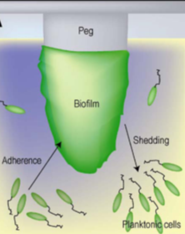
In-vitro activity BAL30072 (UMCU / SERMAS-HURYC)
SUSCEPTIBILITY OF BAL30072 TESTED IN BIOFILM MODELS
In vitro activity on biofilms
CLOSED SYSTEMS
OPEN SYSTEMS
Differences in the effect of most antibiotics when acting on planktonic or biofilm bacteria
1-CLOSED SYSTEM: “CALGARY BIOFILM DEVICE”
MIC Results
50 P. aeruginosa + 50 other CF pathogens
BAL30072, TOBRAMYCIN, COLISTIN, AZTREONAM
ADVANTAGES
Simplicity and applicability in high-throughput analysis
Determination of PD parameters which establish the antibiotic activity on biofilms
Notes:
Determination of different parameters which establish the antibiotic activity on biofilms:

Slide 2
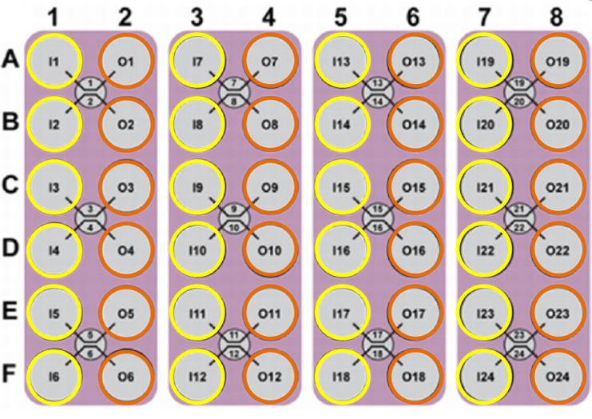
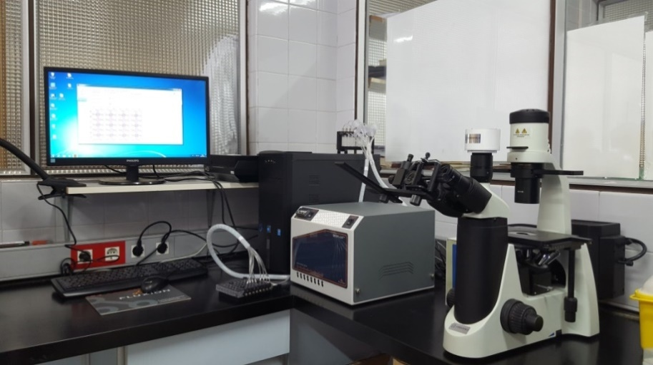
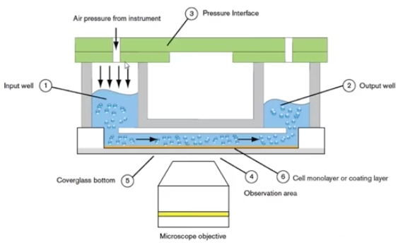
In-vitro activity BAL30072 (UMCU / SERMAS-HURYC)
SUSCEPTIBILITY OF BAL30072 TESTED IN BIOFILM MODELS
2-OPEN SYSTEM: BIOFLUX-FLUXION BIOSCIENCES Microfluidic channels
Inlet wells
Outlet wells
ADVANTAGES
Replicates the in vivo conditions
Control of:
nutrient delivery
flow
temperature

Slide 3
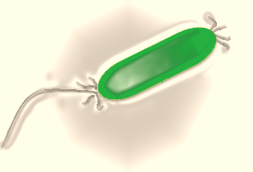
In-vitro activity BAL30072 (UMCU / SERMAS-HURYC)
SUSCEPTIBILITY OF BAL30072 TESTED IN BIOFILM MODELS
EXPERIMENTS WITH TOBRAMYCIN- CF P. aeruginosa
6 P. aeruginosa (+ATCC 27853) strains from cystic fibrosis patients
Diferent morphotypes
(mucoid, smooth, small colony…)
Tobramycin MICs: (susceptible)
0.5-4 mg/l
Tobramycin BICs:
2-32 mg/l
Chronic infection
Primoinfection
Age (15-45 years old)

Slide 4



















In-vitro activity BAL30072 (UMCU / SERMAS-HURYC)
EXPERIMENTS WITH TOBRAMYCIN- CF P. aeruginosa-BIOFLUX RESULTS
Pab1
Pab2
Pab3
INOCULUM 24H
TOBRAMYCIN MIC
TOBRAMYCIN BIC
Pab4
Pab5
ATCC 27853
Pab6
INOCULUM 24H
TOBRAMYCIN MIC
No biofilm formation
TOBRAMYCIN BIC

Slide 5

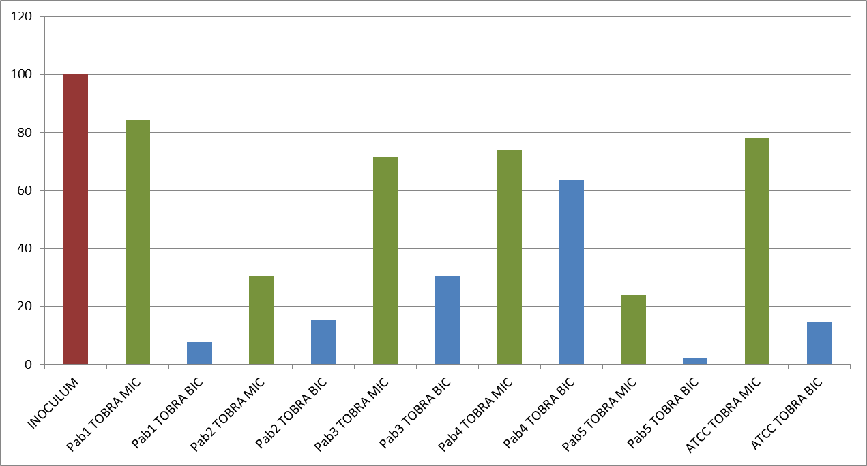
In-vitro activity BAL30072 (UMCU / SERMAS-HURYC)
SUSCEPTIBILITY OF BAL30072 TESTED IN BIOFILM MODELS
BIOFLUX SOFTWARE
ANALYSIS OF IMAGES
INTENSITY OF COLOR-PIXELS
= 0
= 255
VALUE = media of the intensity of the selected area in the microchanel
% BIOFILM
Mann–Whitney test
TOBRA MIC | TOBRA BIC
0.0547 | 0.0065
p<0.01

Slide 6
In-vitro activity BAL30072 (UMCU / SERMAS-HURYC)
Coming next…
Calgary
Biofilm activity of BAL30072, comparators
Bioflux
Fluorescence: dead/alive cells after antibiotic exposure
Confocal images
Polymicrobial cultures
interspecies interactions
Drugs alone and in combination

