Slide 1
Relationship and Sexuality Education in Wales 2019
Sarah Andrews and Gemma Cox
3rd October 2019

Slide 2

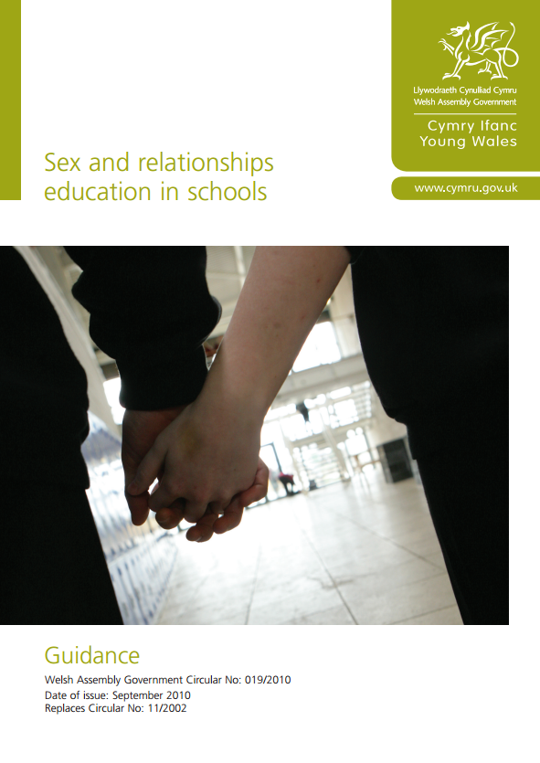

Current state of play of RSE (1)
Recent years
Current guidance
  All maintained secondary schools are required to include sex education for all registered pupils as part of the basic curriculum of the school.
  Primary schools are not required to provide sex education as part of the basic curriculum. They can provide sex education but it is at the discretion of the school.
  Maintained special schools and pupil referral units can provide sex education for primary age learners and must provide sex education for secondary age learners.
In practice
  Patchy coverage, some excellent work.
  Primary schools slowly starting to deliver well once teachers trained
  Secondary schools: wide variation
RSE in Wales 2019

Slide 3

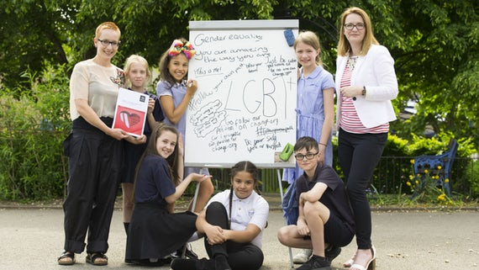
Current state of play of RSE (2)
Major changes under way
Minister for Education (Wales) Expert Panel drew upon international research evidence about how to deliver high quality SRE in schools more effectively and concluded that Sex and Relationships Education (SRE) in schools is too biological and too negative, with insufficient attention given to rights, gender equity, emotions and relationships. These findings led the panel to recommend a major overhaul of the SRE curriculum.
RSE in Wales 2019

Slide 4
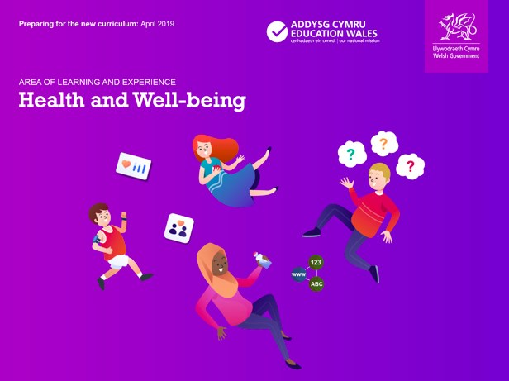

Current state of play of RSE (3)
Complete curriculum reform
RSE in Wales 2019

Slide 5
Current state of play of RSE (4)
Preparing for new guidance
Education Minister announced she would support the recommendations of the expert panel, including
  Name change to Relationships and Sexuality Education
  Statutory part of curriculum ages 3-16
  Whole school approach
  Core principles include: rights and gender equity, holistic, inclusive, protective and preventative
  RSE professional development pathway, all schools to have trained RSE lead
February –April 2019: public consultation on updated curriculum guidance

Slide 6
Key changes and challenges in last 10 years
Progress
Gradual but steady changes towards understanding and acceptance of the parts of RSE that were previously controversial or “difficult”
  Gender and sexual orientation; diverse family structures
  Body image
  The meaning of and recognition of consent
  On-line and social media safety, and the toxic environment of pornography
Still discomfort from teachers over many non-scientific topics especially love 
Bilingual school environment: reduced choice of teaching materials
Wales has seen very little faith-based challenge to RSE
RSE in Wales 2019

Slide 7

Links between RSE and health services
Some innovation but resources thin
School nursing
  Some supporting delivery of RSE lessons, replacing or supporting teachers
  Time pressures due to expanding immunisations and safeguarding work
School based clinics and advice services
  Many regional and local differences
  Some Health Boards supporting RSE for vulnerable groups e.g. Project Jiwsi
Community-based clinics and young people’s advisory services
Referrals to health services:
  Sexual health clinics
  GPs/family doctors
RSE in Wales 2019

Slide 8

How I see RSE progressing in next 5 years
Hopes for the future
Implementing and embedding the new curriculum for Wales
Supporting schools to build their own RSE structure
  Using the Healthy Schools Network county-level teams
  Using school-level data from the School Health Research Network surveys
Securing funding for adequate training and materials
Integrating emerging topics and concepts
Ensuring inclusion of RSE for vulnerable and excluded groups
More integration of accessible sexual health services
RSE in Wales 2019

