Slide 1
Relationships and Sexuality Education in Ireland
Annette Honan

Slide 2
Historical background and context
RSE introduced as a mandatory part of the Social, Personal and Health Education (SPHE) curriculum in 1999 (primary) and the junior cycle curriculum in 2000
SPHE not mandatory across the 3 years of senior cycle education (16-18 yrs) but RSE is mandatory
Challenges and enablers to effective implementation evident from the early days

Slide 3
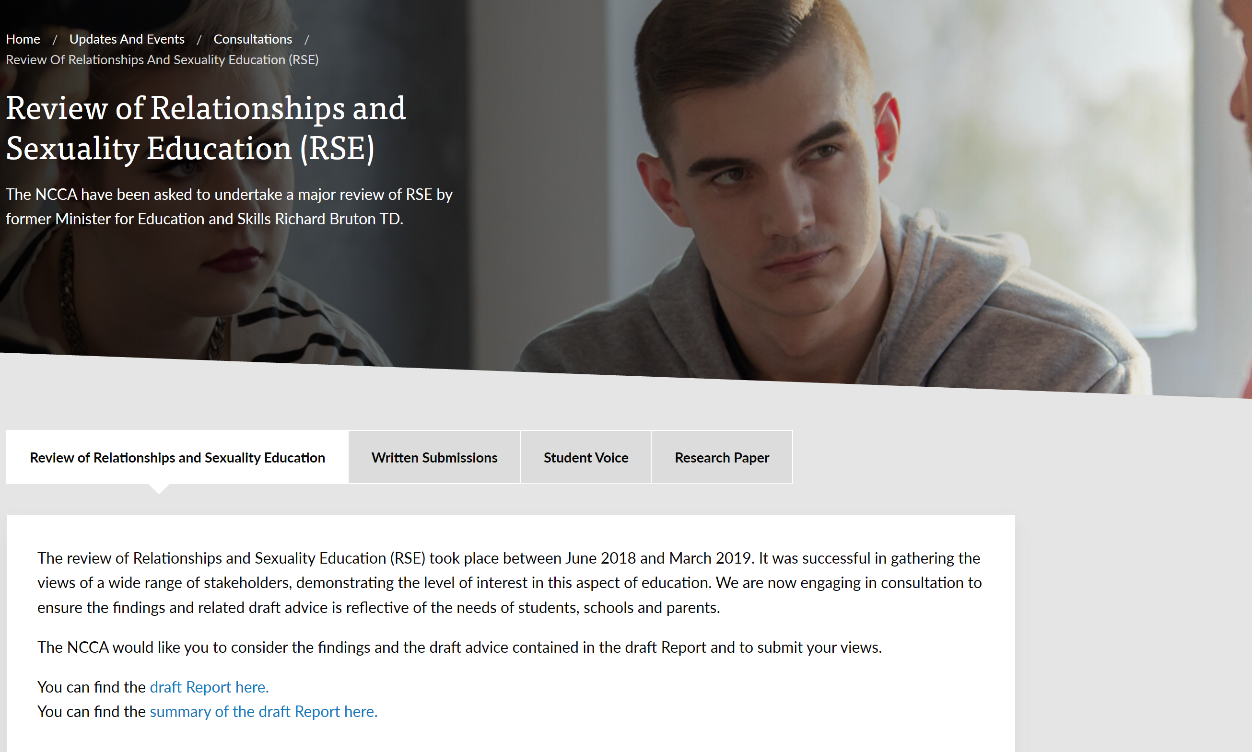
Review of RSE
www.ncca.ie/en/updates-and-events/consultations/review-of-relationships-and-sexuality-education-rse

Slide 4
Key challenges
Moving to a more holistic approach
Creating an up-to-date and integrated curriculum & resources
Building teacher capacity through ITE and CPD in RSE/SPHE
System coordination

Slide 5
Looking forward
Interim guidelines
Collaborate in developing a portal site for resources
Promote interagency collaboration and co-ordination to enable enhanced professional development for teachers
Development of a revised integrated curriculum for SPHE/RSE
Undergraduate / post-graduate professional qualification to teach SPHE/RSE at post-primary

Slide 6
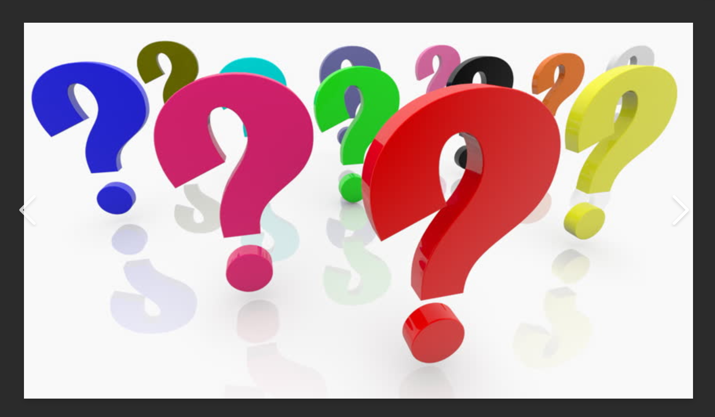
Comments or questions

