Slide 1

CSE in the Netherlands
Ineke van der Vlugt, since 2018 programmanager Contraception & Abortion
Has been programme coördinator of comprehensive sexuality education in the Netherlands for ten years

Slide 2

Current state of RSE in the Netherlands
Development and availability of evidence based CSE lesson packages for all age groups, in a learning path, based on the standards WHO Europe, starting at a young age!
Also out of school CSE and online reliable youth friendly information on sexuality (sense.info = rated 8.4 among youth < 25)
Collaboration with public municipal health centres and youth health care (e-learning, training, materials, meetings with parents)
Annual national campaigns: Week of Springfever and Week of Love, to promote CSE in schools
98% of young people get information on sexuality in school. Some topics are less addressed, like: sexual coercion, sexual diversity, pleasure and sex in the media (Graaf et all; 2017).

Slide 3



Key changes and challenges in the last 10 years :
Since 2012 sexuality education is more or less mandatory (4-15 year olds), more involvement of Ministery of Health > however still no explicit curriculum, great freedom, lack of time in schools
In 2015 legislation on safe schools > sexuality like sexting/sexual harassment is one of the topics in school, not only health related
2016 Inspectorate of education researched the implementation of the core goal on sexuality, sexual diversity and sexual resistance: great support in schools but quality differs a lot, no structural implementation, dependency on individual teachers
In CSE programmes more attention to informed consent, sexual agency, pleasure, mutual relationships, gender and sexual diversity, online world with sexual scripts in an age appropriate and positive way > not all the topics are addressed, quality differs
In general positive sexual health outcomes among youth, survey Sex under 25!: more pleasure, less sexual coercion, higher contraceptive use > but not for all groups, sexual coercion is still a problem (Graaf et all, 2017)
More investment in interactive online tools/games (Canyoufixit.nl) and participation of youth themselves > still a gap between teachers and needs of young people
Evaluation and monitoring CSE among youth themselves > quality has to be improved, safe learning environment and competencies of teachers is sometimes lacking

Slide 4
Topics on sex education in school
(% of the young people who said they received enough information (de Graaf, et al, 2017)
5,8
Sex on television or sex online
Nice sides of sex
Sending nude photos and sex films
Sex against your own will
Homosexuality
Being in love and relationships
STI and HIV
Pregnancy, family planning and abortion
The pill, condoms and other methods
Boys
Girls

Slide 5
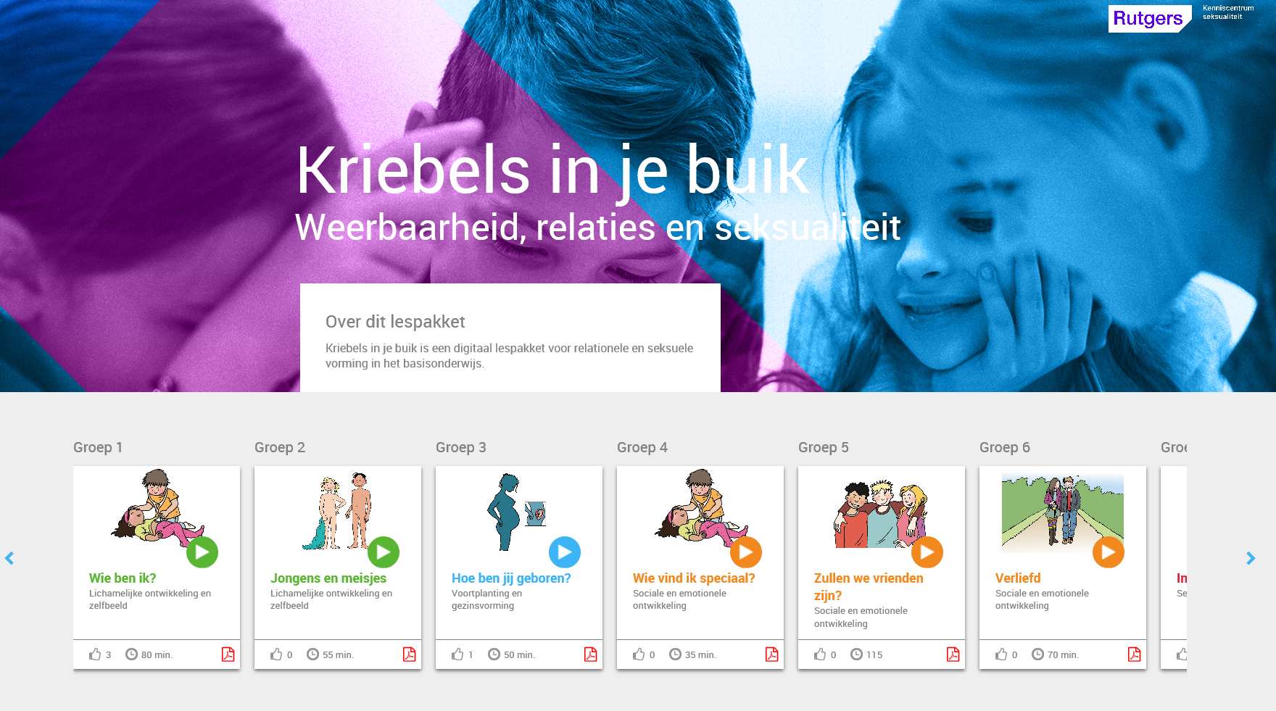
What are the links between RSE & Health Services?
In all CSE lesson packages strong links to (online) information, help and advice on all topics of sexuality
Collaboration with the Public Health Centres (GGD) (24): vaccination, screening, monitoring (sexual) health among youth, health promotion and youth health care
Sense.info and Sense (youth friendly services: without charge, from 12 to 25 year old ones (information, chat/mail, f2f contact) in coordination with 8 PH centres) (additional on regular help, 10% of young people make use of it )
Sense and public health care professionals support schools: with materials, trainings, meeting with parents, using audited evidence based interventions, identifying risk groups, sexual health is part of the Whole School approach

Slide 6
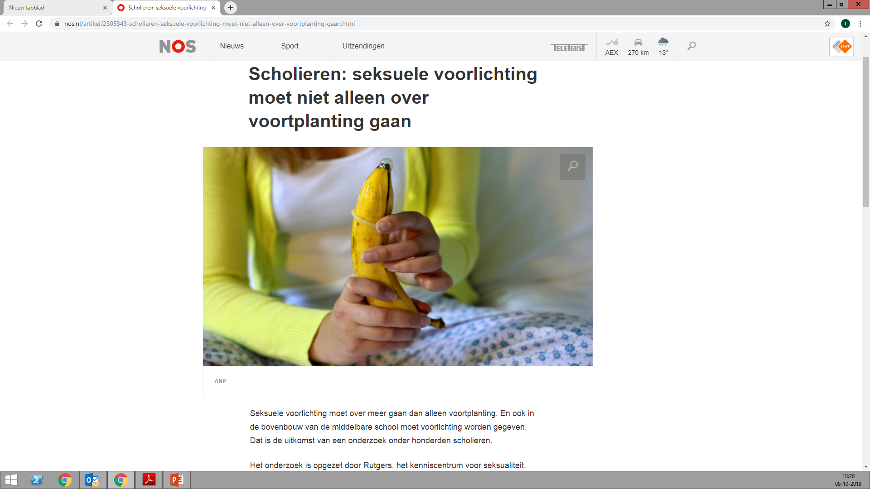
Experience with CSE in schools, participatory research with students (Cense & Grauw, 2019)
More time
More inclusiveness
More attention to pleasure, relationships, sexting, online, consensual sex
Better quality of teachers
More room for discussion and interaction
Safe learning environment

Slide 7
How do you see RSE progressing in the next 5 years?
Stronger collaboration between ministry of Health and ministry of Education (extra money CSE and prevention Teenage pregnancies )
More explicit curriculum on sexuality, acknowledge competencies of teachers in CSE
Less dependency of schools/teachers by introducing new technologies/online information, online games, moderating online meetings
More studies on the results, impact, effectiveness and benefits of CSE
Higher quality of CSE, upscaling CSE, improving sexual agency among youth
A more pedagogic and learner centred approach, interactive and participatory
More support for risky and reluctant groups, but also more inclusive (cultural/gender sensitive in different social contexts)

Slide 8
Multicomponent approach
School
Compreh.SE
Parents & environment
Open
Online
Reliable
Services
Youth friendly
Warm
Supportive
Age appropriate
Safe learning climate
Attractive
Relevant
Complete
Gender sensitive
Whole school approach
Speaking up
Confidential
Accessable

Slide 9
Links to websites in the Netherlands
Rutgers.nl
Rutgers.international (in English)
Seksuelevorming.nl (for teachers in schools/parents)
Sense.info (for young people, also in English)
Seksonderje25e.nl (Survey, summary in English)
Zanzu.nl (for non-Dutch groups, in 16 languages)

