Slide 1
Six Nations: RSE Seminar
The England Perspective
Statutory RSE – finding our way
Alison Hadley, Director, Teenage Pregnancy Knowledge Exchange, University of Bedfordshire
Lucy Emmerson, Director, Sex Education Forum
Jonathan Baggaley, Chief Executive, PSHE Association

Slide 2
For 30+ years….
The Sex Education Forum
  Collecting and disseminating evidence, including from young people.
  Working with practitioners and supporting educators
  Maintaining links with government – with or without funding
  Using the media to shift public opinion
  Influencing parliamentarians
  Speaking as a group of organisations – sexual health, education, faith, youth - held together by shared values and principles

Slide 3
What is the current state of play of Relationships and Sexuality Education (RSE)?
Notes:
Over-arching structure of the legislation, including Health Education for reference.
If you zoom in, these are examples of the subject content.

Slide 4
Huge improvements over last 20 years …but
Non-statutory status and lack of investment resulted in:
Insufficient priority and curriculum time
Inconsistent provision – a postcode lottery for children and young people
Failing to meet young people’s needs. Most neglected issues LGBT, healthy relationships, grooming, pleasure, pornography
Untrained and unconfident teachers: 29% have had no training at all in the subject
‘Pregnancy choices’ and ‘explicit online content’ identified as gaps in teacher competence
…but thanks to persistent advocacy…
Notes:
Over-arching structure of the legislation, including Health Education for reference.
If you zoom in, these are examples of the subject content.

Slide 5
Finally statutory status in all English schools!
New legislation requires:
Relationships education in all primary schools (4-11)
Relationships and sex education in all secondary schools (11-16)
Health education in both primary and secondary
Statutory guidance for schools published in 2019
Statutory status starts in September 2020
Notes:
Over-arching structure of the legislation, including Health Education for reference.
If you zoom in, these are examples of the subject content.

Slide 6
What have been the key changes in the past 10 years that have led to the current state of RSE and what have been the key challenges?
Notes:
Over-arching structure of the legislation, including Health Education for reference.
If you zoom in, these are examples of the subject content.

Slide 7
The 1970s: a more liberal decade
Open and positive relationships and sex education
Contraception becomes free on the NHS
Guidance on young people friendly services provided by Department of Health
Teenage pregnancy rate drops 25%
Notes:
Over-arching structure of the legislation, including Health Education for reference.
If you zoom in, these are examples of the subject content.

Slide 8
The 1980s: a new government and a more conservative decade
Government views sex as a ‘private issue’ – funding withdrawn from first large national sexual attitudes and behaviour survey
Government refuses dissemination of Health Education Authority sex education booklet for young people
Cuts in contraceptive clinics and rise in youth unemployment
Teenage pregnancy rate increases 20%
Notes:
Over-arching structure of the legislation, including Health Education for reference.
If you zoom in, these are examples of the subject content.

Slide 9

The 1980s: the threat of HIV/AIDs but media outrage at LGBT inclusive sex education
Sex Education Forum founded to advocate for compulsory comprehensive RSE. 8 founding members
Brook
FPA
Relate
SPOD
NCB
Health Education Authority
Church of England Marriage Education Panel
Catholic Marriage Advisory Council (Marriage Care)
1988 - ‘Section 28’ to prevent ‘promotion’
of homosexuality or publish material
Notes:
A copy of Jenny lives with Eric and Martin, probably the first children’s book in English to discuss homosexuality, was discovered in a school library in London. Hysterical outbursts in the press against school sex education and teaching about homosexuality followed and led to legislation that year to restrict school sex education and later in 1988 to the infamous Section 28. The amendment was enacted on 24 May 1988, and stated that a local authority "shall not intentionally promote homosexuality or publish material with the intention of promoting homosexuality" or "promote the teaching in any maintained school of the acceptability of homosexuality as a pretended family relationship". Repealed in 2000.

Slide 10
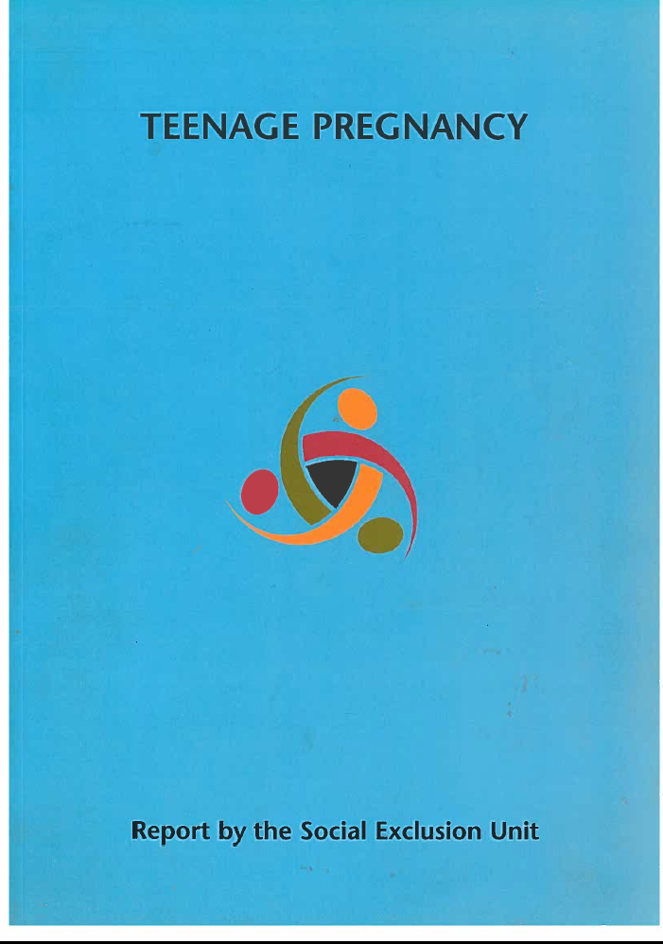
1999: New government launches Teenage Pregnancy Strategy
Strategy endorses evidence for comprehensive RSE in all schools
..but stops short of making it compulsory to avoid negative media reaction
Section 28 legislation repealed (2000)
Notes:
Over-arching structure of the legislation, including Health Education for reference.
If you zoom in, these are examples of the subject content.

Slide 11
2000-2010: Significant government and NGO activity to improve RSE (despite non-statutory decision)
New Department for Education guidance for schools
Government funded RSE and PSHE professional development programme for teachers
Funding for NGOs – Sex Education Forum and PSHE Association to build capacity
New evidence for effectiveness of RSE – Doug Kirby (2007) and John Santelli (2008)
Consensus building among parents, professionals and young people on importance of, and support for RSE
Notes:
Over-arching structure of the legislation, including Health Education for reference.
If you zoom in, these are examples of the subject content.

Slide 12
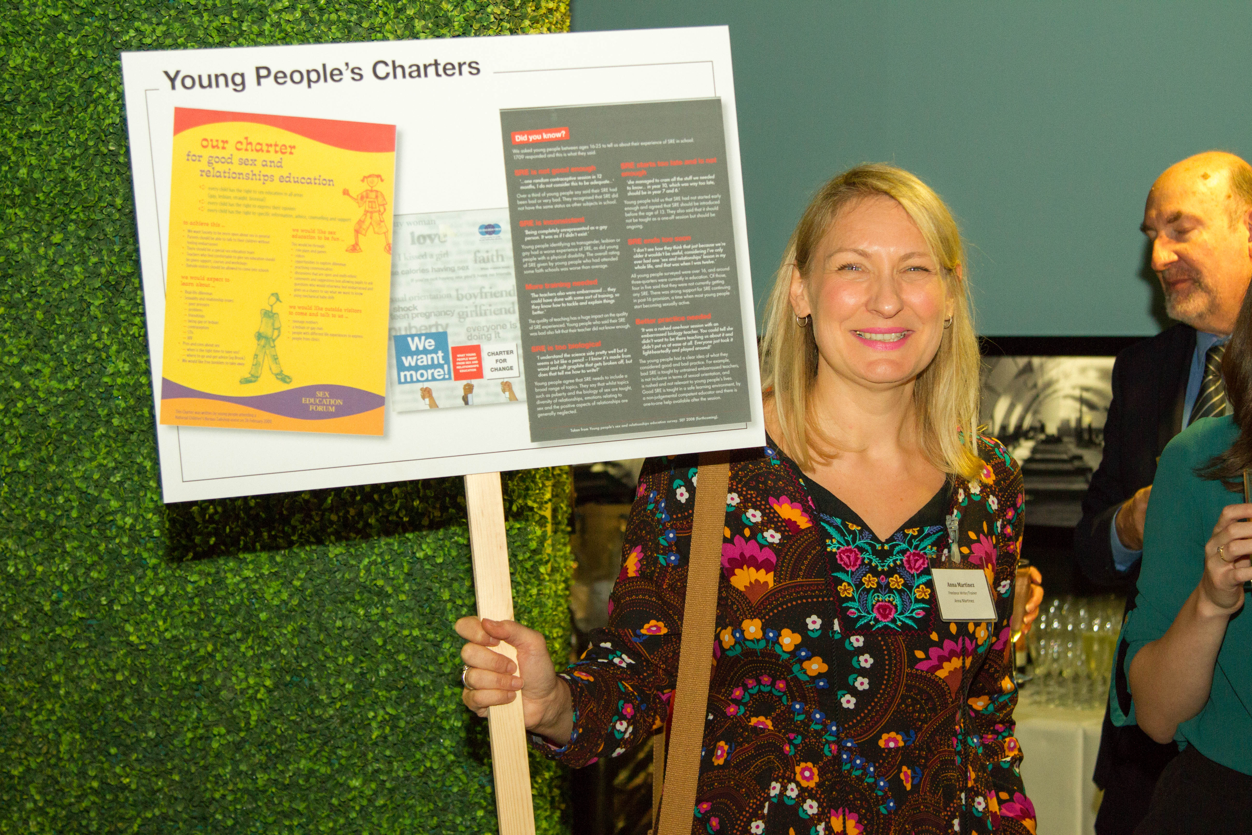
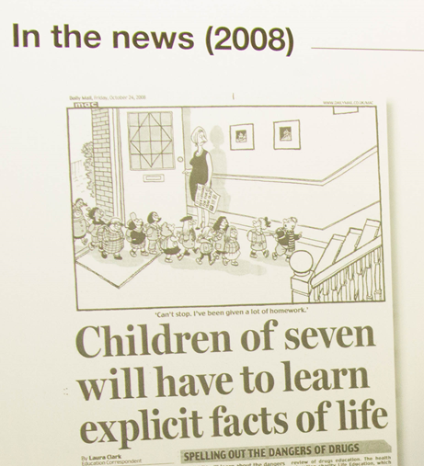
2000-2010: Youth advocacy and growing support for legislative change
2007: Youth led petition and survey on RSE and PSHE prompts government to take action
2008: RSE and PSHE Review – young people co-chaired. Ministers accept recommendation for statutory status
2010: Statutory RSE and PSHE legislation fails to become law due to General Election
Notes:
UKYP survey and petition of young people about SRE, delivered to No 10, led to young people having place on Review group

Slide 13
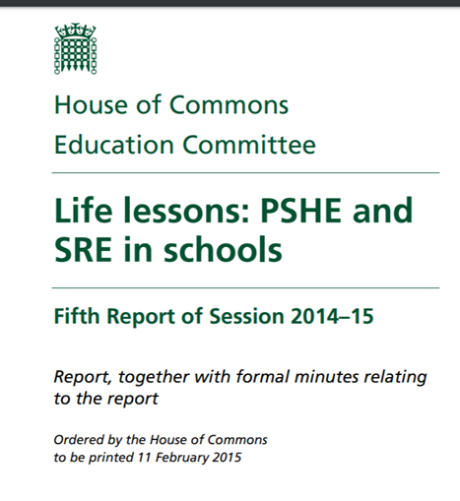
2010: a change of government
Strong advocacy for statutory status from NGOs, professional organisations and young people continues
Increasing concern about internet, pornography and sexual abuse/exploitation supports case for improved RSE
Education Select Committee (cross party) takes evidence and publishes report recommending statutory status
Legislation for statutory status passes in 2018
Notes:
Over-arching structure of the legislation, including Health Education for reference.
If you zoom in, these are examples of the subject content.

Slide 14

Significant legislative and policy changes on equality
Equality Act 2010
Marriage (Same Sex Couples) Act 2013
Notes:
Over-arching structure of the legislation, including Health Education for reference.
If you zoom in, these are examples of the subject content.

Slide 15
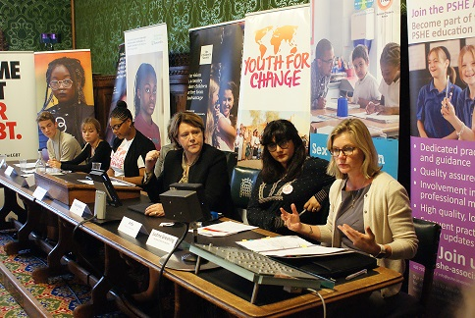
Young people continued to influence parliamentarians to achieve statutory status
2017, Parliamentary Event with Secretary of State, Rt Hon Justine Greening

Slide 16
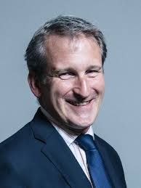
2019: Statutory guidance published
New RSE and Health Education Guidance passed by Parliament with large majority from cross party cross-party Parliamentarians
Parental opt out from sex education remains
Health Education also made statutory, but not financial education
Sex Education Forum and partners publish twelve principles for effective RSE, based on UNESCO technical guidance (2018)
“ I believe that, now more than ever, it is necessary for us to give young people the knowledge that they need in every context to lead safe, happy and healthy lives “
Damian Hinds, Secretary of State for Education, 25th February 2019
Notes:
While there may be things that we will continue to disagree on, I think this is one area that as teachers, educators, parents and others, that we can all agree. Health Education also made statutory.

Slide 17
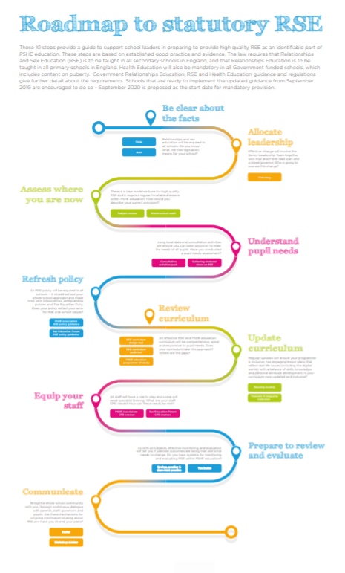

12 principles for effective RSE
Produced by Sex Education Forum and PSHE Association. Download here.
Produced by Sex Education Forum Download here.
Notes:
If you haven’t already seen these, I would like to draw your attention to two important tools that are out there to support your journey towards statutory.
The 12 principles of high quality RSE (*Lucy may have spoken about this already)
If you have read the new guidance, you will know that there is quite a bit of information about what students need to learn about, but very little information about how you should do that, or what it looks like when it is good.
We worked with over 60 national partners, including 6 teaching unions, to agree these 12 principles of high quality RSE. They are overarching principles that apply to every setting and every age group. These are a quick, accessible tool that can be used to start a conversation as well as to guide, review and improve your provision.
2. The Roadmap was developed with the PSHE Association to support schools through the steps needed to be ready for statutory. We found, that many schools were going straight to their curriculum and checking whether what they were providing was meeting the requirements. However, your RSE curriculum content, is only one aspect of RSE and is not enough on its own. The Roadmap takes a whole school approach, as outlined in the guidance and ensures that you have covered all the relevant areas and that you bring your whole community with you.

Slide 18
Curriculum Content for all schools: Core areas
See RSE guidance from Gov.uk website
Relationships Education (KS1+2 ) | Relationships and Sex Education (KS3+4) | Health Education (KS1-4)
Families and people who care for me Caring friendships Respectful relationships Online relationships Being safe | Families Respectful relationships including friendships Online and media Being safe Intimate and sexual relationships including sexual health | Mental wellbeing Internet safety and harms Physical health and fitness Healthy eating Drugs, alcohol and tobacco Health and prevention Basic first aid Changing adolescent body
Notes:
Over-arching structure of the legislation, including Health Education for reference.
If you zoom in, these are examples of the subject content.

Slide 19
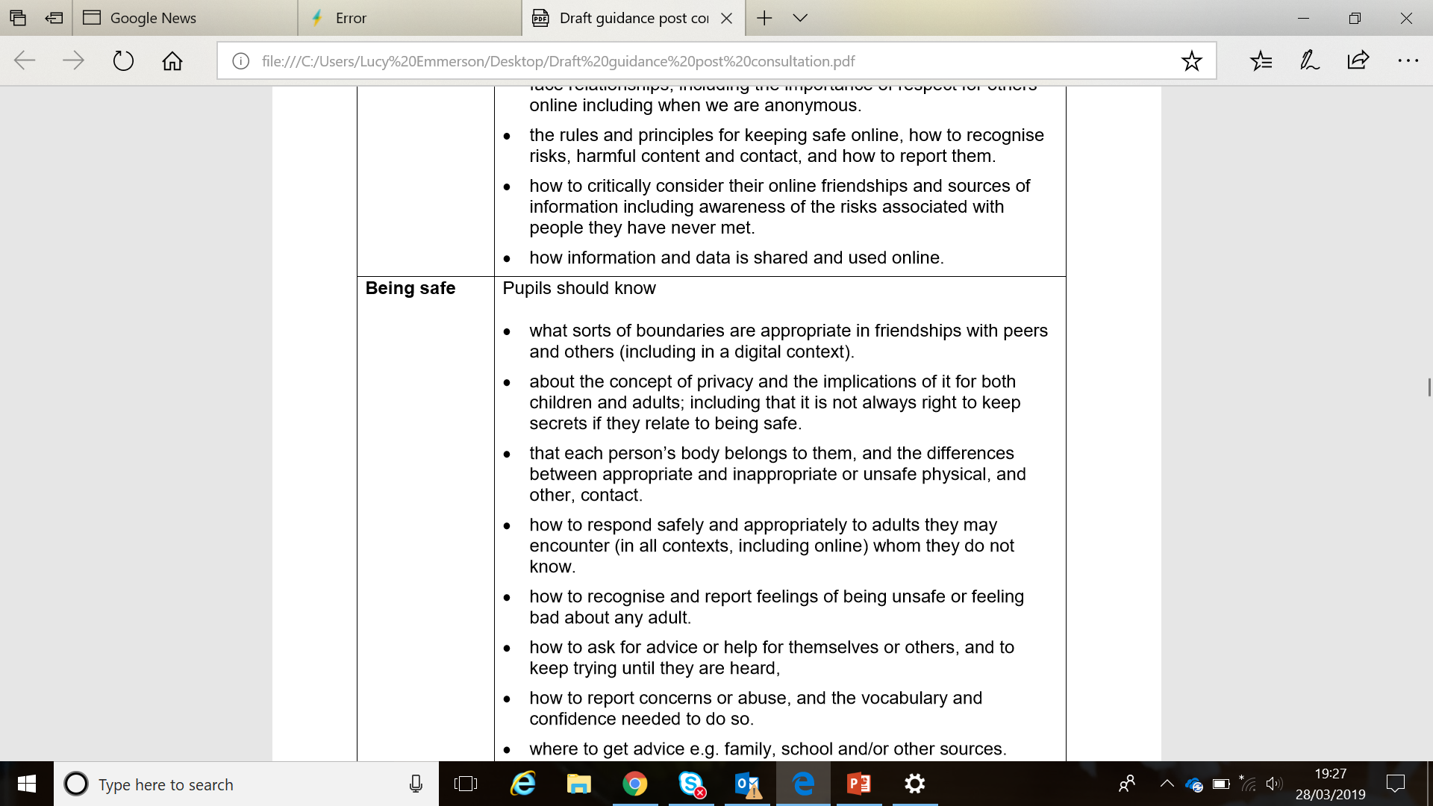
Notes:
By the end of…SHOULD KNOW

Slide 20
What are the links between RSE and health services?
Notes:
Over-arching structure of the legislation, including Health Education for reference.
If you zoom in, these are examples of the subject content.

Slide 21
What are the links between RSE and health services?
Current and new statutory guidance requires students to know about local services, but how to make the links is a local decision:
Information only provided as part of lesson
Practitioner from local service ‘introduces’ the service to students in RSE lesson
School nurse provides 1-1 confidential support and referral to services as required
School based on site health clinic, including contraception, condoms, STI testing

Slide 22
How do you see RSE progressing in the next 5 years?
Notes:
Over-arching structure of the legislation, including Health Education for reference.
If you zoom in, these are examples of the subject content.

Slide 23
Benefits of statutory status relies on implementation reflecting the international effectiveness factors
Sufficient investment in training to have competent, confident teachers in every school
Sufficient curriculum time in every school year
Assessment of quality and monitoring of improvement
Involving and supporting parents
Narrowing inequalities for vulnerable young people
Ensuring factually accurate information on sexual and reproductive health, including abortion
Notes:
Over-arching structure of the legislation, including Health Education for reference.
If you zoom in, these are examples of the subject content.

Slide 24
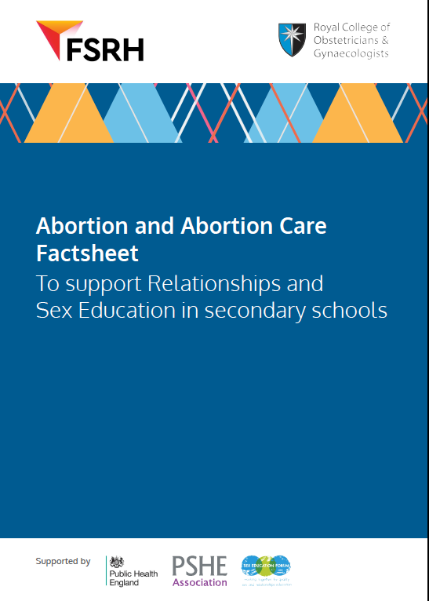
RSE statutory guidance, secondary level (11-16)
That there are choices in relation to pregnancy (with medically and legally accurate, impartial information on all options, including keeping the baby, adoption, abortion and where to get further help).

Slide 25
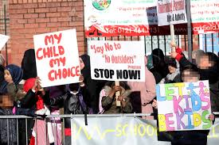
Strengthening and coordinating advocacy to counteract opposition
The vast majority of parents support statutory RSE
Coordinating and promoting consistent messages on benefits of RSE
Making good RSE more visible - to counteract opposition, myths, misinformation and fear
Harnessing the power of young people to demand their right to RSE
Yet a small minority of opponents get the majority of media coverage
Notes:
Over-arching structure of the legislation, including Health Education for reference.
If you zoom in, these are examples of the subject content.

